Slide 1

ISPyB
Back end evolution
Neil A Smith
12th February 2020
Notes:
1

Slide 2
Contents
Current Landscape
Future Landscape
Database
Services

Slide 3
ISPyB Steering committee request
“[developers]…tasked with studying the alternatives of evolving the current data base and backend, or making a fresh start and rewriting, and present the alternatives with pros and cons at the review meeting.”

Slide 4
Current LAndSCAPE

Slide 5
ISPyB Collaboration
Database
schema
Software
stack
Software
stack
Database
schema
EXI
UI
SynchWeb
UI
ISPyB
ISPyB’
Java Web
Services
SynchWeb
Services
Scope of collaboration
Outside collaboration but within community

Slide 6
Resource levels limited across sites
Site | “ISPyB” FTEs | Comments
DLS | ~ 3.5 | From March 2020
ESRF | ~ 1.5
SOLEIL | ~ 0.5
ALBA | ~ 0.5
MAXIV | ~ 0.5
HZB | ?
Global Phasing | ?
EMBL | ~ 0.5
Elletra | ~?

Slide 7
Technical Options
Database
Evolve what we have
New approach
NoSQL?
Time series db?
Nexus based?
Services
Evolve what we have
SynchWeb and/or Java Web services?
New services
Language?
Design principles?

Slide 8
FUTURE LAndSCAPE

Slide 9
What does future look like?
We could do with a shared vision for where ISPyB is going
Scope: At DLS, ISPyB will be the central part of a facility wide Experiment Information Management System (EIMS)
Technical architecture: Currently interest from DLS in heading towards micro-service architecture
Improve flow of information pre/during/post beamtime activity
Isolate services from file system where possible
Expect more use of APIs for machine ⬄ machine communication rather than UI⬄machine (e.g. external LIMS systems) so we need to manage resources
Caveat: consideration at this stage rather than a concrete plan
Bonus: Heading towards services means we can converge on common set of software over time rather than a costly intensive migration

Slide 10
DATABASE: Evolution or revolution?

Slide 11
Database Options: Evolution
Current solution works but,
developer friction caused by inconsistent naming conventions
mixture of explicit and implicit relationships
“Junk DNA”, many columns not used anymore (or at all!)
Improvement could be made by removing redundant tables and columns
Used schemaspy to generate report (see later slide)
Shows you what tables are in use and anomalies
Establish consistent naming convention and remove Oracle legacy
proposalNumber vs number (reserved word limitations?)
AutoProcProgram vs AutoProcProgam_has_Int (30 char table limit)
BLSESSIONID vs sessionId
BF_fault? Or BeamlineFault
BLSession has 26 columns of which 10/11 could be deleted
!

Slide 12
BLSession example
Column
sessionId | blsessionid, Session reserved word in Oracle?
bltimeStamp | timeStamp but context? Created/Updated timestamp?
visit_number | visitNumber
lastUpdate | always 0000-00-00 00:00:00
projectCode | always NULL
usedFlag | not since 2016
sessionTitle | not title (as in Proposal) always NULL
structureDeterminations | NULL or 0
dewarTransport | NULL or 0
dataBackupFrance | always NULL
dataBackupEurope | always NULL
expSessionPk | NULL at DLS, SMIS id? relates to externalId?
protectedData | always NULL
operatorSiteNumber | always NULL

Slide 13
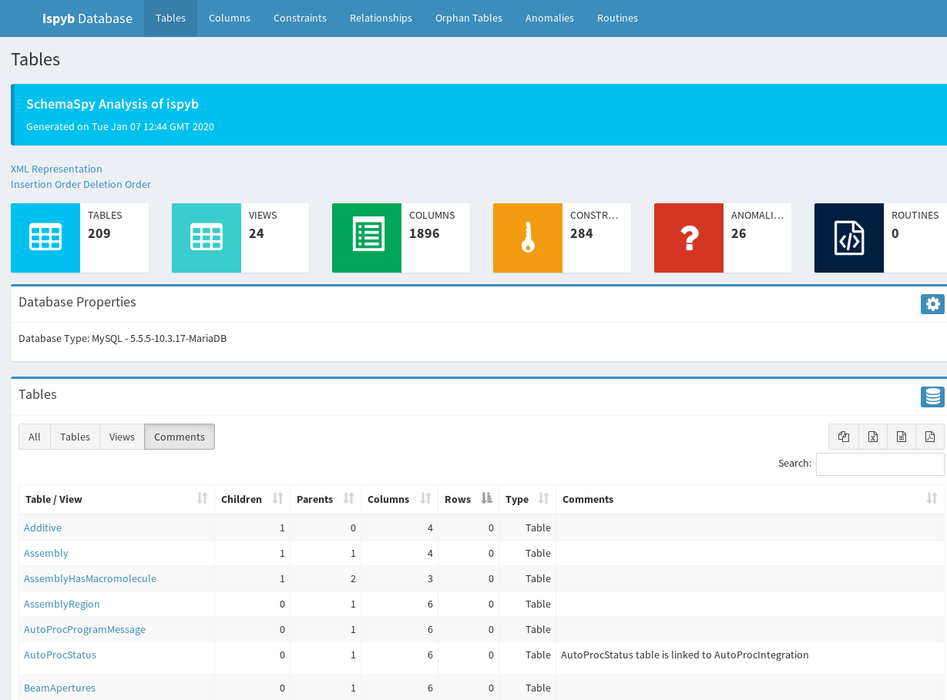
Schemaspy.org

Slide 14
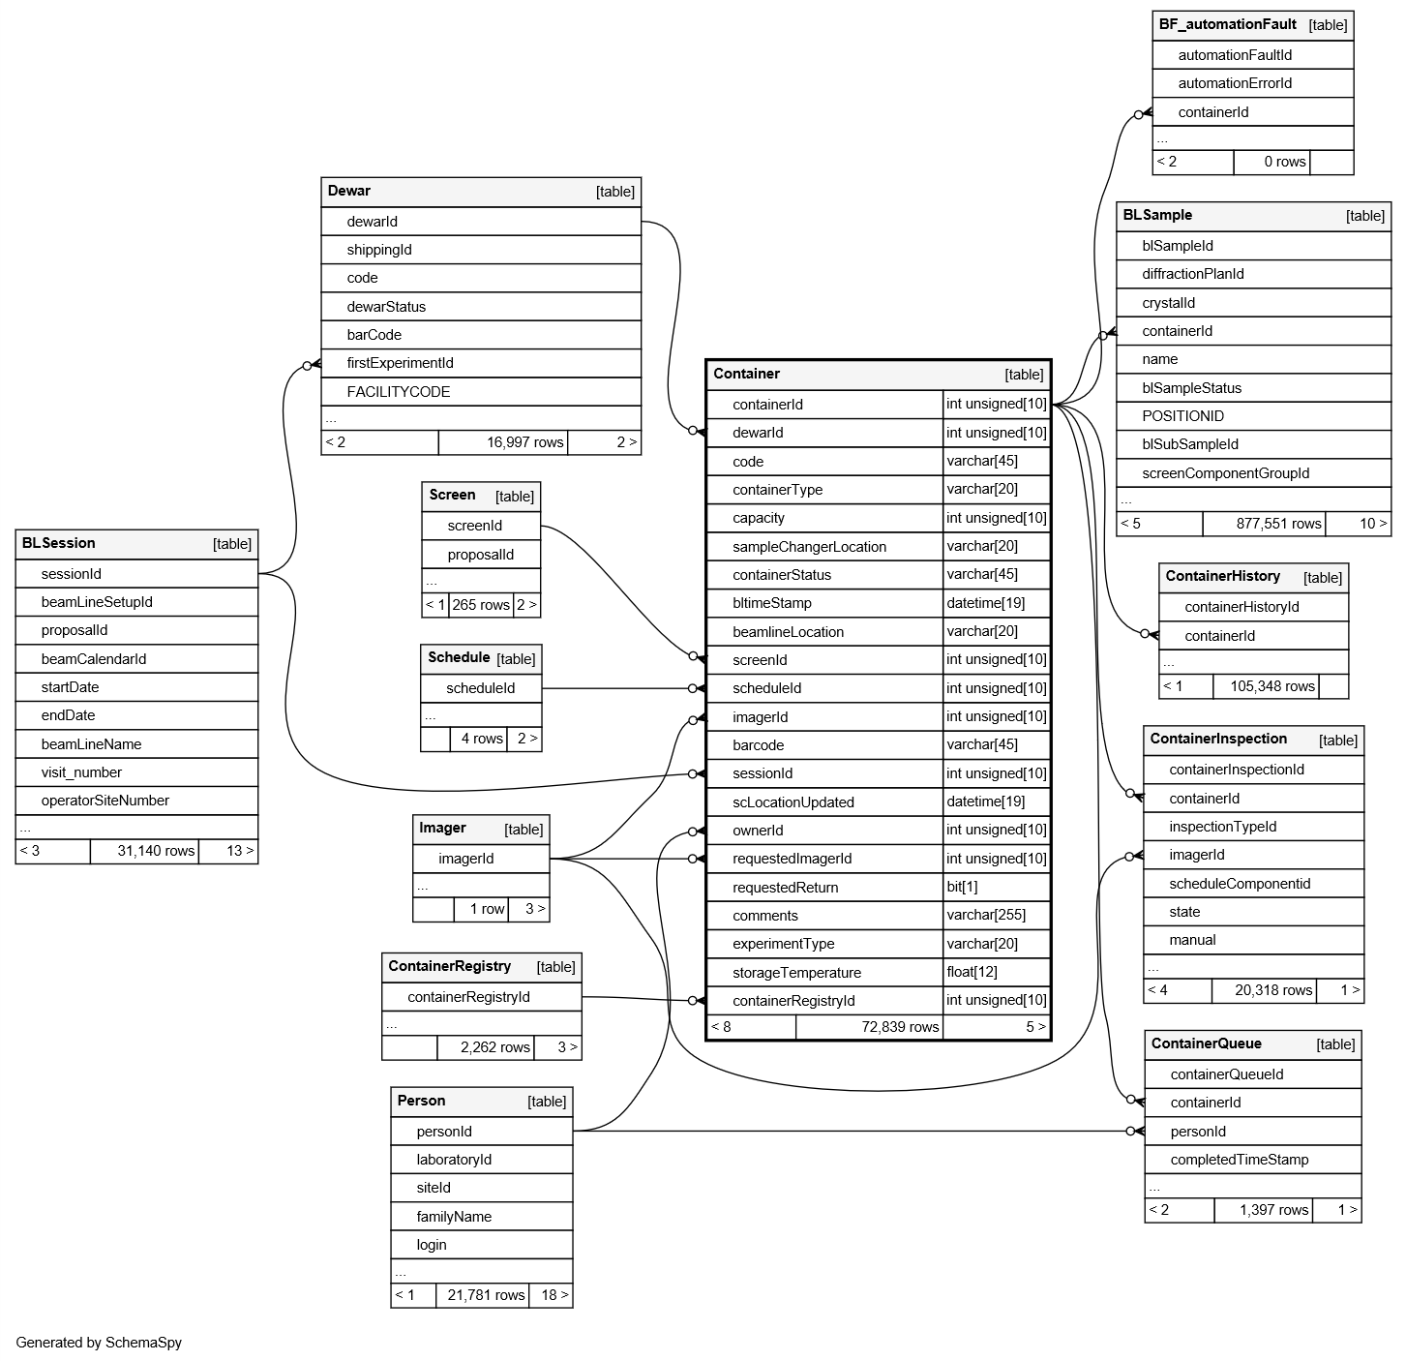

Slide 15
Schemaspy
If other sites want to generate the report:
Download schemaspy, mysql-connecter.jar
Create an ispyb.properties file with credentials
Run command (below) against database
Generates an output folder with html report
Command Line
java –jar schemaspy-6.1.0.jar \
–configFile ispyb.properties \
–dp ./mysql-connector-java-8.0.16.jar \
–vizjs
–o output/
-s ispyb
ispyb.properties
schemaspy.t=mysql
schemaspy.host=<host>
schemaspy.port=<port>
schemaspy.db=<db name>
schemaspy.u=<db user>
schemaspy.p=<db password>

Slide 16
Why refactor?
Improving software quality saves time and money in the long run
Without fixing issues, software will become increasingly complex and hard to change
New changes currently do not need to conform to any standard increasing the maintenance burden
Easier to assess impact of changes if relationships are explicit and clear
Data model lasts longer than code. Applications come and go – bad data structures infect software
Changing names will break applications but with modern IDEs refactoring code is not complicated
Developer context switching – less time spent looking up relationships
Less disruptive than change of technology

Slide 17
Database Options: Revolution
New design
Completely undefined what that looks like
Any technology or a mixture
PostgreSQL, Time Series?
Significant effort required in any case that would take away from current developments
A redesign of relational database with same technology lowest risk
Could learn from multiple years experience to redesign current relational database schema through future workshops
Could outsource design to a third party but domain knowledge required?
Increasing complexity/time/cost
New
RDBMS
design
PostgreSQL?
Time Series
Hybrid
(Mix of solutions)

Slide 18
Database Options: Evolve
Pros
Continue to provide service for main domains
Current system is performant (mostly!)
Should continue to work for next ~5 years….?
Low risk approach
Can alter tables online without disrupting user access
Could address constraints and inconsistencies over time
Cons
Current schema inconsistent naming conventions
Relationships complex and don’t always make sense (need example)
Significant work to remove dead tables/columns
Developer friction…?
Need careful consideration when extending

Slide 19
Database Options: New
Pros
No constraints – could pick anything!
Opportunity to build on knowledge/lessons gained from past 10+ years
Clean design with clear relationships
Could adopt more flexible schema that would be easier to extend
Exploit features of other solutions (Row level security, Time series database?)
Could use expertise from collaboration to design new approach as theoretical exercise
Cons
Also a con: No constraints – could pick anything!
High risk activity to keep equivalent functionality
Large development effort and consequences for collaboration members
Old system would cease to be supported – leading to orphaned sites unless they all upgrade
Impact on scaling, performance unknown
Less expertise in alternative database technologies

Slide 20
SERVICES

Slide 21
Services approach
Main development sites ESRF and DLS on different software stacks
Small contributions from other members
Some sites up and running with Java technology stack
Others installing/evaluating Java Web stack, some have installed Synchweb
Any switch between SynchWeb and EXI for DLS/ESRF would be take multiple years worth of effort
One approach is to plan for the future with a longer term goal rather than “big bang approach”

Slide 22
Stage 1
Extract pre-beamline (shipping) and post-beamline (stats and reporting) into separate services
Example: stats and reports service from SynchWeb could sit along side existing Java WS installations
ISPyB
DB
DC
Samples
Processing
Admin
Sessions
…
Shipping
Stats & Reports

Slide 23
Stage 2
Over time move towards setup where services are composed for each site depending on what they need. Different sites could take lead on particular service?
ISPyB
DB
DC (CryoEM)
DC (BioSAXS)
Shipping
Processing (MX)
Samples
DC (MX)
Processing (EM)
Stats & Reporting
Domain/techniques based services

Slide 24
Stage 3
Extended example where most capability provided through separate services. Technical challenges will need to be addressed such as integration with authorisation service (however, it should be possible to adopt standard design patterns).
ISPyB
DB
DC
Images
Shipping
Processing
Samples
DC
Images
Processing
Admin
Faults
Sessions
Stats & Reporting

Slide 25
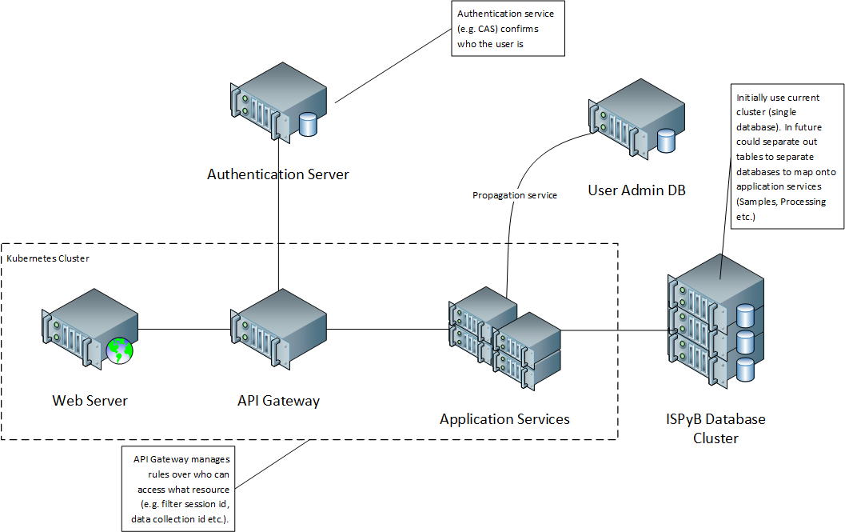

Slide 26
Services Options: Evolve
Pros
Changes over time should imply less disruption if planned properly
Allow sites to move at their own pace
Open possibility for code sharing at more granular level
Recognises that “one size does not fit all”
Cons
Technically more complex solution
Still need to agree APIs for multiple services
Need to establish common authentication/authorization approach
Not necessarily same instance

Slide 27
Services Options: New Same argument as with new database solution really – not a clear alternative.
Pros
No constraints – could pick anything!
Opportunity to build on knowledge/lessons gained from past 10+ years
Clean design with clear relationships
Could use expertise from collaboration to design new approach as theoretical exercise first before committing to deployment
Cons
No constraints – could pick anything!
No point building something new if it does not increase contributions from members
High risk activity to keep equivalent functionality
Large development effort and consequences for collaboration members
Old system would cease to be supported – leading to orphaned sites unless they all upgrade
Impact on scaling, performance unknown

Slide 28
Way forward
Collaboration on database has been healthy
Seek agreement on establishing naming convention for database
Analyse existing installations and identify what tables/columns can be removed
Establish design principles for shared services
Pick an example to design shared service
Stats and reporting?
Metadata harvesting?
GraphQL?
Define common API principles

