Slide 1
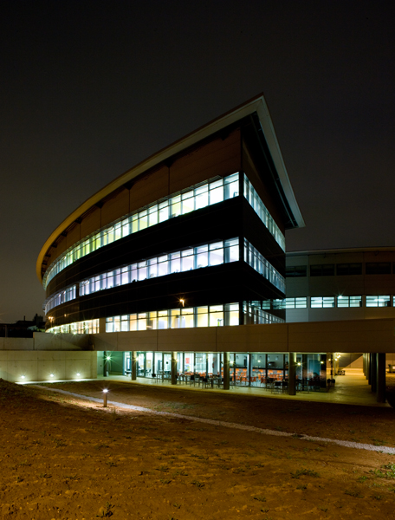
ISPyB implementation at ALBA
Status

Slide 2
Status
User Office integration is done.
Test environment ready to be used on real proposals.
Integration with MxCuBe to be tested with real data.
Will provide the platform for Friendly, and In House, users.
Once acceptance is given, the Production environment will be prepared.
Access from outside ALBA will be provided as this point.

