Slide 1



Status update: ICEBEAR home-lab LIMS
Ed Daniel – FBMM, University of Oulu, Finland
Diamond, January 2018

Slide 2
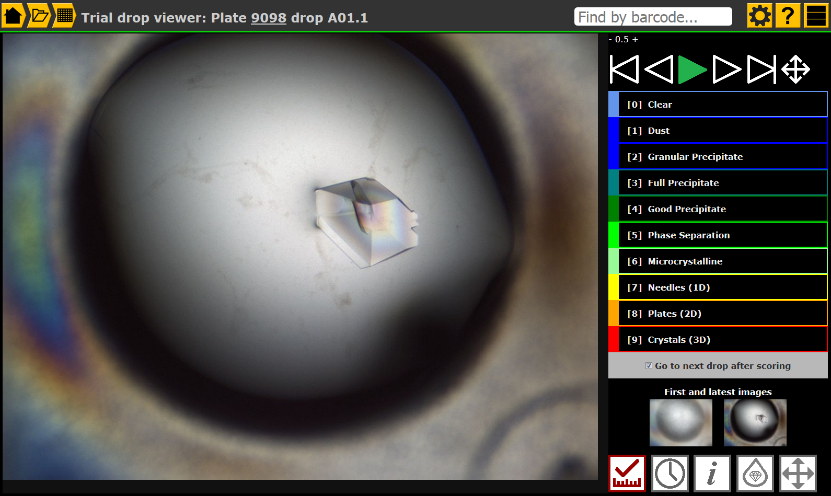
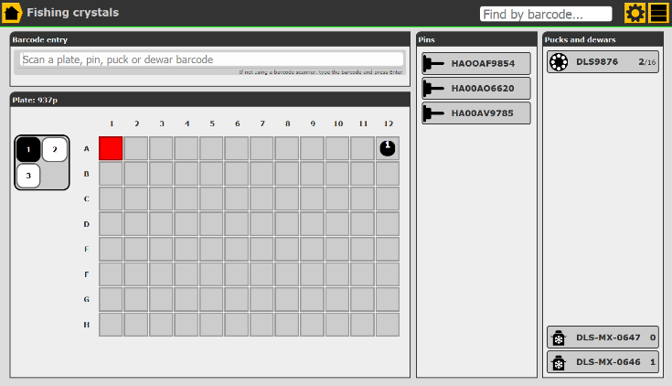

Imaging
Viewing/scoring
Fishing/mounting
Shipping
Formulatrix
Rigaku
(manual)

Slide 3
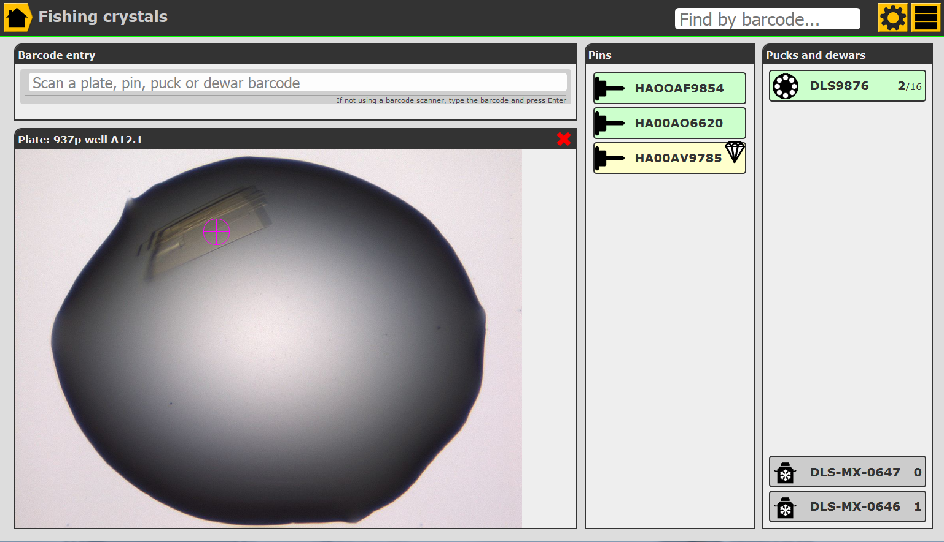
Crystal fishing
Drag-drop fishing UI, absolute minimum user interaction needed
Filled pins automatically inserted into first empty puck slot
Supports non-barcoded pins (dragging directly to puck)
Usable even with no imaging system (drag directly from well)
Users can add notes and shipping comments – live, or later

