Slide 1
ISPyB at MAX IV
Feb. 12, 2020
Jie Nan

Slide 2
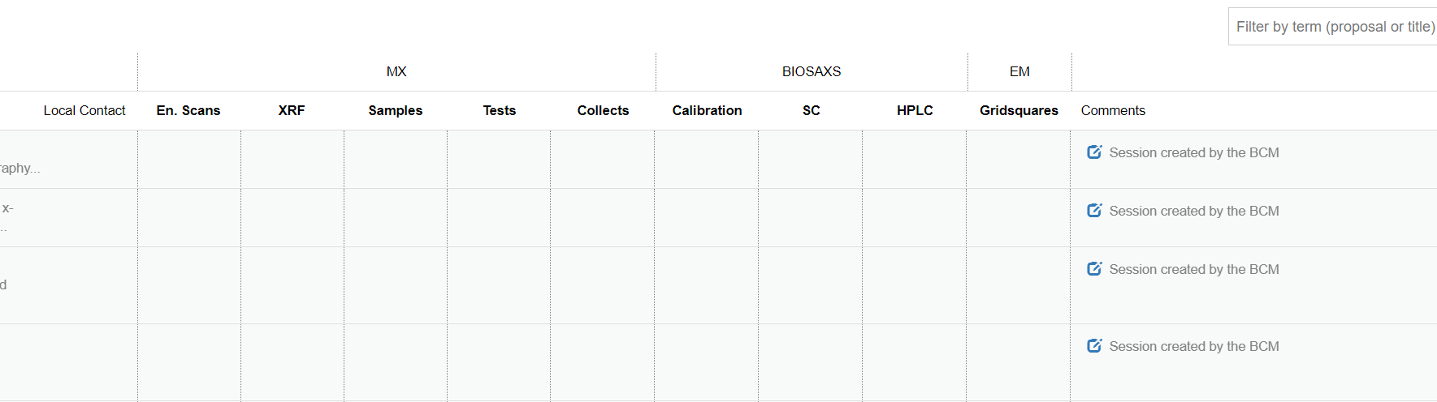
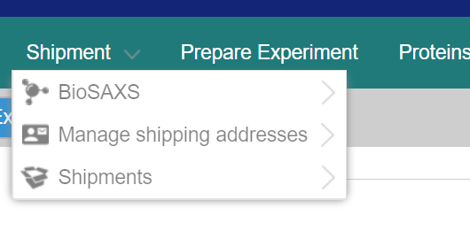
ISPyB Status at MAX IV
ISPyB UI in production
EXI installed (version 5.18.2) and being adapted to BioMAX/MAXIV
Not so easy to adapt (some results displayed in ISPyB, but not EXI)
A list of issues to fix, e.x. issue with printing shipment
Tested mostly by BL staff, user interface to be improved
Getting closer to production
Update ISPyB and EXI to the latest versions

Slide 3
ISPyB Status at MAX IV
Currently used for MX (BioMAX)
FragMAX
Simpler interface for handling sample and shipment information
MicroMAX is interested and need features for SSX
Experimental meta information
Record and display results and statistics of on-the-fly analysis
Support SSX processing pieplines
Interactive offline re-processing
CoSAXS needs a LIMS, ISPyB vs. SciCAT?

Slide 4
About Refactoring
Current API, difficult to maintain and to add new features
Backend, Graphql is preferred than REST, used in several applications at MAX IV

