Slide 1
ISPYB @ EMBL HH MX
ISPYB review meeting
HH 12 02 2020
Gleb Bourenkov

Slide 2
In use since 2014, as an essential dependency of MxCuBE 2.0
ISPYB, EXI
SynchWeb on top of ESRF/MxCuBE-style data base since 2019, not yet advertised to the users
ISPYB is addictive for MX both beamline staff users
Very little contribution to development until now

Slide 3
Comments on the current state in MX
ISPYB user in a bunch of collaborative projects, c.a. 1K data sets / year
Great – your 2015 data are just there!
Can it be a unique LIMS for your beamline work?
flat sample (“protein->crystal”) model
need to book keep samples some place else
no curation of processed data
need to book keep processed data some place else

Slide 4
Strong demand for ISPYB functionalities in new experiments
Time-resolved MX
70 shifts / year @T-REXX end station
Solid support SSX, hit-and-return, liquid application
>10 chips, 500 “data sets” per shift
MxCuBE
Automatic processing in place
Almost “measurements”

Slide 5
Tr-MX vs MX in ISPYB:
Protein->Crystal: exact same
Sample containers, shipment etc.: very different
Data collection: very different
Data processing: very different
Processing results: some commonalities (limited)

Slide 6
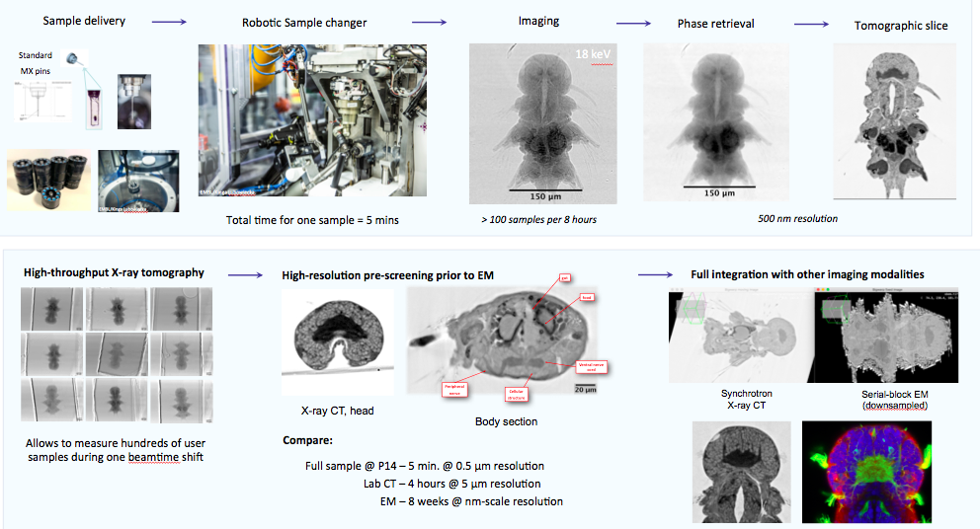
High throughput X-ray imaging (XRI) and micro-tomography

Slide 7
XRI vs MX in ISPYB:
Sample: very different
Sample containers, shipment etc.: identical
Data collection: almost identical
Data processing: very different
Processing results: very different

Slide 8
Modularity – in development and deployment
Collaborate on all components – data bases, services/APIs, frontends
Share development framework for all (or most) components
Share modules (like standard MX)
Depending on the outcome of the meeting, up to 1.5 additional FTEs on ISPYB-related developments for next ~3 years

