Slide 1





TAP
IT
JUST DEVELOPED !!

Slide 2

WHAT is TAP IT! and ITS PURPOSE ?
Tap IT is a game which is completely on the grounds of sustainability.
Its intention is to introduce some unknown or known but essential sustainable facts for the better ecofriendly environment.
Tap IT tries to give an awareness to the people and through our game we just convince them to be more sustainable , such that while seeing a unpleasant surrounding they unconsciously say that ITS NOT SUSTAINABLE.! And take a step towards attaining sustainability.

Slide 3
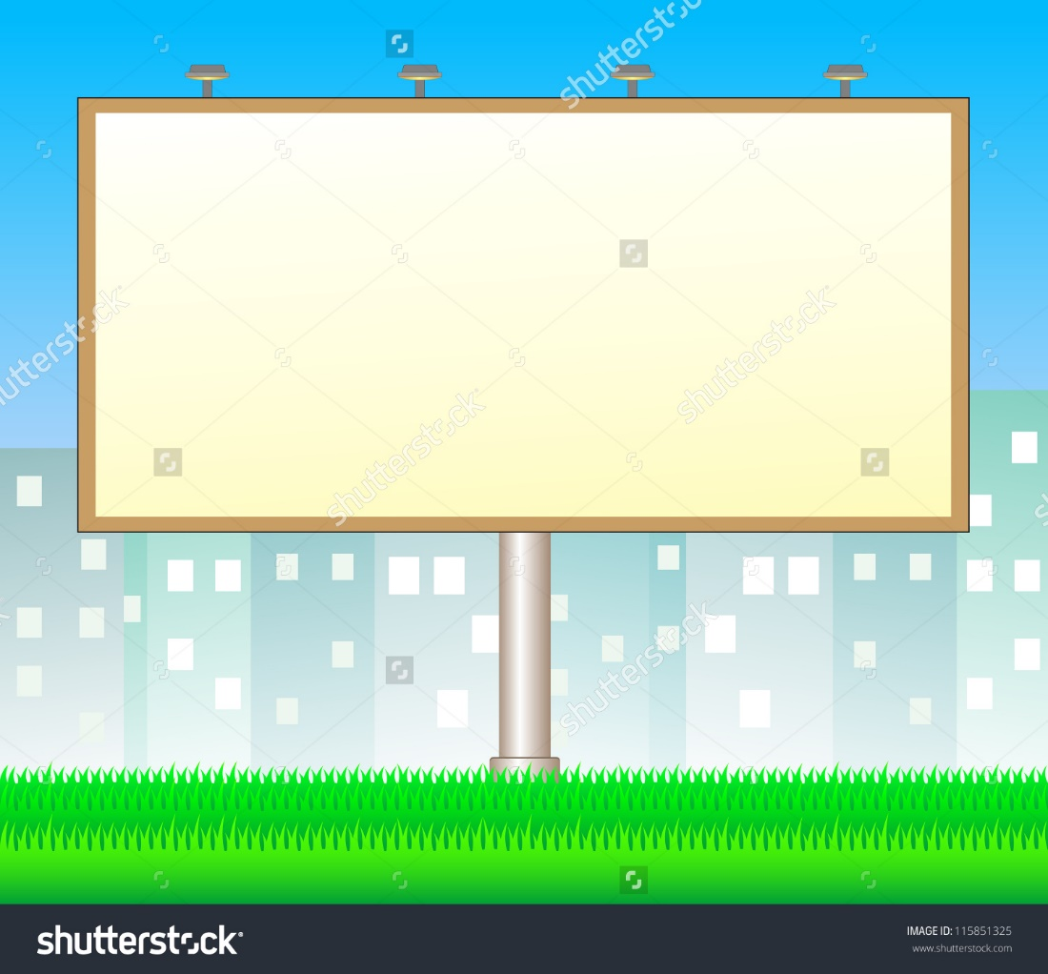
WHAT IS SUSTAINIBILITY?

Slide 4

Development that meet the needs of the present without compromising the ability of future generations to meet their own needs.
Sustainability doesn’t mean that without luxuries but rather being aware of your resources consumption and reducing unnecessary waste.
In simplest terms , sustainability is about our children and our grand children and the world we will leave them.

Slide 5

HOW TO BE SUSTAINABLE.?

Slide 6

Reduce household energy use.
Dispose with disposals.
Recycle.
Rely less on cars.
Go Chemical-Free
Green Your Transportation

Slide 7


DID YOU KNOW.!!
By 2025, 1.6 billion people will live in countries with absolute water scarcity; 440 million school days are already missed every year because of diarrheal diseases.

Slide 8

DID YOU KNOW.!!
More than 2 million people die each year because of indoor and outdoor pollution.

Slide 9

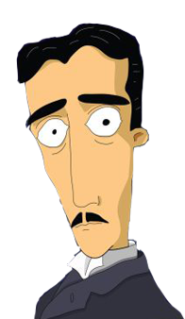
DID YOU KNOW !!!
A heavy coat of dust on a light bulb can block up to half of the light.
DID YOU KNOW !!
By recycling 1 plastic bottle , students can save enough energy to power their computer for 25 minutes

Slide 10
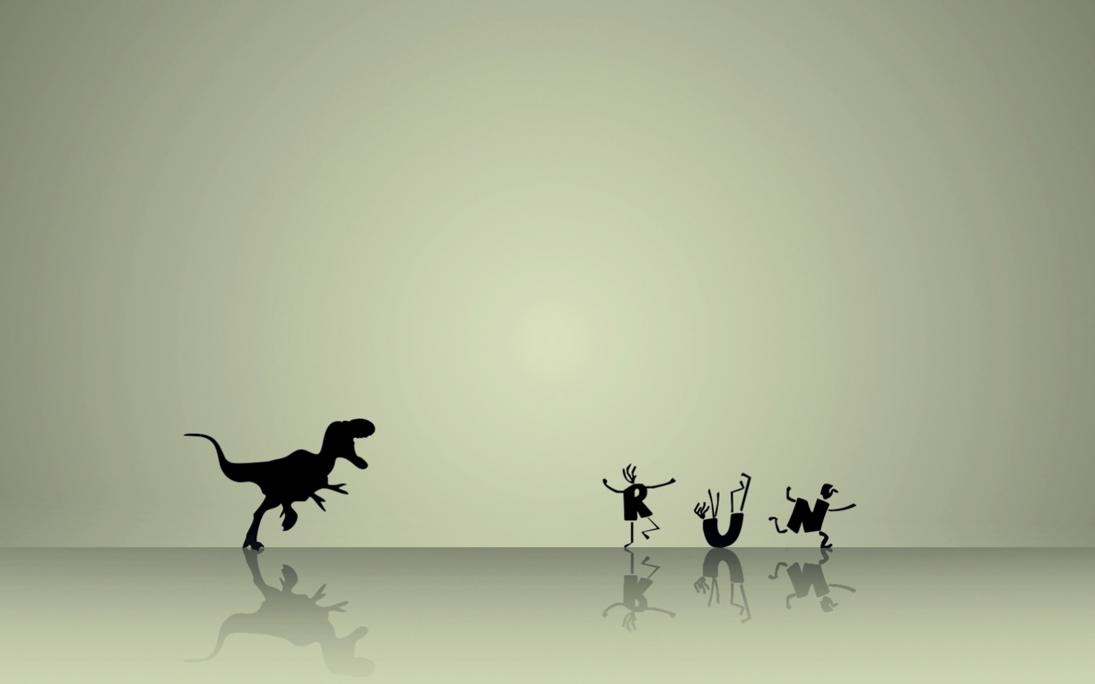
FUTURE OF TAP IT !
Tap it is a game which offers the values of sustainability to the common society. Here, we are introducing the unknown/known sustainable facts through our game.
We are planning to integrate with the government ,thereby we are beginning to recognize and understand the detrimental effect of our actions on the natural environment.
Code of TAP IT !! is completely an open source. Our intention is to spread the moral values of sustainability as a social work.
Creating a sustainable lifestyle takes a lifelong commitment-to learning, experimenting, exploring, committing to increasingly sustainable practices and above all, loving.

Slide 11
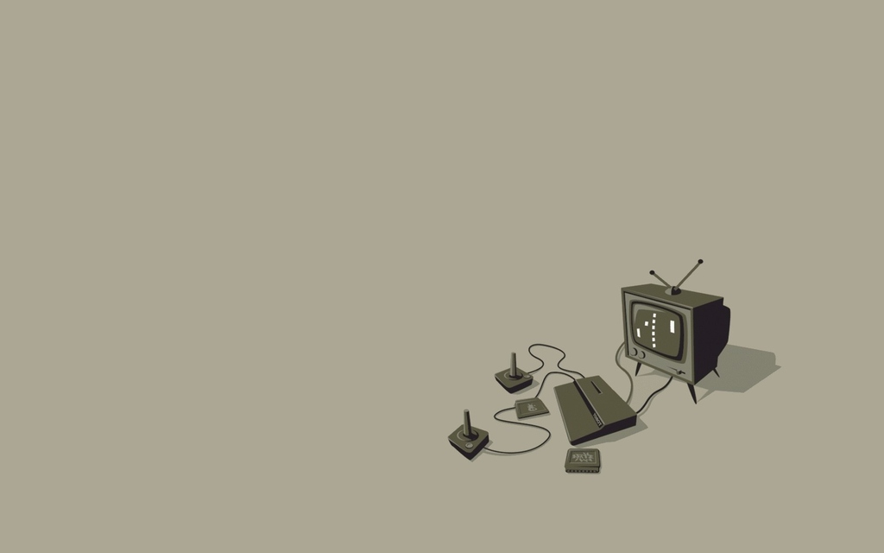
HOW TO PLAY ????
Click PLAY button.
Platform of the game goes up with particular speed.
On either side of the platform, tasks are provided.
Players need to tap that issues and it will be solved .
And the credits are allotted.!

Slide 12

TEAM : EL-CODERS
AISWARYA S
CIMI C PATANI
PRAVEENA SAJAN
SURYA R
TINTU SEBASTIAN

Slide 13

THANK YOU!

Slide 14
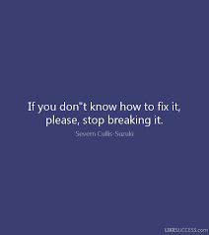
If you don’t know how to fix it..then stop breaking it

