Slide 1
NEOPHYTES
BHAVYASREE SASINDRA
JEETHU SUSAN JOHN
REEBA ANN THOMAS

Slide 2


LARA CROFT

Slide 3
GAME ??

Slide 4



INSTRUCTIONS
MOVES LARA CROFT RIGHT
MOVES LARA CROFT LEFT
JUMP

Slide 5


Slide 6
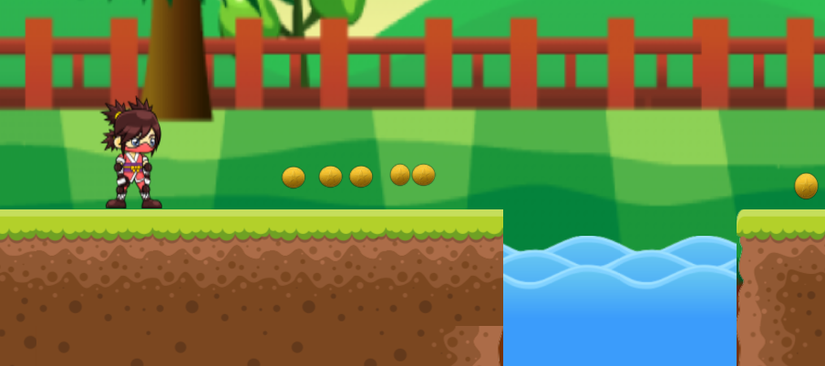

Slide 7
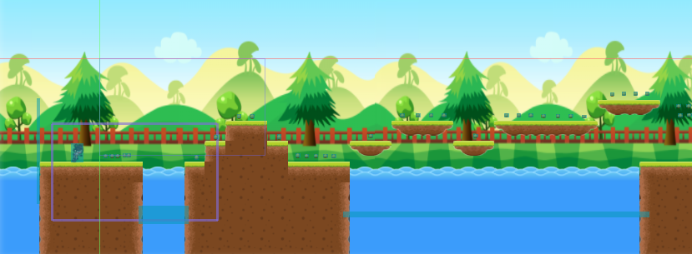

Slide 8


Slide 9


Slide 10
THANKYOU

