Slide 1
Overview
Views of linear programming
  Geometry/Visualization
  Algebra
  Economic interpretations

Slide 2
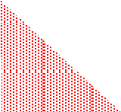
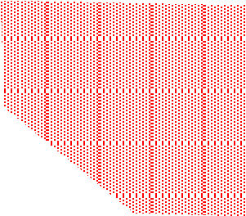
Different types of LPs
max x
s.t. x + y ≤ -1
x ≥ 0, y ≥ 0
max x
s.t. x + y ≤ 1
x ≥ 0, y ≥ 0
max x
s.t. x + y ≥ 1
x ≥ 0, y ≥ 0
Try to develop an LP with one or two variables for each of the following three properties.
it has no solution
it has an optimal solution
the solution is unbounded
Infeasible LP’s: that is, there is no feasible solution.
LPs that have an
optimal solution.
LPs with unbounded objective. (For a max problem this means unbounded from above.)

Slide 3
Any other types
Theorem. If the feasible region is non-empty and bounded, then there is an optimal solution.
This is true when all of the inequalities are “<=
constraints”, as opposed to “< constraints”.
e.g., the following problem has no optimum
Maximize | x
subject to | 0 | < x < 1

Slide 4
Convex Sets
A set S is convex if for every two points in the set, the line segment joining the points is also in
y
the set; that is,
if p₁, p₂ ∈ S, then so is (1 - λ)p₁ + λp₂ for λ ∈ [0,1].
3
Theorem. The feasible region of a linear program is convex.
p₁
2
1
p₂
x
1
2
3
4
22

Slide 5
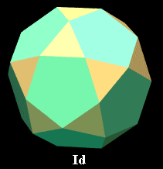

More on Convexity
Which of the following are convex ?
or not ?
y
5
4
3
2
1
© source unknown. All rights reserved. This content is excluded from our Creative
1 2 3 4 5 6
x
Commons license. For more information, see http://ocw.mit.edu/help/faq-fair-use/.

Slide 6
The feasible region of a linear program
is convex
y
5
4
3
2
1
1
2
3
4
5
6
x

Slide 7
Corner Points
A corner point (also called an extreme point) of the feasible region is a point that is not the midpoint of two other points of the feasible region. (They are only defined for convex sets, to be described later.)
Where are the corner points of this feasible region?

Slide 8
Fact: a feasible LP region has a corner point so long as it does not contain a line.
5
Region 1.
No corner point. Feasible region contains a line.
4
3
Region 2.
Two corner points. Unbounded feasible region
2
1
Region 3.
1
2
3
4
5
6

Slide 9
Facts about corner points.
If every variable is non-negative, and if the feasible region is non-empty, then there is a corner point.
In two dimensions, a corner point is at the intersection of two equality constraints.
Region 2.
Two corner points. Unbounded feasible region

Slide 10
Optimality at corner points
If a feasible region has a corner point, and if it has an optimal solution, then there is an optimal solution that is a corner point.
Example 1: minimize x+y
Example 2: maximize y
Example 3: maximize y

Slide 11
Suppose an LP has a feasible solution. Which of the following is not possible?
The LP has no corner point.
The LP has a corner point that is optimal.
The LP has a corner point, but there is no optimal solution.
4. The LP has a corner point and an optimal
solution, but no corner point is optimal.

Slide 12
Edges of the feasible region
In two dimensions, an edge of the feasible region is one of the line segments making up the boundary of the feasible region. The endpoints of an edge are corner points.
In two dimensions, it is a (bounded) equality constraint.
An edge
31

Slide 13
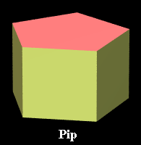
Edges of the feasible region
In three dimensions, an edge of the feasible region is one of the line segments making up the framework of a polyhedron. The edges are where the faces intersect each other. A face is a flat region of the feasible region.
In two
dimensions it is a
A face
An edge
bounded intersection of two equality constraints.
A face
32

Slide 14
Extreme Rays
An extreme ray is like an edge, but it starts at a corner point and goes on infinitely.
y
Two extreme rays.
5
4
3
2
1
1
2
3
4
5
6
x
33

