Slide 1

Student Grades Management System
ABDULRAHMAN BADR-ALDEEN B2105.090055
ESRA TURAN B2105.090124
MERVE CAKIR B2105.090098

Slide 2
OVERVIEW
This project is a Java Swing-based desktop application designed to manage students, courses, and grades using an embedded SQLite database. It includes two user roles : student and instructor.
🔧 Technologies Used
Java SE: Core language and GUI (Java Swing)
SQLite: Lightweight relational database
JDBC: To perform SQL operations in Java
NetBeans IDE: Development environment

Slide 3
USE CASES
Students: Can register, log in, view their grades, calculate GPA, and manage course enrollment.
Instructors: Can log in, view/manage courses, assign grades to enrolled students, and track course enrollment.

Slide 4
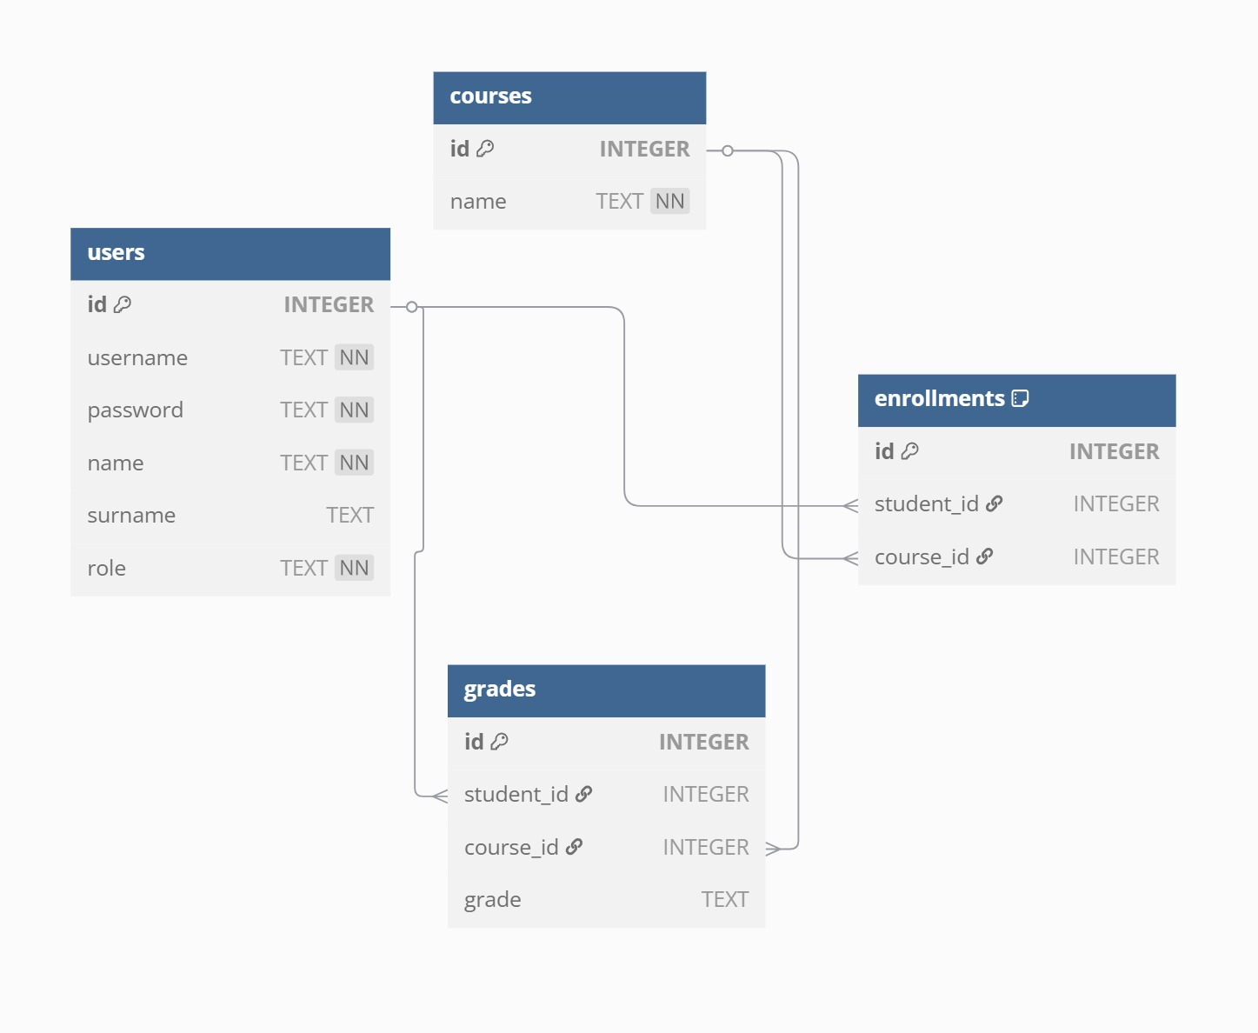
DATABASE ER DIAGRAM

Slide 5
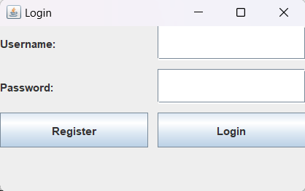
PROGRAM STRUCTURE
1. LoginPage.java
Swing window with username and password fields
Validates password using a regex for strength
Checks login credentials from the users table
On success: redirects user based on role to either Student Page or Instructor Page

Slide 6
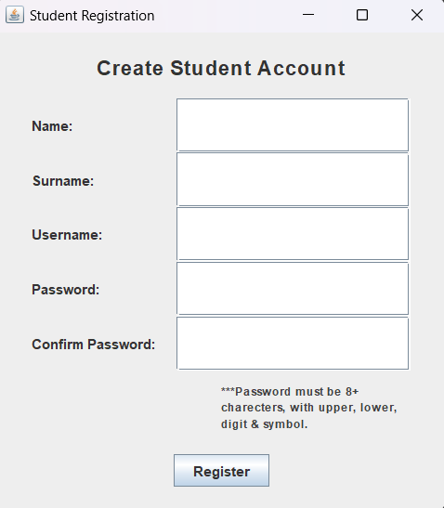
PROGRAM STRUCTURE
2. RegisterPage.java
Swing form with Name, Surname, Username, and Password fields
Validates password and empty fields
Inserts the new user into the users table with role = 'student'

Slide 7
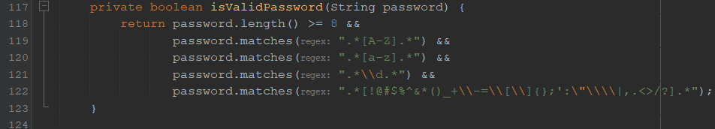
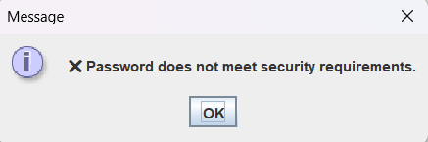
PASSWORD VALIDATION
the logic is handled by this method:
password.length() >= 8 Password must be at least 8 characters long
password.matches(".*[A-Z].*") Must contain at least one uppercase letter (A–Z)
password.matches(".*[a-z].*") Must contain at least one lowercase letter (a–z)
password.matches(".*\\d.*") Must contain at least one number (0–9) \\d is the regex for "digit"
password.matches(".*[!@#$%^&*()_+\\-=\\[\\]{};':\"\\\\|,.<>/?].*") Must contain at least one special character This includes symbols like !, @, #, %, etc.

Slide 8
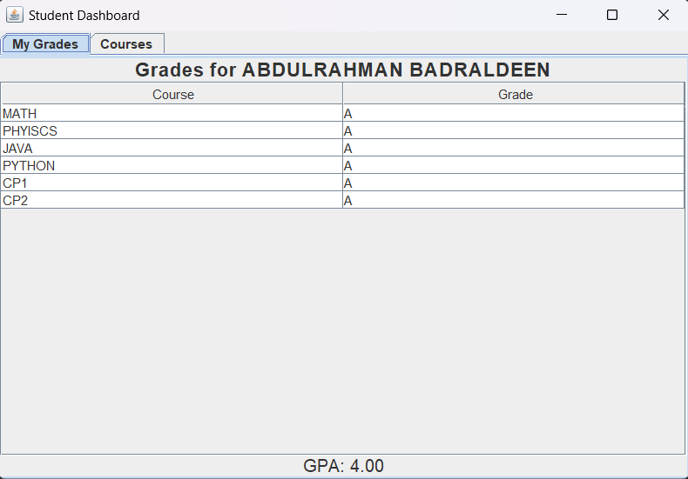
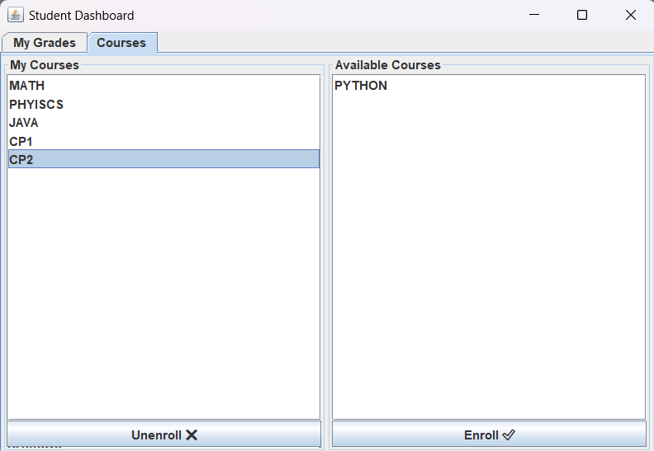
PROGRAM STRUCTURE
3. StudentPage.java
Main student dashboard shown after login
Tab 1 - My Grades:
Shows a read-only table of enrolled course grades
GPA calculated using a switch-case method
Tab 2 - Courses:
Two list models: My Courses (enrolled), Available Courses (not enrolled)
Buttons to Enroll/Unenroll in courses, backed by enrollments table

Slide 9
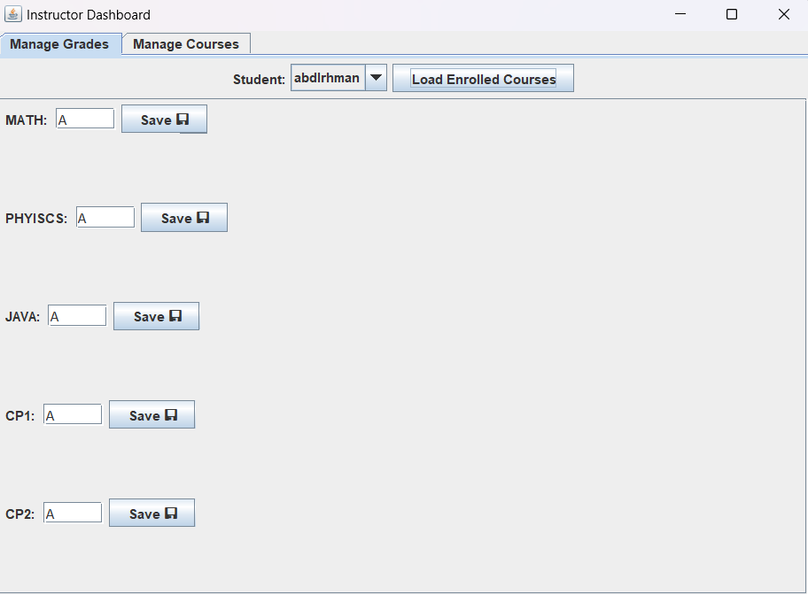
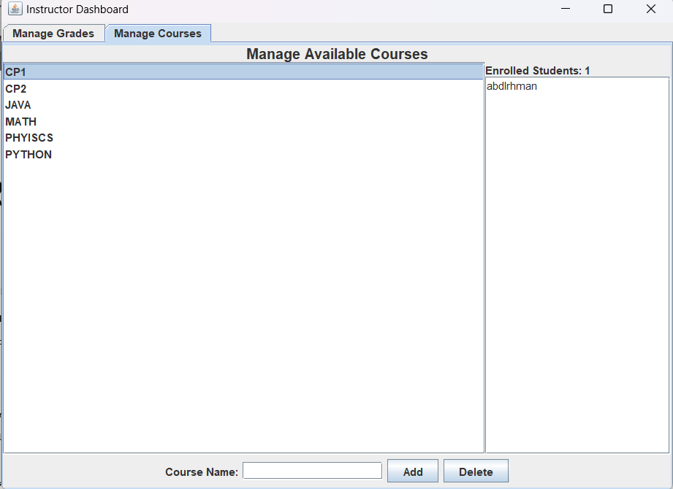
PROGRAM STRUCTURE
4. InstructorPage.java
Main instructor dashboard
Tab 1 - Manage Grades:
Dropdown to choose student
Table shows only the student’s enrolled courses
Instructor can enter/update grades inline
Tab 2 - Manage Courses:
List of all available courses
Instructor can add or delete courses
Panel shows student count and names enrolled in the selected course

Slide 10

Thank you

