Slide 1
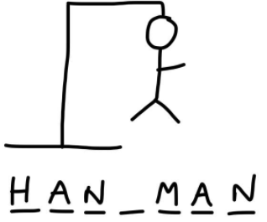
HANGMAN
Bruna and Isra

Slide 2
Description your game
Hangman is a paper and pencil guessing game for two or more players. One player thinks of a word, phrase or sentence and the other(s) tries to guess it by suggesting letters within a certain number of guesses.
Our game is a one player game against the machine. The computers select a random word from a 50.000 words list. The player has 8 rounds to guess the letters of the words or the word. During the game it is displayed information to keep the player aware of the progress.

Slide 3
Challenges
1st Pulling and Pushing in GitHub.
2nd Splitting the coding tasks. We have created two MVPs separately and we lost much time with the MVPs.
3rd List of words or Library. We found some issues with the format of the list
4th Creating a list with underscores ‘_’ instead of letters and then replace the the guessed letters that were right.
5th Display the hangman progress. ASCII vs Pictures

Slide 4
Proccess
Design Proccess:
Brain storm of ideas.
Draft of the structure of the game.
Coding Proccess:
Get random word.
Find, save and edit a list of words.
Use random choice to get a word from the list
Input letters and word:
Error handling for the letter and the word.
Save letters or words to be displayed when needed and avoid the reusage of them.
Create an empty list with underscore and replace them with the right letter when needed.
Count down the fails and display the hangang man stages.
Sum up:
Readme.md
PPT presentation

Slide 5
Learnings
While loops
Enumerate function enumerate()
Statements
Functions
List formatting
Don’t complicate yourself. There is always a simpler solution.

Slide 6
If I were start from the scratch
We would spend more time on the designing fase in order to do a draft in pseudo-code for being able to split the coding taks.
Start coding with classes to make our game easier to improve.

Slide 7
Improvemts
Two players – Classes.
Designing phase.
Task sharing to avoid duplicated work.
Pictures instead of ASCII in the game.

Slide 8
Highlights
The engage of both students to deliver a functional game.
The learning proccess during the game creation.

