Slide 1


Disciplined Entrepreneurship
“ rAsif ”
THE SMART TRANSPORT HUB
Know the When, Master the Day
Prepared by: Israa Bazzal, Fatima Somaka, Rana Ali Bourji, Sarah Atat
Under the direction of: Dr. Rawan Raya
Academic year 2025 - 2026

Slide 2




MEET OUR MEMBERS
Israa Bazzal
Fatima Somaka
Rana Bourji
Sarah Atat
We are four university students who face daily challenges with public transportation in the Bekaa. And our experience is exactly what inspired this project.”

Slide 3








Problem Statement (Market Pull)
Long waiting times
No real-time information
Missed classes & delays
Zero communication from drivers
No tracking system

Slide 4

Zero communication from drivers
No real-time information
Missed classes & delays
Problem Statement (Market Pull)
Long waiting times
No tracking system

Slide 5


Evidence of the Problem
1
Primary Market Research
2
Porter / SWOT analysis
3
Competitive analysis

Slide 6
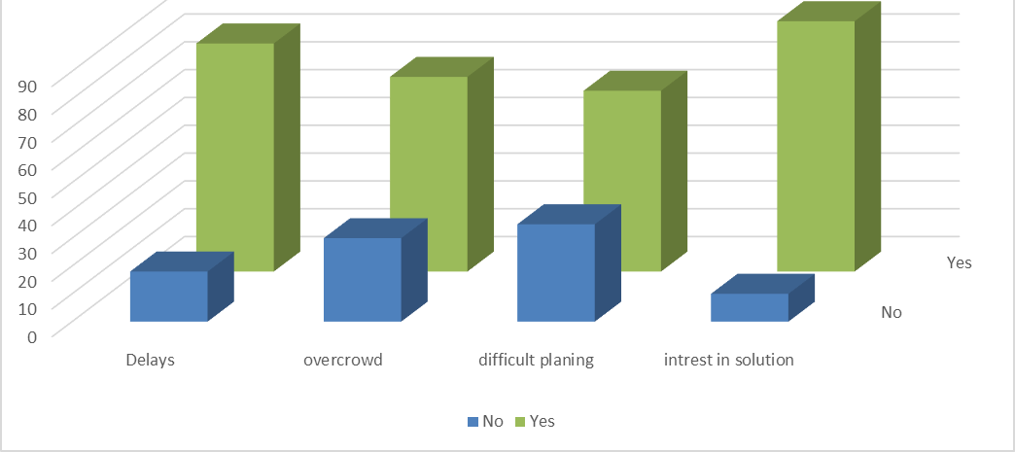
Primary Market Research
1
Evidence of the Problem
Surveys targeted students and transport providers in Bekaa to assess current transportation challenges and interest in smart solutions.
Users reported frequent delays, overcrowding, and difficulty planning trips due to lack of reliable information.
Strong interest in real-time tracking, notifications, and app-based booking to improve travel experience.
Drivers also expressed willingness to use technology for better scheduling and increased passenger satisfaction.
Overall results show a clear demand for reliable, tech-enabled transport solutions like rAsif.
porter / SWOT analysis
2
compettitive analysis
3

Slide 7
Evidence of the Problem
1
Primary Market Research
2
Porter / SWOT analysis
3
Competitive analysis

Slide 8
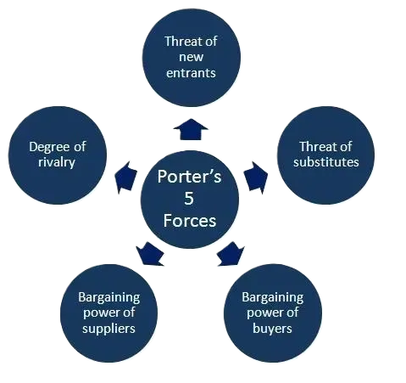
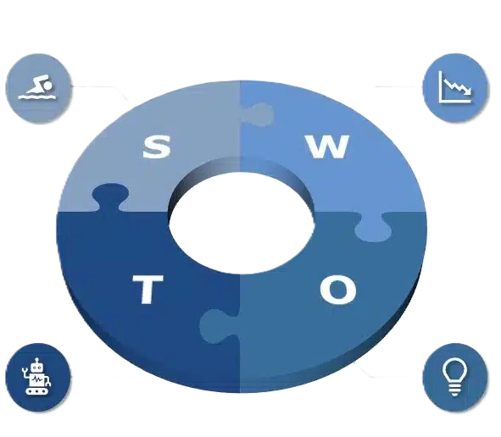
Evidence of the Problem
2
porter / SWOT analysis
Strength
Weakness
1
Primary Market Research
Threats
Opportunities
The smart transport project operates in a market with strong customer demand and significant public sector influence, while facing moderate supplier power and moderate threat from new entrants.
The main competitive pressures come from strong substitutes and high customer expectations, but low competition and supportive government policies create strategic opportunities for growth.
The startup has strong technical capabilities and market-fit (real-time tracking, AI predictions, scalable and localized solution) with major growth opportunities through digital adoption, government initiatives, partnerships, and expansion potential.
It faces financial and operational challenges (costs, infrastructure reliance, permissions, driver cooperation, low brand awareness) along with external risks such as political/economic instability, industry resistance, legal concerns, and competition from established apps.
3
compettitive analysis

Slide 9
Evidence of the Problem
1
Primary Market Research
2
Porter / SWOT analysis
3
Competitive analysis

Slide 10
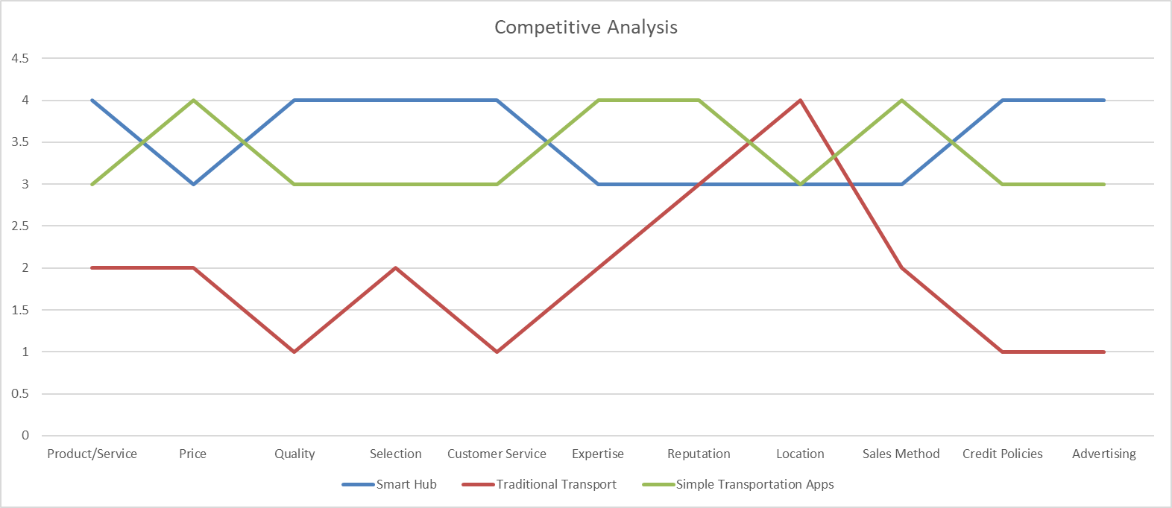
compettitive analysis
Evidence of the Problem
3
1
Primary Market Research
2
porter / SWOT analysis

Slide 11

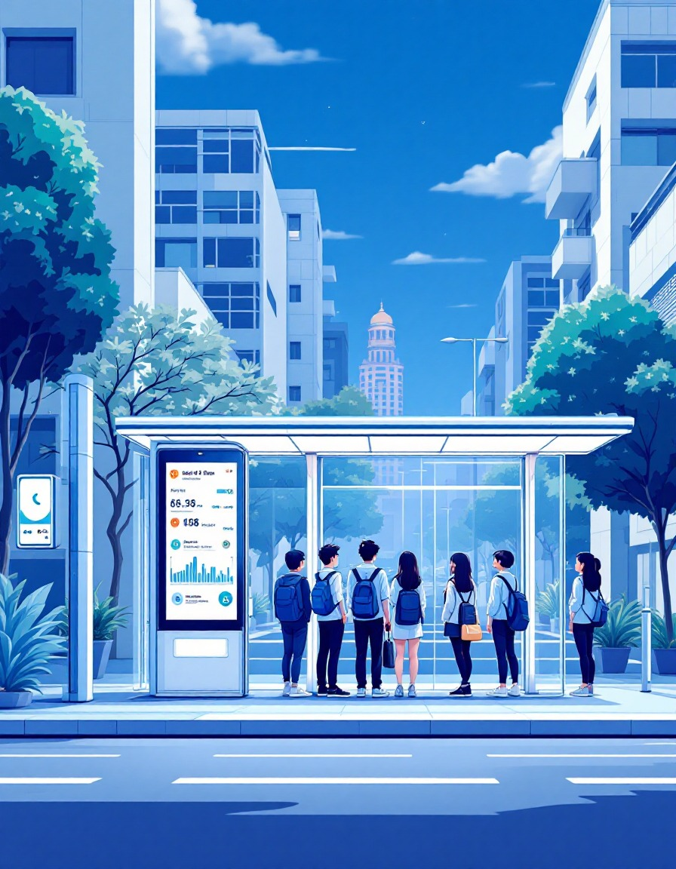

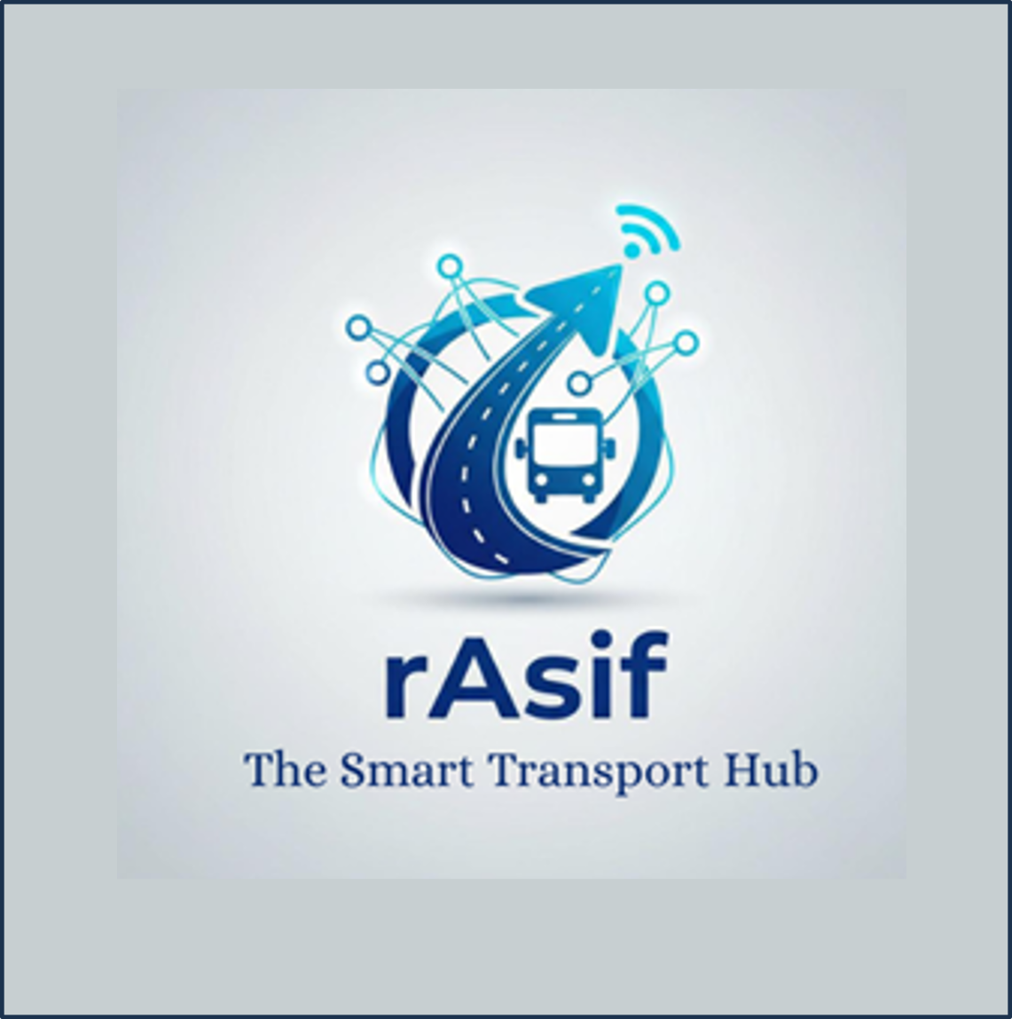



Our Solution: rAsif
A connected smart station system that improves public transport efficiency through real-time digital services.
Key Features
Real-time bus tracking
AI-predicted arrival times
LED/LCD smart station screens
Driver app with GPS data
Delay + arrival notifications
Digital advertising space
Value:
Reduces waiting time
Improves reliability
Generates new revenue streams

Slide 12

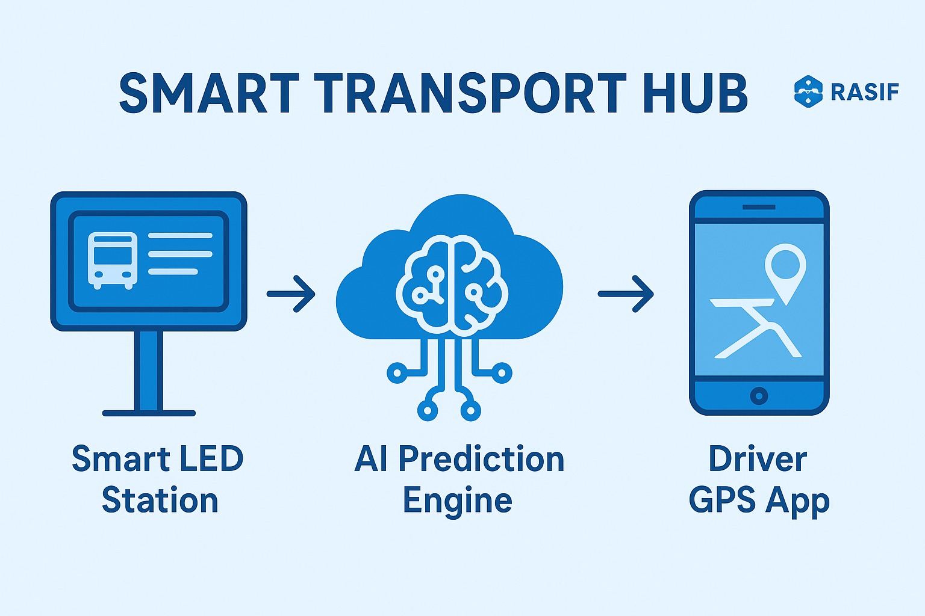
How It Works?
Three-Part Flow
1)Driver app sends GPS location
2)AI predicts arrival time using distance, traffic, and history
3)Smart station displays accurate arrival time to passengers
Continuous updates every few seconds

Slide 13

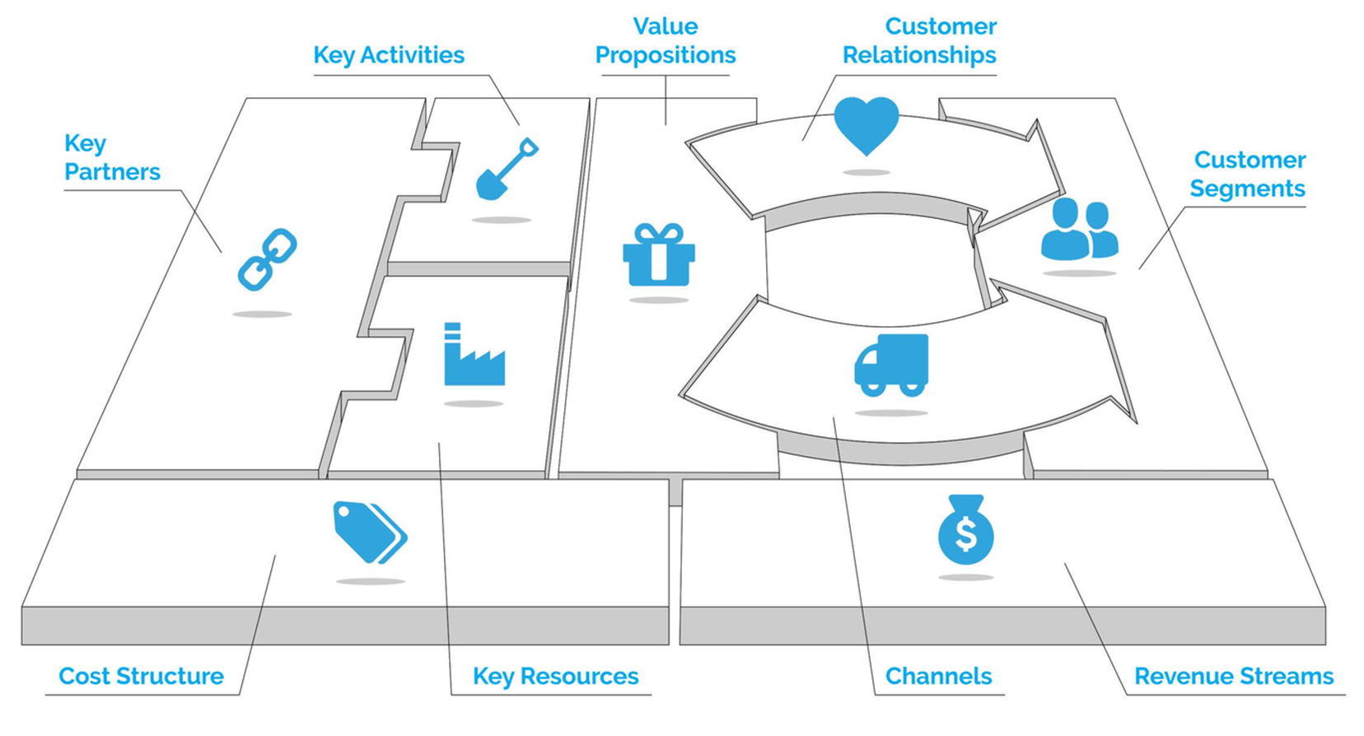
Our Business Model

Slide 14

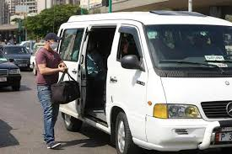
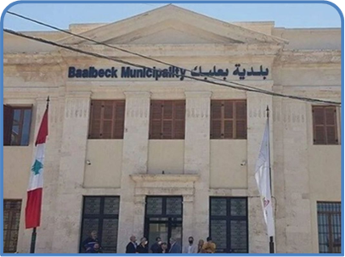







We deliver predictable, stress-free transportation to university students in the Bekaa by solving their core problem: unreliable, chaotic, and time-wasting commutes. We do this through a connected ecosystem of smart stations, a real-time tracking app, and AI predictions that provide accurate arrival times, reduce waiting, and restore a sense of control over their daily travel.
Partners List:
PROBLEM
SOLUTION
VALUE
Universities & Colleges
Transport Companies
Local Municipalities
Technology Suppliers
Advertising Partners

Slide 15
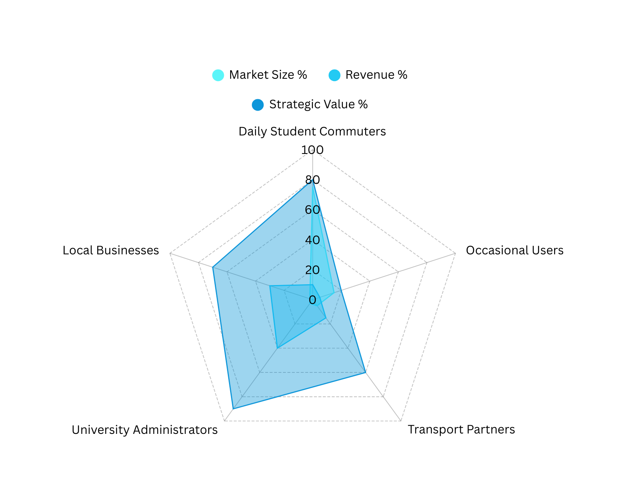
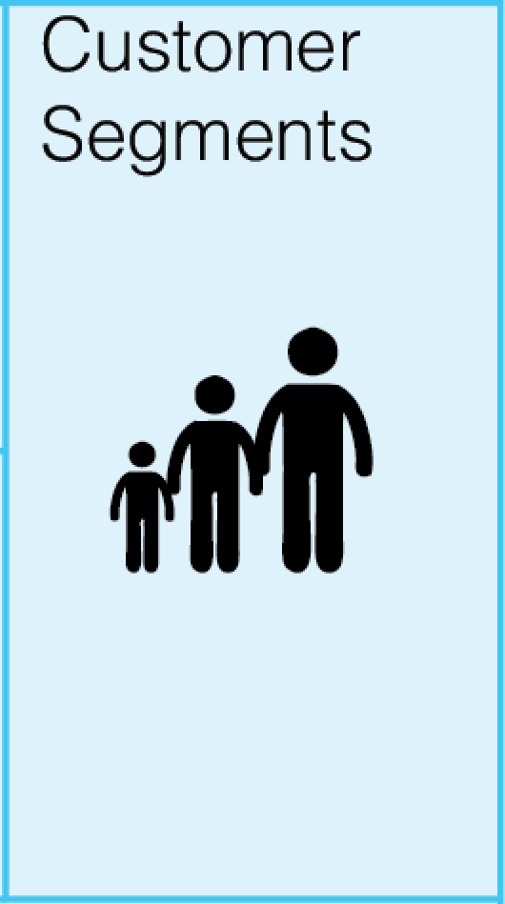
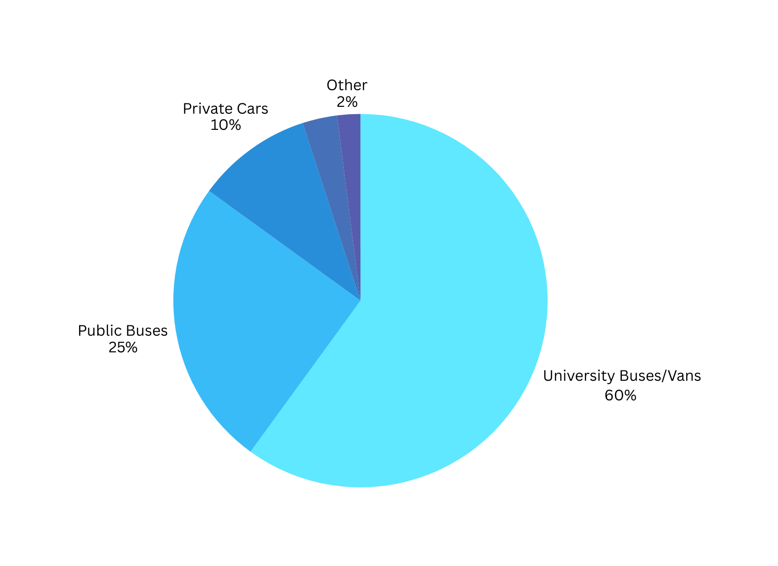
Four Core Customer Segments:
The radar chart shows our strategic customer mix: students provide the user base, universities bring institutional partnerships, transport companies enable service delivery, and advertisers fund operations—each playing a different but essential role in our ecosystem.
🎓 STUDENTS (Primary Users)
Daily commuters needing reliable transport
Value: Time savings, reduced stress, predictability
🏛️ UNIVERSITIES (Primary Partners)
Institutions needing better transport management
Value: Improved services, student satisfaction, safety
🚌 TRANSPORT COMPANIES (Secondary Partners)
Operators needing efficiency tools
Value: Route optimization, customer satisfaction
📢 ADVERTISERS (Secondary Customers)
Businesses wanting student market access
Value: Targeted advertising platform
"60% use university buses and vans—our primary target market"

Slide 16





KEY RESOURCES
Physical Resources
Smart Stations
LED / LCD Screens
Connectivity Devices (Wi-Fi / Routers)
Server Infrastructure
Driver Smartphones (GPS through app)
Intellectual Resources
AI Prediction Algorithms
Software Platform (App + Dashboard)
Real-Time Data Models
Brand Identity & Credibility
Human Resources
Developers & Data Engineers
Field Technicians
Marketing Team
Customer Support Agents
University/Transport Coordinators
Financial Resources
Seed Funding
Operational Budget
Maintenance & Development Costs

Slide 17



Digital & Network Resources
Real-time GPS data from drivers’ smartphones
Cloud servers and hosting platforms
Mobile and web applications
AI algorithms & prediction models
System dashboards for operators
API connections between apps and smart stations
Internet connectivity for stations
Data Resources
Real-time GPS location data
Arrival time & route history
User activity and usage analytics
Ad performance data
System logs for AI improvement
Partnership Resources
Universities & campus administrations
Public and private transport companies
Local municipalities (for station placement approval)
Advertising partners & local businesses
Tech vendors (LED screens, networking hardware)
Customer support outsourcing partners
Resource Timeline & Milestones
MONTH 1-3: Software MVP + 1 Pilot Station
MONTH 4-6: 2 University Partners + Driver App
MONTH 7-12: Full System Launch + First Advertisers
YEAR 2: 5+ Universities + Optimized AI + Revenue Growth

Slide 18
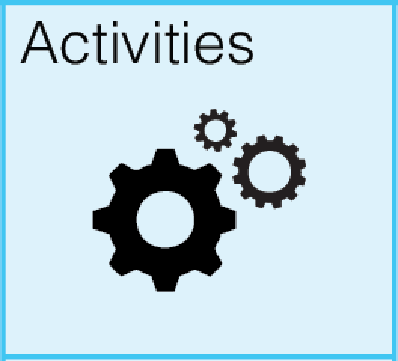
Value Proposition Activities
Maintain AI & GPS
Update mobile app
Technical support
Build smart stations
Manage digital ads
Distribution Channel Activities
Install & maintain stations
Update app features
Expand to universities
Coordinate with partners
Integrate GPS with AI
Customer Relationship Activities
Customer support
Personalized alerts
Clear communication
Collect feedback

Slide 19

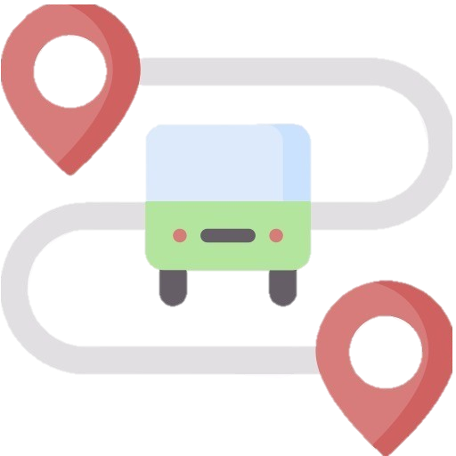


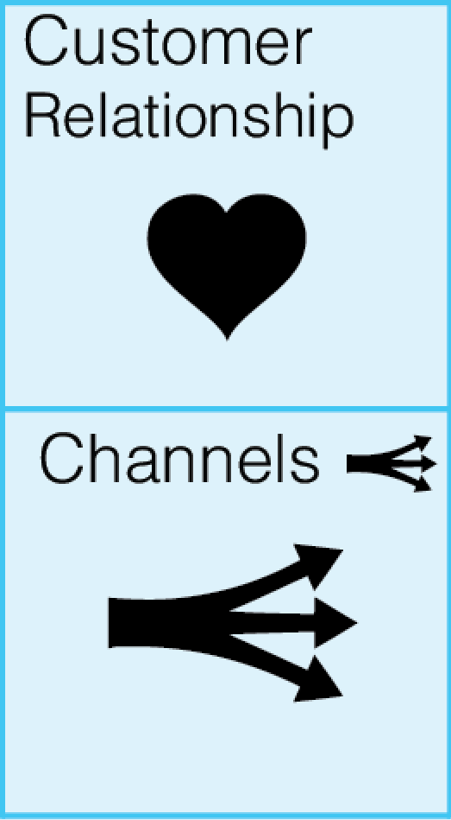
Universities & Colleges
Students
Transport Companies & Drivers
Advertisers
Channels
Preferred Channels: Universities, mobile app, and social media platforms.
Current Channels Used: Pilot programs with universities + targeted online marketing.
Integration of Channels: Mobile app and smart stations are fully synchronized through the same AI + GPS system.
Most Effective Channels: University partnerships and mobile app engagement.
Most Cost-Efficient Channels: Digital and social media advertising due to low cost and precise student targeting.
Integration into Customer Routine: Students can easily check bus arrival times or reserve seats directly from their phones before commuting.
University Partnerships

Slide 20


Cost structure:
Total Monthly Cost =
Fixed Cost +Variable Cost =22,410$
High fixed costs ensure stable operations
Variable costs increase with usage and growth
Cost structure supports sustainable expansion
Costs
(K)

Slide 21

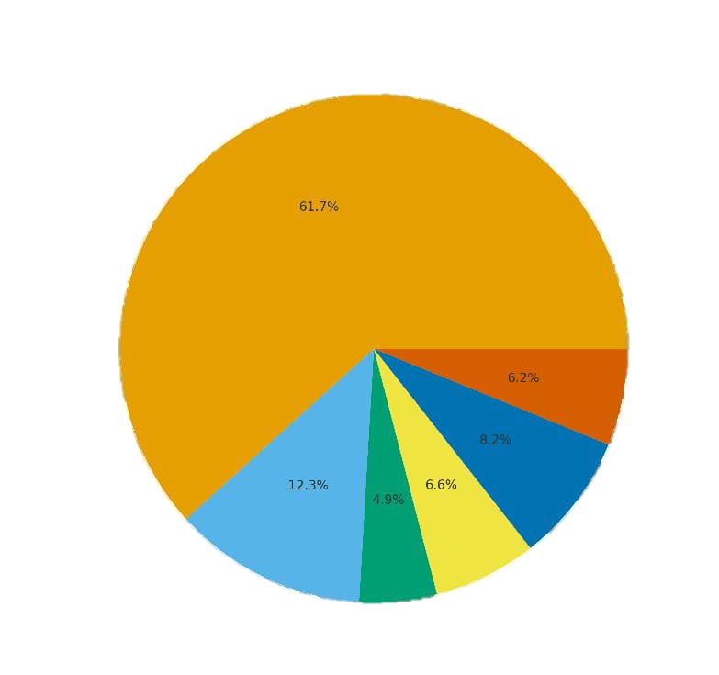
Monthly Revenue Structure - Smart Transport Hub
Profit Structure:
Smart Station Contracts $15K
Maintenance & Service Fees $1,5K
Data Insights & Analytics $2K
Premium App Features $1,6K
Digital Advertising $3K
Driver/Company Subscriptions $1,2K
With total revenue =$24,300 / month
Monthly Profit: $1,890

Slide 22
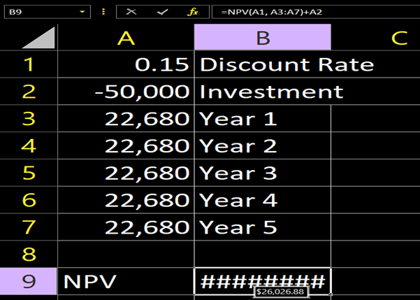
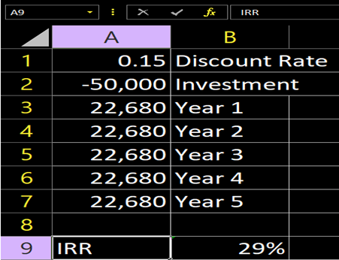
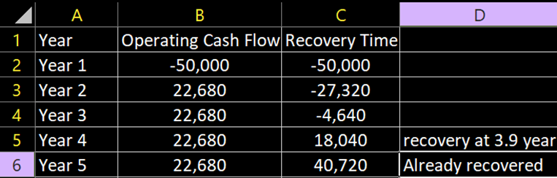
Financial Analysis:
Net present value (NPV) over 5 years :
Internal rate of return calculation:
Profitability Index :
Profitability Index = (Net present value + invested amount) / invested amount
= (26,203+50,000)/50,000 = 1.52 > 1 => the project is profitable
The company can expect to cash $ 0.52 for every dollar invested. That is, the net present value is $ 0.52.
26,026.88
Recovery time of the amount invested:

Slide 23
Evaluation tools:

Slide 24

THANK YOU
With kind regards from our team
VISIT US

