Slide 1

GSMA MENA IGNITE OPEN GATEWAY HACKATHON · 2026
Smart Profits
AI-Driven Financial Analytics & Telco-Secured Merchant Platform
Theme 4: Secure FinTech, Payments & Anti-Fraud Innovation
GSMA CAMARA APIs via Nokia Network-as-Code + Smart Guard AI Agent (Allow / Step-up / Freeze)
SIM Swap
Number Verif.
Location Verif.
Device Swap
AI Agent
Israa Nael Hamad · University of Palestine, Gaza · Bitsandbytesdude Software Agency
github.com/BITSANDBYTESDUDE/Smart-Profits · bitsandbytesdude.vercel.app
Smart Profits · GSMA MENA Ignite · Theme 4 Secure FinTech
01 / 20

Slide 2
EXECUTIVE SUMMARY
One sentence for the judges
The pitch
Smart Profits is a bilingual merchant SaaS that turns messy Excel into profit decisions — protected by 4G/5G network intelligence so a stolen SIM cannot open or upload the store's financial files.
Problem
Solution
Proof
MENA merchants run on Excel. Phantom profit hides real losses. SIM swap beats SMS OTP on the same login.
Financial AI + Smart Guard Agent orchestrating Nokia NaC CAMARA APIs on every sensitive action.
Working Next.js product. Live Nokia RapidAPI logs. Policy engine: Allow · Step-up · Freeze.
Mandatory CAMARA — ✓
Mandatory AI Agent — ✓
Theme 4 FinTech — ✓
MENA AR+EN — ✓
Smart Profits · GSMA MENA Ignite · Theme 4 Secure FinTech
02 / 20

Slide 3
1. PROBLEM
The P&L lives in Excel. So does the fraud.
Financial blindness
Profit leakage
Account takeover
Messy Arabic/English Excel, CSV, PDF. Rent and salaries missing. Phantom profit looks healthy. No CFO.
Weak SKUs, unexamined margins, unplanned OpEx. A 'good month' in sales can still be cash-negative.
SIM swap beats SMS OTP. Attacker downloads P&L, changes prices, steals sales files — the business itself.
Banks already buy network APIs. The SaaS that holds the merchant's books usually does not.
Theme 4 gap: financial files without telco-grade identity — on the same login SMS OTP cannot protect.
Smart Profits · GSMA MENA Ignite · Theme 4 Secure FinTech
03 / 20

Slide 4
2. MARKET & TIMING
Why MENA, why now
Excel commerce
SIM-swap fraud
WhatsApp + spreadsheet is the ERP for millions of independent stores across MENA.
High mobile-first commerce + OTP reliance = account takeover on merchant SaaS.
Open Gateway
5G/4G identity
GSMA CAMARA makes operator APIs programmable — FinTech SaaS is the consumption layer.
Number Verification works because the phone is on-network — not because we sent another SMS.
Smart Profits · GSMA MENA Ignite · Theme 4 Secure FinTech
04 / 20

Slide 5
3. SOLUTION
Two brains. One login. Network-secured books.
Financial AI engine
Smart Guard AI Agent
Cleans messy workbooks (AR/EN). Diagnoses store health, profit leaks, inventory. 30-day action plan. File-grounded advisor Q&A — answers only from the open file.
On login, register, upload, export, price change: calls Nokia Network-as-Code, fuses network + financial risk, decides Allow / Step-up / Freeze. Explains in Arabic or English.
Positioning for judges
Not a generic Excel chatbot.
A FinTech control plane for SMEs — using 5G/4G CAMARA signals the way a bank uses them, on the merchant's own books.
No sensitive action completes unless Smart Guard has run the network loop.
Smart Profits · GSMA MENA Ignite · Theme 4 Secure FinTech
05 / 20

Slide 6
MANDATORY REQUIREMENT A
GSMA CAMARA APIs via Nokia Network-as-Code
Accessed only through Nokia NaC — never operator-by-operator.
CAMARA API | Sensitive action | Agent decision
SIM Swap | Login · register · password reset · price change | Recent swap → FREEZE session
Number Verification | Login · step-up identity (silent 4G/5G) | Network confirms MSISDN — not SMS
Location Verification | Excel/CSV/PDF upload · P&L export | Outside store geofence → block / step-up
Device Swap | Same sensitive actions as SIM Swap | Recent device change → FREEZE
Live integration: Nokia Network-as-Code on RapidAPI (passthrough CAMARA paths).
Structured server logs: [nac-live] nacMode=live provider=Nokia transport=RapidAPI status=200 requestId=…
Official test MSISDNs from Nokia docs — policy never hardcodes outcomes.
Smart Profits · GSMA MENA Ignite · Theme 4 Secure FinTech
06 / 20

Slide 7
MANDATORY REQUIREMENT B
AI Agent orchestration — not a chatbot caption
Smart Guard is the hackathon-required agent layer.
1 · Sense
2 · Query
3 · Decide
4 · Act
Merchant action triggers guard: login, register, file upload, export.
Parallel CAMARA calls via Nokia NaC: SIM Swap, Device Swap, NV, Location.
Policy engine outputs exactly three decisions: ALLOW · STEP-UP · FREEZE.
Freeze = no file stored, no export. Step-up = network code (not SMS). Allow = proceed.
Decision policy (lib/smart-guard/policy.ts — unchanged business rules)
SIM swap detected → FREEZE
Device swap detected → FREEZE
Location mismatch (hard) → FREEZE
Number not verified → STEP-UP (network code)
Location soft / unknown → STEP-UP
All signals clean → ALLOW
Smart Profits · GSMA MENA Ignite · Theme 4 Secure FinTech
07 / 20

Slide 8
4. TECHNICAL ARCHITECTURE
Production-ready stack — not slide-only
Merchant UI · Next.js / TypeScript · Arabic RTL + English · Dashboard · Advisor · Upload · Admin
Smart Guard Agent
Orchestrates CAMARA + financial context
Allow / Step-up / Freeze
Financial engine
Excel/CSV/PDF parse · P&L · leaks · Q&A
PostgreSQL
Users · files ·
guard_decisions log
nokia-adapter.ts
Live RapidAPI +
audit logs
Nokia NaC
CAMARA passthrough
4G/5G networks
Separation of concerns (judge-friendly):
policy.ts = business rules (frozen) · nokia-adapter = live HTTP · nac-client = live vs mock routing · enforce.ts = server-side gate on register/login/upload
Smart Profits · GSMA MENA Ignite · Theme 4 Secure FinTech
08 / 20

Slide 9
5. LIVE NOKIA INTEGRATION
Evidence judges can verify in code and logs
What runs today
Test MSISDNs (Nokia official)
With NAC_API_KEY: Smart Guard hits live RapidAPI endpoints.
SIM Swap / Device Swap / Location → HTTP 200 from Nokia.
Number Verification → 401 on sandbox (OAuth gap) → STEP-UP path — not fake success.
+99999991001 → clean (register demo)
+99999991000 → SIM/device swap → FREEZE
+99999991002 → location PARTIAL → STEP-UP on upload
+99999991003 → location UNKNOWN (live only)
Sample live log line (terminal)
[nac-live] nacMode=live provider=Nokia transport=RapidAPI api=sim-swap endpoint=/passthrough/camara/v1/sim-swap/sim-swap/v0/check status=200 outcome=success latencyMs=877 requestId=21578300-…
Fail-closed: provider 401/403/404/429/timeout → block or step-up — never allow by default.
Smart Profits · GSMA MENA Ignite · Theme 4 Secure FinTech
09 / 20

Slide 10
6. DEMO JOURNEY A
Trusted merchant — usual shop (ALLOW)
Steps
Signals shown in UI
Judge takeaway
1. Register with +99999991001 + new email
2. Smart Guard: SIM Swap ✓ Device Swap ✓
3. NV unavailable (live) → network step-up code
4. Enter demo code → auto-complete registration
5. Upload messy furniture Excel
6. Ask advisor: highest profit product
7. See phantom vs real net profit
Nokia NaC panel in overlay:
· SIM Swap (24h): OK
· Device Swap (24h): OK
· Number Verification: pending → verified
· Location Verification: TRUE / PARTIAL
Decision badge: دخول طبيعي / Allow
Real product value (analytics) +
real network security on the
same user journey.
Not security bolted on after —
Smart Guard gates register,
login, and file upload.
Smart Profits · GSMA MENA Ignite · Theme 4 Secure FinTech
10 / 20

Slide 11
7. DEMO JOURNEY B
SIM swap attack — FREEZE (Theme 4 anti-fraud)
Attack scenario
Agent response
Attacker with freshly swapped SIM tries login or file upload.
SMS OTP would pass. Smart Guard does not trust SMS alone.
Nokia NaC SIM Swap → recent change detected
Policy → FREEZE · Upload disabled · Account flagged
Merchant notified in Arabic/English with CAMARA signal breakdown.
Demo with +99999991000
Register or login → Smart Guard overlay shows freeze
· SIM Swap: BAD (recent hours shown)
· Sensitive actions blocked until re-auth from trusted line
· Admin panel shows: مجمّد — تبديل شريحة
Smart Profits · GSMA MENA Ignite · Theme 4 Secure FinTech
11 / 20

Slide 12
8. DEMO JOURNEY C
Location mismatch — STEP-UP / block upload
Scenario
Agent response
Session tries to upload monthly_sales.xlsx outside the store geofence.
Could be hijacked account or insider exfiltration.
Location Verification → PARTIAL or FALSE
Policy → STEP-UP or FREEZE (by match rate)
File never lands until Number Verification on trusted MSISDN.
Demo with +99999991002
Upload financial file → step-up required
Network code sent (demoCode in dev — not forgeable SMS)
After verify → upload proceeds
Logs: location-verification status=200 outcome=partial
Smart Profits · GSMA MENA Ignite · Theme 4 Secure FinTech
12 / 20

Slide 13
9. DIFFERENTIATION
Why Smart Profits wins Theme 4
Typical Excel AI | Smart Profits
Reads a spreadsheet | Reads + diagnoses + bilingual Q&A on open file
Trusts SMS OTP | SIM Swap + Number Verification via network
No location concept | Location Verification binds uploads to store
Chatbot only | AI Agent calls CAMARA tools + enforces freeze
Generic SaaS | Built for MENA (RTL Arabic, messy AR/EN ledgers)
Slide-only Open Gateway | Live Nokia NaC + structured audit logs
Judges see both mandatory requirements in the decision path — not in an appendix.
Smart Profits · GSMA MENA Ignite · Theme 4 Secure FinTech
13 / 20

Slide 14
10. BUSINESS MODEL
SaaS revenue + Open Gateway COGS
FULL PRODUCT
SINGLE STORE
MULTI-BRANCH
Free trial · 7 days
Pro · $49/mo
Business · $99/mo
Upload, diagnosis, advisor, Smart Guard demo. No card to start.
P&L, leaks, Q&A, telco-secured login/upload/export.
Tighter geofences, team seats, priority freeze review.
B2B2X path with operators
CAMARA calls = security COGS per sensitive action.
Future: operator bundles Number Verification + SIM Swap + Location for merchant SaaS tiers.
Smart Profits = consumption layer GSMA Open Gateway needs — not a one-hack demo.
Smart Profits · GSMA MENA Ignite · Theme 4 Secure FinTech
14 / 20

Slide 15
11. IMPACT
Why GSMA · Nokia · operators should care
Operators
Merchants
B2B FinTech that actually consumes Open Gateway APIs at scale — login, upload, export.
CFO-grade insight + bank-like protection of the files that ARE the business.
Region
Innovation
High WhatsApp/Excel commerce, high SIM-swap fraud, low formal accounting.
AI Agent + CAMARA = template for secure SME SaaS across MENA.
Smart Profits · GSMA MENA Ignite · Theme 4 Secure FinTech
15 / 20

Slide 16
12. SECURITY & PRIVACY
Fail-closed by design
Consent
Location Verification only after merchant consent. Store allow/deny + timestamp — not raw coords beyond policy.
Fail-closed
Nokia 401/403/404/429/timeout → block or step-up. Never fail-open on provider errors.
Passwords
scrypt hashed. Admin never exposes hashes. Smart Guard logs in guard_decisions table.
CSRF + rate limit
Same-origin on sensitive routes. Register/login rate limited server-side.
Smart Profits · GSMA MENA Ignite · Theme 4 Secure FinTech
16 / 20

Slide 17
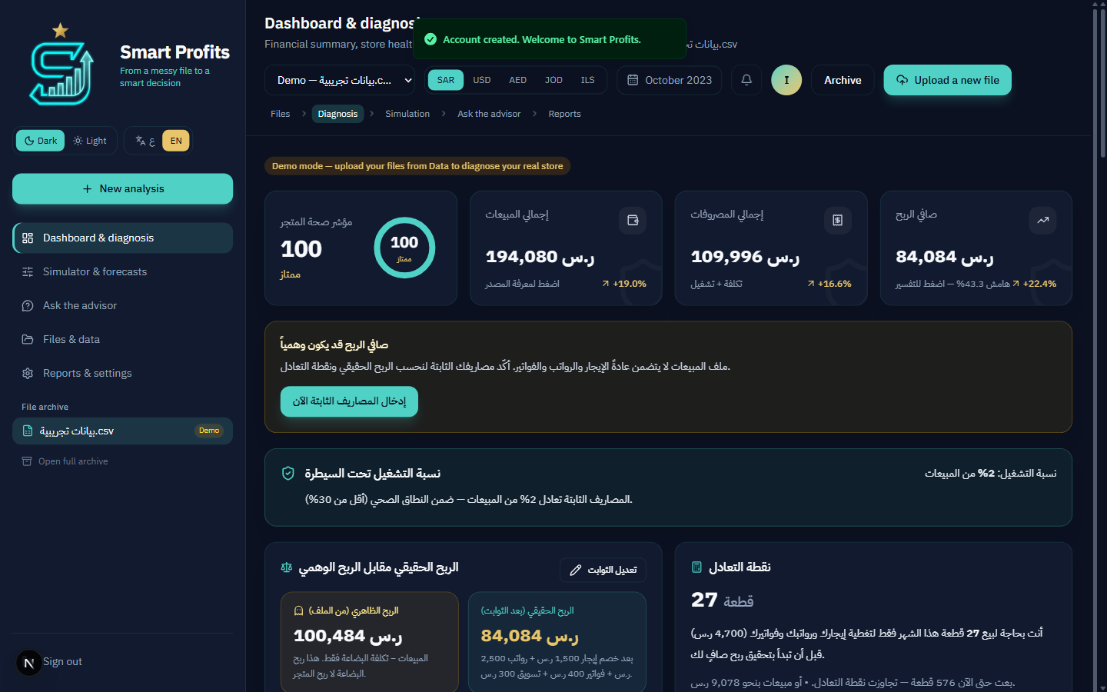
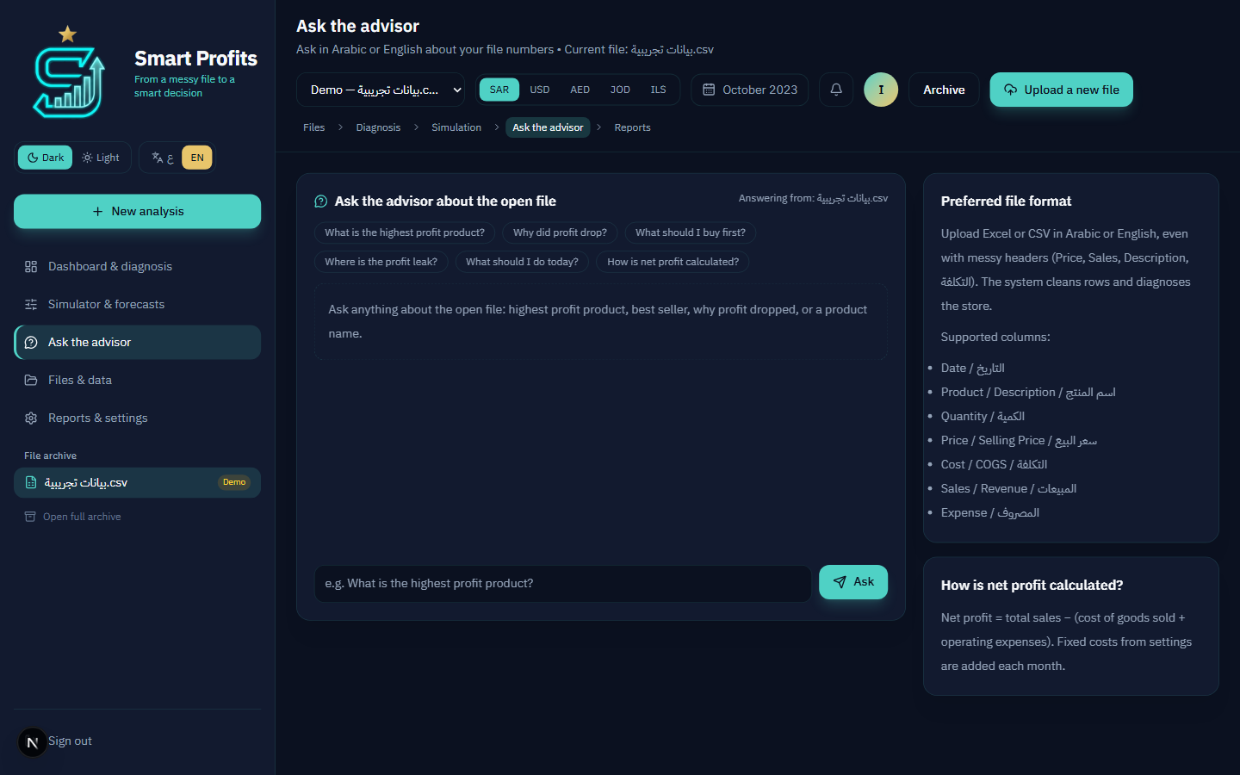
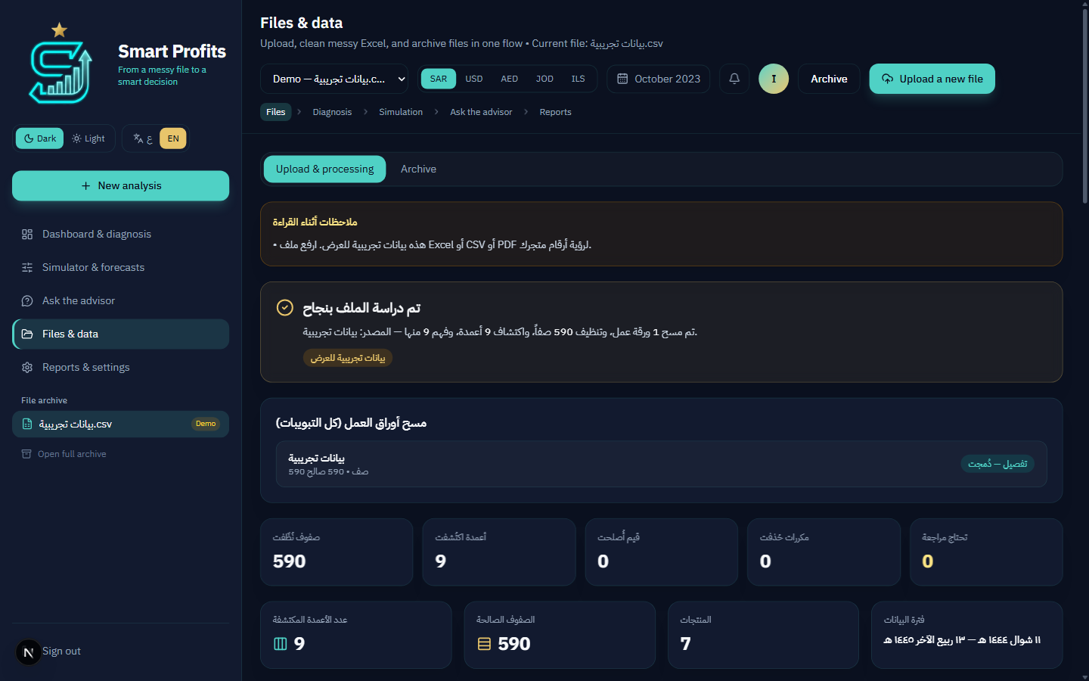
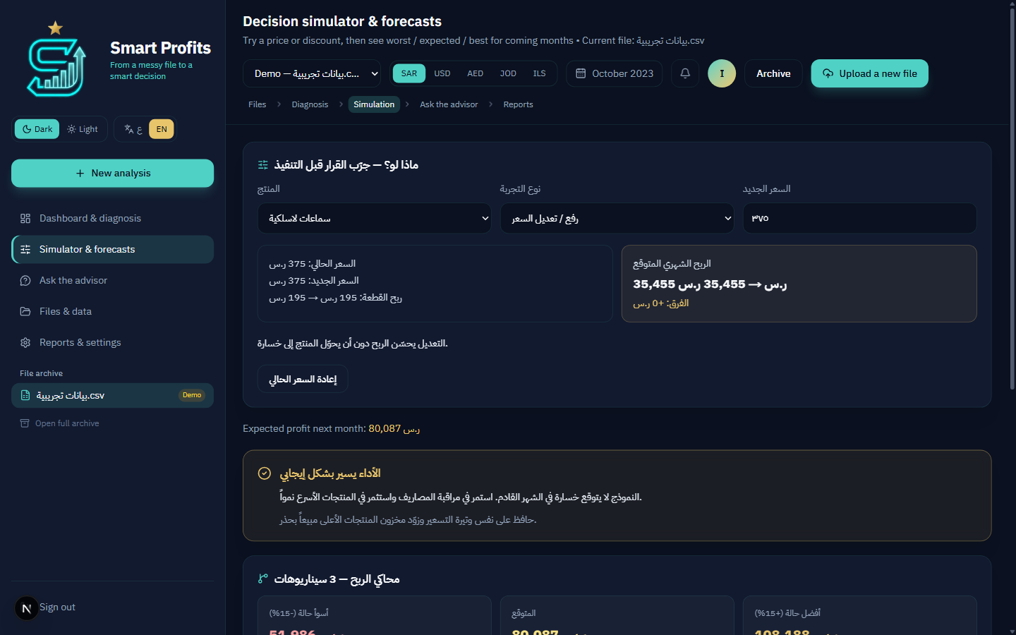
13. PRODUCT SCREENSHOTS
Working merchant platform
Dashboard — P&L & health
Advisor — file Q&A
Excel cleaned AR/EN
What-if simulator
Smart Profits · GSMA MENA Ignite · Theme 4 Secure FinTech
17 / 20

Slide 18
14. ROADMAP
From hackathon prototype to MWC Doha 2026
Phase 1 · Done
Idea Capture + Pitch + architecture. Theme 4 mapping. Working product locally.
Phase 2 · Now
Public deploy · 3-min demo video · live Nokia logs · HackerEarth prototype submission.
Phase 3
NV OAuth on live API · operator pilot · admin guard analytics for B2B.
MWC Doha · Nov 2026
Present to telecom executives. Travel funded by GSMA for winners.
Smart Profits · GSMA MENA Ignite · Theme 4 Secure FinTech
18 / 20

Slide 19
15. TEAM
Gaza product inside a shipping software studio
Israa Nael Hamad — Founder / Product Lead
Mir Kashif — Principal / Technical Co-Founder
Software Engineering, final year — University of Palestine, Gaza.
Product vision, merchant UX, bilingual FinTech experience, Theme 4 narrative.
Smart Profits is her product, incubated at Bitsandbytesdude.
Bitsandbytesdude Software Agency.
Full-stack platforms, AI agent workflows, cloud delivery.
Next.js architecture, Nokia NaC integration, Smart Guard enforcement.
Bitsandbytesdude — high-performance software, AI automation, product systems
bitsandbytesdude.vercel.app · bitsandbytesdude@gmail.com · Remote-first, MENA-rooted
Smart Profits · GSMA MENA Ignite · Theme 4 Secure FinTech
19 / 20

Slide 20
THE ASK
Advance Smart Profits to the
prototype finals under Theme 4.
A real merchant SaaS · A real AI Agent · Real CAMARA APIs through Nokia Network-as-Code
Live logs · Official test MSISDNs · Fail-closed security · MENA-first bilingual UX
CAMARA via Nokia NaC
AI Agent orchestration
Live prototype
Theme 4 FinTech
3-minute live demo ready on request
Israa Nael Hamad · Mir Kashif · Bitsandbytesdude
github.com/BITSANDBYTESDUDE/Smart-Profits
Smart Profits · GSMA MENA Ignite · Theme 4 Secure FinTech
20 / 20

