Slide 1

GSMA MENA IGNITE OPEN GATEWAY HACKATHON · 2026
Smart Profits
AI-Driven Financial Analytics & Telco-Secured Merchant Platform
Theme 4: Secure FinTech, Payments & Anti-Fraud Innovation
The merchant’s CFO in the chat. Bank-grade SIM-swap defence on the login.
CAMARA APIs via Nokia Network-as-Code. Decisions by an AI Agent — not by SMS.
SIM Swap
Number Verification
Location Verification
Device Swap
Smart Guard AI Agent
Israa Nael Hamad · University of Palestine, Gaza · Bitsandbytesdude Software Agency · MENA
Smart Profits · GSMA MENA Ignite · Theme 4 · Nokia Network-as-Code
01 / 19

Slide 2
THE STORY — PITCH OPENER
A merchant. An Excel file. A stolen SIM.
Start every pitch with this narrative — then show the live demo that stops it.
A merchant in the Middle East runs the business from Excel. Their phone line is hijacked through a SIM swap. The attacker opens the advisor, downloads the P&L, and changes product prices.
Smart Profits stops that — from the moment of registration until the latest financial file upload.
Same files = business
SMS OTP fails
Smart Guard stops it
The spreadsheet IS the books. Whoever owns login owns profit, prices and exports.
After SIM swap, SMS codes go to the attacker. Network APIs do not trust that channel.
CAMARA signals + financial sensitivity → Allow · Step-up · Freeze before damage.
Smart Profits · GSMA MENA Ignite · Theme 4 · Nokia Network-as-Code
02 / 19

Slide 3
EXECUTIVE SUMMARY
One slide for the jury
What we built, why it wins Theme 4, and how both mandatory requirements are met.
The problem
Our solution
Why we win
MENA merchants run the business from Excel. Phantom profit hides real cash flow. A SIM swap defeats SMS OTP — then the attacker owns the P&L files, prices, and exports.
Smart Profits = Financial AI + Smart Guard AI Agent. Analytics on messy Arabic/English ledgers, protected by GSMA CAMARA signals from Nokia Network-as-Code.
Real product (Next.js + PostgreSQL). Real agent policy (Allow / Step-up / Freeze). Live Nokia RapidAPI logs in prototype. Built for MENA (RTL Arabic + English).
Mandatory requirements — explicit declaration
• Requirement A — GSMA CAMARA APIs via Nokia Network-as-Code: SIM Swap, Number Verification, Location Verification, Device Swap on every sensitive merchant action.
• Requirement B — AI Agent orchestration: Smart Guard calls network tools, fuses risk with financial context, and executes Allow / Step-up / Freeze — not a chatbot caption.
Smart Profits · GSMA MENA Ignite · Theme 4 · Nokia Network-as-Code
03 / 19

Slide 4
1. PROBLEM STATEMENT
The P&L lives in Excel. So does the fraud.
Financial blindness
Profit leakage
Account takeover
Independent MENA merchants use messy Arabic/English Excel, CSV, PDF and photos. Rent, salaries and utilities are missing. Phantom profit looks healthy. There is no CFO.
Weak SKUs, unexamined margins and unplanned OpEx hide real net profit. A ‘good month’ in the sales sheet can still be cash-negative.
SIM swap beats SMS OTP. Attacker opens advisor, downloads P&L, changes prices, exfiltrates sales files. Upload from another country = hijacked session.
Theme 4 gap: Banks already buy Open Gateway APIs. The SaaS that holds the merchant’s books usually does not.
Smart Profits closes that gap — financial intelligence and telco-grade identity on the same login.
Smart Profits · GSMA MENA Ignite · Theme 4 · Nokia Network-as-Code
04 / 19

Slide 5
2. MARKET & OPPORTUNITY
Why MENA, why now
Excel-first commerce
SIM-swap fraud
WhatsApp + spreadsheet workflows dominate SME retail. Arabic/English mixed headers are the norm, not the exception.
OTP hijacking is a documented FinTech risk. Network verification beats SMS that can be intercepted after a swap.
Open Gateway moment
Operator B2B2X
GSMA CAMARA standardises operator APIs. Nokia Network-as-Code gives developers one path — Smart Profits is a reference FinTech consumer.
Every secured login, upload and export is a billable CAMARA event — SaaS revenue for us, API usage for operators.
Smart Profits · GSMA MENA Ignite · Theme 4 · Nokia Network-as-Code
05 / 19

Slide 6
3. SOLUTION OVERVIEW
One platform. Two brains. Network-secured decisions.
Financial AI engine
Smart Guard AI Agent
Cleans messy Excel/CSV/PDF. Diagnoses store health, profit leaks, inventory, 30-day plan. File-grounded Q&A in Arabic or English. OpEx-aware net profit — not phantom revenue.
Orchestrates Nokia NaC CAMARA calls on login, reset, upload, export, price change. Outputs Allow · Step-up · Freeze. Explains decisions to the merchant in AR/EN.
Sensitive actions protected by Smart Guard
Register · Login · Password reset · Excel/CSV/PDF upload · P&L export · Price / settings change
Positioning: Not a generic Excel AI. A FinTech control plane for SMEs — using 4G/5G CAMARA signals the way banks do, on the merchant’s own books.
Silent Authentication on the clean path (Number Verification on the network). Friction only when risk is real. No sensitive action completes unless Smart Guard runs the network + financial-risk loop.
Smart Profits · GSMA MENA Ignite · Theme 4 · Nokia Network-as-Code
06 / 19

Slide 7
4. MANDATORY HACKATHON REQUIREMENTS
Both compulsory building blocks — implemented, not slideware
Requirement | Implementation in Smart Profits | Evidence
A — CAMARA via Nokia NaC | SIM Swap, Number Verification, Location Verification, Device Swap via RapidAPI passthrough paths | Live logs: [nac-live] provider=Nokia transport=RapidAPI status=200
B — AI Agent orchestration | Smart Guard Agent: tool-calling loop → policy.ts → Allow / Step-up / Freeze | Server-side enforce.ts blocks API until decision=allow
Theme 4 — FinTech anti-fraud | Freeze on swap; step-up on NV/location gaps; block upload outside store geofence | Demo MSISDNs + working UI overlay + admin guard status
Declaration
This solution uses GSMA CAMARA network APIs through Nokia Network-as-Code AND uses an AI Agent to orchestrate those APIs and take security decisions. Both mandatory requirements are satisfied in the live decision path — not as optional plugins.
Smart Profits · GSMA MENA Ignite · Theme 4 · Nokia Network-as-Code
07 / 19

Slide 8
5. NOKIA CAMARA APIS
What we call, when, and what the agent does
CAMARA API | Trigger | Agent decision
SIM Swap | Login, register, reset, sensitive settings | Recent swap → FREEZE session. SMS OTP is untrusted.
Number Verification | Login, step-up identity | Silent 4G/5G check — confirm live network number, not spoofed SMS.
Location Verification | Financial file upload, P&L export | Must match store geofence — else STEP-UP or block upload.
Device Swap | Same sensitive actions as SIM | Recent device change → FREEZE (complements SIM signal).
Frictionless security — Silent Authentication
In the normal path, Number Verification runs quietly on the operator 4G/5G network — the merchant does not wait for SMS or type a code.
Security friction appears only when risk is real (SIM/device swap → Freeze, soft location mismatch → Step-up).
Demo MSISDNs: +99999991001 clean · +99999991000 freeze · +99999991002 step-up. Policy stays pure — no fake success on provider failure.
Smart Profits · GSMA MENA Ignite · Theme 4 · Nokia Network-as-Code
08 / 19

Slide 9
6. SMART GUARD AI AGENT
Not a static rule engine — an agent that fuses network risk + financial sensitivity
Sense → Query tools → Decide with context → Act (enforce).
1 · Sense
2 · Query
3 · Decide
4 · Act
Action + file context: login, register, upload size/name, price change, account age.
Parallel CAMARA tools via Nokia NaC: SIM Swap, Device Swap, Number Verification, Location.
Fuse network signals WITH financial risk (financialSuspicion). Output Allow · Step-up · Freeze.
Server enforce (403/503). UI step-up only when needed. Explain in AR/EN.
Why this is an AI Agent decision — not plain if/else
• Small network change + ordinary purchases file → Agent ALLOWS — no merchant friction.
• Same small network change + sensitive P&L upload OR price change → Agent STEP-UPS — financial risk raises the bar.
• SIM/device swap (any action) → Agent FREEZES — SMS OTP is untrusted after swap.
• Tools are CAMARA APIs; the brain is policy.ts fused with financialSuspicion (file size, dump names, new account + large file). That fusion is the agent.
Smart Profits · GSMA MENA Ignite · Theme 4 · Nokia Network-as-Code
09 / 19

Slide 10
7. TECHNICAL ARCHITECTURE
Production-ready stack — not a hackathon script
Merchant UI · Next.js / TypeScript · Arabic RTL + English · Dashboard · Advisor · Upload · Admin
Smart Guard AI Agent
server/smart-guard/ · enforce.ts fail-closed
Allow / Step-up / Freeze
Financial engine
Excel/CSV/PDF parse · P&L · leaks · Q&A on open file
PostgreSQL
Users · files · guard_decisions log
nokia-adapter.ts
Live RapidAPI + structured [nac-live] audit logs
Nokia Network-as-Code
CAMARA passthrough endpoints
Security: NAC_API_KEY server-only · CSRF same-origin · scrypt passwords · guard logs with IP/UA · admin Smart Guard status dashboard.
Repository: https://github.com/israahamed765/Smart-Profits
Smart Profits · GSMA MENA Ignite · Theme 4 · Nokia Network-as-Code
10 / 19

Slide 11
8. LIVE PROTOTYPE EVIDENCE
What judges can verify in code and logs
Live Nokia RapidAPI
Automated tests
[nac-live] nacMode=live provider=Nokia transport=RapidAPI api=sim-swap status=200
[nac-live] api=device-swap status=200
[nac-live] api=number-verification status=401 → step-up (not fake success)
Provider failures ≠ business rejection — distinct error messages in enforce.ts
tests/nac-provider.test.ts — live mapper, auth/404 handling
tests/smart-guard-policy.test.ts — Allow/Step-up/Freeze policy
tests/backend-guard.test.ts — server enforcement fail-closed
Demo numbers (Nokia official sandbox MSISDNs)
+99999991001 → clean path (register + analytics)
+99999991000 → SIM/device swap → account FREEZE
+99999991002 → location PARTIAL → step-up on file upload
+99999991003 → location UNKNOWN (live API only)
Step-up code: network challenge (6 digits) — shown in dev demo inbox; not spoofable SMS.
Smart Profits · GSMA MENA Ignite · Theme 4 · Nokia Network-as-Code
11 / 19

Slide 12
9. DEMO WALKTHROUGH (3 MINUTES)
Three journeys judges should see
Journey A — Trusted merchant
+99999991001 · new email · upload messy Excel · advisor: highest profit SKU · phantom vs real net profit · ALLOW
Journey B — SIM swap attack
+99999991000 · login or register · Smart Guard FREEZE · upload/export disabled · Arabic/EN explanation · SMS untrusted
Journey C — Location mismatch
+99999991002 · upload financial file · Location Verification PARTIAL · STEP-UP network code · file blocked until verified
Links for judges:
GitHub: https://github.com/israahamed765/Smart-Profits
Studio: https://bitsandbytesdude.vercel.app/
Live demo URL: [deploy before submission — Railway/Vercel + NAC_API_KEY + PostgreSQL]
Smart Profits · GSMA MENA Ignite · Theme 4 · Nokia Network-as-Code
12 / 19

Slide 13
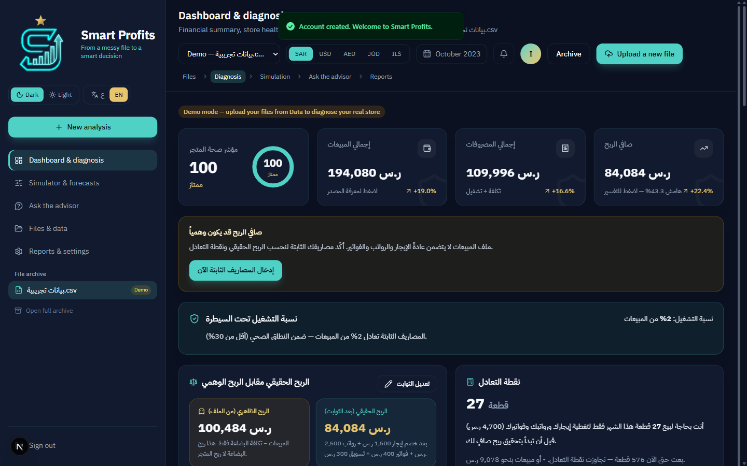
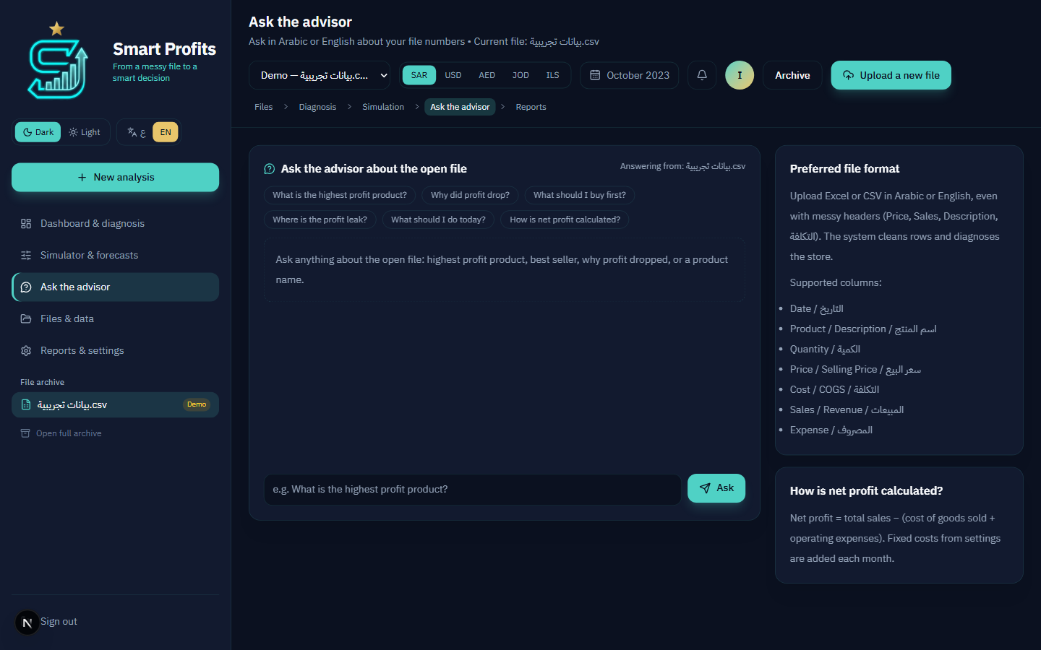
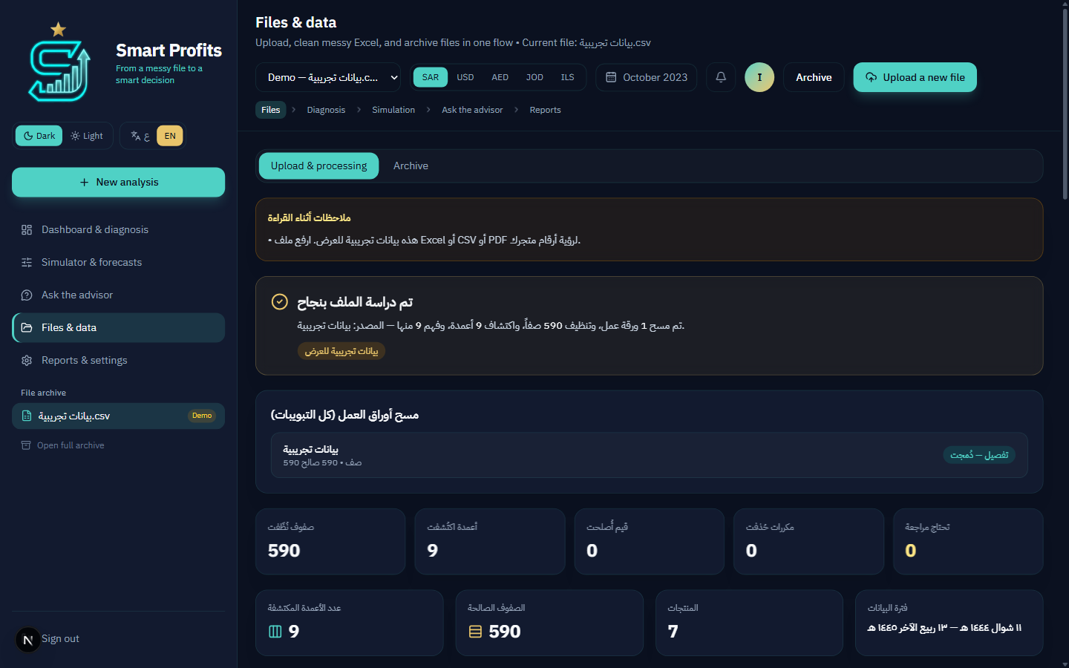
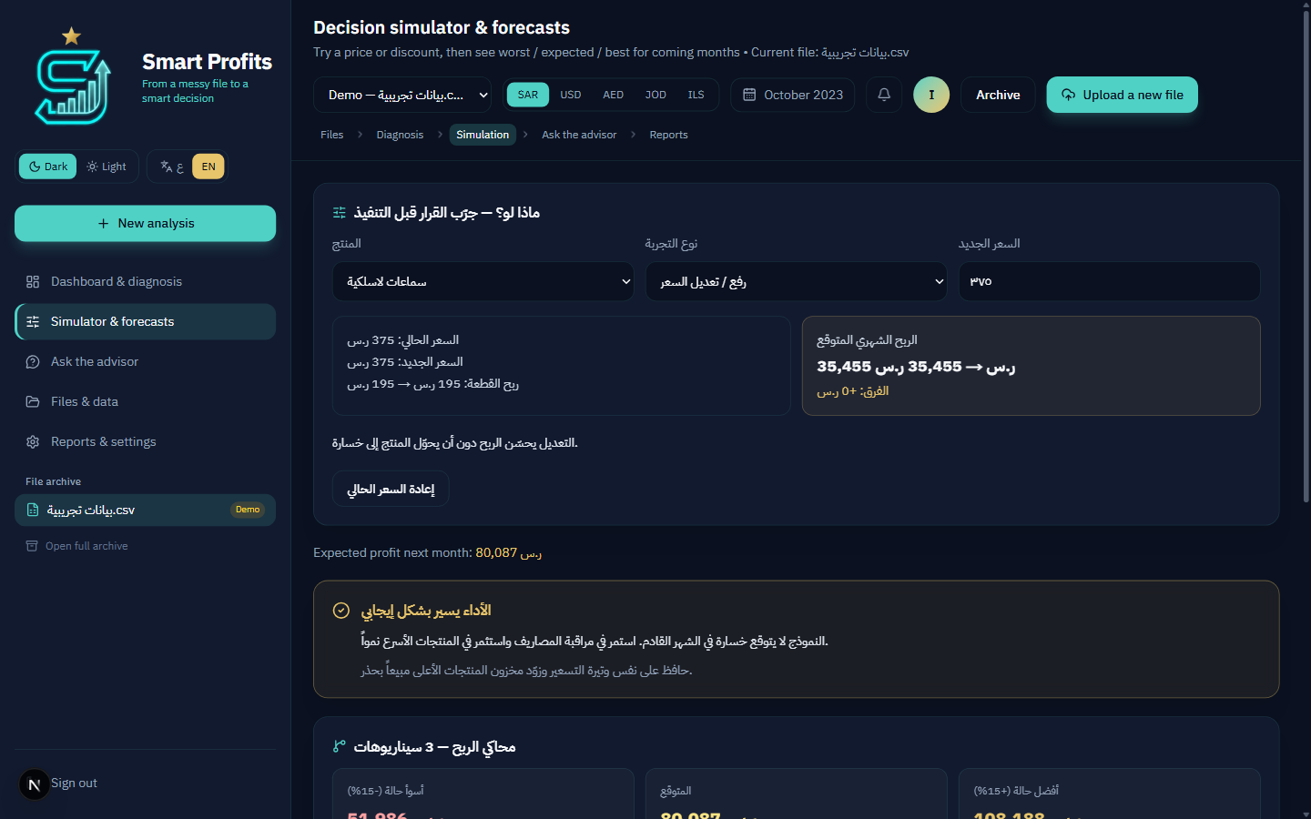
10. PRODUCT SCREENSHOTS
Working merchant SaaS — bilingual, dark/light, file-grounded AI
Dashboard — health & P&L
Advisor — file-grounded Q&A
Files — messy Excel cleaned
What-if simulator
Smart Profits · GSMA MENA Ignite · Theme 4 · Nokia Network-as-Code
13 / 19

Slide 14
11. DIFFERENTIATION
Why Smart Profits is not another Excel chatbot
Typical Excel AI | Smart Profits
Reads a spreadsheet | Reads + diagnoses + bilingual Q&A on the open file
Trusts SMS OTP | SIM Swap + Number Verification via the network
No location concept | Location Verification binds uploads to the store
Chatbot only | AI Agent calls CAMARA tools and enforces freeze
Generic SaaS | Built for MENA merchants (Arabic RTL, messy AR/EN ledgers)
Slide-only Open Gateway | Live Nokia NaC integration with audit logs
Smart Profits · GSMA MENA Ignite · Theme 4 · Nokia Network-as-Code
14 / 19

Slide 15
12. BUSINESS MODEL
How operators make money from Smart Profits
SaaS for merchants + continuous CAMARA API usage for telcos (B2B2X).
Free trial · 7 days
Pro · $49 / month
Business · $99 / month
Full product — upload, diagnosis, advisor, Smart Guard. Converts to Pro.
Single store — P&L, leaks, Q&A, telco-secured login/upload/export.
Multi-branch — tighter geofences, team seats, priority guard review.
Operator revenue — continuous API consumption (B2B2X)
• Every login, register, password reset, Excel upload, P&L export and price change triggers CAMARA calls (SIM Swap, Device Swap, Number Verification, Location).
• That is recurring, metered Open Gateway usage — not a one-time integration demo. More active merchants = more billable API events for the operator.
• Merchant SaaS subscription funds the product; CAMARA usage is the telco monetization layer GSMA sponsors care about.
• Future white-label: banks, wallets and marketplaces consume the same Smart Guard + NaC path under operator B2B2X deals.
Smart Profits · GSMA MENA Ignite · Theme 4 · Nokia Network-as-Code
15 / 19

Slide 16
13. IMPACT & WHY GSMA SHOULD CARE
Real API consumer · Real regional problem · Real agent
For operators
For merchants
B2B FinTech that consumes Open Gateway APIs at scale — login, upload, export — not slide-only integration.
CFO-grade insight AND bank-like protection of the files that ARE the business.
For the region
For 5G/4G
High WhatsApp/Excel commerce, high SIM-swap fraud, low formal accounting — exact Theme 4 conditions.
Number Verification works because the phone is on the operator network — not because we sent another SMS.
Target outcome: Top 3 → showcase at MWC Doha 2026 (8–10 Nov) · prizes up to $10,000
Smart Profits · GSMA MENA Ignite · Theme 4 · Nokia Network-as-Code
16 / 19

Slide 17
14. ROADMAP
From hackathon prototype to MENA commercial product
Now — Hackathon
Live NaC · demo video · deploy public URL · pitch + GitHub README for judges.
Q4 2026
NV OAuth on live operators · operator pilot · admin guard analytics · Pro billing.
2027
Multi-branch geofences · B2B2X with MENA telco · marketplace integrations.
MWC Doha
Live freeze demo on stage · executive pitch · operator meetings.
Smart Profits · GSMA MENA Ignite · Theme 4 · Nokia Network-as-Code
17 / 19

Slide 18
15. TEAM
Gaza product inside a shipping software studio
Israa Nael Hamad — Founder / Product Lead
Mir Kashif — Principal / Technical Co-Founder
University of Palestine, Gaza · Software Engineering (final year).
Product vision, merchant UX, bilingual FinTech experience, Theme 4 narrative: phantom Excel profit vs SIM-swap takeover of the same files.
Email: tsraathmd@gmail.com
Bitsandbytesdude Software Agency.
Full-stack platforms, AI agent workflows, cloud delivery. Next.js architecture, Nokia NaC integration, Smart Guard enforcement.
Studio: bitsandbytesdude@gmail.com · https://bitsandbytesdude.vercel.app/
Bitsandbytesdude — high-performance software, AI automation and product systems.
Remote-first · MENA-rooted · Smart Profits is a core product line, not a side project.
Smart Profits · GSMA MENA Ignite · Theme 4 · Nokia Network-as-Code
18 / 19

Slide 19
THE ASK
Advance Smart Profits under Theme 4.
• A real merchant SaaS — not slideware.
• A real AI Agent — fuses network risk WITH financial sensitivity (Allow / Step-up / Freeze).
• Silent Authentication on the clean path — Freeze only when SIM swap is real.
• Real CAMARA APIs via Nokia NaC — continuous operator API revenue (B2B2X).
✓ CAMARA via Nokia NaC
✓ AI Agent orchestration
✓ Theme 4 FinTech
✓ Live prototype
Thank you · Questions?
Israa Nael Hamad · Mir Kashif · Bitsandbytesdude · University of Palestine, Gaza
Smart Profits · GSMA MENA Ignite · Theme 4 · Nokia Network-as-Code
19 / 19

