Slide 1
Facade Design Pattern
Provide a unified interface to a set of interfaces in a subsystem. Defines a high level interface that makes the subsystem easier to use.

Slide 2
Facade Problem:
Problem:
Need for a simplified interface to the overall functionality of a complex system.
A subsystem contains lots of classes, all of which are necessary to perform its function
Most of the subsystem's internal complexity is not directly relevant to its clients
We want to simplify the client's interface to the subsystem to make it easier to use
We want to minimize client dependencies on the subsystem's internal details

Slide 3
Motivation is the solution :
“Common design goal is to minimize the communication and dependencies between subsystems. One way to achieve this goal is to
Reduce Complexity: Introduce a façade object that provides a single, simplified interface to a more general facilities of a subsystem.

Slide 4
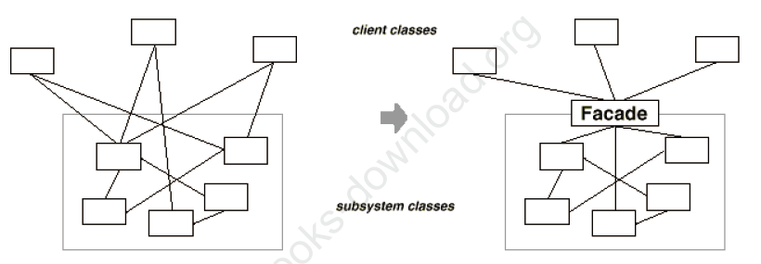
Motivation:
Introduce a Façade object that provides a simplified interface to the subsystem
The Façade's interface provides exactly those operations needed by most clients, and no more
The Façade translates high-level client requests into lower-level requests on subsystem objects
Internal subsystem objects have no knowledge of the Façade

Slide 5
Facade – Why and When?
Applicability
Use the facade pattern when you want to provide a simple interface to a complex system.
You want to layer your subsystem
Consequences
Shielding clients from subsystem promotes weak coupling b/w subsystem and the clients.
Simplifies porting systems to other platforms.
Liabilities
Does not prevent clients from accessing the underlying classes.

Slide 6
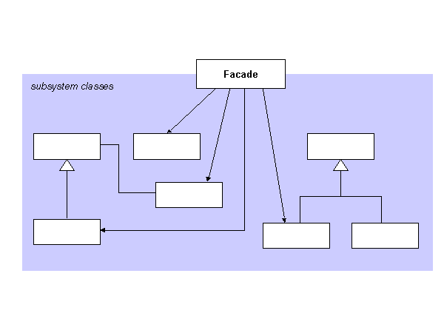
Facade - Structure

Slide 7
Facade - Participants
Façade
Implements subsystem functionality
Knows which subsystem classes are responsible for a request.
Delegates client requests to appropriate subsystem objects
Handles work assigned by the façade object
Has know knowledge of the façade

Slide 8
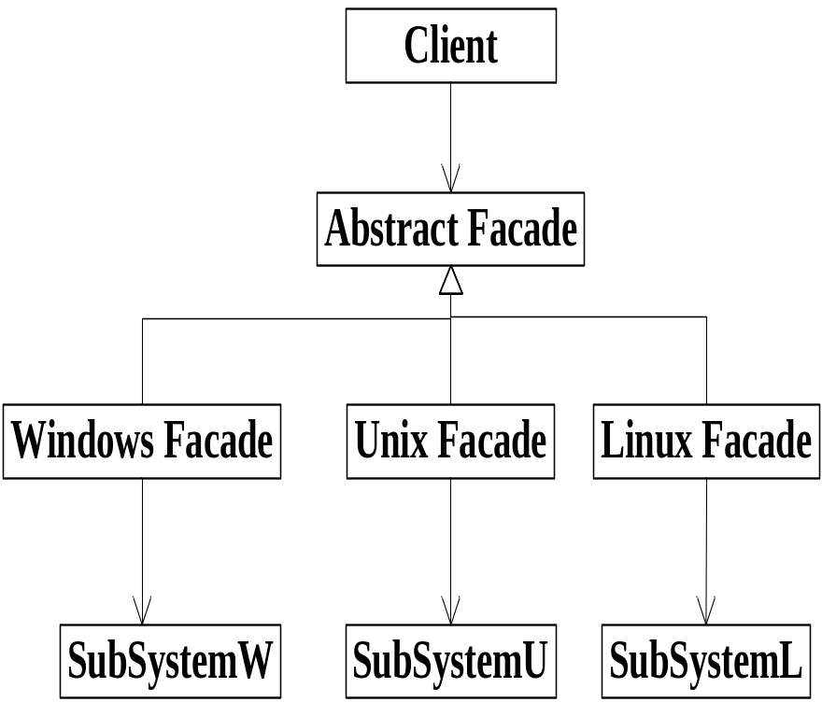
Facade - Implementation
Reduces client subsystem coupling
Provides an abstract coupling between the façade abstract class and the concrete subclasses for different implementation of a subsystem.
Public vs. Private subsystem classes
Subsystem is analogous to a class in that a class encapsulates state and operations, while a subsystem encapsulates classes.
The public interface of a system consists of classes that all clients can access.
Private interface is just for subsystem extenders.
The Façade class is part of the public interface, but not only part of it, other subsystem classes are also usually public.
Just like using name spaces in C++ to make subsystem classes private.

Slide 9
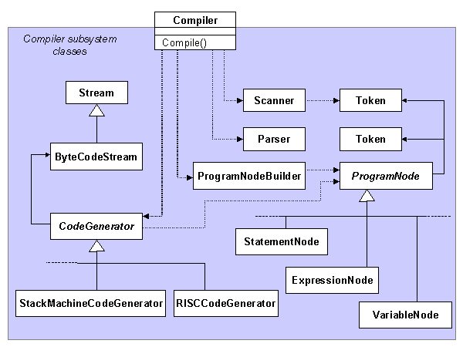

Slide 10
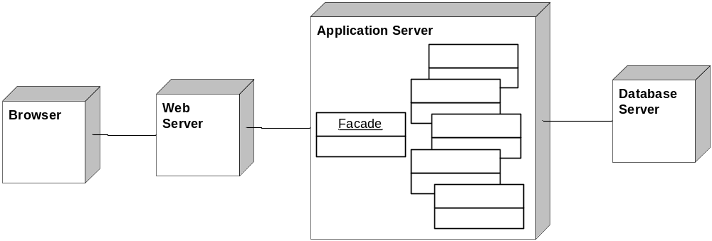
Known Uses: Web Applications

Slide 11
Advantages
Facade can make a software library easier to use and understand since the facade has convenient methods for common tasks.
It can reduce dependencies of outside code on the inner workings of a library since most code uses the facade. This allows for more flexibility in developing a system using library.
Facade can wrap a poorly designed collection of APIs with a single well-designed API.

