Slide 1




PARTNER PAGE LAUNCH · 12 AUGUST 2026
Ten partners.
One essential network.
A launch designed to give every partner a visible, respected place in the platform.
FIND
PRICE
PROVE
SECTION 01 / VIP WELCOME
01
Notes:
Open by positioning the partners as the launch itself—not as an audience being asked to admire a technical release.
[Sources]
- Internal implementation commit d7896011d31277d88eab93e43698d5a68ea5050a.
- Internal brand and character assets from public/images/brand and public/images/ai-team.

Slide 2
SECTION 01
VIP WELCOME
Partners are not a dropdown.
THE NETWORK GUEST LIST
They are the platform.
01
Investor
06
Care Provider
Every role now receives its own language, its own route and a visible place in the shared impact model.
02
Landlord
07
Support Provider
03
Developer
08
Social Worker
04
Housing Association
09
Broker
A dedicated front door says: we built this with you in mind.
05
Local Authority
10
Resident
10
essential roles
SECTION 01 / VIP WELCOME
02
Notes:
Move across the guest list slowly. The point is not that ten pages exist; it is that ten different partner identities are recognised without flattening them into one generic audience.
[Sources]
- Internal product source: src/content/partners.ts (ten partner archetypes and role names).

Slide 3
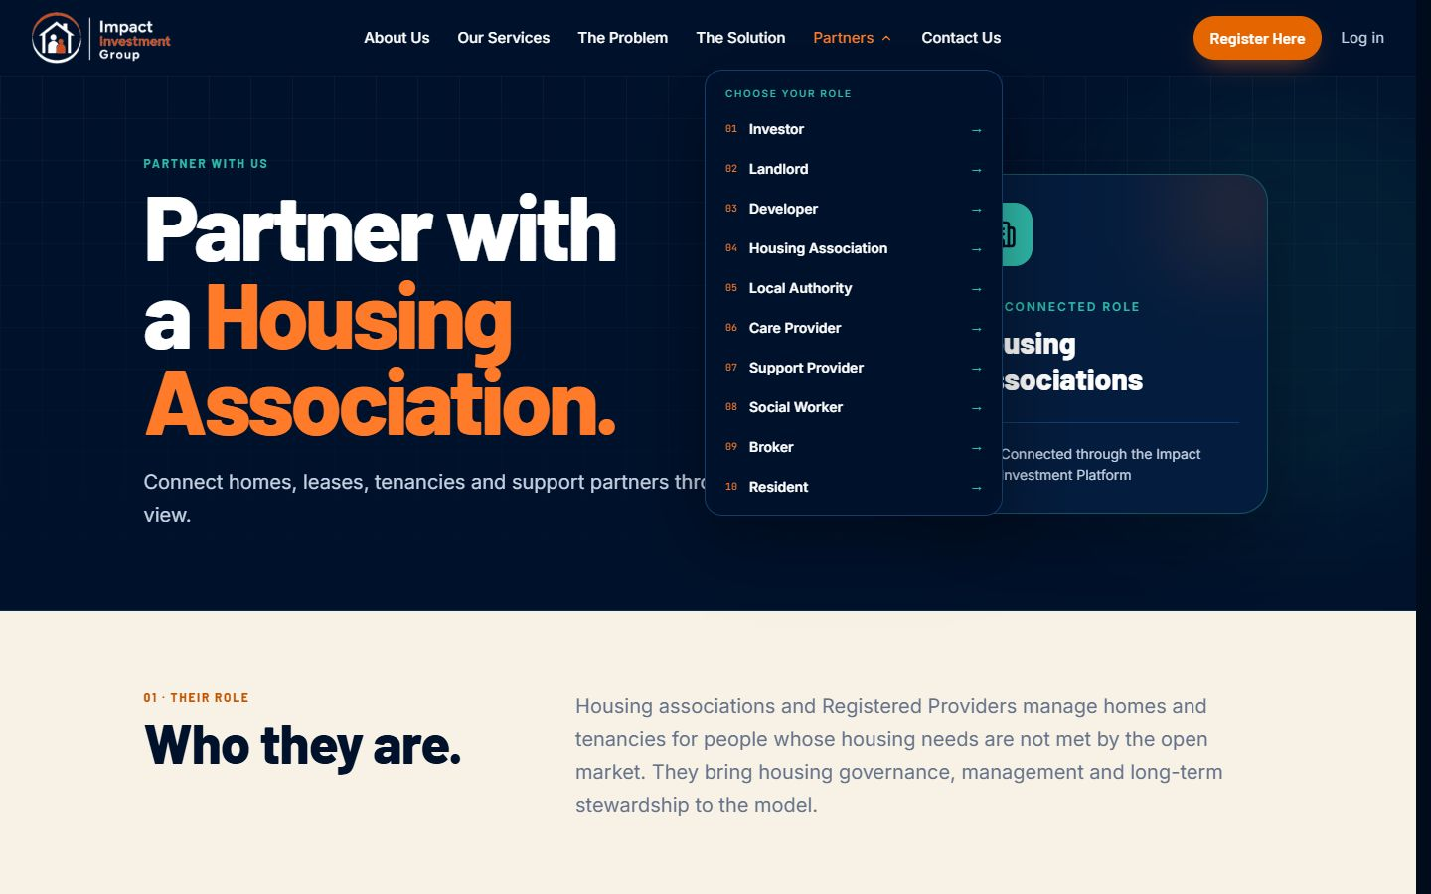
SECTION 02
A FRONT DOOR FOR EVERY ROLE
Your role now has a front door.
01
Recognised by name
02
Explained in context
03
Connected to impact
The new Partners menu makes the network visible before a visitor reads a single page.
DESKTOP PARTNER ENTRY
SECTION 02 / ROLE ENTRY
03
Notes:
Use the three beats as a reveal. Then point to the real navigation capture and show how the partner identity is visible at the exact moment of entry.
[Sources]
- Internal implementation: src/components/site-header.tsx.
- Internal localhost QA capture: partners-dropdown-desktop.png, 12 August 2026.

Slide 4
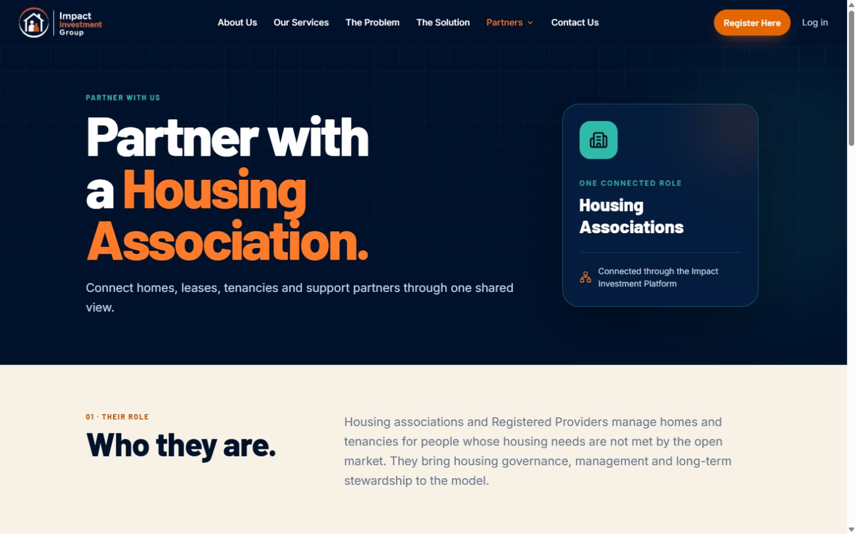
SECTION 02
A FRONT DOOR FOR EVERY ROLE
Each page speaks the partner’s language.
Not a generic profile. A role-specific journey from identity to impact.
01
Who you are
↓
02
What you can do
↓
03
How you create impact
↓
04
Where you connect
LIVE ROLE PAGE
Every page closes with a custom organisational view—not a stock diagram.
SECTION 02 / ROLE EXPERIENCE
04
Notes:
Walk the audience through the four-part page journey. Stress that the final organisational view changes with the role, which is what makes the partner feel seen rather than templated.
[Sources]
- Internal implementation: src/components/partners/partner-page.tsx.
- Internal route example: src/routes/partner-with-housing-association.tsx.
- Internal localhost QA capture: partner-desktop-viewport.png, 12 August 2026.

Slide 5
SECTION 03
THE SHARED IMPACT JOURNEY
Impact becomes a chain, not a claim.
Each partner page makes the route from contribution to outcome visible.
INPUT
ESSENTIAL ROLE
VISIBLE OUTCOME
Capital + criteria
INVESTOR
Suitable homes · delivery · reporting
Demand + matched property
HOUSING ASSOCIATION
Lease · management · resident home
Needs + preferences
RESIDENT
Suitable home · support · outcomes
SECTION 03 / IMPACT CHAINS
05
Notes:
Read one row end to end, then let the audience scan the other two. The diagrams make the partner contribution explicit while keeping the outcome visible.
[Sources]
- Internal product source: src/content/partners.ts (Investor, Housing Association and Resident diagram definitions).

Slide 6
SECTION 03
THE SHARED IMPACT JOURNEY
The network grows. The person stays central.
Nine specialist roles connect around one human purpose: a suitable home with joined-up support.
Landlord
Developer
Housing Association
Investor
Local Authority
RESIDENT
home · support · outcomes
Care Provider
Broker
Social Worker
Support Provider
Every partner remains essential because every connection carries a different responsibility.
SECTION 03 / PERSON-CENTRED NETWORK
06
Notes:
Use the visual to reinforce that the resident is not a supply category. Each surrounding role stays distinct, and the value comes from coordination rather than role-blurring.
[Sources]
- Internal product source: src/content/partners.ts (ten role descriptions and Resident positioning).
- The three-cluster interpretation is a presentation synthesis of the role descriptions, not a new operating claim.

Slide 7
SECTION 04
PLATFORM ARCHITECTURE STORY · 1/4
Choose a role. Follow its value.
Pick any archetype—the platform gives it a clear entry, workflow and impact destination.
PEOPLE + ACCESS
SUPPLY
10
Resident
01
Investor
09
Broker
02
Landlord
IMPACT
Social Worker
08
PLATFORM
03
Developer
10 routes · one network
07
Support Provider
04
Housing Association
06
Care Provider
05
Local Authority
DELIVERY
ARCHITECTURE STORY 01 → 02 → 03 → 04
07
Notes:
Make this interactive: ask the audience to name one archetype they want to follow. Use Housing Association if no one chooses, then advance to the worked example.
[Sources]
- Internal product source: src/content/partners.ts (ten archetypes and dedicated routes).
- The supply/delivery/people grouping is an audience navigation device inferred from the role descriptions.

Slide 8
SECTION 04
PLATFORM ARCHITECTURE STORY · 2/4
One role in. Three outcomes out.
The architecture changes its logic for every archetype—not just the title.
INPUTS
SELECTED ARCHETYPE
VISIBLE OUTCOMES
Housing demand
01
Lease & tenancy
04
→
Housing
→
Association
Housing management
02
Matched property
One connected role
03
Resident home
9 more archetypes carry their own inputs, responsibilities and impact outcomes.
Investor
Landlord
Developer
Local Authority
Care Provider
Support Provider
Social Worker
Broker
Resident
ARCHITECTURE STORY 01 → 02 → 03 → 04
08
Notes:
Trace the Housing Association path left to right. If the audience selected a different role, explain that the same page architecture swaps in that role's own inputs and outcomes.
[Sources]
- Internal product source: src/content/partners.ts (Housing Association diagram and all ten role-specific diagram definitions).

Slide 9
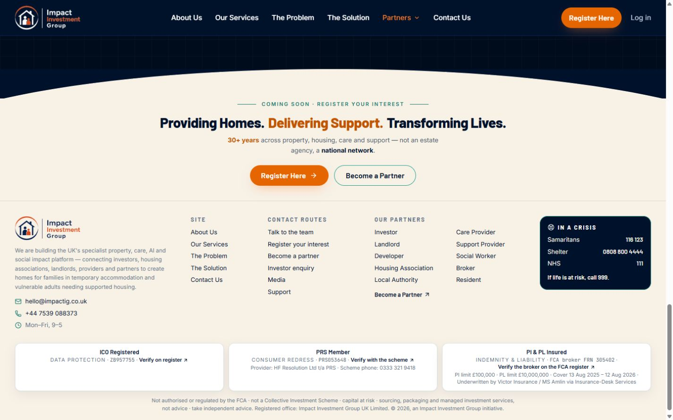
SECTION 04
PLATFORM ARCHITECTURE STORY · 3/4
The partner network is discoverable everywhere.
Integration turns ten standalone pages into one connected site experience.
10
LIVE ROUTES
HEADER ENTRY
FOOTER DIRECTORY
HEADER
DIRECT URL
SITEMAP
FOOTER
ARCHITECTURE STORY 01 → 02 → 03 → 04
09
Notes:
Use the horizontal rail as the integration story: partners can enter through navigation, direct URLs, search discovery via the sitemap, or the footer directory.
[Sources]
- Internal implementation: src/components/site-header.tsx and src/components/site-footer.tsx.
- Internal implementation: src/routes/partner-with-*.tsx and src/routes/sitemap[.]xml.ts.
- Internal localhost QA captures: partners-dropdown-desktop.png and footer-partners-desktop.png, 12 August 2026.

Slide 10
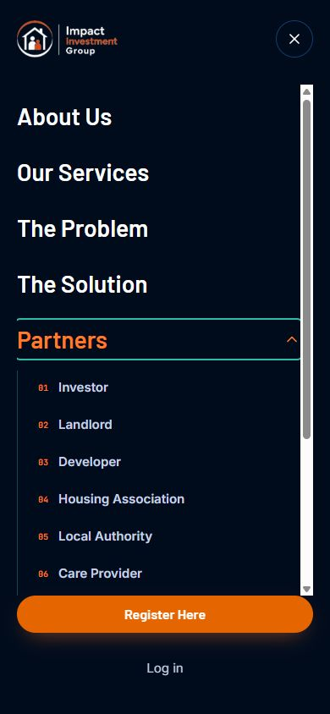
SECTION 04
PLATFORM ARCHITECTURE STORY · 4/4
The experience holds together across devices.
The launch was verified as a connected journey—not just ten pages that render.
10/10
partner routes live
DESKTOP + MOBILE
QA passed
Navigation · page flow · diagrams · partner directory
DESKTOP
The architecture is ready. Now every partner can see where they belong.
ARCHITECTURE STORY · COMPLETE
10
Notes:
Close by resolving the opening promise. The platform now recognises ten partner identities, carries their impact logic through the site and holds together on desktop and mobile.
[Sources]
- Internal QA, 12 August 2026: all ten partner routes returned HTTP 200.
- Internal QA, 12 August 2026: desktop and mobile navigation and page layouts visually inspected.
- Internal localhost captures: partner-desktop-viewport.png and partners-mobile-menu-fixed.png.

