Slide 1
HOUSE
PARTS OF THE

Slide 2
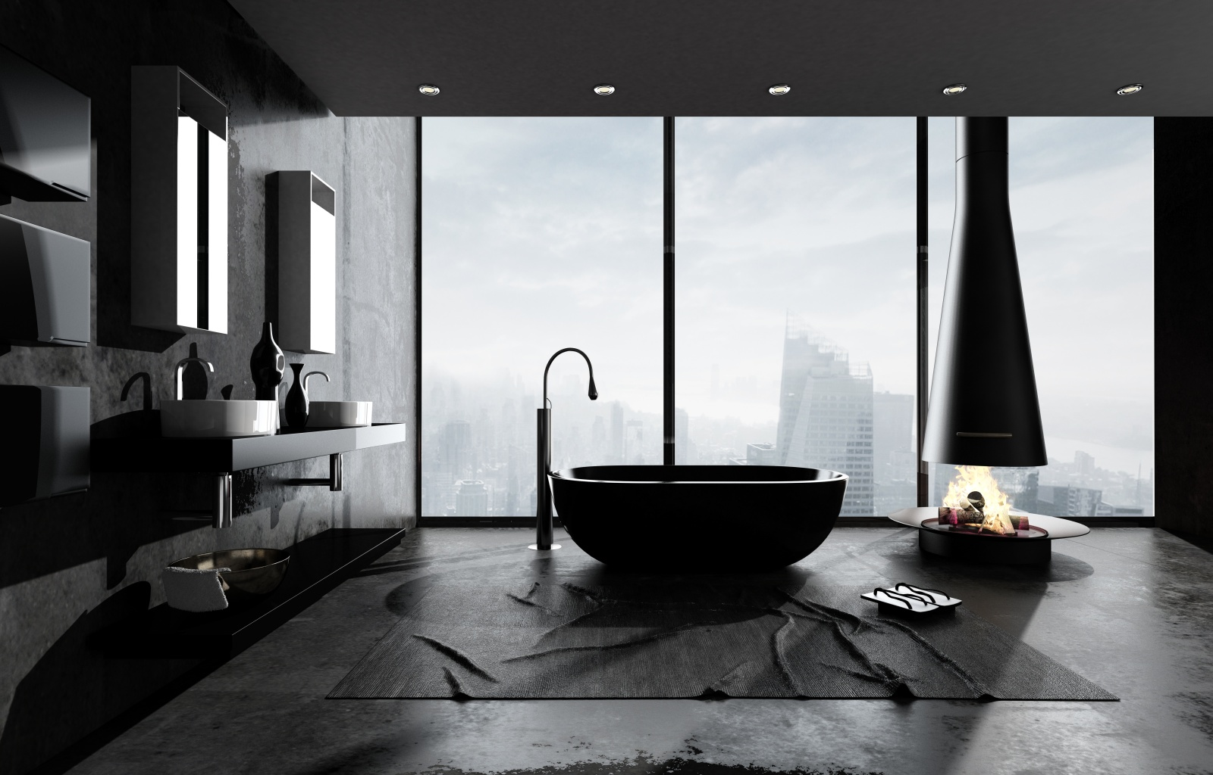
BATHROOM
BAÑO

Slide 3
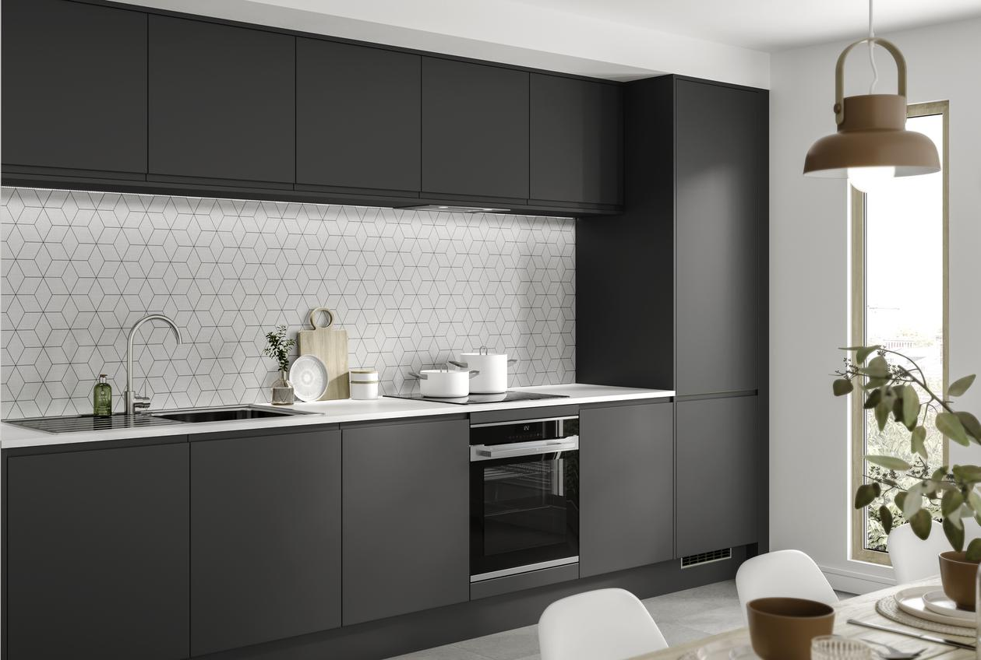
KITCHEN
COCINA

Slide 4

BEDROOM
DORMITORIO

Slide 5
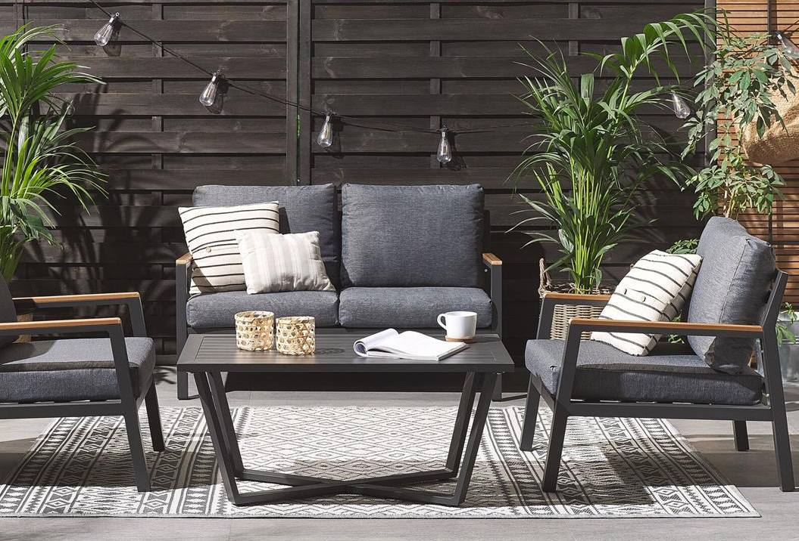
TERRACE
TERRAZA

Slide 6
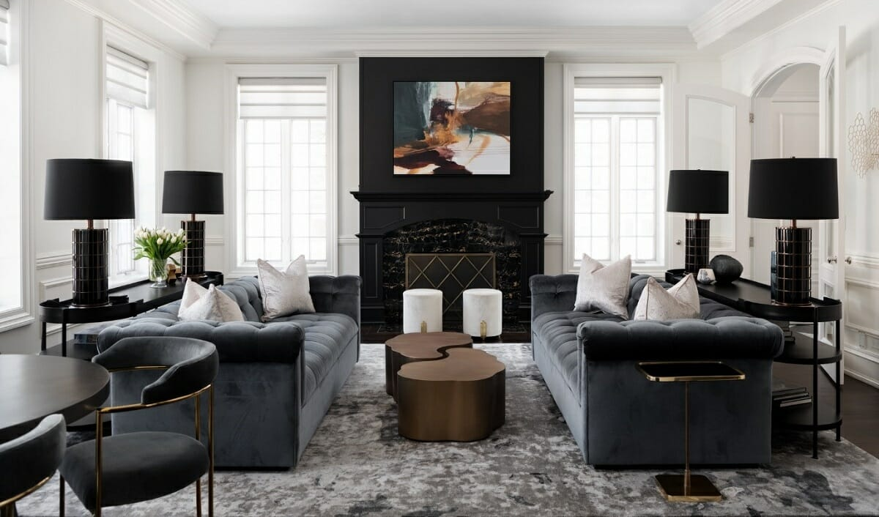
LIVING ROOM
SALA DE ESTAR

