Slide 1
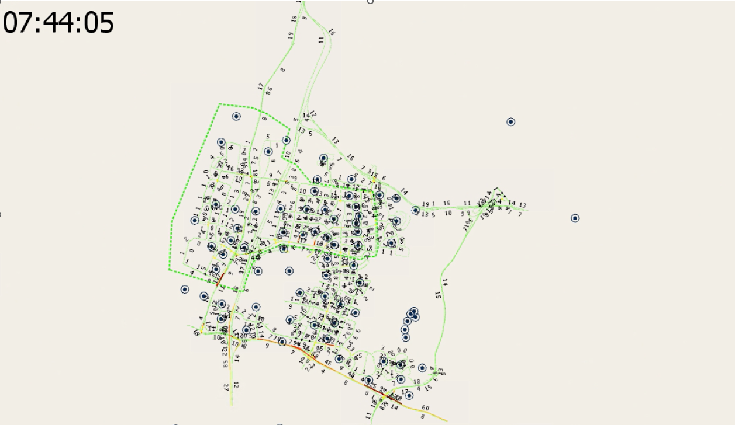
Send Box Area – Herzliya & Ramat Hasharon
https://drive.google.com/drive/folders/19HPf2tpnM06XAaEK1HgqIydzolcg81G-?usp=sharing_eip_m&ts=6304a62a

Slide 2
First round of Data from Sand Box
ID | start_time | end_time | count | travelTime | speed | Lengthm | NumberOfLanes | RoadType | TypeName
513 | 06:00 | 06:10 | 266 | 7.37 | 58.19 | 86.06 | 5 | 177 | Primary (primary)
513 | 06:10 | 06:20 | 233 | 5.66 | 62.36 | 86.06 | 5 | 177 | Primary (primary)
513 | 06:20 | 06:30 | 214 | 4.64 | 68.16 | 86.06 | 5 | 177 | Primary (primary)
513 | 06:30 | 06:40 | 251 | 6.04 | 60.96 | 86.06 | 5 | 177 | Primary (primary)
513 | 06:40 | 06:50 | 245 | 6.07 | 63.11 | 86.06 | 5 | 177 | Primary (primary)
513 | 06:50 | 07:00 | 238 | 6.30 | 60.26 | 86.06 | 5 | 177 | Primary (primary)
 |  |  |  |  | 33,104 Rows
4 Road types

Slide 3
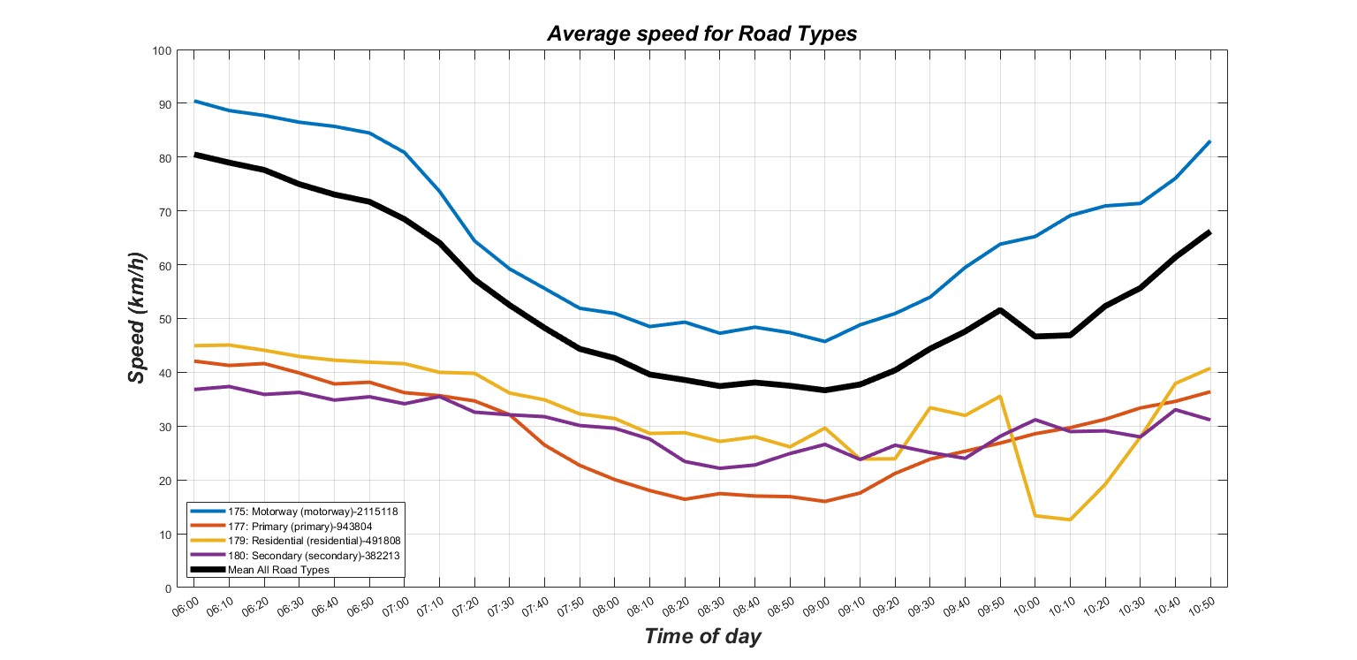

Slide 4
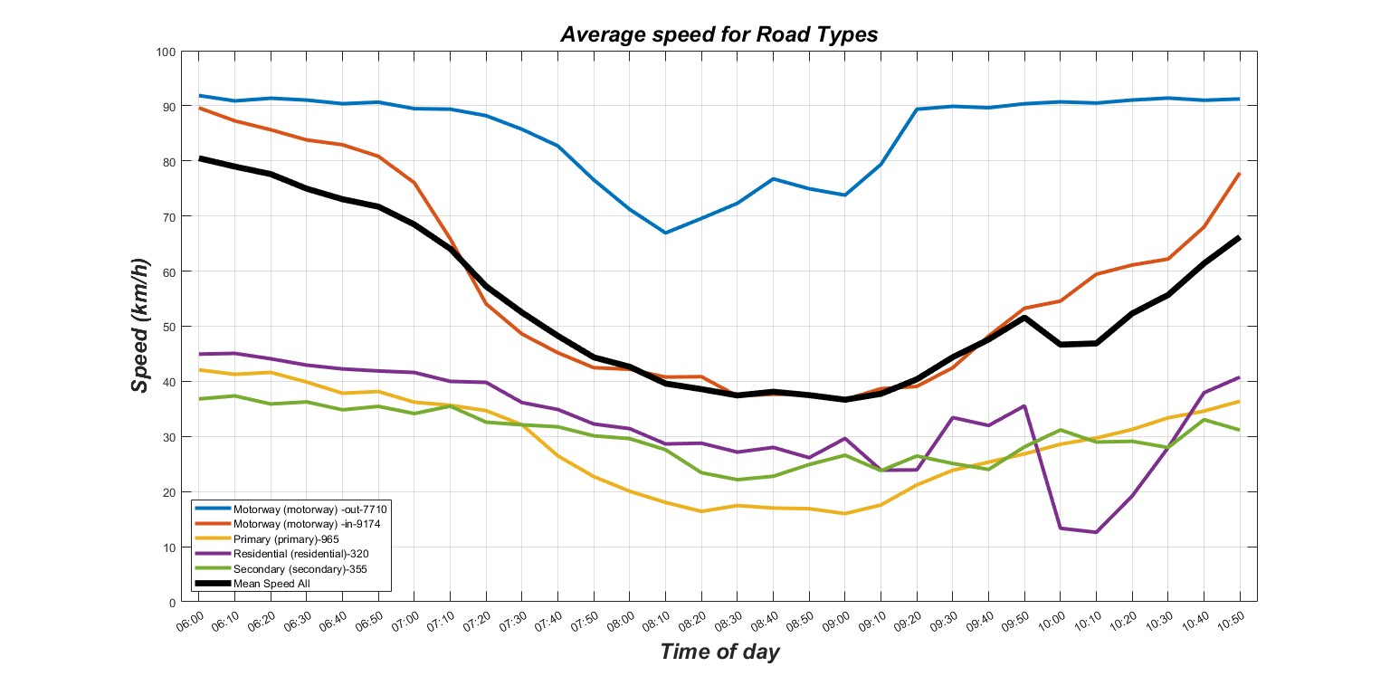

Slide 5
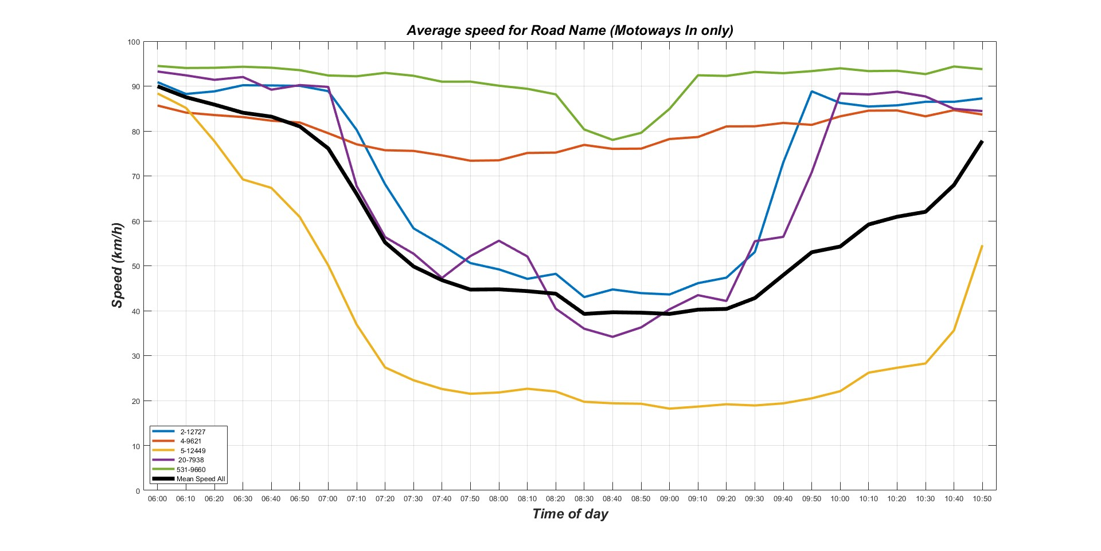

Slide 6
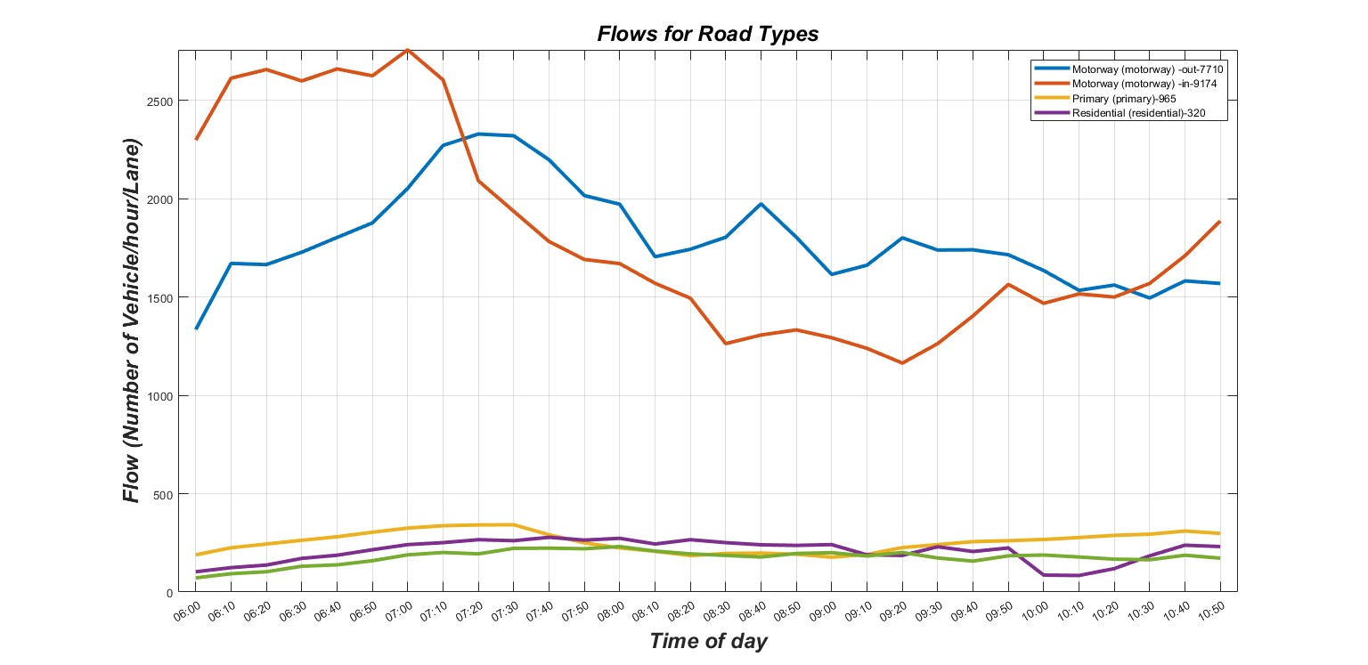

Slide 7
