Slide 1
Exploration of Deep Learning Regression of Diastolic and Systolic Blood Pressure estimation through ECG (electrocardiogram) and PPG (photoplethysmogram)
BESE300 – Introduction to Deep Learning -- Project Presentation
Israel Filho - 179023

Slide 2
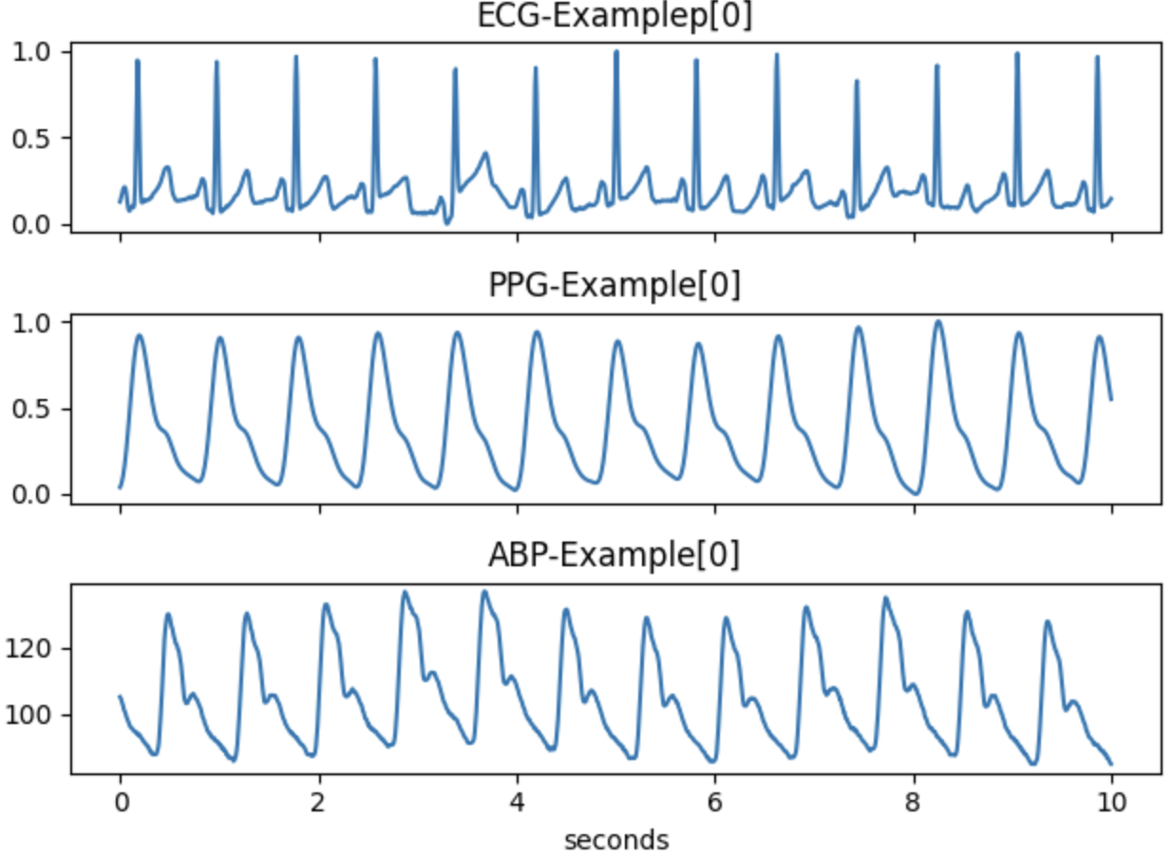
Motivation
Complementary Information:
ECG and PPG signals capture different aspects of cardiovascular activity.
ECG provides information about the electrical activity of the heart, while PPG measures changes in blood volume.
Combining these modalities allows for a more comprehensive understanding of cardiac function, enabling a more accurate assessment of the physiological state.
Example from PULSEDB. Dataset used.

Slide 3
Motivation
Feature Learning:
Deep learning models excel at automatically learning relevant features from raw data.
In the context of multimodal fusion, these models can learn complex patterns and relationships between ECG and PPG signals that might be challenging for traditional signal processing methods.
Systolic blood pressure is the maximum blood pressure during contraction of the ventricles; diastolic blood pressure is the minimum pressure recorded just prior to the next contraction.
Example from PULSEDB. Dataset used.

Slide 4
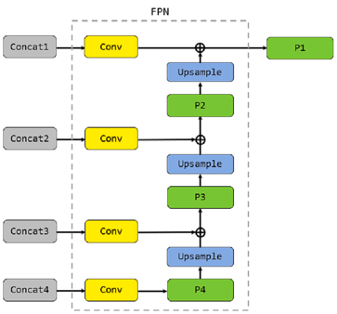
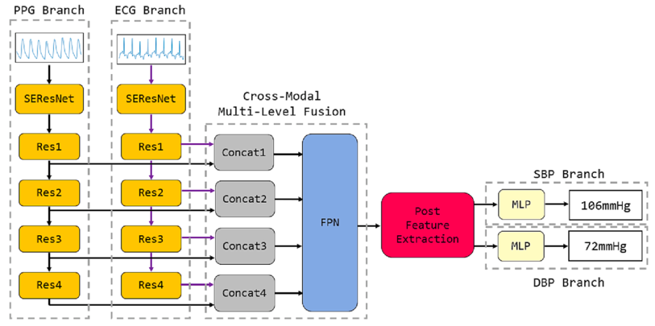
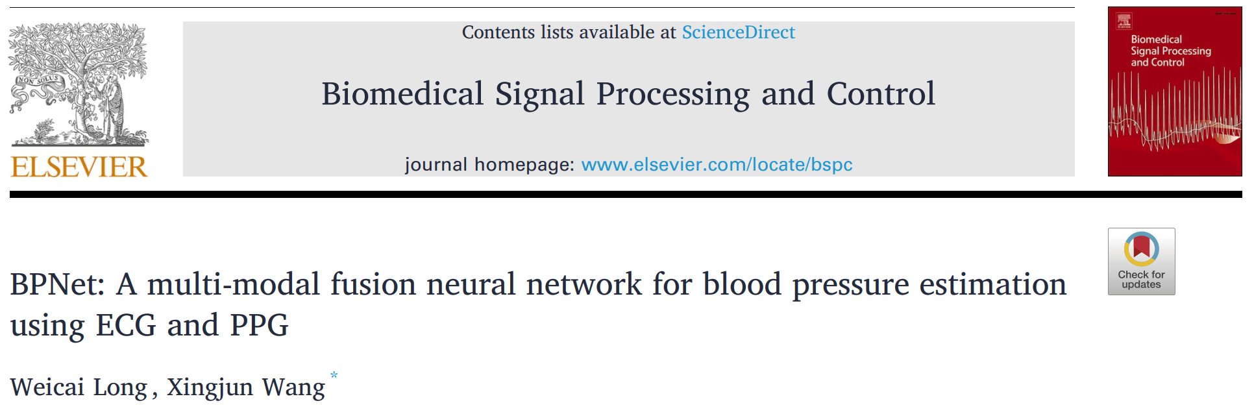
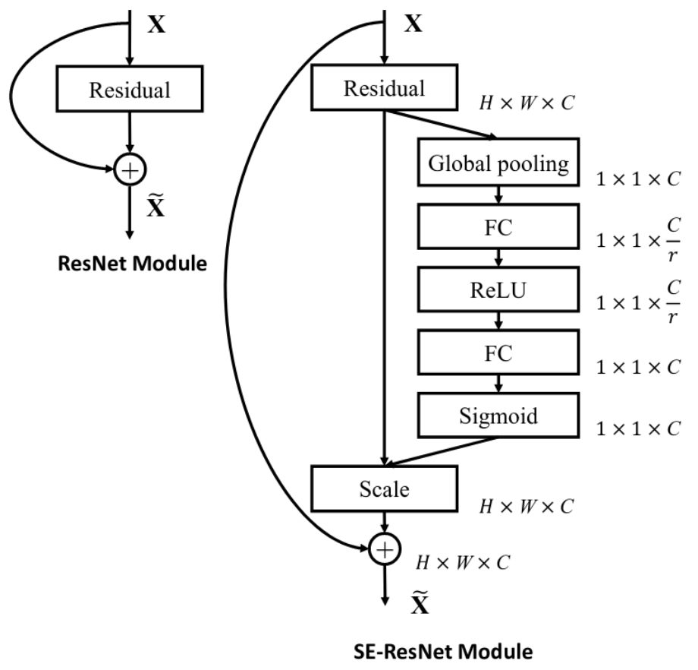
Model
Model based on the paper:
Jie Hu, et all, Squeeze-and-Excitation Networks
(2019)

Slide 5
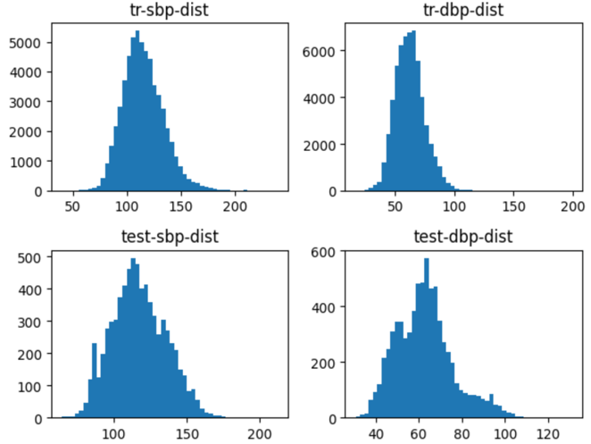
Model
Dataset used:
PulseDB
Curated dataset that contains raw and processed bio-markers:
ECG
PPG
ABP
Diastolic and Systolic blood pressures annontations
Temporal signal length:
10 seconds
Sample frequency: 125Hz
Training set:
51825 samples of ECG and PPG
51825 samples of DBP and SBP
Test set:
7200 samples of ECG and PPG
7200 samples of DBP and SBP

Slide 6
Model
Model Hyperparameters:
Learning rate: 1e-6
Optimizer: Adam
Cost Function: L1Loss
Evaluation Metrics:
Mean Absolute Value
Root Mean Square Error

Slide 7
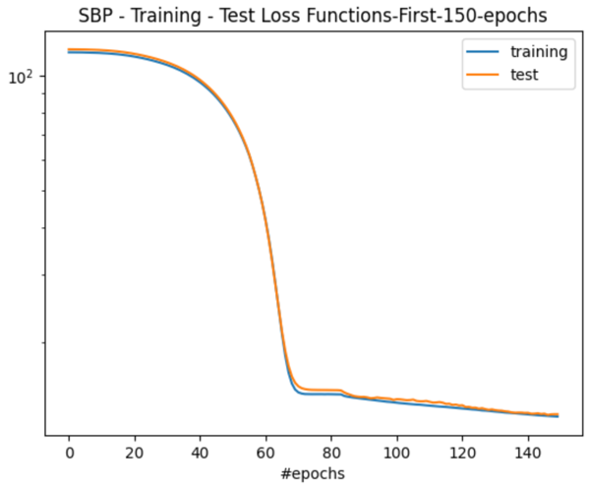
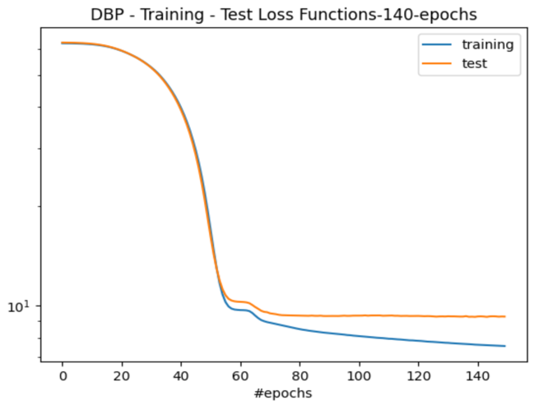
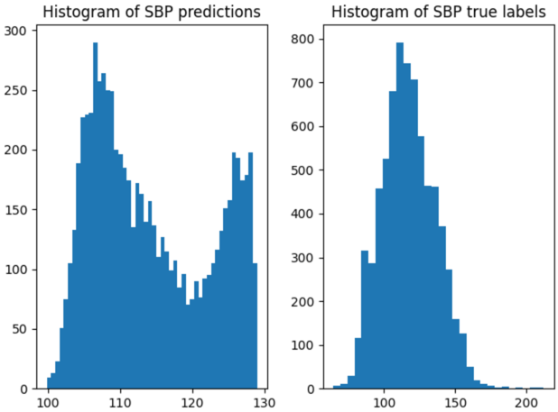
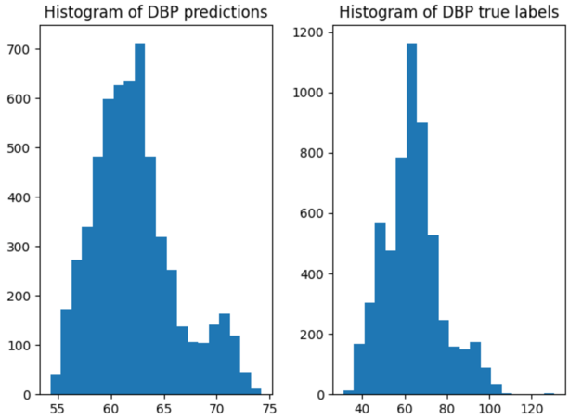
Results
Model Hyperparameters:
Learning rate: 1e-6
Optimizer: Adam
Cost Function: L1Loss
Evaluation Metrics:
Root Mean Square Error
Mean Absolute Value
DBP model:
DBP RMSE on test set: 11.8361
DBP MAE on test set: 9.2952
SBP model:
SBP RMSE on test set: 16.2643
SBP MAE on test set: 12.9888

Slide 8
Conclusion and Future endeavors
Use and exploration of different modalities, aka signals, can be usefull to build robust models and help with different tasks.
I was not able to replicate exactly the same result values related in the paper, but from the histogram we can see that both models learned some representation that helps to distinct both quantities of interest (abp and sbp).
Multi modal fusion is a big trend in the deep learning and the biomedical field started to use new ways of use these tools to study and propose ways of using this representations to solve problems.
I would like to quantize and study new models and ways of not only compute these new features, but also, infer their importance to solve the given task. I believe that this would bring more reliability on the use of those tools and would help to understand better the outputs of the models.

