Slide 1
The Cloud for Modern Business
Azure Cloud Camp

Slide 2
Why the cloud?

Slide 3
Why the cloud?
Rapidly setup environments to drive business priorities
Scale to meet peak demands
Increase daily activities, efficiency and reduced cost.
Speed
Scale
Economics
Notes:
Shifting aspects of your applications and services into Azure can be attractive for many reasons, such as:
1. Reducing costs (and improving efficiency) by more closely matching demand and capacity. 2. Improve agility and time to market by reducing or removing infrastructure barriers. 3. Increasing audience reach to new markets such as mobile devices. 4. Benefiting from the massive scale of cloud computing by building new applications that can support a global audience in geo-distributed datacenters.

Slide 4
Why the cloud?
Hosting models
Business model
On Premises
Infrastructure
(as a Service)
Platform
(as a Service)
Software
(as a Service)
Applications
Applications
You manage
Applications
Applications
You scale, make resilient and manage
You scale, make
resilient & manage
Data
Data
Data
Data
Runtime
Runtime
Runtime
Runtime
Scale, resilience and management by vendor
Middleware
Middleware
Middleware
Scale, resilience and management by vendor
Middleware
O/S
O/S
O/S
O/S
Virtualization
Virtualization
Managed by vendor
Virtualization
Virtualization
Servers
Servers
Servers
Servers
Storage
Storage
Storage
Storage
Networking
Networking
Networking
Networking

Slide 5
Azure

Slide 6
17 regions worldwide in 2014
Azure footprint
Data Centers
Regional Partners
Notes:
600,000 servers per region

Slide 7
How we differentiate with Azure
Hyper-scale
Enterprise Grade
Hybrid

Slide 8


















Support for Open Source
Languages
CMS
Devices
Databases / Apps
Operating
systems
Management

Slide 9
Trust through transparency
$
Monthly SLAs
ISO 27001 Cloud Security Alliance (STAR)
Industry standards
Regulatory compliance
Trust center
Yearly audits
Independently verified
Real-time status
Service dashboard
HIPAA Business Associate Agreement (BAA)

Slide 10
Azure Services

Slide 11



Microsoft Azure Services
Access Control
Layer
AD
Multifactor
Authentication
BizTalk Services
Service Bus
CDN
Traffic Manager
Virtual Networks
Express Route
Integration
layer
API Mgmt
Mobile Services
App Services
Cloud Services
VM
Media Services
Notification Hubs
Scheduler
Automation
Application
layer
Blobs
Tables
Queues
SQL Database
Document Db
HD Insight
Caching
Backup and Recovery
StorSimple
Data Layer
Storage
Data

Slide 12
Demo: Azure Portal

Slide 13
Virtual Machines
Getting started
Select image and VM size
New disk persisted in storage
Management portal
Windows Server
Boot VM from new disk
>_
Linux
Scripting
(Windows, Linux and Mac)
Blob Storage
Extra Small
Small
Medium
Large
X-Large
REST API
Cloud
Comprehensive
Networking

Slide 14

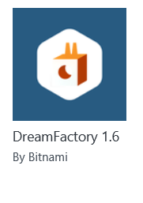

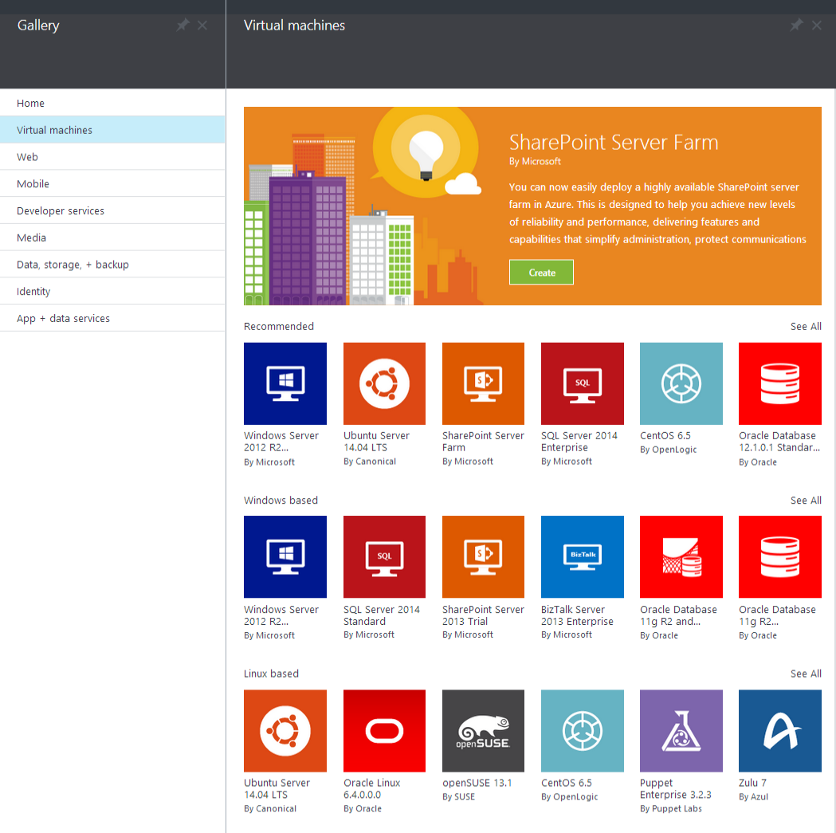

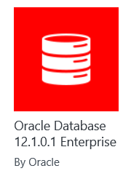
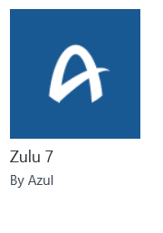
Microsoft Azure
Certified

Slide 15
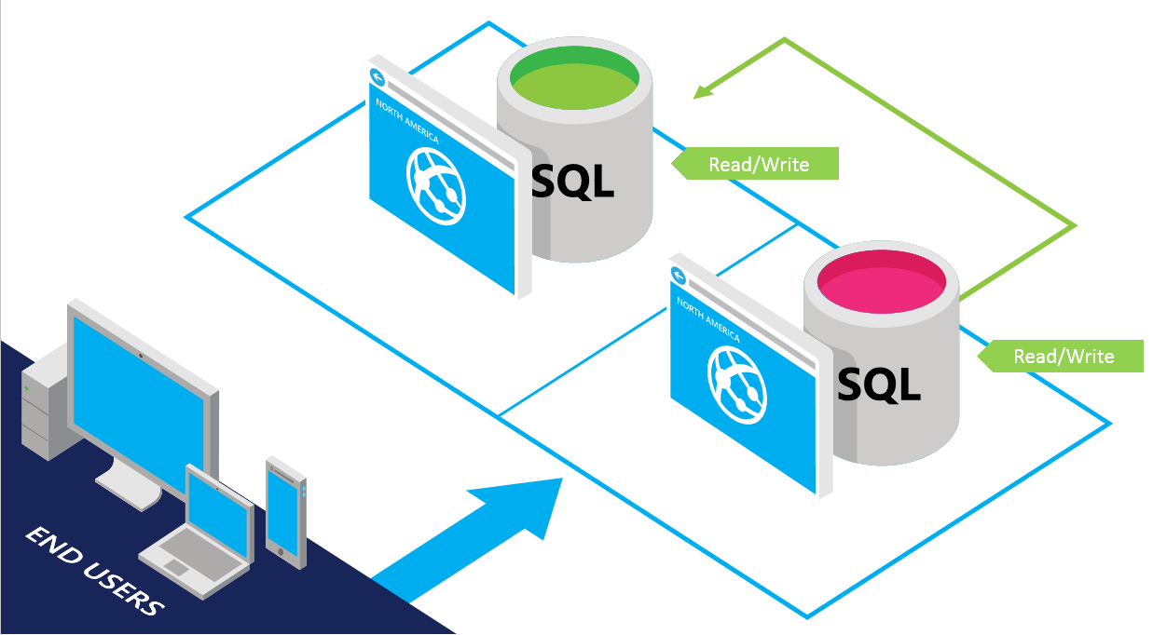
SQL Database
SQL Server database technology as a service
Fully Managed
Enterprise-ready with automatic support for HA
Designed to scale out elastically with demand
Ideal for simple and complex applications
Full support for TDS and ODBC
Familiar language and framework support
Cross Datacenter failover and backups to support disaster recovery scenarios

Slide 16

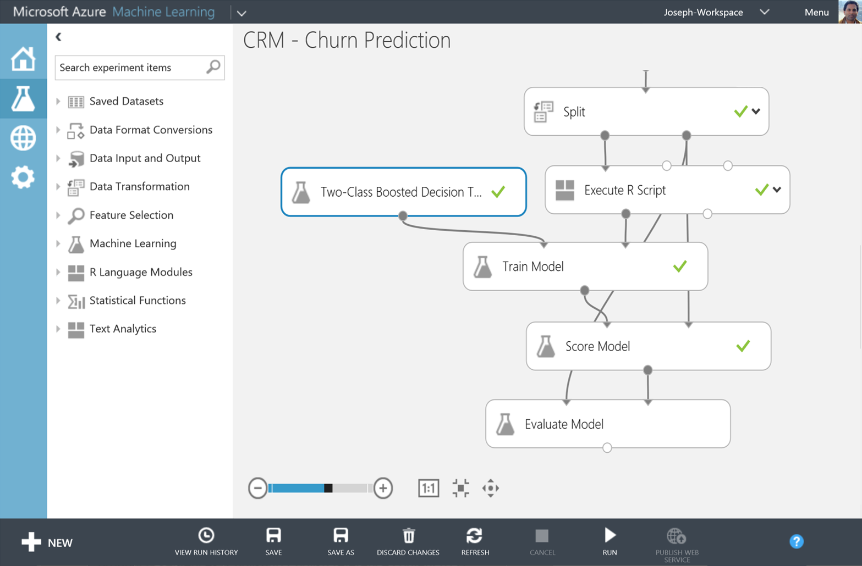
Big Data Insights
Microsoft Azure HDInsight
Microsoft Azure Machine Learning
Microsoft instance of Hadoop distribution running as service
Support existing ecosystem from Hive, Pig, etc
Extended to support Excel and BI tooling
Integration with diverse sources of data
Mashup sophisticated intelligent algorithms
Enables data scientists and developers to efficiently embed predictive analytics into their applications
Elastic, pay as you go with low operating costs
Extend with Power BI, Hadoop and cloud hosted data

Slide 17



Microsoft Azure Web Sites
Start simple
Code smart
Go live
Create new sites in seconds
Easily manage and scale your sites
Automatic load balancing and shared storage across instances
Scale out or up to reserved instances for improved performance and scale
Built-in web jobs support
Use ASP.NET, ASP, PHP, Java or Node.js
SQL Azure or MySQL databases
Start with open source apps and frameworks
Develop with VS and WebMatrix
Supports any Web development tool on any platform (Windows, OSX, Linux)
Rapid deployment for quick iteration
Integrated source control with Team Foundation Server (TFS) and Git
Built-in monitoring of perf and usage data
Quick access to request logs, failed requests diagnostics and diagnostics
Office Blog ASP.NET microsoft.com

Slide 18
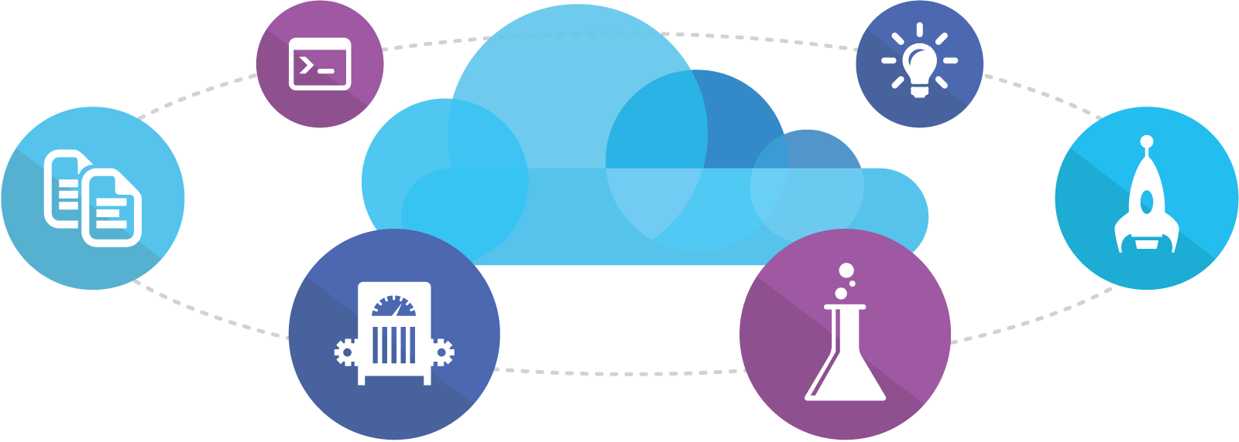
Visual Studio Online
Code
Insights
Agile
Deploy
Build
Test
Full Portal Integration
Not just for Microsoft shops

Slide 19
You
Microsoft Azure Active Directory
Synchronize your corporate and 3rd party identities
Integration with O365
Support modern protocols
OAuth 2.0
OpenID Connect
WS-Fed
SAML 2.0
Identity and Access Mgmt Permissions
Users
Groups
Applications
Microsoft Azure AD
3rd party clouds/hosting
PCs and devices

Slide 20

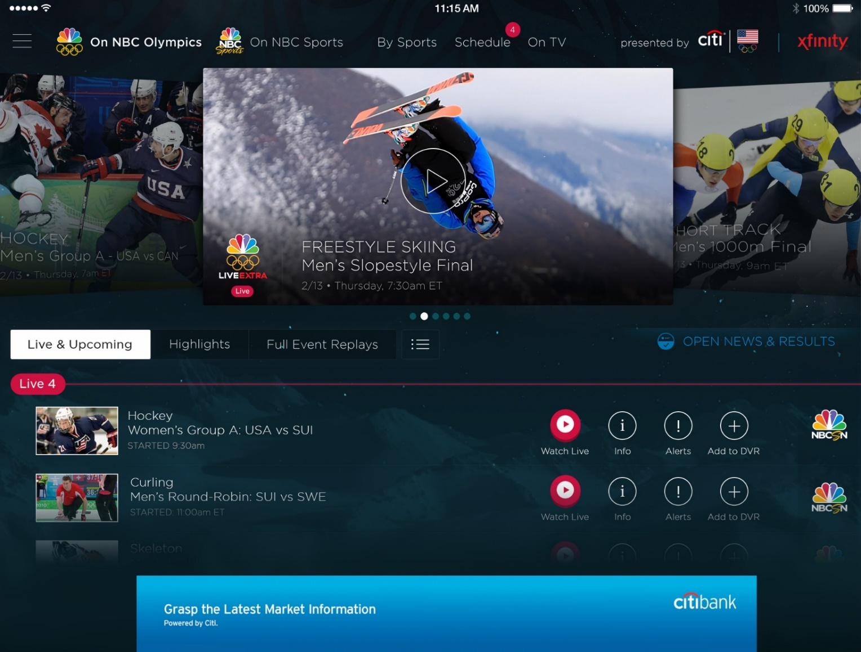
Azure Media Services
Olympics NBC Sports
On Demand Media Services
Video-on-demand
Ingest
Encode
Package
Encrypt
Delivery
Live Streaming Support
Live video encoding and streaming
Web + Mobile
100 million viewers
2.1 million concurrent HD viewers during the USA vs. Canada hockey match

Slide 21







Mobile Services
Provides essential services to support client development
Client Support
iOS
Android
HTML5/Web
Xamarin
Windows
Windows Phone
PhoneGap
Sencha
Storage
Authentication
Logic
Push
Scheduler
Notes:
Speaking Notes
Azure Mobile Services is a Backend-as-a-Service
Instead of you having to design, build, test, deploy, manage, and upgrade your whole backend, we do it for you
Features of Mobile Services
Storage – SQL DB
Authentication – built in support for social providers w/ ability to custom auth
Backend logic – data validation, logical flows, etc
Push Notifications – across all major mobile platforms
Scheduler – backend job processing

Slide 22
LAB: Azure Portal

Slide 23
Key Scenarios to get started with Microsoft Azure
Dev / Test
Full Test and Dev environments in minutes
VSO integration
Lift and Shift
Take existing work loads and run then in a certified instance
Storage
Archive key data in inexpensive cloud storage
Big Data
Process key data into business intelligence using Hadoop or Machine Learning
Identity
Synchronize all your identities through Azure AD to control access to Apps, Data and Services
Web Apps
Take your web apps to the cloud using inexpensive Web Sites

Slide 24
Activate your MSDN Benefits…
+
3 VMs for 16 hrs a day
80 VMs for 20 hour load test
Up to 100 web sites + DB
Up to
$150
33%^{off}
25%^{off}
89
per Month
Dev/Test VMs
Other Dev/Test
Countries

Slide 25
Get started today at http://azure.microsoft.com

