Slide 1
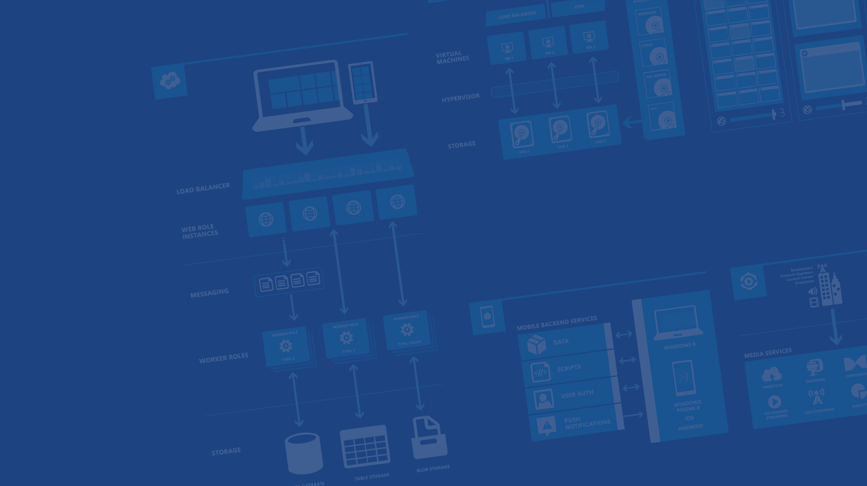
Building Cloud Solutions
Microsoft Azure
Notes:
Presentation Objectives:
This presentation provides an overview of how to design and deploy cloud solutions (unofficial term) on Azure. In addition to introduction of PaaS and Azure Resource Manager, this presentation also sets the context for all later sessions.
The theme of this session is the partnership between developers/ISVs and Azure. A successful service is a result of collaboration between the developer and Azure.
You bring the code (app + infrastructure), Azure bring the resources
Depends on the level of control/customization you want, you pick from the spectrum from IaaS to PaaS to SaaS.
Azure provides supports for improved QoS, you leverage them to improve your service
Speaker Notes:
It’s important to convey the idea that whether an application should be deployed on website or cloud service, PaaS or IaaS should not be an upfront architectural decision, but a choice.

Slide 2
Agenda
→ Your services and Azure
→ Design for Cloud
→ Cloud Services
Notes:
Slide Objectives:
Explain the agenda of the session.
Speaker Notes:
Explain this presentation is a high-level overview, so not everything is covered in-depth.

Slide 3
Your service
Notes:
Slide Objectives:
Explain how Azure helps developers to refocus on their applications.
Speaker Notes:
Before we discuss about specifics, let’s refocus on what you care about – your application/service.
Azure is taking a application-centric approach and brings tools and services to support DevOps scenarios.

Slide 4
→ Your application code
→ Your infrastructure code
→ Required resources
Notes:
Slide Objectives:
Explain application is made up by application code and infrastructure code.
Speaker Notes:
Let’s start with something that you know inside-and-out: your application code. [click]
Then, for whatever reason, you decide to deploy your application to Azure. [click]
What you do is to allocate a bunch of related resources out of the humongous resource pool provided by Azure, deploy your application code to these resources, and you have a running service. [click]
For DevOps’ perspective, you need a way to reliable capture and apply your requirements on resources, which can be referred as infrastructure code.

Slide 5
You: Code (application, infrastructure)
Azure: Resources (IaaS, PaaS, SaaS)
Notes:
Slide Objectives:
Reiterate the point that to make your service successful, you are partnering with Azure. You bring the code, and Azure brings resources.
Speaker Notes:
In terms of infrastructure code, you can use it to define desired states of required resources (Note: current Azure Resource Manager only support a small number of Resource Providers). [Click]
You can define hosting environments, such as websites, cloud services and VMs. [Click]
Required services. [Click]

Slide 6
Demo: code + resources
Deploying a Website to Azure
Notes:
Demo: Deploying a ASP.NET Website to Azure
Prerequisites:
An active Azure subscription.
The firework application (Cache-Redis-Firework-SignalR) has been loaded in Visual Studio. Compiled and verified to work locally.
Steps:
Open Ibiza portal and click the NEW button at the lower-left corner.
Select Website and provision a new website.
Run the firework application locally. Explain this is a regular ASP.Net application (your application code) that you want to deploy to Azure.
In Solution Explorer, right-click the web project and select Publish.
Follow the publish wizard to publish the application to the website we just provisioned.
Test the application. Invite audience to participate if possible.
Switch back to slide to explain what just happened.

Slide 7
What just happened?
Notes:
Slide Objectives:
Explain what happened during demo, and pave the discussion of Resource Manager.
Speaker Notes:
You provided code. [Click]
Azure provided resource (website). [Click]
Your code is deployed to the resource and you have a running site.
Transition:
Of course here we just went through a simple scenario. A more complex system would probably require a group of resources. Introducing Azure Resource Manager that provides an extensible architecture for managing resources on Azure.

Slide 8
Cloud Services

Slide 9
Cloud Services
→ Focus on your application
→ Scalability, availability and reliability
→ Monitoring and diagnostics
Notes:
Slide Objectives:
Explain the agenda of the session.
Speaker Notes:
Explain this presentation is a high-level overview, so not everything is covered in-depth.

Slide 10
What is a Cloud Service?
A container of related service roles
Web Roles Worker Roles VMs
Notes:
Note: VM is separated out as IaaS offering.

Slide 11
How do roles communicate?
Public endpoints
Publicly accessible, load balanced
Internal endpoints
Private to cloud service, load balanced
Instance Input endpoints
Address individual instance
Microsoft Azure

Slide 12
Web Role
All features of a worker role + IIS 7, 7.5 or IIS 8.0*
ASP.NET 3.5 SP1, 4.0 or 4.5* – 64bit
Hosts
Webforms or MVC
FastCGI applications (e.g. PHP)
Multiple Websites
Http(s)
Web/Worker Hybrid
Can optionally implement RoleEntryPoint *with Windows Server 2012
Notes:
Slide Objective
Understand how a Web Role extends the standard worker role
Speaker Notes
A web role takes all the capabilities and semantics of a worker role and adds the IIS Hostable Web Core
Web Roles run ASP.NET websites- they do this by using the IIS hostage web core.
pretty much anything that will work in a standard IIS ASP.NET Web Site should work in Microsoft Azure. At MIX09, we additionally added support for IIS7’s FastCGI capability. As a note, any files that are part of a asp.net project on Microsoft Azure are READ ONLY! If you need to be able to change the contents of files:
User Blob Storage
If its configuration, use the service model files – which can be changed at runtime.
Inbound protocols are http(s) – outbound protocols are any TCP connection but NOT UDP.
Notes
http://msdn.microsoft.com/en-us/library/dd179341.aspx
http://blogs.msdn.com/b/carlosag/archive/2008/04/14/hostyourownwebserverusingiis7.aspx
http://blogs.iis.net/ksingla/archive/2007/12/20/ins-amp-outs-of-hostable-web-core.aspx

Slide 13
Worker Role Patterns
Queue Polling Worker
Poll and Pop Messages within while(true) loop
E.g. Map/Reduce pattern, background image processing
Listening Worker Role
Create TcpListener or WCF Service Host
E.g. Run a .NET SMTP server or WCF Service
External Process Worker Role
OnStart or Run method executes Process.Start()
Startup Task installs or executes background/foreground process
Custom Role Entry Point (executable or .Net assembly)
E.g. Run a database server, web server, distributed cache
Notes:
Slide Objective
Understand the 3 common patterns of worker roles
Speaker Notes
Pattern 1 – Polling
Worker role polls a Queue
Pops message
Performs work
Polls queue again
Pattern 2
Worker listens for inbound TCP request Can implement with Raw TcpListeners or use WCF or use Hosted Web Core
Pattern 3
Run a 3rd party process When the role starts up or runs use a Process.Start() call to run a standard windows executable
E.g. Running a database server
Notes
http://blog.smarx.com/posts/build-your-own-web-role-running-hosted-web-core-in-windows-azure
http://blog.smarx.com/posts/making-songs-swing-with-windows-azure-python-and-the-echo-nest-api

Slide 14
Roles and Instances
Roles are defined in a Hosted Service
A role definition specifies:
VM size
Communication Endpoints
Local storage resources
etc.
At runtime each Role will execute on one or more instances
A role instance is a set of code, configuration, and local data, deployed in a dedicated VM
Notes:
Slide Objective
Understand the difference between Roles and Instances
Speaker Notes
The Service model defines the shape of a service-
the Roles it will have
endpoints it will listen on
Types of VMs that will be run
At runtime each Role will run at a given scale
Specifically each role will be deployed onto and executed on one or more VMs
A VM runs a single role
Notes
Notes on the various security roles involved in running a Microsoft Azure account
http://blog.toddysm.com/2010/01/subscription-and-service-administration-in-windows-azure.html

Slide 15
Demo: Cloud Service
A Hello World Cloud Service
Notes:
Demo:
Create a Hello World Cloud Service.
Steps:
Create a Cloud Service with a Web Role and Worker Role (with SB queue).
Launch, explain local emulator.
Show publish menu.

Slide 16
Mobile Services

Slide 17
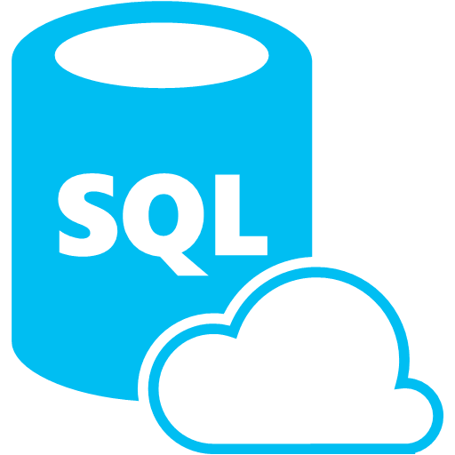






What is Mobile Services?
Storage
Authentication
Logic
Push
Scheduler
Notes:
Speaking Notes
Azure Mobile Services is a Backend-as-a-Service
Instead of you having to design, build, test, deploy, manage, and upgrade your whole backend, we do it for you
Features of Mobile Services
Storage – SQL DB
Authentication – built in support for social providers w/ ability to custom auth
Backend logic – data validation, logical flows, etc
Push Notifications – across all major mobile platforms
Scheduler – backend job processing

Slide 18
Structured Storage
Powered by SQL Database
Supports rich querying capabilities
Dynamic Schematization
Data management in:
Azure Portal
SQL Portal (Silverlight)
SQL Management Studio
REST API
Azure CLI Tools
SQL CLI
Microsoft Azure
Notes:
Speaking points
Mobile Service easily connects to SQL Database
SQL offers rich querying and indexing capabilities
Dynamic Schematization means you don’t have to be a DBA and manage schema
Data can be managed in:
Azure Portal (read and delete data)
SQL Portal (Silverlight)
SQL Management Studio (windows)
REST API (used by SDKs)
Azure CLI tools
SQL CLI (Node module)

Slide 19
The REST API
Base Endpoint: https://MobileService.azure-mobile.net/tables/*
Action | HTTP Method | URL Suffix
Create | POST | /TodoItem
Read | GET | /TodoItem?filter=id%3D42
Update | PATCH | /TodoItem/id
Delete | DELETE | /TodoItem/id
Microsoft Azure
Notes:
Speaking points
This is the mapping for the REST API exposed by table storage
Standard REST
Anything that can talk REST can connect to your Mobile Service

Slide 20
Server Side Table Scripts
Node.js scripts
.NET Web API
backend in
Visual Studio
Passes through to SQL by default
MongoDB, Table Storage, SQL out of the box
Intercept CRUD requests to tables
Fully customizable
Notes:
Speaking points
Node backend generates Node scripts for each table action
Scripts intercept CRUD requests
Pass to SQL by default
Custom logic added here
Edit in portal (NODE)
.NET Backend creates Visual Studio project

Slide 21
Node Modules
request
push.*
sendgrid
console
mssql
pusher
tables
azure
twilio
Notes:
Speaking points
Node backend comes with pre-included modules
Request – make web requests against other services
Push.* - perform push notifications
Console – log information
Mssql – call stored procedures / custom SQL
Tables – OO way of accessing tables in backend
Azure – access service bus, blob, table storage, notification hubs, etc
Partners
Sendgrid – send emails
Pusher – web socket style communications
Twilio – SMS and voice
Most have a free tier you can use

Slide 22
Demo: Getting Started
Your first Mobile Service
Notes:
Demo: Getting Started
Go to the portal
Create a new mobile service (Node backend works with most of deck)
Walk through Getting started screen
Choose platform
Download quick start
Run quick start
Save and update data
Show data in portal (Node)
Walk through client code that deals with Mobile Service

Slide 23
Design for Cloud

Slide 24
A different mindset
→ Embracing errors
→ Design for availability, reliability, scalability
→ Performance
Notes:
Slide Objectives:
Explain the agenda of the session.
Speaker Notes:
Explain this presentation is a high-level overview, so not everything is covered in-depth.

Slide 25
Sample architecture
WAAD
Service Bus
Paired NS
SQL Database
US West
Data Sync
Worker Role/VM
User
Internet
Traffic Manager
US East
Worker Role/VM
NoSQL DB
Geo-redundancy
CDN
Cache

Slide 26
Redundancy in Microsoft Azure
Microsoft Azure Storage with replicas
SQL Database built-in backup servers
Microsoft Azure Caching with high availability enabled
Multi-instance Microsoft Azure Web Sites and Cloud Services
Load-balanced Virtual Machines
Built-in redundancy in Microsoft Azure Virtual Network gateways
Failover with Microsoft Azure Traffic Manager

Slide 27
Reliability in Microsoft Azure
Auto recovery of crashed/nonresponsive instances
Fault domain to scatter instances across racks
Virtual machine Availability set to allocate VMs across Fault domains
Upgrade domain to avoid shutting down all instances at the same time
VIP swap to allow promoting staging to production
Simulator, Intellitrace and enhanced diagnostics
First party and third party support for telemetry
Handle transient errors using the Transient Fault Handling Application block

Slide 28
What does failsafe mean for my applications?
It depends… but some general practices apply.
Take advantage of Microsoft Azure features
Avoid single point of failure
Failure mode analysis
Transient errors
Graceful degradation
Eliminate human factors
Notes:
It depends, but….

Slide 29
Scaling in Microsoft Azure
Scale up by choosing different VM sizes
Scale out by adding more instances
Auto-scale with Autoscaling Application Block
Scale out by using multiple service entities
CDN to distribute user traffic
Caching to offset server workloads

Slide 30

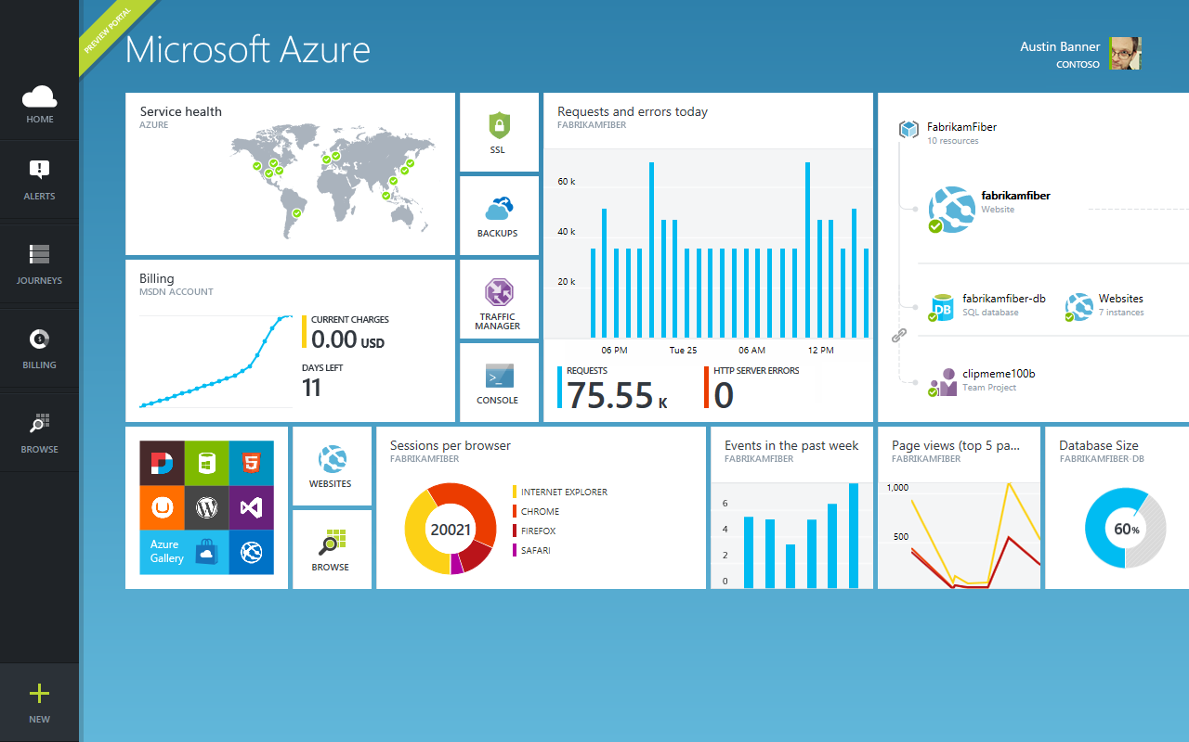
Get started
Visit azure.microsoft.com

