Slide 1
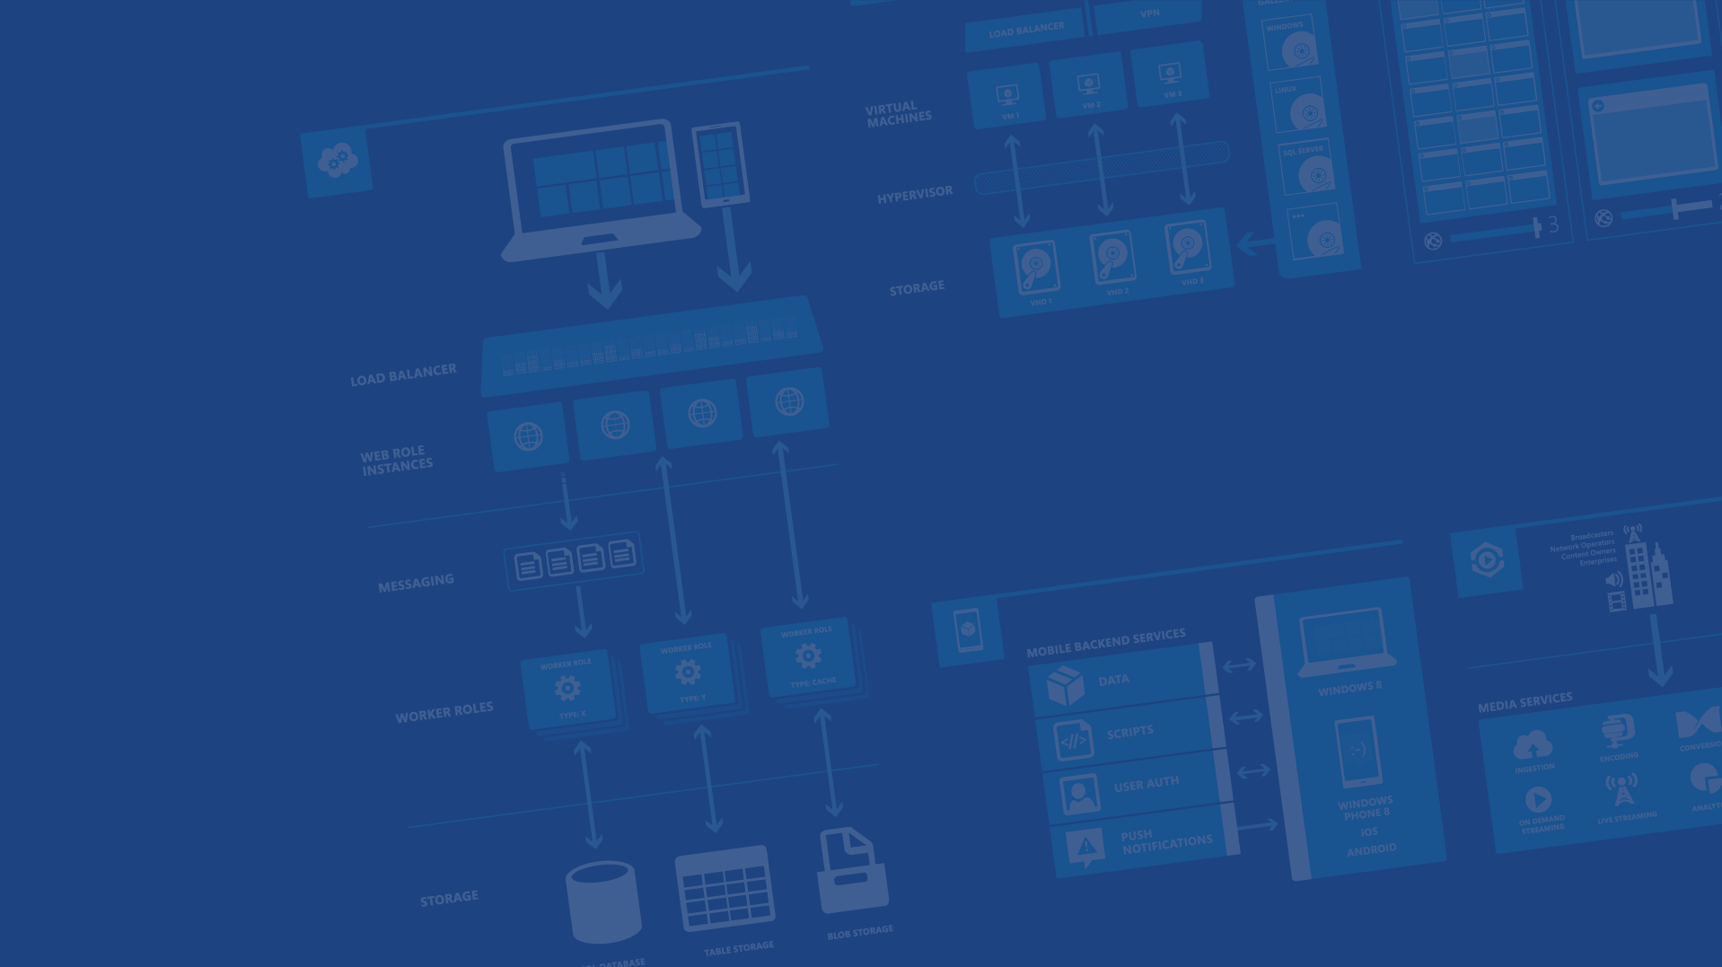
Azure App Service Formerly Web Sites++
Microsoft Azure

Slide 2
Agenda
Site creation
Language Support
Deployment
Source Control Integration
Scale
Web Jobs
Site Slots
Traffic Manager
Backup
Lab
API App
Logic App
Mobile App
Lab

Slide 3
Fastest way to build for the cloud

Slide 4
Develop apps with…
.NET | Node.js | PHP | Python | Java

Slide 5
Demo
Language Support
Notes:
FTP files (ASP, Node, PHP, etc.) to new website created in demo 1

Slide 6


App Service Plan
$
+
+
Azure Subscription
Pricing Tier
Geographic Region
Notes:
Web Hosting Plan is a scale unit for websites. It is comprised of a Geographic Region and a Pricing Tier within the same Azure Subscription. When you scale a site to either Basic or Standard all of the sites within the Web Hosting Plan will be placed on the same Virtual Machine.

Slide 7
Benefits of App Services
Automatic OS patching
Enterprise-grade security
High availability
Automated scale out/in
Built-in load balancing
Supports many languages and platforms
.NET, Node.js, Python, Ruby and many more
Easy continuous deployment
Continuous delivery from third-party source control providers
Built-in Git repo

Slide 8
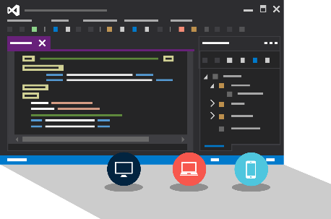
Visual Studio + App Service Web Apps
Create Azure Resources during File / New
Create Web App during deploy
Manage with Server Explorer

Slide 9
Demo
Fireworks Web App + Redis
Notes:
File / New Web Application
Show Host In The Cloud dialog
Select Empty web site (for quick create)
Right-click project, select Publish
Show Azure Website creation
Cancel publish
Show Azure Websites in Server Explorer
Right-click one Website and show settings

Slide 10
Continuous Delivery with App Service

Slide 11

Continuous Deployment for Web Apps
Web App Production Slot
Agility through Continuous Deployment
Auto-Swap
Hooks
Git pull
Commits
Changes
Web App Staging Slot
Source Control / Code Repo
Developer

Slide 12

Choose your own Adventure!
Visual Studio
Online
CodePlex
Git
GitHub
BitBucket
DropBox
FTP
Notes:
Slide Objectives:
Objective #1
Transition:
Transition statement(s) to setup the slide
Speaking Points:
Speaking Point #1
Speaking Point #2
Notes:
Any notes go here

Slide 13
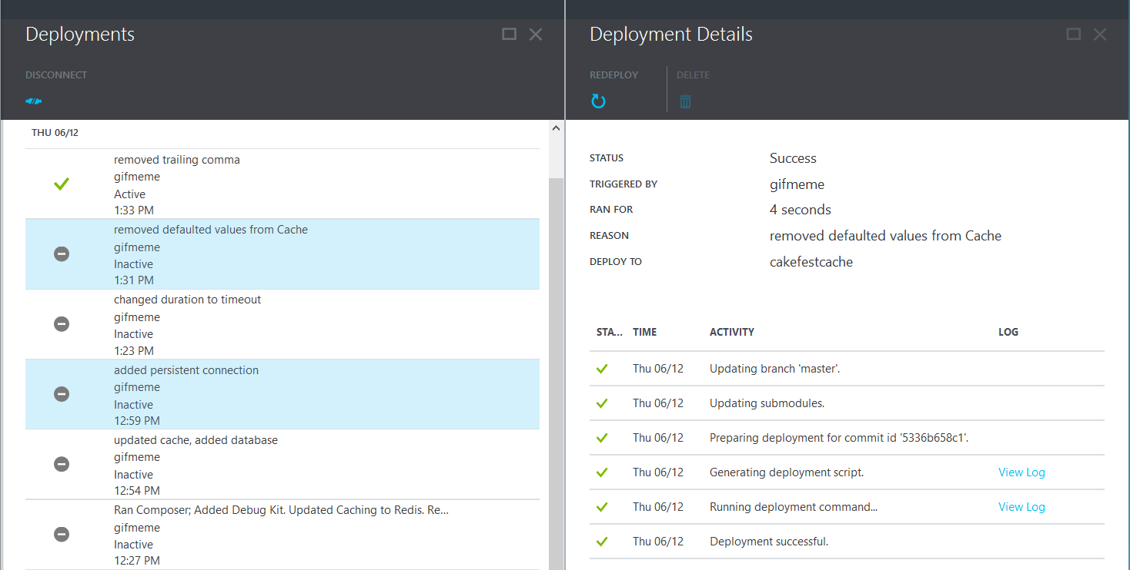
Deployments

Slide 14
Demo
Continuous Integration
Notes:
File / New Web Application
Show Host In The Cloud dialog
Select Empty web site (for quick create)
Right-click project, select Publish
Show Azure Website creation
Cancel publish
Show Azure Websites in Server Explorer
Right-click one Website and show settings

Slide 15
Scale

Slide 16
Manual Scaling
Instance Count
1
6
Instances

Slide 17

AutoScale
Web App

Slide 18
AutoScale
Web App

Slide 19
AutoScale
Web App

Slide 20
Auto-Scaling (Metric)
Instance Count
2
6
Instances
[Metric]
60
80
Percent
CPU Percentage | Memory Percentage | Disk Queue Length | HTTP Queue Length | Data In | Data Out

Slide 21
Auto-Scale Considerations
Only Scales the Web Tier
Scale Up/Down is not instantaneous

Slide 22
Site Slots

Slide 23
Staging
Web App

Slide 24
Staging
Web App

Slide 25
Staging
Web App

Slide 26
Staging
Web App

Slide 27
Web Jobs

Slide 28
WebJobs

Slide 29
WebJobs

Slide 30
Backups
Websites Files
Websites Settings Manifest
Database (Optional)

Slide 31



Hybrid Connections
Corporate Network
Microsoft SQL Server
Web Sites
Hybrid Connection Manager
Other published resources
Hybrid Connection
Mobile Services

Slide 32
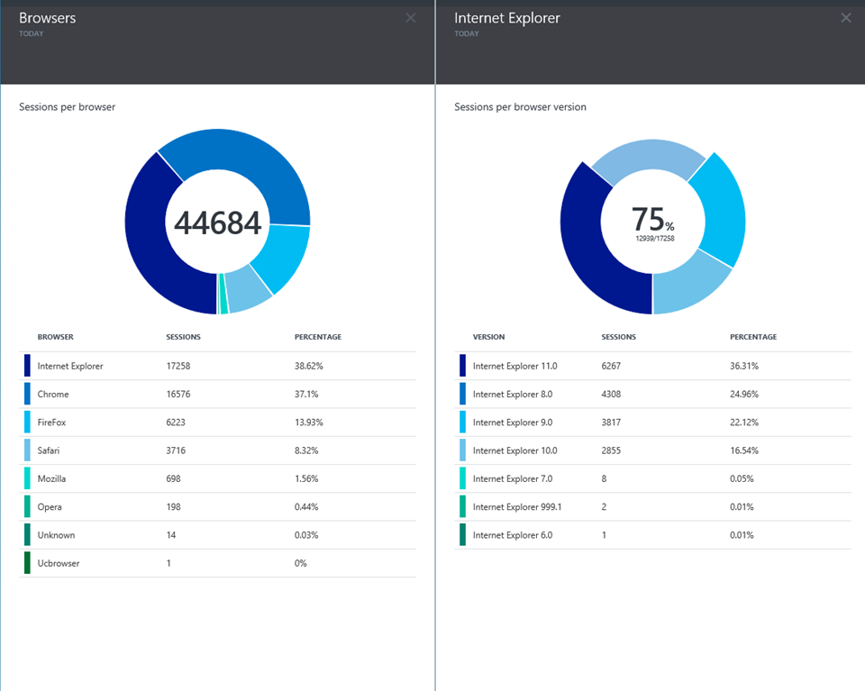
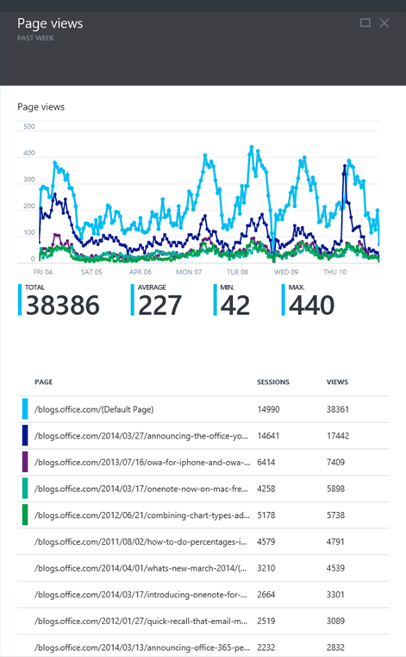
Application Insights

Slide 33
App Service Web App Architecture
Deployment
Server(s)
File Server
Publish Endpoint
Blob Storage
Application Database
Frontend (IIS ARR)
Microsoft Azure
Load Balancer
Metering
Runtime Database
API Endpoint
Notes:
Disable sticky-session by using : (ARR – Application Request Routing)
<system.webServer>
<httpProtocol>
<customHeaders
<add name="Arr-Disable-Session-Affinity" value ="true
</customHeaders>
</httpProtocol>
</system.webServer>

Slide 34
LAB – Web App

Slide 35
Azure App Service

Slide 36


Azure App Service Build and scale great cloud apps
Web Apps
Mobile Apps
Logic Apps
API Apps

Slide 37
App Service - one integrated offering
Web Apps
Mobile Apps
Web apps that scale with your business
Build Mobile apps for any device
LOGIC Apps
API Apps
Automate business process across SaaS and on-premises
Easily build and consume APIs in the cloud

Slide 38
Web Apps

Slide 39
Full capability set available including:
.NET, Node.js, Java, PHP, and Python
WebJobs for long running tasks
Integrated VS publish, remote debug…
CI with GitHub, BitBucket, VSO
Auto-load balance, Autoscale, Geo DR
Virtual networking and hybrid connections
Site slots for staged deployments
Web Apps
Web apps run as-is
no changes required

Slide 40
API Apps

Slide 41
Easily use cloud or custom APIs:
An ecosystem of APIs for any need
Create and publish custom, reusable APIs
Visual Studio tooling with one click publish and remote debugging
Automatic client SDK generation for many languages using Swagger
Api Apps
Create, consume and
host APIs more easily

Slide 42
Benefits of API Apps
Bring your API as-is
.NET Web API
Node.js + Express
Java
PHP
Many other technologies
Connect easily to SaaS platforms

Slide 43
API Apps addresses key pains around building and consuming APIs
Build your API
Consume APIs
Web Apps++: Bring you API as is in your language of choice
API discovery
SDK generation
SSO, handled by server
Authentication, built-in to mobile and web SDKs
Expose enterprise APIs
Microservice style
Metadata contract
SSO
Simple access control
Gallery – public & organization

Slide 44
Consuming API Apps
API Apps expose HTTP services
Metadata is exposed using Swagger 2.0 metadata
JSON file
Widely supported
Client applications

Slide 45







Simplifying Integration
Managed Middle Tier
API App[s]
On Premise Applications
Databases in Azure VMs
SharePoint Online
Cloud-Hosted Web Apps
SSO, Auth, Scale, etc.

Slide 46
Demo: Creating an API App

Slide 47
Logic Apps

Slide 48
New Logic Apps for easy automation
No code designer for rapid creation
Dozens of pre-built templates to get started
Out of box support for popular SaaS and on-premises apps
Use with custom API apps of your own
Biztalk APIs for expert integration scenarios
LOGIC Apps
Automate SaaS and
on-premises systems

Slide 49
SaaS integration

Slide 50
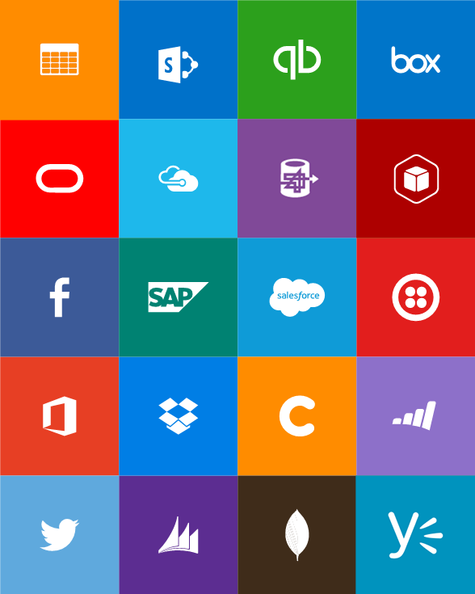
Built-in API Connectors
Connectors
Box
Chatter
Delay
Dropbox
Azure HD Insight
Marketo
Azure Media Services
OneDrive
SharePoint
SQL Server
Office 365
Oracle
QuickBooks
SalesForce
Sugar CRM
SAP
Azure Service Bus
Azure Storage
Timer / Recurrence
Twilio
Twitter
IBM DB2
Informix
Websphere MQ
Azure Web Jobs
Yammer
Dynamics CRM
Dynamics AX
Hybrid Connectivity
Protocols
BizTalk Services
HTTP, HTTPS
File
Flat File
FTP, SFTP
POP3/IMAP
SMTP
SOAP + WCF
Batching / Debatching
Validate
Extract (XPath)
Transform (+Mapper)
Convert (XML-JSON)
Convert (XML-FF)
X12
EDIFACT
AS2
TPMOM
Rules Engine

Slide 51
Target audience is anyone who can use Azure
… but not necessarily business users or consumers

Slide 52
Demo: Creating an API App

Slide 53
Mobile Apps

Slide 54







Azure Mobile Services
Storage
Authentication
Logic
Push
Scheduler
Notes:
Speaking Notes
Summarize earlier slide
Azure Mobile Services is a Backend-as-a-Service
Instead of you having to design, build, test, deploy, manage, and upgrade your whole backend, we do it for you
Features of Mobile Services
Storage – SQL DB
Authentication – built in support for social providers w/ ability to custom auth
Backend logic – data validation, logical flows, etc
Push Notifications – across all major mobile platforms
Scheduler – backend job processing

Slide 55
New capabilities for Mobile apps:
Webjobs for long running tasks
CI with GitHub, BitBucket, VSO
Auto-load balance, Autoscale, Geo DR
Virtual networking and hybrid connections
Site slots for staged deployments
Mobile Apps
Mobile services plus
a whole lot more

Slide 56
App Service Environment

Slide 57
App Service Environment (ASE)
New Premium Tier Feature
Dedicated compute resources and network resources
Increased Scaling Options
Directly created in a Virtual Network
Support all Web App features and capabilities
Support Web, Mobile and API Apps
Global Scale

Slide 58
LAB – API App
http://tinyurl.com/cloudcamp-apiapp

Slide 60

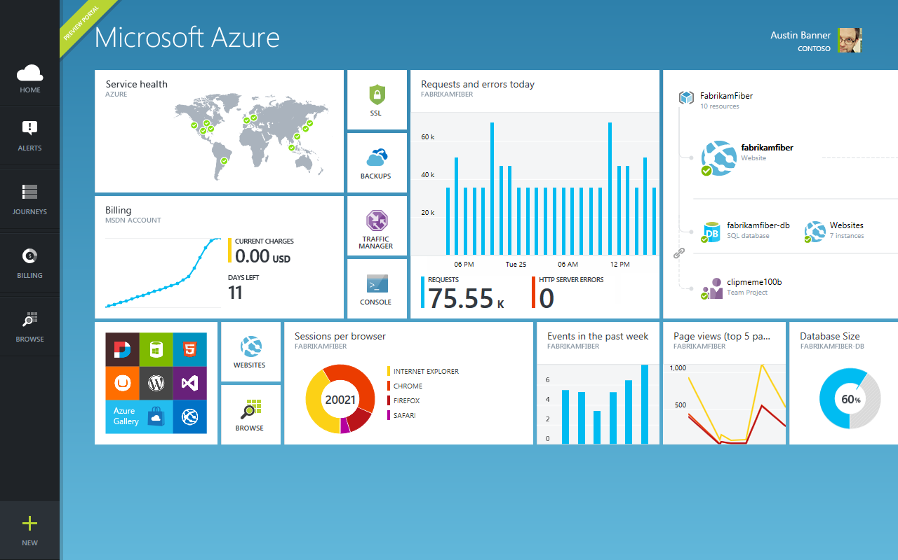
Get started
Visit azure.microsoft.com

