Slide 1
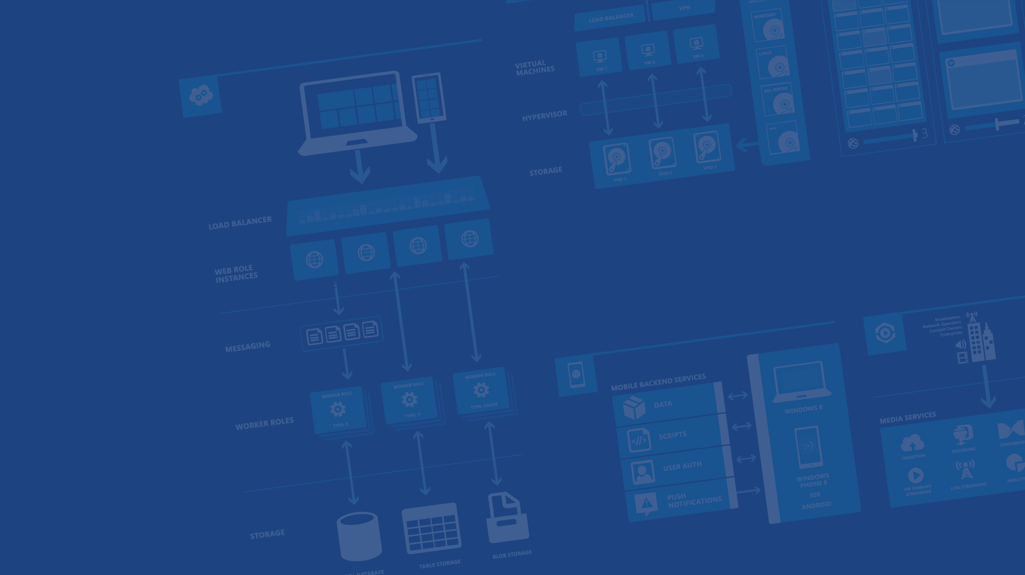
Azure Data Overview
Azure OSS Accelerator

Slide 2
Agenda
SQL Database
SQL on IaaS
NoSQL
Blobs
Files
Cache

Slide 3
SQL Database

Slide 4


A Continuous Offering From Private To Public Cloud
Physical
Virtual
IaaS
PaaS
SaaS
Notes:
Slide Objectives:
Show Microsoft’ continuous Private to Public Cloud Offering, but this presentation will focus on Microsoft’s relational database PaaS offering.
Transition:
Microsoft provides a continuous solution from private cloud to the public cloud. No matter where you are on your technology roadmap we have a solution to fit your needs.
We are a trusted advisor and platform in the traditional enterprise and ISV space with new IaaS offerings that making it easier to bring this same level of trust and ease of use to the public cloud. However, Microsoft Azure SQL Database extends SQL Server capabilities to the cloud by offering SQL Server as a relational database service.
Speaking Points:
Announced New IaaS offering in June
SQL Database provides SQL Server as a relational service.
Notes:

Slide 5

The Basics
SQL Database
SQL Server database technology as a service
Fully Managed
Enterprise-ready with automatic support for HA
Designed to scale out elastically with demand
Ideal for simple and complex applications
Notes:
Slide Objectives:
Understand the overall concepts and benefits of SQL Database
Transition:
Let’s clear up any confusion and look at the basics of what SQL Database really is and some of its benefits.
Speaking Points:
The same great SQL Server database technology that you know, love, and use on-premises provided as a service
Enterprise-ready
Automatic support for High-Availability
Designed to scale on-demand to provide the same great elasticity
Notes:
High-availability – 3 copies of the database free for the cost of the one database. Always in sync. The cost to do this on-premises isn’t cheap. This is FREE in SQL Database.
Scalability using SQL Federation (discussed later in the presentation).

Slide 6
A Server Is Not A Machine
SQL Server
A Machine
SQL Database Server
A TDS Endpoint
Notes:
Slide Objectives:
Understand that while there are physical SQL Server boxes behind the scenes, when connecting to SQL Database, you are not connecting to a physical server, but to a TDS endpoint.
Transition:
The key to understanding SQL Database is understanding while SQL Database is SQL Server, we do not interact with them in the same physical manner.
Speaking Points:
In an on-premises environment, we typically have physical access to the actual SQL Server server.
In Microsoft Azure, we do not have physical access to the actual server.
Notes:
It is important that the attendee understands that it IS INDEED SQL Server at the platform layer. There are physical boxes running SQL Server 2012 Enterprise Edition. However, due to the nature of the Azure environment to provide the high-availability and scalability necessary, access to the physical boxes is currently not supported.

Slide 7
How It Works
Client Layer
PHP
SQL Server
Applications
and Tools
WCF Data Services
Architecture
Client Layer - Used by application to communicate directly with SQL Database.
Services Layer – Gateway between Client layer and Platform layer.
Platform Layer – Includes physical servicers and services that support the Services layer.
Infrastructure Layer – IT administration of the physical HW and OS.
ODBC
ADO.NET
Tabular Data Stream (TDS)
TDS+SSL
Services Layer
Provisioning
Provisioning
Provisioning
…
Billing and Metering
Billing and Metering
Billing and Metering
…
Connection Routing
Connection Routing
Connection Routing
…
Platform Layer
SQL Server
SQL Server
SQL Server
…
SQL Database Fabric
SQL Database Fabric
SQL Database Fabric
…
Management Services
Management Services
Management Services
…
Infrastructure Layer
Notes:
Slide Objectives:
To understand the actual architecture that provides the enterprise-ready SQL Database service.
Transition:
Developers have spent years working with their technology of choice, and Microsoft wanted to ensure that the technologies and tools you use today will continue to work with SQL Database without learning a whole new set of technologies.
Speaking Points:
Familiar technology and tools
Similar architecture as that of on-premises
Additional layer providing server and database partitioning, client connection routing, and billing.
Same great SQL Server technology on the backend.
Additional services (SQL Database Fabric) to ensure SLAs are met and to ensure optimum performance.
Notes:
Client - The client layer resides closest to your application, and is used by your application to communicate directly with SQL Database. The client layer can reside on-premise in your datacenter or be hosted in Windows Azure. Because SQL Database provides the same tabular data stream (TDS) interface as SQL Server, you can use familiar tools and libraries to build client applications for data that is in the cloud.
Services - The services layer functions as a gateway between the client layer and the platform layer, where the data resides. The services layer provides three functions: provisioning, billing and metering, and connection routing.
The services layer provisions the databases that you specify with your Windows Azure platform account. The billing and metering aspect of the services layer enables multi-tenant support by providing monitoring and billing for database usage based on individual Windows Azure platform accounts. SQL Database is built on a scalable platform involving numerous physical servers; this layer handles all the connections routing between your application and the physical servers where your data resides.
Platform - The platform layer includes the physical servers and services that support the services layer. The platform layer consists of many instances of SQL Server, each of which is managed by the SQL Database fabric.
The SQL Database fabric is a distributed computing system composed of tightly integrated networks, servers, and storage. It enables automatic failover, load balancing, and automatic replication between physical servers.
Management services monitor the health of individual servers and enable automated installation of service upgrades and software patches.
Infrastructure - The infrastructure layer represents the IT administration of the physical hardware and operating systems that support the services layer.

Slide 8
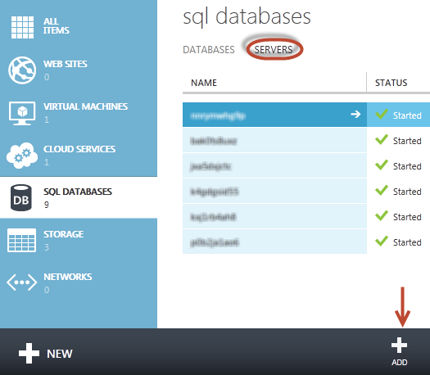
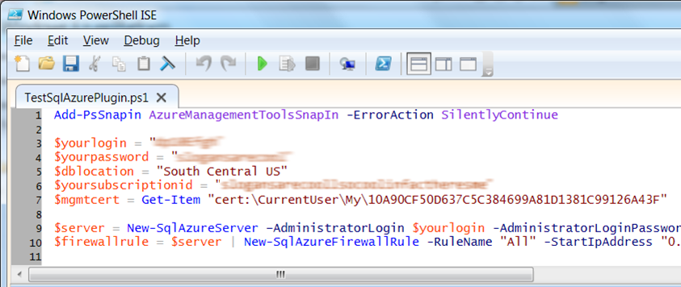
Server Provisioning
Server Defined
Service head that contains databases
Connect via automatically generated FQDN (xxx.database.windows.net)
Initially contains only a master database
Provision Servers Interactively
Log on to Microsoft Azure Management Portal
Create a SQL Database server
Specify admin login credentials
Add firewall rules and enable service access
Automate Server Provisioning
Use Microsoft Azure Platform PowerShell cmdlets (or use REST API directly)
wappowershell.codeplex.com
Notes:
Slide Objectives:
Show the different methods of provisioning a SQL Database server along with how easy it is. Plus, help the attendees understand what a SQL Database “server” really is.
Transition:
Provisioning an on-premises SQL Server box can be time consuming, costly, and at times, a challenge. With SQL Database, provisioning a “server” is painless, quick, and provisioned in a matter of seconds.
Speaking Points:
Provision servers interactively using the Management Portal
Automate server provisioning using the Microsoft Azure Management API or PowerShell.
Notes:
While the “server” is technically a TDS endpoint, much of the SQL Server process is similar. Administration login credentials are still needed for security, and more importantly defining service access is essential, and required, for maintaining the integrity of your server through firewall rules.

Slide 9
Create Database…
Use Familiar Technologies
Transact-SQL
Languages
.NET Framework (C#, Visual Basic, F#) via ADO.NET
C / C++ via ODBC
Java via Microsoft JDBC provider
PHP via Microsoft PHP provider
Frameworks
OData, Entity Framework, WCF Data Services, NHibernate
Tools
SQL Server Management Studio (2008 R2 and later)
SQL Server command-line utilities (SQLCMD, BCP)
CA Erwin® Data Modeler
Embarcadero Technologies DBArtisan®
SQL Server Comparison
Focus on logical vs. physical administration
Database and log files automatically placed
Three high-availability replicas maintained for every database
Tables require a clustered index
Maximum database size is 500 GB
Unsupported SQL Server Features
Use command, distributed transactions, distributed views
Service Broker
Common Language Runtime (CLR)
SQL Agent
SQL Profiler
Native Encryption
Notes:
Slide Objectives:
Point out that 1) The same great technologies that developers use today on-premises works with SQL Database 2) high-level differences between on-premises and SQL Database 3) SQL Database features currently unsupported
Transition:
Creating, managing, and deploying a database in Microsoft Azure SQL Database isn’t difficult. The key is understanding the features that are supported and how SQL Database compares to on-premises SQL Server and the technologies that can be used with SQL Database.
Speaking Points:
The same great technologies that developers use today on-premises works with SQL Database, including developer languages, Frameworks, and Tools. Nothing new to learn!
SQL Server Comparison -> highlight the physical vs. logical administration. Developers and DBAs can now focus on things they love to do and not worry about the physical aspect.
Features unsupported by SQL Database -> Many of the unsupported features are hardware based and thus don’t need to be in SQL Database. Other features, such as encryption, are server-based and become a challenge in solving in a shared-environment.
Notes:
CLR data types ARE supported, SQLCLR is not yet supported.
Backup/Restore: PIT Coming; Import/Export can be used for backup to BLOB storage. Third-party backup products available via RedGate and Enzo.
Data can be stored encrypted but the encryption must be done at the application level.
Native encryption is being looked at.
**Linked Servers and Distributed Queries are now supported, linking a SQL Database instance from an on-premises server. Linking two SQL Database instances is NOT supported.

Slide 10
Selecting the right Edition
Service Tier | Performance Level | Common App Pattern | Performance |  |  | Business Continuity
 |  |  | Max DB Size | Trans. Perf. Objective | DTUs | PITR | DR / GEO-Rep
Basic | Basic | Small DB, SQL opp | 2 GB | Reliability / Hr. | 5 | Past 7 Days | DB Copy + Manual Export
Standard | S1 / S2 | Wrkgp/cloud app, multiple concurrent operations | 250 GB | Reliability / Min. | 15/ 50 | Past 14 Days | Passive Geo-Replication
Premium | P1 / P2 / P3 | Mission Critical, High volume, Many concurrent Users | 500 GB | Reliability / sec. | 100/ 200/ 800 | Past 35 Days | Active Geo-replication
Notes:
Slide Objectives:
Highlight what’s new in the latest SQL Database service update.
Transition:
In late September a service update was deployed to Microsoft Azure SQL Database that included new functionality.
Speaking Points:
Linked Server – This is a new component for database hybrid solutions spanning on-premises corporate networks and the Microsoft Azure cloud.
Recursive Trigger – Just like SQL Server 2012, the option can be configured via ALTER DATABASE dbname SET RECURSIVE_TRIGGERS ON|OFF
DBCC – The query optimizer uses statistics to estimate the cardinality or number of rows in the query result, which enables the query optimizer to create a high quality query plan.
Firewall Rules – different rules for different databases hosted on the same logical SQL Database server
Notes:

Slide 11
Selecting the right Edition
Service Tier/Performance Level | DTU | MAX DB Size | Max WorkerThreads | MaxSessions | Benchmark Transaction Rate | Predictability
Basic | 5 | 2 GB | 30 | 300 | 16,600 transactions per hour | Good
Standard/S0 | 10 | 250 GB | 60 | 600 | 521 transactions per minute | Better
Standard/S1 | 20 | 250 GB | 90 | 900 | 934 transactions per minute | Better
Standard/S2 | 50 | 250 GB | 120 | 1,200 | 2,570 transactions per minute | Better
Standard/S3* | 100 | 250 GB | 200 | 2,400 | 5,100 transactions per minute | Better
Premium/P1 | 100 | 500 GB | 200 | 2,400 | 105 transactions per second | Best
Premium/P2 | 200 | 500 GB | 400 | 4,800 | 228 transactions per second | Best
Premium/P3 | 800 | 500 GB | 1,600 | 19,200 | 735 transactions per second | Best

Slide 12
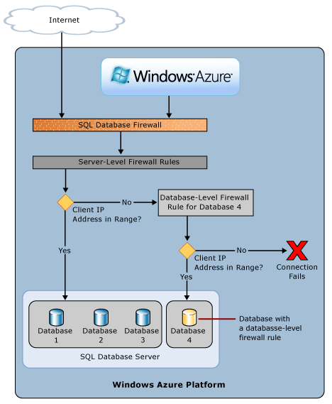
SQL Database Firewall
Securing your data
IP Address-based access control for SQL Database
Rules can be defined at the server and database
No IP authorized by default
Configurable using the SQL Database Portal and REST API
Option to disable/enable access from applications hosted in Microsoft Azure
Notes:
Slide Objectives:
Illustrate the how SQL Database Firewall
Transition:
Transition statement(s) to setup the slide
Speaking Points:
By default, no-one is allowed to access the database.
Server Rules enable clients to access your entire SQL Database server
Database rules enable clients to access individual databases within your SQL Database server
Rules are originating IP Address-based.
Notes:
Maximum of 128 Rules
Rather than using a REST API like the other Azure storage services, SQL Database is accessed via Tabular Data Stream (TDS), the same protocol used by Microsoft SQL Server (operating over port TCP/1433). To help protect the data, the SQL Database firewall prevents all access to your SQL Database server until you specify which computers have permission.
Initially, all access to your SQL Database server is blocked by the SQL Database firewall; connection attempts originating from the Internet or Windows Azure will not be able to reach your SQL Database server. In order to begin using your SQL Database server, you must go to the SQL Database Portal and specify one or more firewall settings that enable access to your SQL Database server. Use the firewall settings to specify which IP address ranges from the Internet are allowed, and whether or not Windows Azure applications can attempt to connect to your SQL Database server.

Slide 13
Application Connectivity
Connecting To SQL Database
TDS (Tabular Data Stream) protocol over TCP/IP supported
SSL required
Use firewall rules to connect from outside Microsoft data center
ASP.NET EXAMPLE:
Considerations And Best Practices
login: [login]@[server]
Idle connections
Long running transactions
Failover events
Throttling
Connection pooling and Retry logic
Latency introduced for updates
No cross-database dependencies
<connectionStrings>
<addname="AdventureWorks"connectionString=
"Data Source=[server].database.windows.net;
Integrated Security=False;
Initial Catalog=ProductsDb;
User Id=[login];
Password=[password];
Trusted_Connection=False;
Encrypt=true;"
providerName="System.Data.SqlClient"/>
</connectionStrings>
Notes:
Slide Objectives:
Highlight application connectivity requirement, considerations and best practices to SQL Database.
Transition:
While connecting to SQL Database is fairly straight forward, there are some general considerations and recommended coding practices when developing Windows Azure SQL Database applications.
Speaking Points:
Login:
Idle connections terminated after 30 minutes
Long running transactions terminated after 24 hours
DoS guard terminates suspect connections with no error message
Failover events terminate connections
Throttling may generate errors…which leads to:
Implement Connection Pooling and Retry logic to handle transient failures
Latency introduced for updates due to HA replicas
No cross-database dependencies: resultsets from different database must be combined in the application tier (Fan out queries)
Notes:

Slide 14
Demo
Creating A SQL Database Server
Notes:
Use Azure Portal (Ibiza) to create a new database server

Slide 15
SQL on IaaS

Slide 16
Run SQL on VM
Run any SQL product on cloud VM
Support for SQL Server, Oracle, MySql
Ready to go VM images available in Gallery
Persistent storage using attached disk in blob storage
Microsoft Azure

Slide 17
SQL Database vs SQL IaaS Comparison
SQL Database
Fully managed SQL Server environment
HA/DR features automatically included
Automatic backup enabled by default
SQL IaaS
Choice of a variety of DB engines (SQL Server, Oracle, MySql)
Larger database sizes possible (16TB)
All features of native DB available
Windows authentication available (requires VM to be joined to on-premises domain)
Microsoft Azure

Slide 18
Blob Storage

Slide 19
Blob Storage Concepts
http://<account>.blob.core.windows.net/<container>/<blobname>
Account
Container
Blob
Pages/ Blocks
PIC01.JPG
images
Block/Page
PIC02.JPG
contoso
Block/Page
videos
VID1.AVI
Notes:
Slide Objectives
Understand the hierarchy of Blob storage
Speaker Notes
The Blob service provides storage for entities, such as binary files and text files.
The REST API for the Blob service exposes two resources:
Containers
Blobs.
A container is a set of blobs; every blob must belong to a container.
The Blob service defines two types of blobs:
Block blobs, which are optimized for streaming.
Page blobs, which are optimized for random read/write operations and which provide the ability to write to a range of bytes in a blob.
Blobs can be read by calling the Get Blob operation. A client may read the entire blob, or an arbitrary range of bytes.
Block blobs less than or equal to 64 MB in size can be uploaded by calling the Put Blob operation.
Block blobs larger than 64 MB must be uploaded as a set of blocks, each of which must be less than or equal to 4 MB in size.
Page blobs are created and initialized with a maximum size with a call to Put Blob.
To write content to a page blob, you call the Put Page operation. The maximum size currently supported for a page blob is 1 TB.
Notes
http://msdn.microsoft.com/en-us/library/dd573356.aspx
Using the REST API for the Blob service, developers can create a hierarchical namespace similar to a file system. Blob names may encode a hierarchy by using a configurable path separator. For example, the blob names MyGroup/MyBlob1 and MyGroup/MyBlob2 imply a virtual level of organization for blobs. The enumeration operation for blobs supports traversing the virtual hierarchy in a manner similar to that of a file system, so that you can return a set of blobs that are organized beneath a group. For example, you can enumerate all blobs organized under MyGroup/.

Slide 20
Blob Containers
Multiple Containers per Account
Special $root container
Blob Container
A container holds a set of blobs
Set access policies at the container level
Associate Metadata with Container
List the blobs in a container
Including Blob Metadata and MD5
NO search/query. i.e. no WHERE MetadataValue = ?
Blobs Throughput
Effectively in Partition of 1
Target of 60MB/s per Blob
Notes:
Slide Objective
Understand containers
Speaker Notes
Account can contain unlimited number of containers
Root container useful when serving Silverlight and flash out of Blob storage. May need to store Cross domain access policy files in root of the domain
Metadata is up to 8KB of name value pairs per container
Notes
http://msdn.microsoft.com/en-us/library/dd179361.aspx
http://msdn.microsoft.com/en-us/library/ee395424.aspx
A root container serves as a default container for your storage account. A storage account may have one root container. The root container must be explicitly created and must be named $root.
A blob stored in the root container may be addressed without referencing the root container name, so that a blob can be addressed at the top level of the storage account hierarchy. For example, you can now reference a blob that resides in the root container in the following manner:

Slide 21
Blob Details
PutBlob
GetBlob
DeleteBlob
CopyBlob
SnapshotBlob
LeaseBlob
Main Web Service Operations
Notes:
Slide Objectives
Understand the hierarchy of Blob storage
Speaker Notes
Put Blob - Creates a new blob or replaces an existing blob within a container.
Get Blob - Reads or downloads a blob from the system, including its metadata and properties.
Delete Blob - Deletes a blob
Copy Blob - Copies a source blob to a destination blob within the same storage account.
SnapShot Blob - The Snapshot Blob operation creates a read-only snapshot of a blob.
Lease Blob - Establishes an exclusive one-minute write lock on a blob. To write to a locked blob, a client must provide a lease ID.
Using the REST API for the Blob service, developers can create a hierarchical namespace similar to a file system.
Blob names may encode a hierarchy by using a configurable path separator. For example, the blob names MyGroup/MyBlob1 and MyGroup/MyBlob2 imply a virtual level of organization for blobs.
The enumeration operation for blobs supports traversing the virtual hierarchy in a manner similar to that of a file system, so that you can return a set of blobs that are organized beneath a group.
For example, you can enumerate all blobs organized under MyGroup/.
Notes
The Blob service provides storage for entities, such as binary files and text files. The REST API for the Blob service exposes two resources: containers and blobs. A container is a set of blobs; every blob must belong to a container. The Blob service defines two types of blobs:
Block blobs, which are optimized for streaming. This type of blob is the only blob type available with versions prior to 2009-09-19.
Page blobs, which are optimized for random read/write operations and which provide the ability to write to a range of bytes in a blob. Page blobs are available only with version 2009-09-19.
Containers and blobs support user-defined metadata in the form of name-value pairs specified as headers on a request operation.
Using the REST API for the Blob service, developers can create a hierarchical namespace similar to a file system. Blob names may encode a hierarchy by using a configurable path separator. For example, the blob names MyGroup/MyBlob1 and MyGroup/MyBlob2 imply a virtual level of organization for blobs. The enumeration operation for blobs supports traversing the virtual hierarchy in a manner similar to that of a file system, so that you can return a set of blobs that are organized beneath a group. For example, you can enumerate all blobs organized under MyGroup/.
A block blob may be created in one of two ways. Block blobs less than or equal to 64 MB in size can be uploaded by calling the Put Blob operation. Block blobs larger than 64 MB must be uploaded as a set of blocks, each of which must be less than or equal to 4 MB in size. A set of successfully uploaded blocks can be assembled in a specified order into a single contiguous blob by calling Put Block List. The maximum size currently supported for a block blob is 200 GB.
Page blobs are created and initialized with a maximum size with a call to Put Blob. To write content to a page blob, you call the Put Page operation. The maximum size currently supported for a page blob is 1 TB.
Blobs support conditional update operations that may be useful for concurrency control and efficient uploading.
Blobs can be read by calling the Get Blob operation. A client may read the entire blob, or an arbitrary range of bytes.
For the Blob service API reference, see Blob Service API.

Slide 22
Blob Details
Standard HTTP metadata/headers (Cache-Control, Content-Encoding, Content-Type, etc)
Metadata is <name, value> pairs, up to 8KB per blob
Either as part of PutBlob or independently
Associate Metadata with Blob
Notes:
Slide Objectives
Understand the hierarchy of Blob storage
Speaker Notes
Put Blob - Creates a new blob or replaces an existing blob within a container.
Get Blob - Reads or downloads a blob from the system, including its metadata and properties.
Delete Blob - Deletes a blob
Copy Blob - Copies a source blob to a destination blob within the same storage account.
SnapShot Blob - The Snapshot Blob operation creates a read-only snapshot of a blob.
Lease Blob - Establishes an exclusive one-minute write lock on a blob. To write to a locked blob, a client must provide a lease ID.
Using the REST API for the Blob service, developers can create a hierarchical namespace similar to a file system.
Blob names may encode a hierarchy by using a configurable path separator. For example, the blob names MyGroup/MyBlob1 and MyGroup/MyBlob2 imply a virtual level of organization for blobs.
The enumeration operation for blobs supports traversing the virtual hierarchy in a manner similar to that of a file system, so that you can return a set of blobs that are organized beneath a group.
For example, you can enumerate all blobs organized under MyGroup/.
Notes
The Blob service provides storage for entities, such as binary files and text files. The REST API for the Blob service exposes two resources: containers and blobs. A container is a set of blobs; every blob must belong to a container. The Blob service defines two types of blobs:
Block blobs, which are optimized for streaming. This type of blob is the only blob type available with versions prior to 2009-09-19.
Page blobs, which are optimized for random read/write operations and which provide the ability to write to a range of bytes in a blob. Page blobs are available only with version 2009-09-19.
Containers and blobs support user-defined metadata in the form of name-value pairs specified as headers on a request operation.
Using the REST API for the Blob service, developers can create a hierarchical namespace similar to a file system. Blob names may encode a hierarchy by using a configurable path separator. For example, the blob names MyGroup/MyBlob1 and MyGroup/MyBlob2 imply a virtual level of organization for blobs. The enumeration operation for blobs supports traversing the virtual hierarchy in a manner similar to that of a file system, so that you can return a set of blobs that are organized beneath a group. For example, you can enumerate all blobs organized under MyGroup/.
A block blob may be created in one of two ways. Block blobs less than or equal to 64 MB in size can be uploaded by calling the Put Blob operation. Block blobs larger than 64 MB must be uploaded as a set of blocks, each of which must be less than or equal to 4 MB in size. A set of successfully uploaded blocks can be assembled in a specified order into a single contiguous blob by calling Put Block List. The maximum size currently supported for a block blob is 200 GB.
Page blobs are created and initialized with a maximum size with a call to Put Blob. To write content to a page blob, you call the Put Page operation. The maximum size currently supported for a page blob is 1 TB.
Blobs support conditional update operations that may be useful for concurrency control and efficient uploading.
Blobs can be read by calling the Get Blob operation. A client may read the entire blob, or an arbitrary range of bytes.
For the Blob service API reference, see Blob Service API.

Slide 23
Tour of the Blob Service
demo
Notes:
No specific demo identified. Use the MMC or MyAzureStorage.com or Visual Studio to interact with blob storage.

Slide 24
Two Types of Blobs Under the Hood
Block Blob
Targeted at streaming workloads
Each blob consists of a sequence of blocks
Each block is identified by a Block ID
Size limit 200GB / 50,000 blocks per blob
Optimistic Concurrency via Etags
Page Blob
Targeted at random read/write workloads
Each blob consists of an array of pages
Each page is identified by its offset from the start of the blob
Size limit 1TB per blob
Optimistic or Pessimistic (locking) concurrency via leases
Notes:
Slide Objective
Understand different blob types
Speaker Notes
Block blobs are comprised of blocks, each of which is identified by a block ID.
You create or modify a block blob by uploading a set of blocks and committing them by their block IDs.
If you are uploading a block blob that is no more than 64 MB in size, you can also upload it in its entirety with a single Put Blob operation.
When you upload a block to Microsoft Azure using the Put Block operation, it is associated with the specified block blob, but it does not become part of the blob until you call the Put Block List operation and include the block's ID.
The block remains in an uncommitted state until it is specifically committed. Writing to a block blob is thus always a two-step process.
Each block can be a maximum of 4 MB in size. The maximum size for a block blob in version 2009-09-19 is 200 GB, or up to 50,000 blocks.
Page blobs are a collection of pages.
A page is a range of data that is identified by its offset from the start of the blob.
To create a page blob, you initialize the page blob by calling Put Blob and specifying its maximum size.
To add content to or update a page blob, you call the Put Page operation to modify a page or range of pages by specifying an offset and range. All pages must align 512-byte page boundaries.
Unlike writes to block blobs, writes to page blobs happen in-place and are immediately committed to the blob.
The maximum size for a page blob is 1 TB.
A page written to a page blob may be up to 1 TB in size but will typically be much smaller
Notes
http://msdn.microsoft.com/en-us/library/dd135734.aspx

Slide 25

Uploading a Block Blob
blobName = “TheBlob.wmv”;
PutBlock(blobName, blockId1, block1Bits);
PutBlock(blobName, blockId2, block2Bits);
…………
PutBlock(blobName, blockIdN, blockNBits);
PutBlockList(blobName,
blockId1,…,blockIdN);
Uploading a large blob
THE BLOB
10 GB Movie
Block Id 1
Block Id 2
Block Id 3
Block Id N
Benefit
Efficient continuation and retry
Parallel and out of order upload of blocks
TheBlob.wmv
Microsoft Azure Storage
TheBlob.wmv
Notes:
Slide Objective
Understand uploading a block blob
VALUE PROP
Block blobs let you upload large blobs efficiently. Block blobs are comprised of blocks, each of which is identified by a block ID.
Speaking notes
When you upload a block to a blob in your storage account, it is associated with the specified block blob, but it does not become part of the blob until you commit a list of blocks that includes the new block's ID.
New blocks remain in an uncommitted state until they are specifically committed or discarded.
Writing a block does not update the last modified time of an existing blob.
With a block blob, you can upload multiple blocks in parallel to decrease upload time.
Each block can include an MD5 hash to verify the transfer, so you can track upload progress and re-send blocks as needed.
You can upload blocks in any order, and determine their sequence in the final block list commitment step.
Notes

Slide 26


Page Blob – Random Read/Write
Create MyBlob
Specify Blob Size = 10 Gbytes
Sparse storage - Only charged for pages with data stored in them
Fixed Page Size = 512 bytes
Random Access Operations
PutPage[512, 2048)
PutPage[0, 1024)
ClearPage[512, 1536)
PutPage[2048,2560)
GetPageRange[0, 4096) returns valid data ranges:
[0,512) , [1536,2560)
GetBlob[1000, 2048) returns
All 0 for first 536 bytes
Next 512 bytes are data stored in [1536,2048)
0
512
1024
1536
2048
2560
10 GB Address Space
10 GB
Notes:
Slide Objective
Understand page blob
VALUE PROP
Page blobs are a collection of 512-byte pages optimized for random read and write operations.
Speaking notes
The maximum size for a page blob is 1 TB.
To create a page blob, you initialize the page blob and specify the maximum size the page blob will grow.
To add or update the contents of a page blob, you write a page or pages by specifying an offset and a range that align to 512-byte page boundaries.
A write to a page blob can overwrite just one page, some pages, or up to 4 MB of the page blob.
Writes to page blobs happen in-place and are immediately committed to the blob.
Notes

Slide 27
Shared Access Signatures
Fine grain access rights to blobs and containers
Sign URL with storage key – permit elevated rights
Revocation
Use short time periods and re-issue
Use container level policy that can be deleted
Two broad approaches
Ad-hoc
Policy based
Notes:
Slide Objective
Introduce Shared Access Signatures
Speaker Notes
Shared Access Signatures provide access rights to containers and blobs at a more granular level than by simply setting a container’s permissions
Grant users access to a specific blob or to any blob within a specified container for a specified period of time.
Specify what operations a user may perform on a blob that's accessible via a Shared Access Signature.
Use HTTPS to protect the signature (it is like a short dated password)
Two approaches
Ad-hoc Use for very short dated single use scenarios
Policy based Use for longer dated revocable permission sets
Always endeavour to use Least Permission set possible
Notes
http://msdn.microsoft.com/en-us/library/ee395415.aspx

Slide 28
Ad Hoc Signatures
Create Short Dated Shared Access Signature
Signedresource Blob or Container
AccessPolicy Start, Expiry and Permissions
Signature HMAC-SHA256 of above fields
Use case
Single use URLs
E.g. Provide URL to mobile client to upload to container
http://...blob.../pics/image.jpg? sr=c&st=2009-02-09T08:20Z&se=2009-02-10T08:30Z&sp=w &sig= dD80ihBh5jfNpymO5Hg1IdiJIEvHcJpCMiCMnN%2fRnbI%3d
Notes:
Slide Objective
Understand Ad-Hoc Shared Access signatures
Speaker Notes
Ad-hoc Use for very short dated single use scenarios
Include all permissions and expiry in the signed URL
Can only revoke by deleting the blob or waiting for expiry
Use very short dated URLs
Notes
http://msdn.microsoft.com/en-us/library/ee395415.aspx

Slide 29
Policy Based Signatures
Create Container Level Policy
Specify StartTime, ExpiryTime, Permissions
Create Shared Access Signature URL
Signedresource Blob or Container
Signedidentifier Optional pointer to container policy
Signature HMAC-SHA256 of above fields
Use case
Providing revocable permissions to certain users/groups
To revoke: Delete or update container policy
http://...blob.../pics/image.jpg? sr=c&si=MyUploadPolicyForUserID12345 &sig=dD80ihBh5jfNpymO5Hg1IdiJIEvHcJpCMiCMnN%2fRnbI%3d
Notes:
Slide Objective
Understand Ad-Hoc Shared Access signatures
Speaker Notes
Policy Based
Points to a Container level policy
User where want a longer dated permission with ability to revoke
Include all permissions and expiry in the signed URL
Can only revoke by deleting the blob or waiting for expiry
Use very short dated URLs
Notes
http://msdn.microsoft.com/en-us/library/ee395415.aspx

Slide 30
Azure Files

Slide 31
Azure Files – Customer Quotes
“I wish I could go to storage and provision a cloud drive, giving it a namespace, and that drive would then be UNC-addressable by the OSes.”
“I need two VM's running with a shared drive. One will write to the drive, the other will read [it].”
“Hi, I have two VM's in Microsoft Azure. All I want to do is set up a file share between them. Is this possible?”
“Is it possible to share a secondary disk between different VM instances?”

Slide 32
Sharing Files – The old way
Setup an IaaS VM to host a File Share backed by an IaaS Disk
Write code to find the IaaS File Share from the rest of the VMs in your service.
Write some code to provide high availability
Handle host upgrades, node failures
You can only access the File Share from other VMs
IaaS VM
IaaS VM
IaaS VM
PaaS VM
IaaS VM
(Sharing IaaS Disk)
Backup IaaS VMs (Mount/Share after failover)

Slide 33

Azure Files
Shared Network File Storage for Azure
Availability, durability, scalability are managed automatically
Supports two interfaces: SMB and REST
IaaS VM
IaaS VM
IaaS VM
PaaS VM
Azure File Share
(PaaS)

Slide 34
Azure Files - Scenarios
Share data across VMs and applications
Multiple writers, multiple readers using standard file system semantics.
Share settings throughout services
VMs can read settings and files from a common, shared location. These can be updated externally via REST.
Dev/Test/Debug
Very useful to have a shared location for installing applications, setting up VMs, running tools, and keeping notes while developing, testing, and debugging cloud services.

Slide 35
Azure Files vs Blobs
Description | Azure Blobs | Azure Files
Durability Options | LRS, ZRS, GRS (and RA-GRS for higher availability) | LRS, GRS
Accessibility | REST APIs | SMB 2.1 (standard file system APIs) REST APIs
Connectivity | REST – Worldwide | SMB 2.1 - Within region REST – Worldwide
Endpoints | http://myaccount.blob.core.windows.net/mycontainer/myblob | \\myaccount.file.core.windows.net\myshare\myfile.txt http://myaccount.file.core.windows.net/myshare/myfile.txt
Directories | Flat namespace however prefix listing can simulate virtual directories | True directory objects
Case Sensitivity of Names | Case sensitive | Case insensitive, but case preserving
Capacity | Up to 500TB containers | 5TB file shares
Throughput | Up to 60 MB/s per blob | Up to 60 MB/s per share
Object size | Up to 1 TB/blob | Up to 1 TB/file
Billed capacity | Based on bytes written | Based on file size

Slide 36
Azure Files vs Disks
Description | Disk | Azure Files
Relationship with Azure VMs | Required for booting (OS Disk)
Scope | Exclusive/Isolated to a single VM | Shared access across multiple VMs
Snapshots and Copy | Yes | No
Configuration | Configured via portal/Management APIs and available at boot time | Connect after boot (via net use on windows)
Built-in authentication | Built-in authentication | Set up authentication on net use
Cleanup | Resources can be cleaned up with VM if needed | Manually via standard file APIs or REST APIs
Access via REST | Can only access as fixed formatted VHD (single blob) via REST. Files stored in VHD cannot be accessed via REST. | Individual files stored in share are accessible via REST
Max Size | 1TB Disk | 5TB File Share 1TB file within share
Max 8KB IOps | 500 IOps | 1000 IOps
Throughput | Up to 60 MB/s per Disk | Up to 60 MB/s per File Share

Slide 37
Azure Files – Client OS Support
Windows Supported:
Windows Server 2008 R2
Windows Server 2012
Windows Server 2012 R2
Linux Support:
Ubuntu
CentOS
Suse

Slide 38
NoSQL

Slide 39
Generally more scalable
The storage engines of NoSQL stores are designed to minimize contentions enabling higher throughput and therefore more scalable
Lower transaction capability in NoSQL results in less contention and therefore more scalable
Less complex query processor means that a single query can’t degrade service
Built-in replication capability means that store can scale out which better aligns to other application tiers (e.g. websites)
No fixed schema or lower schema requirements
Microsoft Azure

Slide 40
Azure Data Technologies A summary
Operational Data
Analytical Data
Document Store
(DocumentDB, MongoDB, …)
NoSQL
Technologies
Key/Value Store
(Tables, Riak, …)
Big Data Analytics
(HDInsight, Hadoop)
Column Family Store
(HBase, Cassandra …)
Managed service provided by Azure
SQL
Technologies
Relational Database
(SQL Database,
SQL Server, Oracle, MySQL, …)
Relational Analytics
(SQL Server, Oracle, MySQL, …)
Software that can run in Azure virtual machines

Slide 41
Tables

Slide 42
Table Storage Concepts
Account
Table
Entity
Name =…
Email = …
customers
Name =…
EMailAdd=
contoso
Photo ID =…
Date =…
photos
Photo ID =…
Date =…
Notes:
Slide Objectives
Understand Tables
Speaker Notes
The Table service provides structured storage in the form of tables.
The Table service supports a REST API that is compliant with the ADO.NET Data Services REST API.
Developers may also use the .NET Client Library for ADO.NET Data Services to access the Table service.
Notes
http://msdn.microsoft.com/en-us/library/dd573356.aspx

Slide 43

Table Details
Create, Query, Delete
Tables can have metadata
Not an RDBMS! Table
Insert
Update
Merge – Partial update
Replace – Update entire entity
Upsert
Delete
Query
Entity Group Transactions
Multiple CUD Operations in a single atomic transaction
Entities
Notes:
Slide Objectives
Understand Tables
Speaker Notes
Within a storage account, a developer may create named tables.
Tables store data as entities.
An entity is a collection of named properties and their values, similar to a row.
Tables are partitioned to support load balancing across storage nodes.
Each table has as its first property a partition key that specifies the partition an entity belongs to.
The second property is a row key that identifies an entity within a given partition.
The combination of the partition key and the row key forms a primary key that identifies each entity uniquely within the table.
The Table service does not enforce any schema.
A developer may choose to implement and enforce a schema on the client side
Notes
http://msdn.microsoft.com/en-us/library/dd573356.aspx

Slide 44
Entity Properties
Entity can have up to 255 properties
Up to 1MB per entity
Mandatory Properties for every entity
PartitionKey & RowKey (only indexed properties)
Uniquely identifies an entity
Defines the sort order
Timestamp
Optimistic Concurrency
Exposed as an HTTP Etag
No fixed schema for other properties
Each property is stored as a <name, typed value> pair
No schema stored for a table
Properties can be the standard .NET types
String, binary, bool, DateTime, GUID, int, int64, and double
Notes:
Slide Objectives
Understand Tables and Entities
Speaker Notes
Tables store data as entities.
An entity is a collection of named properties and their values, similar to a row- not an RDBMS though
Tables are partitioned to support load balancing across storage nodes.
Each table has as its first property a partition key that specifies the partition an entity belongs to.
The second property is a row key that identifies an entity within a given partition.
The combination of the partition key and the row key forms a primary key that identifies each entity uniquely within the table.
The Table service does not enforce any schema.
A developer may choose to implement and enforce a schema on the client side
Notes
http://msdn.microsoft.com/en-us/library/dd573356.aspx
http://msdn.microsoft.com/en-us/library/dd179338.aspx

Slide 45
DocumentDB A document store
DocumentDB
Collections
Document 1
Document 2
Request
{
"name": "John",
"country": "Canada",
"age": 43,
"lastUse": "March 4, 2014"
}
{
"name": "Eva",
"country": "Germany",
"age": 25
}
Application
{…}
Document 3
Document 4
{
"name": "Lou",
"country": "Australia",
"age": 51,
"firstUse": "May 8, 2013"
}
{
"docCount": 3,
"last": "May 1, 2014"
}

Slide 46
DocumentDB Ways to work with data
All written in JavaScript
RESTful access methods
DocumentDB SQL
Executing logic in the database
For Create/Read/Update/Delete (CRUD) operations
A query language with SQL-derived syntax
Example:
SELECT c.age
FROM customers c
WHERE c.name = "Lou"
Stored procedures
Triggers
User-defined functions (UDFs)
Allow extending DocumentDB SQL

Slide 47
DocumentDB A more complete picture
Database
Collections
Documents
Application
Libraries:
.NET, JavaScript, Node.js, Python, …
RESTful Access Methods
Stored
Procedures
Triggers
UDFs

Slide 48
Tour of the Document DB
demo
Notes:
No specific demo identified. Use the MMC or MyAzureStorage.com or Visual Studio to interact with blob storage.

Slide 49
Comparing Azure Managed Data Services
Maximum
Database
Size
Stored Procedures/ Triggers
Storage
Abstractions
Query
Language
Transaction
Support
Secondary
Indexes
Category
Pricing
Tables,
rows, columns
All rows and tables in a database
SQL Database
Relational
500 GB
SQL
Yes
Written in T-SQL
Units of throughput
Document store
Extended subset of SQL
All documents in the same collection
DocumentDB
Collections, documents
100s of TBs
Written in JavaScript
Units of throughput
Yes
Key/value store
Tables,
partitions,
entities
100s of TBs
Subset of OData queries
All entities in the same partition
Tables
No
None
GBs of storage

Slide 50
Redis Cache

Slide 51

Redis Cache
Stores scalars and serialized entities
Group items to lists, hashes, and sets
Item eviction (LRU, absolute, and sliding)
Atomic transactions for groups of commands
Built-in Pub/Sub messaging
Client API for many programming languages
Server can run on Windows and Linux

Slide 52
Azure Redis Cache
Cache-as-a-Service
Basic / Standard tier
Multiple sizes (250MB – 53GB)
Master-slave replication for high-availability SLA
Secured with SSL and authentication

Slide 53
Azure Redis Cache - Tier Comparison
 | Basic | Standard
Redis features | All | All
Size | 250MB-53GB | 250MB-53GB
Secured | Yes (SSL and authentication) | Yes (SSL and authentication)
Dedicated instance | Yes (for 1GB+) | Yes (for 1GB+)
Throughput | Limited for 250MB cache (Tier 0) | Limited for 250MB cache (Tier 0)
High-availability | No | Yes (Master-Slave)
SLA | Not guaranteed | 99.9%

Slide 54

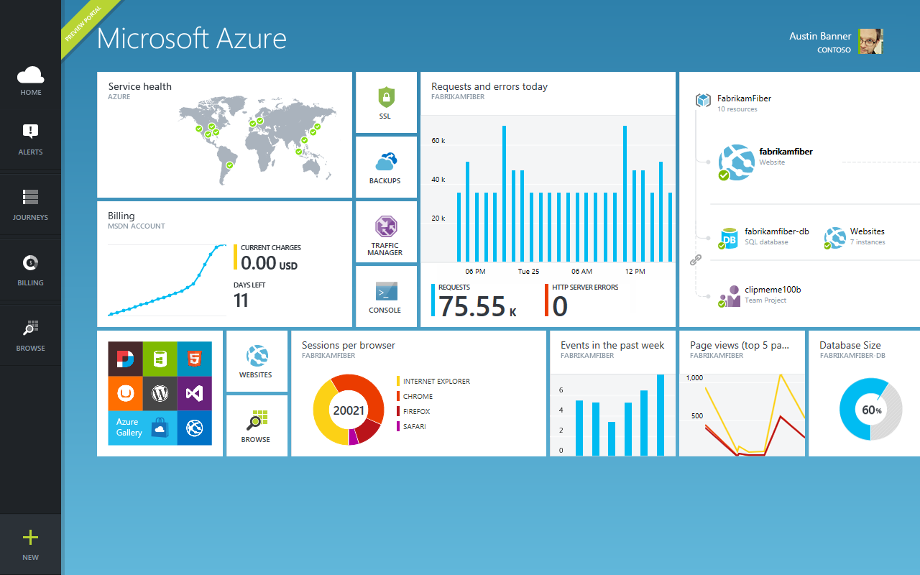
Get started
Visit azure.microsoft.com

