Slide 1
3rd Party Services Dashboard
GMAIL
CALENDAR
GITHUB
NOTION
Claude Code + MCP: Gmail · Google Calendar · GitHub · Notion → local files → one search
HW2 · AI Assisted Development of Products and Services · Prof. Rosenthal · Sruly (Israel Pollak)
Notes:
Goal: connect Claude Code to four services with MCP, download their data into a documented local format, make the download repeatable with a skill, and search everything in a local dashboard.

Slide 2
How the pieces fit together
Gmail
Google Calendar
Claude Code + MCP
4 connections
+ download-service-data skill
dataExports/
local files
metadata.json + content
index.json per service
Dashboard
HTML/CSS/JS
localhost:8000
search all services
GitHub
Notion
Downloads are read-only. The dashboard never calls the services — it only reads the local files.
Notes:
Left: the four services. Claude Code talks to each one through an MCP server. The skill writes everything to dataExports in one documented format. The dashboard is a static site served locally that only reads those files.

Slide 3
Four services, four MCP connections
Service | MCP server | Account / scope | Configured in
Notion | Official Notion MCP (mcp.notion.com) | Workspace created for this project | .mcp.json
GitHub | Official GitHub MCP (api.githubcopilot.com) | Org sruly-hw2-test, fine-grained token | .mcp.json (token via env var)
Gmail | Claude.ai Gmail connector | Test account israelpollak41@gmail.com | Claude.ai account
Google Calendar (extra) | Claude.ai Google Calendar connector | Same test account | Claude.ai account
Why Gmail and Calendar are not in .mcp.json
Google's official Gmail/Calendar MCP servers connected, but every tool call failed: the Google Cloud project must be enrolled in the Workspace Developer Preview Program (Workspace accounts only). With the professor's OK, they run through the Claude.ai connectors instead, which live in the Claude account, not in the project.
Notes:
Notion and GitHub use the vendors' official MCP servers configured in .mcp.json. Gmail and Calendar ended up on the Claude.ai connectors because Google's official MCP requires the Workspace developer preview.

Slide 4
Realistic test data with one shared story
Quillfeather Capital
A fictional fixed-income firm building DuraLens, a duration/convexity tool, for its client Bayview Teachers Pension Fund (Q4 rebalance).
12
emails
12
calendar events
Joe Smith
Portfolio Manager
Maria Delgado
Quant analyst
10 + 9
repos + issues
12
Notion pages
Priya Natarajan
DuraLens developer
Daniel Okafor
Risk manager
Rachel Stein
Client CIO (Bayview)
The same names and topics appear in every service, so one search finds related items everywhere.
Notes:
Data was created in a separate conversation and then cleared with /clear, so the download step had to find the data rather than remember it.

Slide 5
The storage format was designed first
dataExports/
├── gmail/
│ ├── index.json
│ └── 2026-10-16T0351Z_approved-bayview-trades-step-1-10y/
│ ├── metadata.json
│ └── body.txt
├── calendar/ …/metadata.json + description.txt
├── github/ <repo>/ metadata.json, README.md, issues/
└── notion/ <page>/metadata.json + content.md
1
index.json per service
A web page cannot list folders, so each service keeps a list of its items. The dashboard starts there.
2
UTC timestamps
All dates are ISO 8601 in UTC (…Z). Folder names start with the time so they sort chronologically.
3
Upsert, never duplicate
Same id → overwrite in its existing folder. New id → new folder. Nothing is ever deleted.
Specification: localStorageFormats.md · one folder per item · same pattern for all 4 services
Notes:
I wrote the specification before downloading anything, so the format is my decision, not Claude's. When Notion turned out not to return creation dates, the spec was updated: Notion indexes sort by last-edited time.

Slide 6
A skill makes the download repeatable
.claude/skills/download-service-data/SKILL.md — which connector per service, read-only rule, step-by-step procedure, upsert, final checklist
1
Create new items
2 emails, 2 events, 2 GitHub issues, 1 Notion page
2
/clear
Claude forgets the whole conversation
3
Ask plainly
“Download any new emails, calendar events, GitHub issues and Notion pages into the project.”
4
Skill runs by itself
Same format, index.json updated, no duplicates
+7 new items stored
0 duplicates
46 items total
Claude: “Account check … as the skill expects.” The query matched 11 emails; it only wrote the 2 not already stored.
Notes:
This is the test the assignment asks for: after /clear, a plain request with no mention of the skill or the format. Claude found and followed the skill on its own.

Slide 7
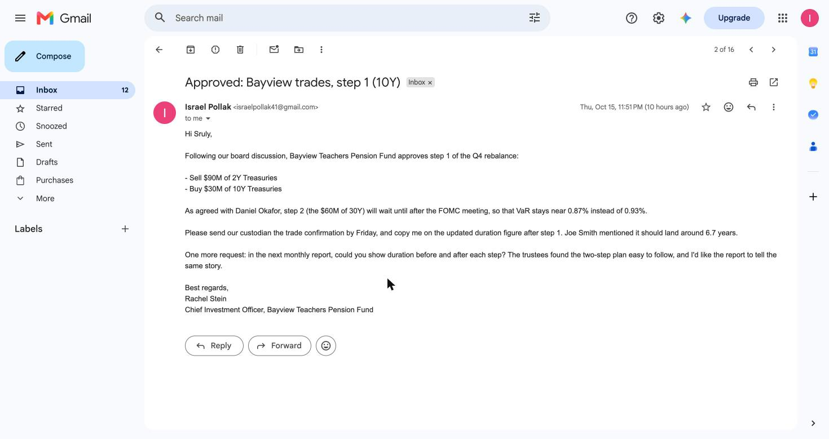
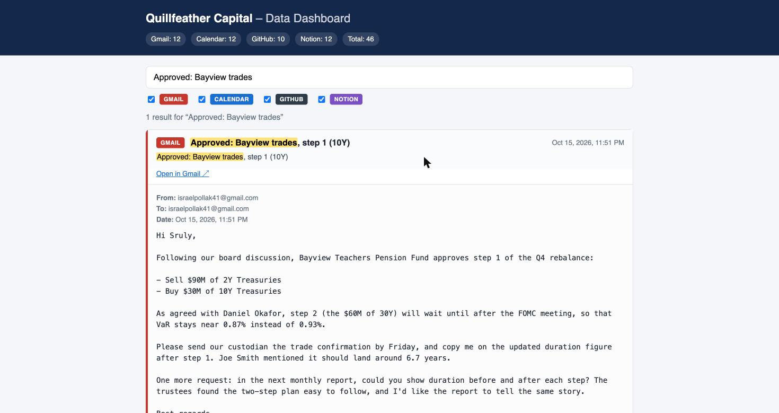
Gmail: the email and its local copy
GMAIL
Original Rachel Stein's approval in the test inbox
Dashboard same email from dataExports/gmail/…/body.txt
→
From, to, date and body are preserved exactly; the dashboard reads metadata.json + body.txt.
Notes:
Left: Gmail test account. Right: the dashboard after searching the subject. The body is identical because body.txt stores the plain text exactly as received.

Slide 8
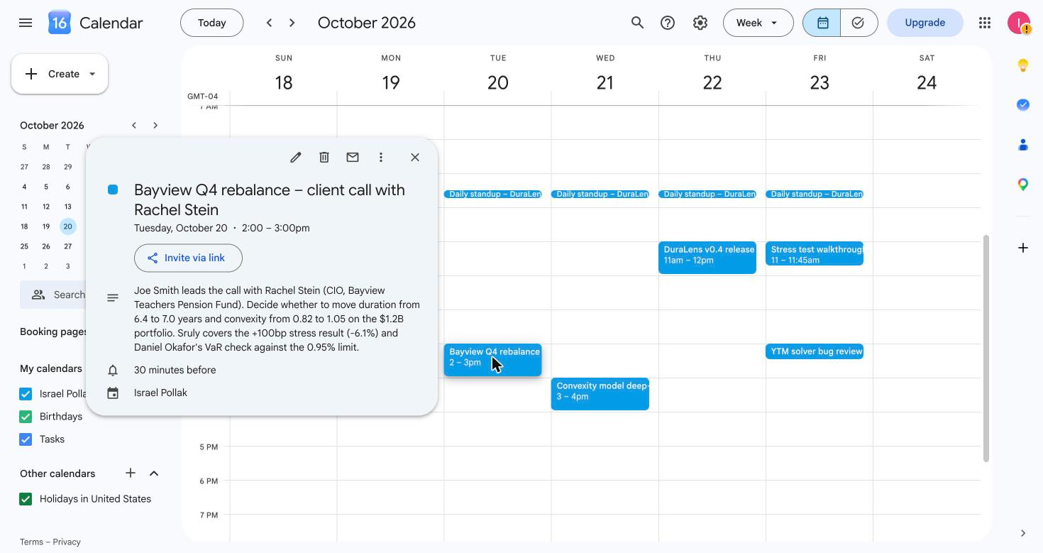
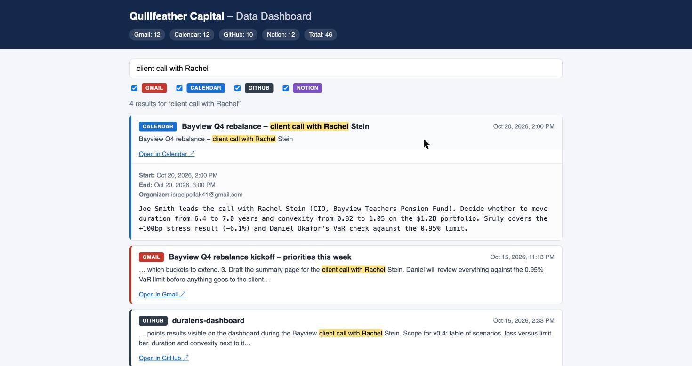
Calendar: event details survive the trip
CALENDAR
Original Bayview client call, Oct 20, 2:00–3:00 PM
Dashboard same event, start/end converted from UTC
→
Stored in UTC, shown in local time: 18:00Z in the file is 2:00 PM New York in both views.
Notes:
Times are stored in UTC in metadata.json and the dashboard converts them back to the browser's local time.

Slide 9
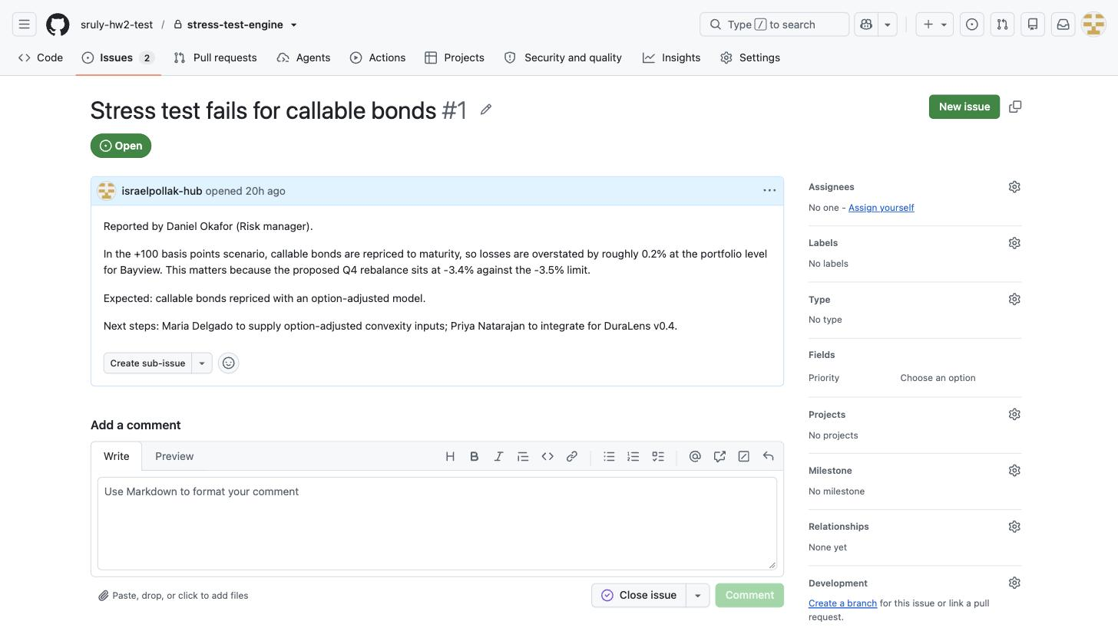
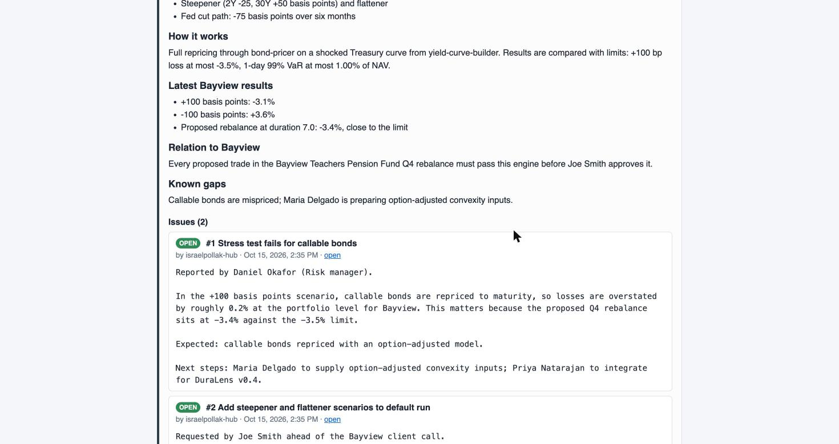
GitHub: repos and their issues
GITHUB
Original stress-test-engine issue #1
Dashboard same issue inside the repo's README view
→
Each repo folder keeps its README.md plus one JSON file per issue under issues/.
Notes:
The dashboard shows the README and then every issue of the repo, read from issues/<n>.json.

Slide 10
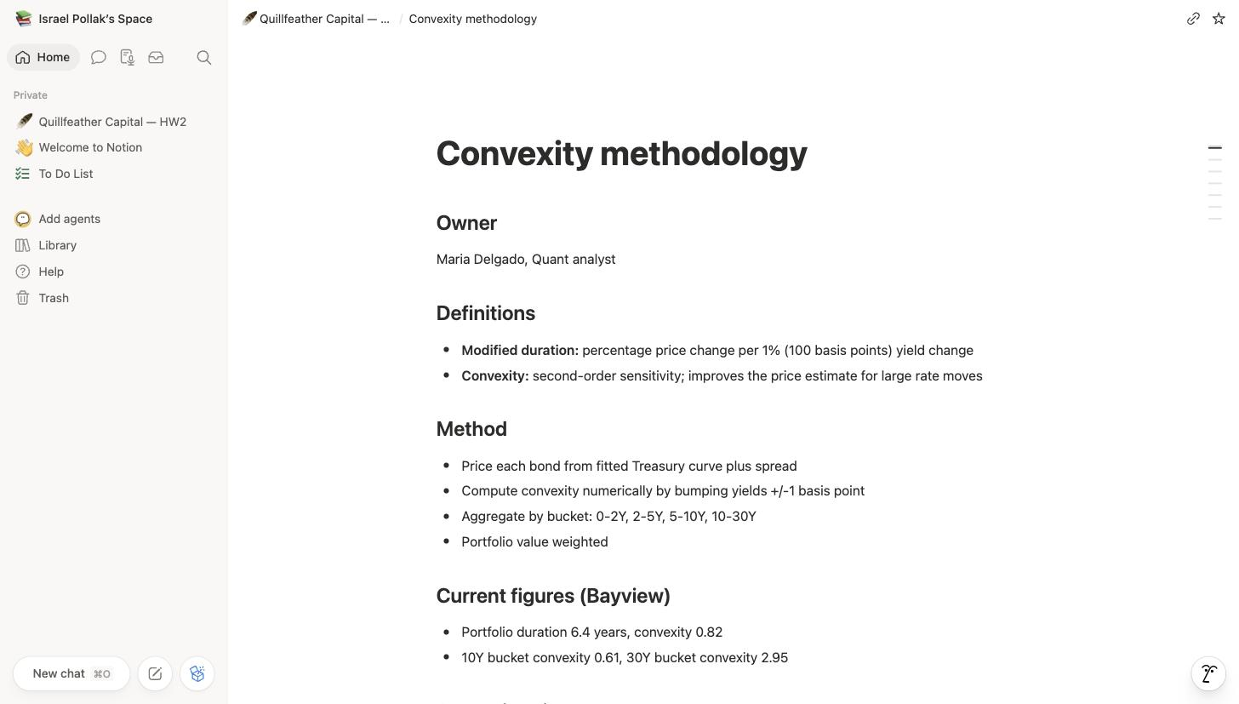
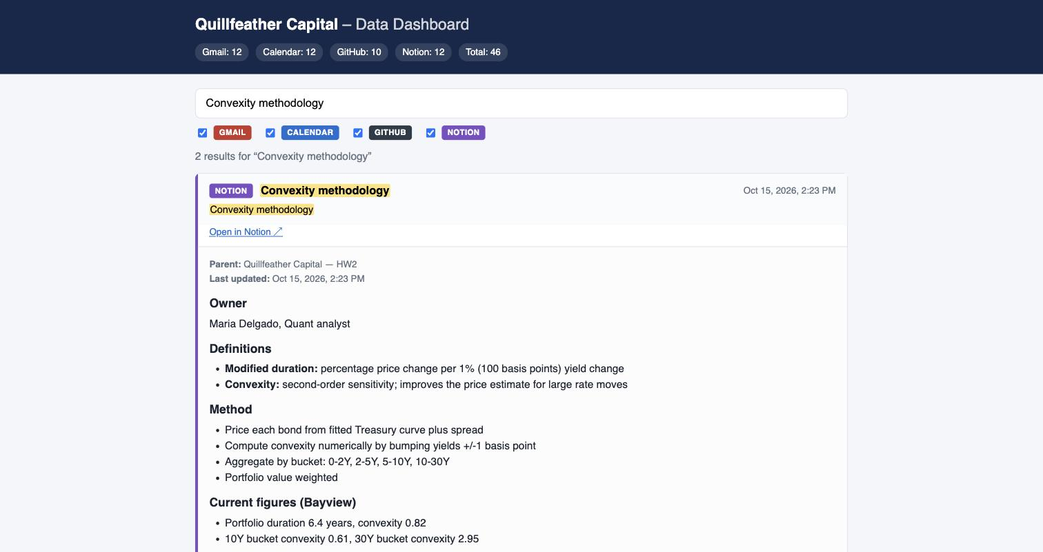
Notion: pages become Markdown
NOTION
Original “Convexity methodology” page
Dashboard same page from content.md
→
Headings, bullets and bold text survive as Markdown, with parent page and last-edited time in metadata.
Notes:
Notion content is stored as Markdown in content.md, so it is readable as a file and renders cleanly in the dashboard.

Slide 11
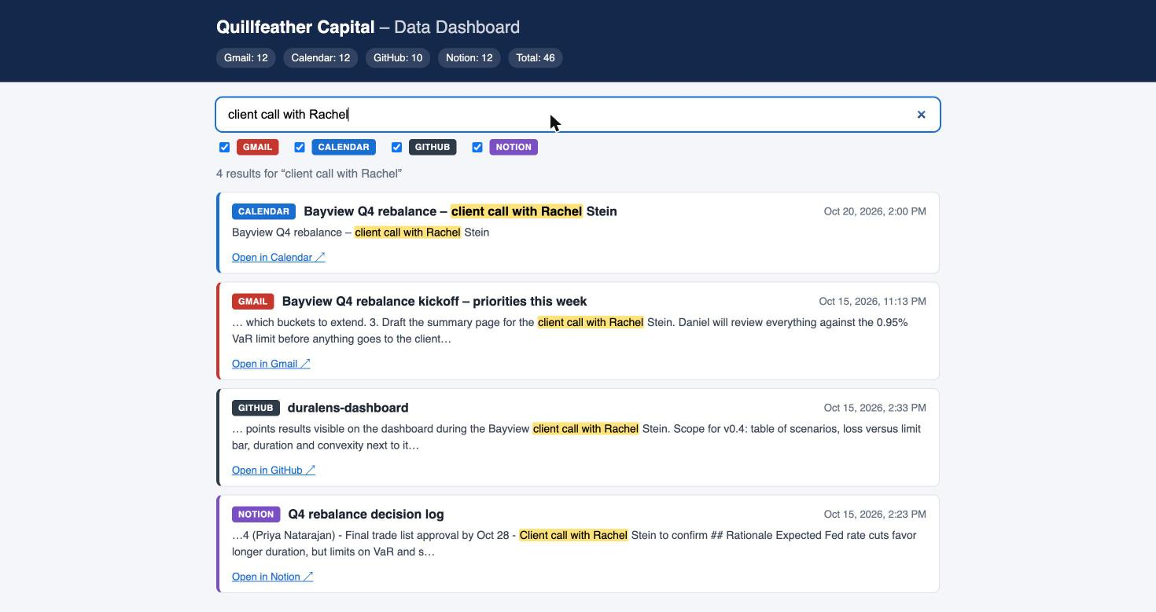
One search across all four services
“client call with Rachel”
4 results, 4 services
Every result carries a colored badge with its service, a date, a highlighted snippet and a link back to the original.
Checkboxes limit the search to one service or any combination.
Notes:
This is the main feature the assignment asks for: search across multiple services at once, with each result clearly labeled by service.

Slide 12
What I learned
Official ≠ available
Google's official MCP worked only after a preview enrollment it never got. Read the requirements before configuring.
Secrets stay off the repo
.mcp.json holds addresses; the token lives in ~/.zshrc as ${GITHUB_PAT}; .gitignore excludes local settings.
AI cannot grant itself access
Claude Code refused to edit its own permissions. The human adds the rules.
Least privilege
Read-only allow rules for downloads; the GitHub token only reaches the test organization.
Spec before data
Writing localStorageFormats.md first made Claude follow my format instead of inventing one.
Formats need iteration
Notion returns no creation date (the spec now sorts by last edit), and its parent page kept raw <page> tags (next fix).
Notes:
The biggest lessons were about access and security, not code: which servers are really usable, where secrets live, and who is allowed to grant permissions.

Slide 13
Try it
github.com/israelpollak-hub/hw2-services-dashboard
cd hw2-services-dashboard
python3 -m http.server 8000
open http://localhost:8000/dashboard/
Notes:
Clone the repo, start the local server from the project root, open the dashboard and search.

