Slide 1
8 Queen Problem

Slide 2
Parent Chromosome - 24748552
8
7
6
5
4
3
2
1

Slide 3
Parent Chromosome - 24748552
Non-Attacked – 6
Attacked – 1
8
7
6
5
4
3
2
1

Slide 4
Parent Chromosome - 24748552
Non-Attacked – 6 5
Attacked – 1 1
8
7
6
5
4
3
2
1

Slide 5
Parent Chromosome - 24748552
Non-Attacked – 6 5 4
Attacked – 1 1 1
8
7
6
5
4
3
2
1

Slide 6
Parent Chromosome - 24748552
Non-Attacked – 6 5 4 4
Attacked – 1 1 1 0
8
7
6
5
4
3
2
1

Slide 7
Parent Chromosome - 24748552
Non-Attacked – 6 5 4 4 3
Attacked – 1 1 1 0 0
8
7
6
5
4
3
2
1

Slide 8
Parent Chromosome - 24748552
Non-Attacked – 6 5 4 4 3 1
Attacked – 1 1 1 0 0 1
8
7
6
5
4
3
2
1

Slide 9
Parent Chromosome - 24748552
Non-Attacked – 6 5 4 4 3 1 1
Attacked – 1 1 1 0 0 1 0
8
7
6
5
4
3
2
1

Slide 10
Parent Chromosome - 24748552
Non-Attacked – 6 5 4 4 3 1 1 0 Total = 24
Attacked – 1 1 1 0 0 1 0 0 Total = 4
8
7
6
5
4
3
2
1

Slide 11
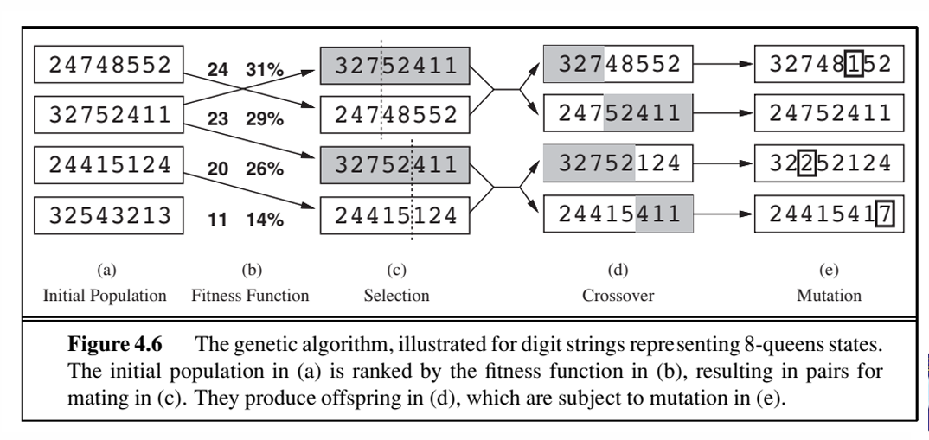
Maximum number of non-attacking pairs of queens for 8-queen :
[n*(n-1)]/2 = (8*7)/2 = 28
Non attacking for the following first state (total non attacking(28)- attacking(4)) = 24
The values (non-attacking) of the four states are 24, 23, 20, and 11.
Probability of non-attacking for the rst state: 24/(24+23+20+11) = 31%

Slide 12
24748552 = (28-4) = 24 non attack for this state.
Attack – 1+1+1+1= 4

