Slide 1
Nested Conditions
in C Programming

Slide 2
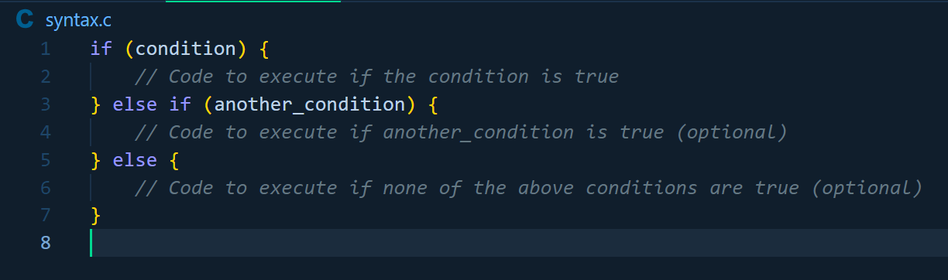
Conditional Statements Recap
Syntax:
Notes:
- Before we dive into nested conditions, let's review the basics. - In C, we have if, else if, and else statements.

Slide 3
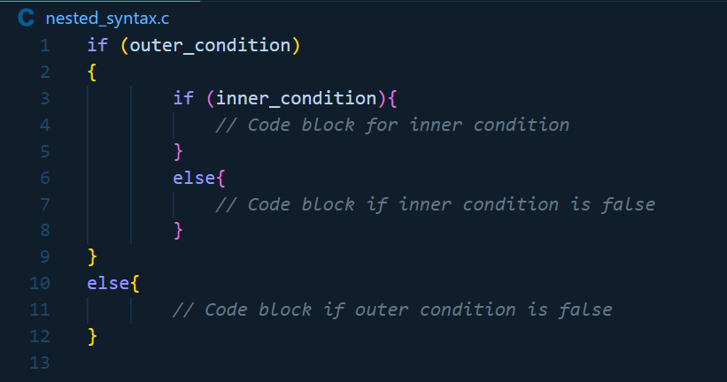
Nested Conditions
What Are Nested Conditions?
Syntax:
Notes:
Nested conditions are conditional statements inside other conditional statements. - They allow for more intricate decision-making in your programs.

Slide 4
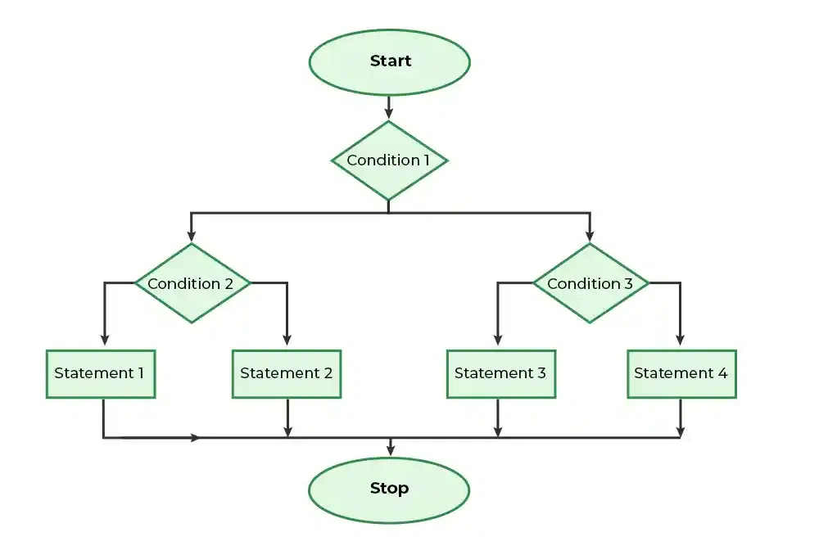
Nested if-else Statements

Slide 5
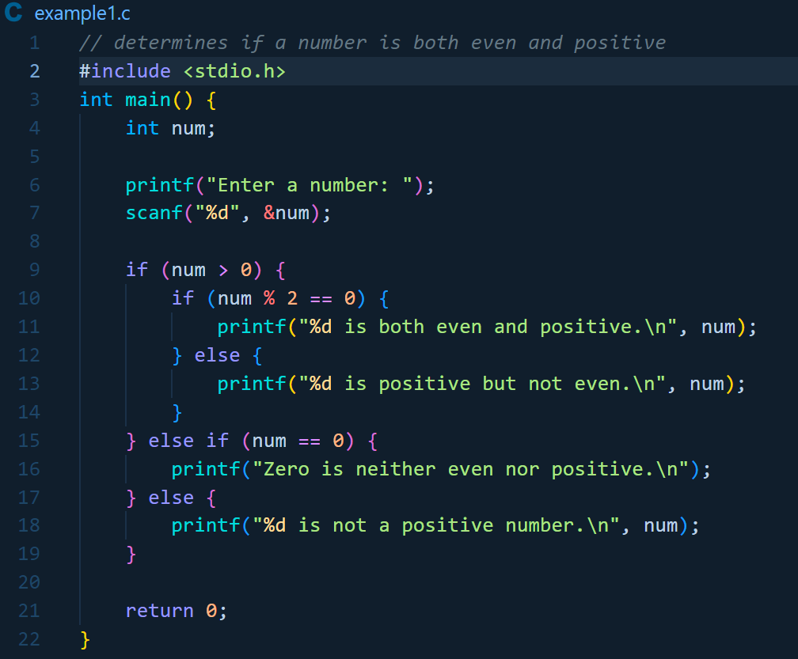
Example: Using Nested Conditions
Notes:
Here's a C program that determines if a number is both even and positive using nested if-else statements.

Slide 6
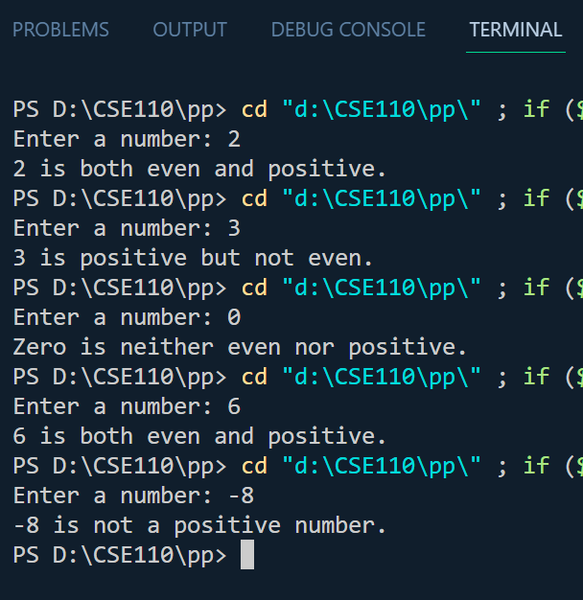
Example: Using Nested Conditions

Slide 7
Advantages of Nested Conditions
Greater control over program flow.
The ability to handle complex decision trees.
Improved readability in specific scenarios.

Slide 8
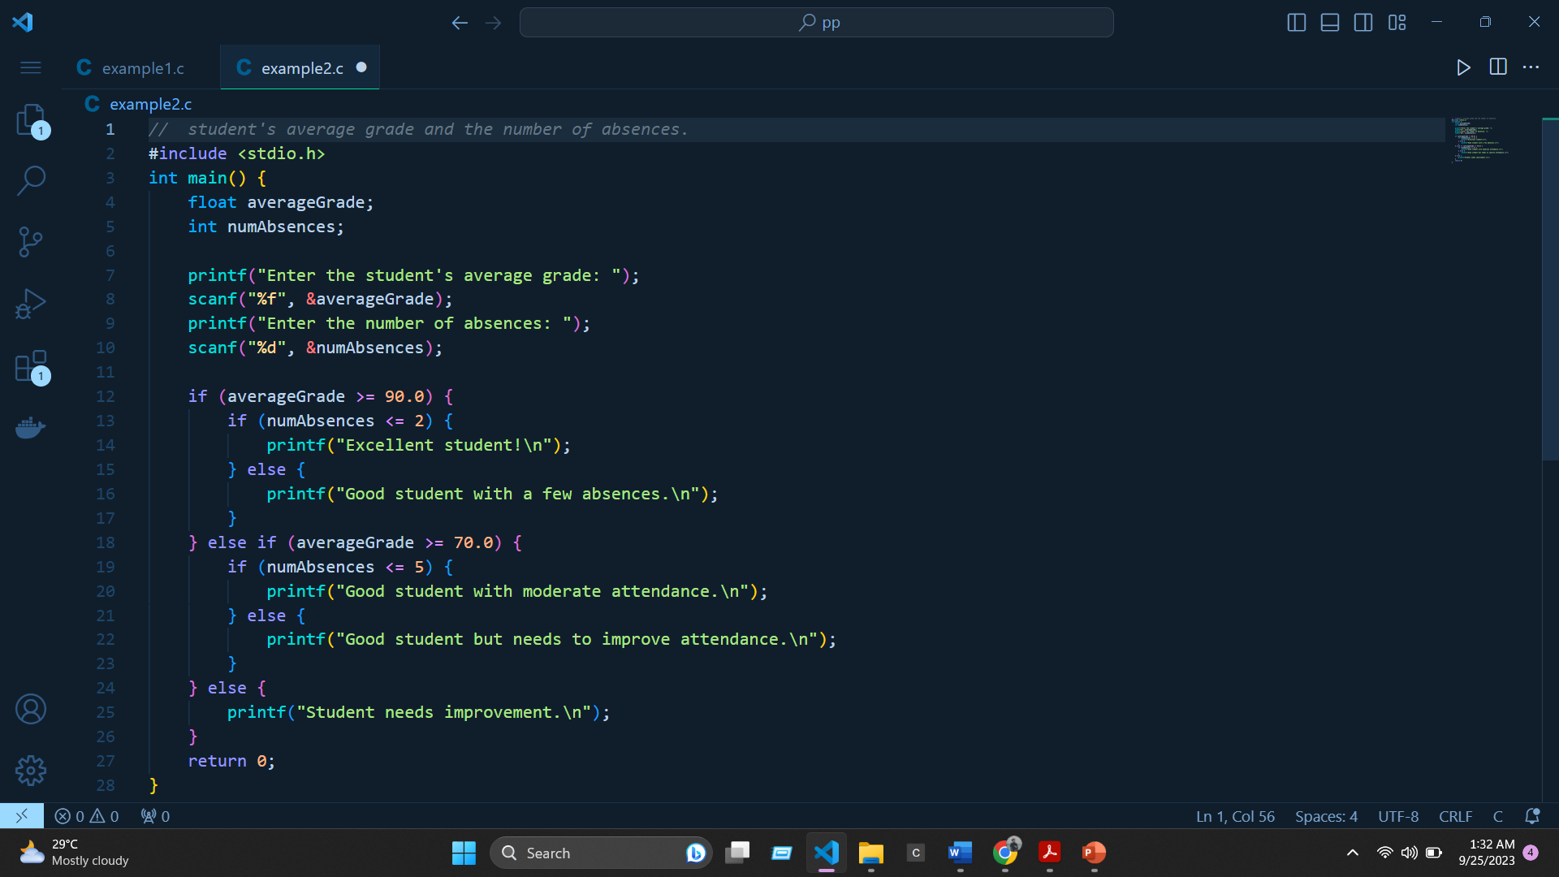
Example: Using Nested Conditions
Notes:
a program that categorizes a student's performance based on multiple criteria.

Slide 9
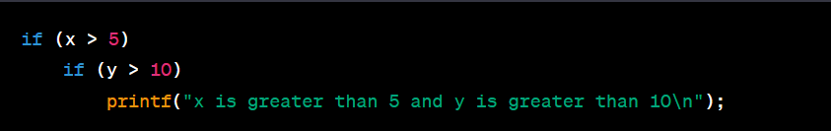
Common Mistakes
Missing Braces
Notes:
second printf statement is not actually part of the inner if condition because of the missing braces

Slide 10

Common Mistakes
Confusing Use of else if
Notes:
In this code, if x is greater than 5, the second condition will not be evaluated, which may not be the intended behavior.

Slide 11
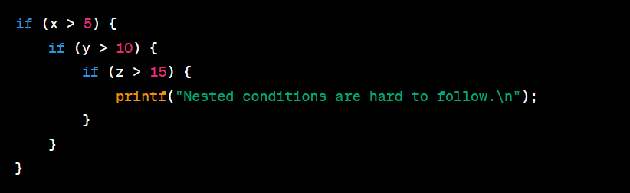
Common Mistakes
Overly Complex Nesting
Notes:
it becomes challenging to discern the logic at a glance due to excessive nesting.

Slide 12
Q&A

Slide 13
THANK YOU

