Slide 1
My First Android App
App Name : TourDeSylhet

Slide 2

Android Logo

Slide 3
What is Android?
Android is a mobile operating system developed by Google, based on a modified version of the Linux kernel and other open source software and designed primarily for touchscreen mobile devices such as smartphones and tablets

Slide 4
App Description
This app contains 15 different tourist places
Information which are located in Sylhet city or
near Sylhet .
Using Tool or IDE: Android Studio 3.2
Language for Programming : Java
Language for Designing : XML

Slide 5
Places
As its my first android app , I made it very simple . Very Simple Design , very simple code with Java. The 15 tourist places in my app are :
Hazrat _Shahjalal_Mazar _Sharif
Shahjalal_University_of_Science_and_Technology
Sylhet_Engineering_College
Sylhet_Agricultural_University
MC_College
Ali_Amjad_s_Clock
Keane_Bridge

Slide 6
Places
Osmani_Museum
Bisanakandi
Jaflong
Ratargul_Swamp_Forest
Tilagor_Eco_Park
Shimul_Garden,_Sunamganj
Tanguar_haor
Others_Spot...

Slide 7
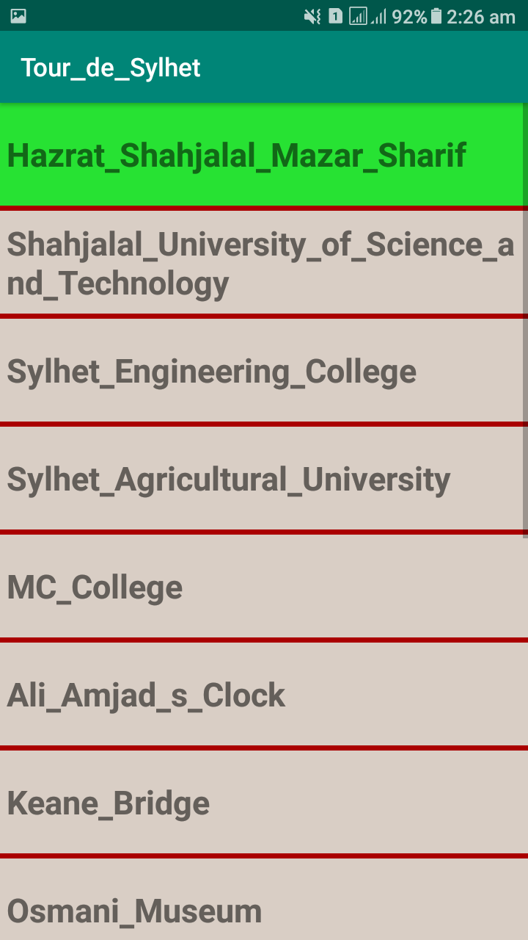
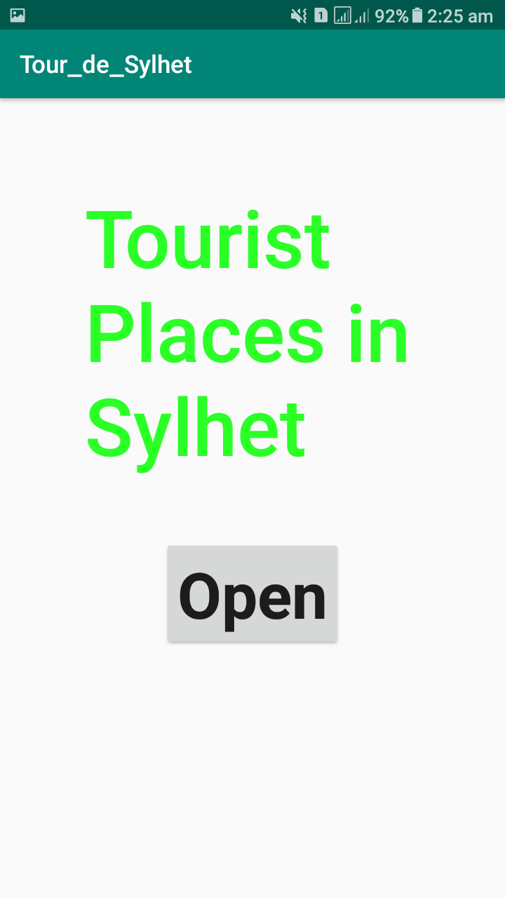
Some screenshots of my app

Slide 8
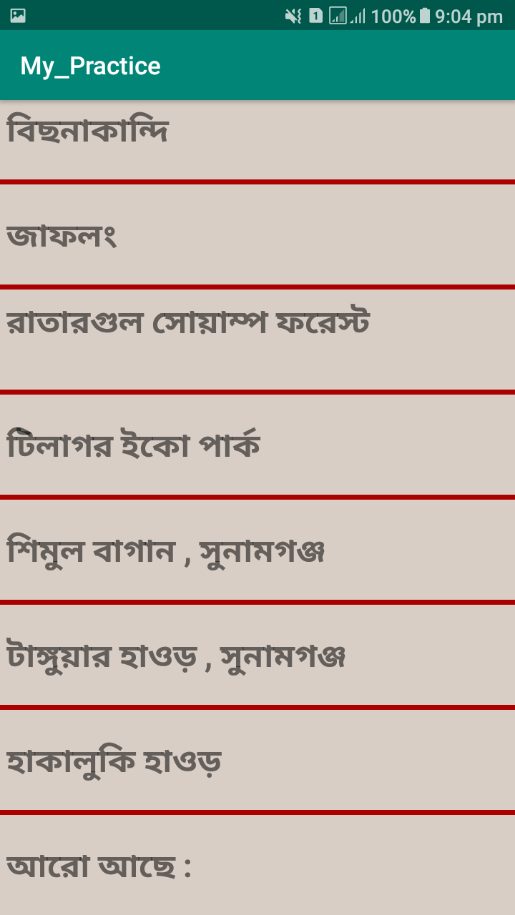
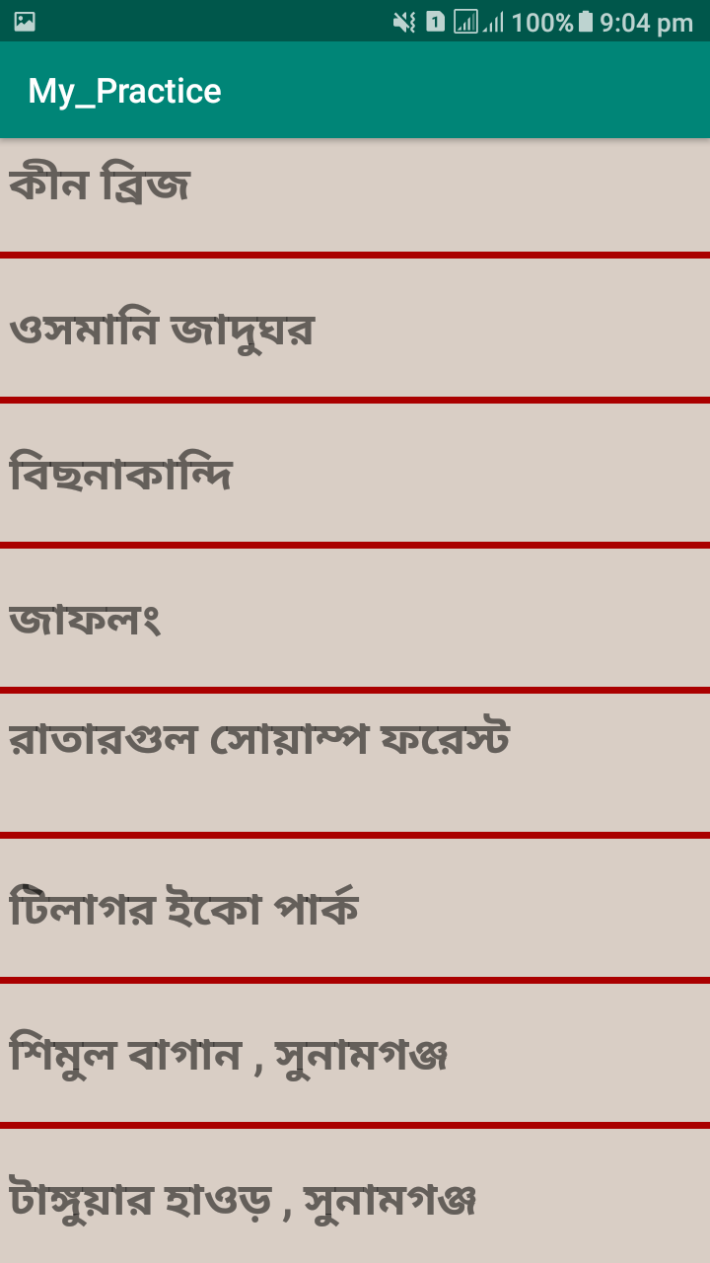
Some screenshots of my app

Slide 9
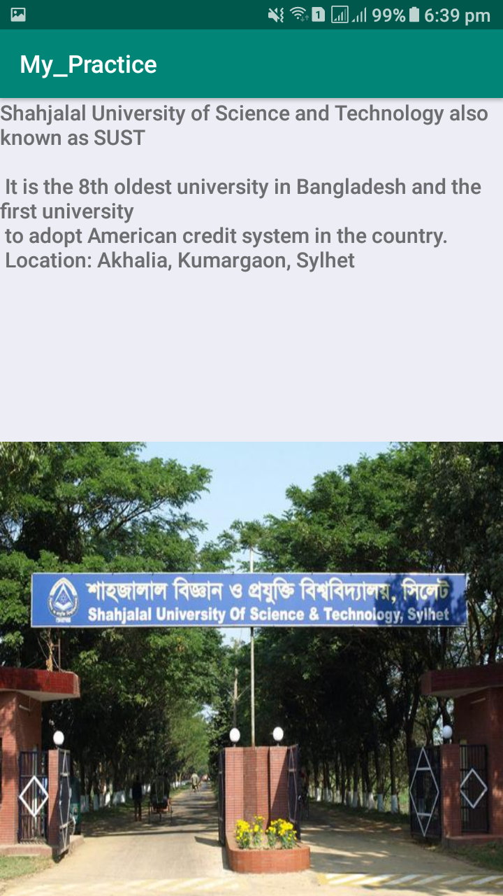
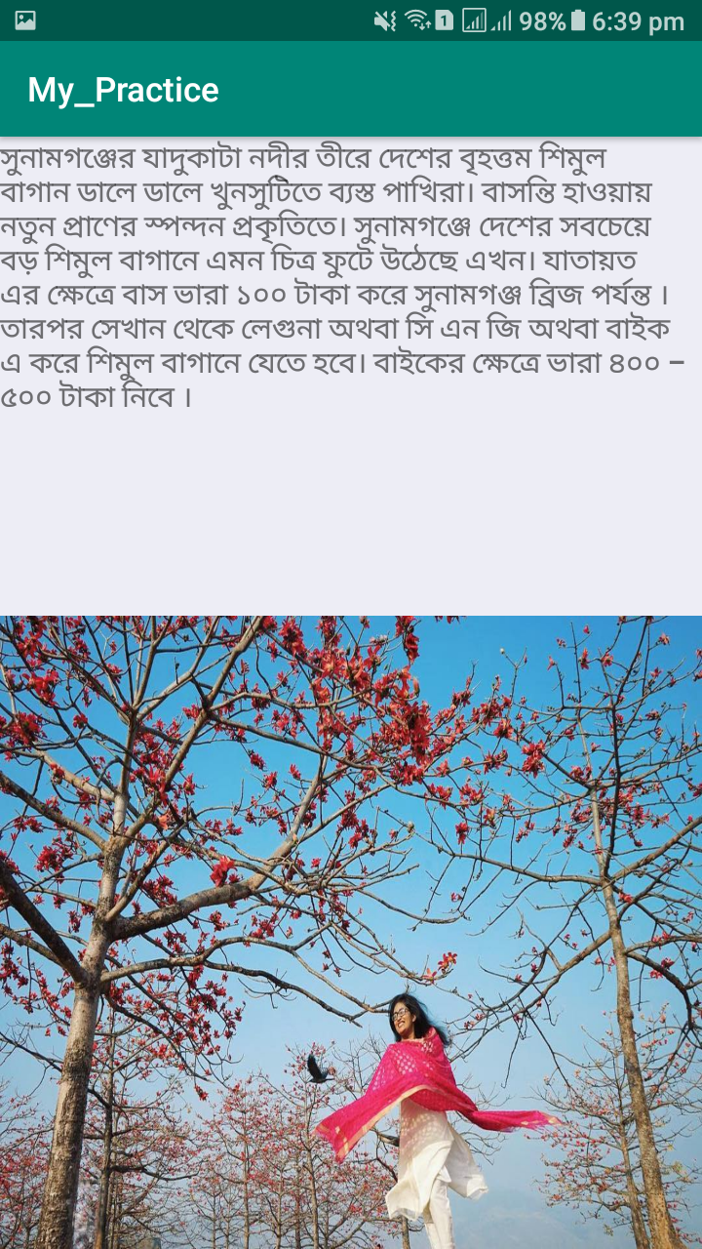
Some screenshots of my app

Slide 10
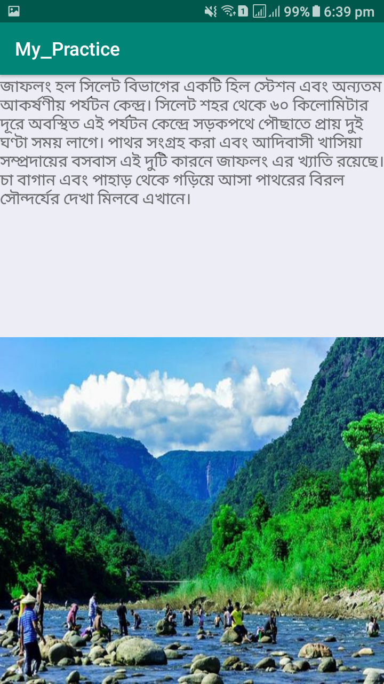
Some screenshots of my app

Slide 11
End
I hope , you will like my first app. It will be very pleasure to me , if you like it .
Thank You…….

