Slide 1

BullyShield
A Machine Learning Approach to Combat Online Bullying
Team Members:
Kazi Israrul Karim (21301509)
Eshtiak Alam Shihab (21301502)
Md Shamsur Shafi Nur E Aziz (21301432)
Instructors:
Zadid Hasan
Labib Hasan Khan

Slide 2
Purpose of BullyShield:
"BullyShield" employs AI and advanced NLP to swiftly detect and counteract online bullying. Utilizing cutting-edge machine learning models, it offers a faster and more accurate means of distinguishing harmful behavior, demonstrating transformative potential for safer and more positive digital interactions across diverse online communities.

Slide 3
Table of contents
01
Data Preprocessing
02
Model Description
03
04
Conclusion
Comparison & Analysis

Slide 4
DATA PREPROCESSING
01
Essential for Accurate and Meaningful Natural Language Processing (NLP) Results.

Slide 5
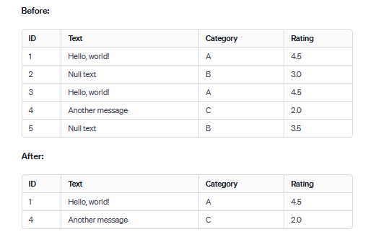
Step: 01
Objective: Removing Duplicates and Null Values
Reason: Duplicates and null values can distort analysis and lead to biased results.

Slide 6
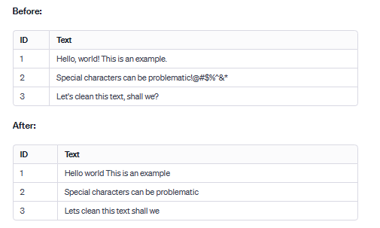
Step: 02
Objective: Removing Punctuation and Special Characters
Reason: Punctuation and special characters are often extraneous and can introduce noise in text analysis

Slide 7
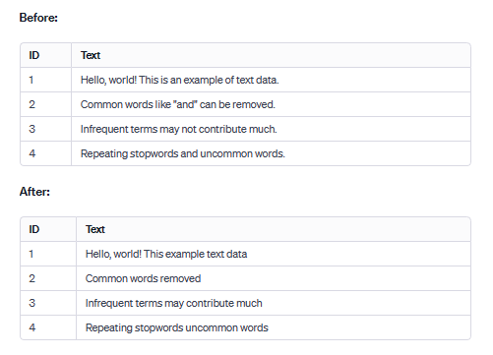
Step: 03
Objective: Removing Stop words and Least Frequent Words
Stopwords:
Excluding common words like "and" or "the" focuses on essential content by removing text elements with minimal contribution.
Least Frequent Words:
By eliminating words with low frequencies, noise is reduced, and the significance of remaining terms is enhanced for better analysis..

Slide 8
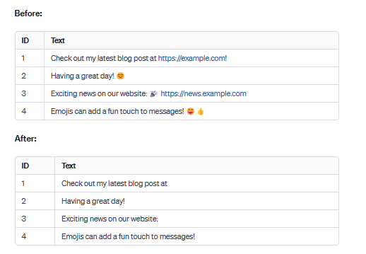
Step: 04
Objective: Removing URLs and Emojis
URLs:
Reason: URLs add noise and are often irrelevant to the text's meaning.
Emojis:
Reason: Emojis can be subjective and lack standardized meanings.

Slide 9
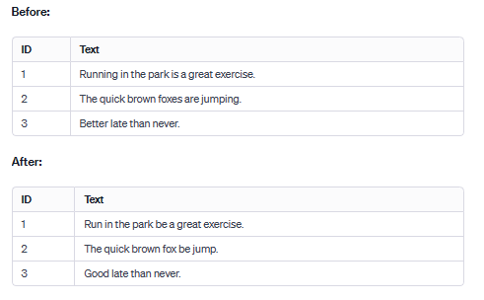
Step: 05
Lemmatization:
Objective: Reducing words to their base or dictionary form (lemma).
Example: "running" -> "run," "better" -> "good."
Result: Lemmatized words are valid words and provide a more meaningful representation

Slide 10
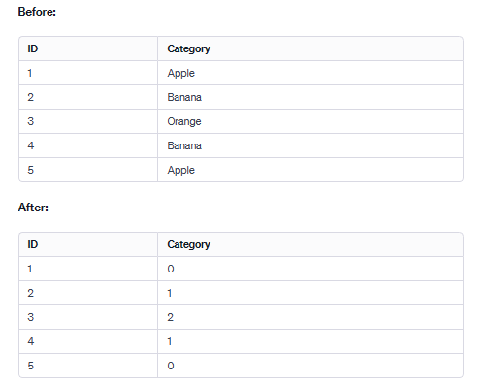
Step: 05
Objective: Label Encoding
Reason: Converting categorical labels to numerical format enables machine learning models to interpret and learn from the data

Slide 11
Step: 06
Objective: Feature Extraction
Reason: Converting categorical labels to numerical format enables machine learning models to interpret and learn from the data

Slide 12
Model
Evaluation
03
Analyzing Accuracy, Recall, and Classification Metrics Across Multiple Models

Slide 13
Logistic Regression
Utilizes a logistic function to model binary outcomes and can be extended to multiclass classification using techniques like one-vs-rest (OvR) or multinomial logistic regression.
Coefficients can be interpreted to understand the importance of each feature.
Can be regularized (L1, L2) to address overfitting and handle high-dimensionality.
Benefits: Efficiently handles large datasets and multiclass problems. Often applied in spam detection and sentiment analysis.

Slide 14
LogReg: Accuracy
TFIDF
BOW
Accuracy: 83.0%
Accuracy: 82.0%

Slide 15
LogReg: Evaluation
TFIDF
High accuracy and balanced performance (83%): effective in correctly predicting labels; balanced precision, recall, and f1-score
Strength in Identifying Age, Ethnicity, and Religion: precision and recall scores in "Age," "Ethnicity," and "Religion" categories (all above 0.93)
Balanced discrimination in Gender and Not Cyberbullying categories: Balanced precision and recall in "Gender" (0.91 and 0.84) and "Not Cyberbullying" (0.60 and 0.56); false positives minimized
Effective handling of Other Cyberbullying category: Achieved balanced precision and recall (0.59 and 0.65)
Consistent macro and weighted averages (82%): indicating the model's reliability and balanced performance across diverse categories

Slide 16
LogReg: Evaluation
BOW
High Overall Accuracy (82%)
Consistent high precision in key categories: "Age" (97%), "Ethnicity" (98%), and "Religion" (97%)
Balanced discrimination in "Gender" and "Not Cyberbullying": balanced precision and recall in "Gender" (91% and 85%) and "Not Cyberbullying" (57% and 57%); false positives minimized
Effective handling of "Other Cyberbullying" category: balanced precision and recall (58% and 64%) in "Other Cyberbullying" category
Consistent macro and weighted averages (83%): indicating the model's reliability and balanced performance across diverse categories.

Slide 17
KNN for Classification
Predicts the class of a data point based on the majority class of its 'K' nearest neighbors.
Distance metrics (e.g., Euclidean, Manhattan) measure proximity to neighbors.
Chooses 'K' for the number of neighbors to consult for determining the class.
Sensitive to the scale of data; preprocessing like normalization is often required.
Benefits: Simple and intuitive, no assumption on data distribution, effective for small datasets.

Slide 18
KNN: Accuracy
IFIDF
BOW
Accuracy: 27.2%
Accuracy: 70.4%

Slide 19
KNN: Evaluation
TFIDF
Challenges in "Religion", "Age" and "Other Cyberbullying" categories: low recall in "religion" (14%), "age" (26%) and "other_cyberbullying" (5%)
Limited discrimination in "Gender" and "Ethnicity" categories: precision-recall trade-off in "gender" (16% precision, 0.27 f1-score) and "ethnicity" (8% precision, 0.14 f1-score) indicates difficulty in distinguishing instances
Imbalanced prediction for "Not Cyberbullying": High recall (96%) but low precision (18%) suggests a high rate of false positives
Overall limited accuracy: model's overall accuracy is low (27%)

Slide 20
KNN: Evaluation
BOW
High precision in "Religion" Category (94%)
Challenges in "Age" and "Gender" Categories: Precision and recall are relatively high for "age"; recall for "gender" is 72%
Low precision in "Not Cyberbullying" (38%) and "Ethnicity" Categories (41%): higher rate of false positives so needs improvement
Imbalanced performance in "Other Cyberbullying": High precision (99%) but lower recall (71%) in "other_cyberbullying" suggests a need to balance model performance for this category
Overall moderate performance: moderate overall accuracy (70%) and balanced macro and weighted averages for precision, recall, and f1-score (around 72-75%)

Slide 21
Naive Bayes
Applies Bayes' theorem with the "naive" assumption of independence between every pair of features.
Can handle discrete and continuous data by choosing appropriate distributions (e.g., Bernoulli, Gaussian).
Works well with high-dimensional datasets and is computationally efficient.
Benefits: Efficiently handles large datasets and multiclass problems. Often applied in spam detection and sentiment analysis.

Slide 22
Naive Bayes: Accuracy
TFIDF
BOW
Accuracy: 76.0%
Accuracy: 77.0%

Slide 23
Naive Bayes: Evaluation
TFIDF
High Accuracy (76%)
Challenges in "Not Cyberbullying" category: Lower precision (67%) and recall (35%)
Balanced discrimination in "Age," "Ethnicity," and "Gender" categories: balance between precision and recall in "Age" (70% precision, 99% recall), "Ethnicity" (84% precision, 90% recall), and "Gender" (83% precision, 86% recall)
Moderate performance in "Other Cyberbullying" category: precision (65%) and recall (47%)
Consistent macro and weighted averages (73%): indicates the model's overall reliability and balanced performance across diverse categories

Slide 24
Naive Bayes: Evaluation
BOW
High accuracy (77%)
Challenges in "Not Cyberbullying" category: lower precision (68%) and recall (36%); challenges in effectively identifying instances in this group
Balanced performance in key categories: precision and recall in key categories like "Age" (74% precision, 99% recall), "Ethnicity" (85% precision, 92% recall), and "Gender" (83% precision, 86% recall)
Moderate Improvement in "Other Cyberbullying" Category:
Shows a slight improvement in precision (65%) and recall (51%) compared to the Naive Bayes (tf/idf)
Consistent macro and weighted Averages (75%):indicating the model's continued reliability and balanced performance across diverse categories.

Slide 25
SVM for Classification
Seeks optimal hyperplane to separate classes with maximum margin.
Uses support vectors to define the boundary.
Employs kernel trick for non-linear data (e.g., Linear, RBF). Kernel functions handle non-linear text feature spaces.
Kernel functions handle non-linear text feature spaces.
Benefits: Effective in high dimensions, memory efficient with kernel functions.

Slide 26
SVM: Evaluation
TFIDF
SVM with TF-IDF achieves an 82% accuracy, indicating a robust capability in identifying instances of cyberbullying.
Noteworthy variations in precision and recall. High proficiency in discerning age, ethnicity, and religion-related bullying, but challenges in not_cyberbullying and other_cyberbullying categories.
Macro and weighted average F1-scores, both at 0.82, underscore a balanced performance across diverse bullying categories.

Slide 27
SVM: Evaluation
BoW
SVM with Bag-of-Words (BoW) achieves an 83% accuracy, indicating a slight improvement over the TF-IDF approach.
Similar precision and recall trends. Strong performance in age, ethnicity, and religion-related bullying. Improvement in not_cyberbullying, but other_cyberbullying sees a notable boost.
Macro and weighted average F1-scores maintain at 0.83, ensuring a consistent and balanced evaluation across diverse bullying categories.

Slide 28
Random Forest
Ensemble method combining multiple decision trees.
Each tree trained on random subsets of data with bootstrap aggregating.
Handles high-dimensional text data effectively.
Aggregates predictions to improve linguistic pattern recognition.
Benefits: Robust to overfitting and maintains accuracy with diverse data. Also useful for sentiment analysis and topic classification.

Slide 29
RF: Evaluation
TFIDF
Random Forest with TF-IDF achieves an 82% accuracy, aligning closely with SVM with TF-IDF.
Similar trends in precision and recall. Strong performance in age, ethnicity, and religion-related bullying. Challenges persist in not_cyberbullying and other_cyberbullying categories.
Both F1-scores stand at 0.82, indicating a stable and balanced model performance across different bullying types.

Slide 30
RF: Evaluation
BoW
Random Forest with Bag-of-Words (BoW) maintains an 81% accuracy, demonstrating a consistent performance across models.
Similar precision and recall patterns. Strong identification of age, ethnicity, and religion-related bullying. Challenges persist in not_cyberbullying and other_cyberbullying categories, mirroring the TF-IDF counterpart.
Macro and weighted average F1-scores remain at 0.81, indicating a reliable and balanced performance for diverse bullying types.

Slide 31
XGBOOST (eXtreme Gradient Boosting)
Optimized gradient boosting library for performance and speed.
Captures complex language patterns through sequential model refinement.
Regularization controls overfitting, crucial for text data variance.
Efficiently manages sparse data, common in text representations.
Benefits: Enhances performance in text classification and sentiment analysis tasks.

Slide 32
XGBoost: Evaluation
TFIDF
XGBoost with TF-IDF achieves the highest accuracy at 84%, showcasing superior performance among the models.
Strong precision and recall across various categories. Particularly noteworthy in accurately identifying age, ethnicity, and religion-related bullying.
Macro and weighted average F1-scores stand at 0.84, emphasizing the consistent and superior performance of XGBoost in diverse bullying categories.

Slide 33
XGBoost: Evaluation
BoW
XGBoost with Bag-of-Words (BoW) maintains a high accuracy of 84%, matching its TF-IDF counterpart.
Strong precision and recall, particularly excelling in identifying age, ethnicity, and religion-related bullying. Challenges persist in not_cyberbullying, though an improvement is noted compared to the TF-IDF version.
Both macro and weighted average F1-scores remain at 0.84, underlining the consistent and exceptional performance of XGBoost across diverse bullying categories.

Slide 34
Model Selection and Decision Making
04
Informed Choices Based on Comparative Analysis

Slide 35
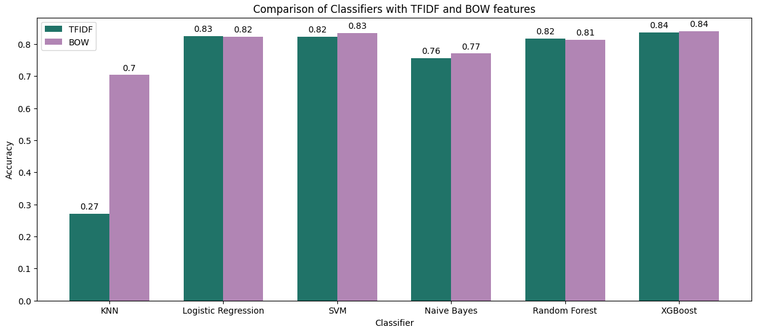
Comparison

Slide 36
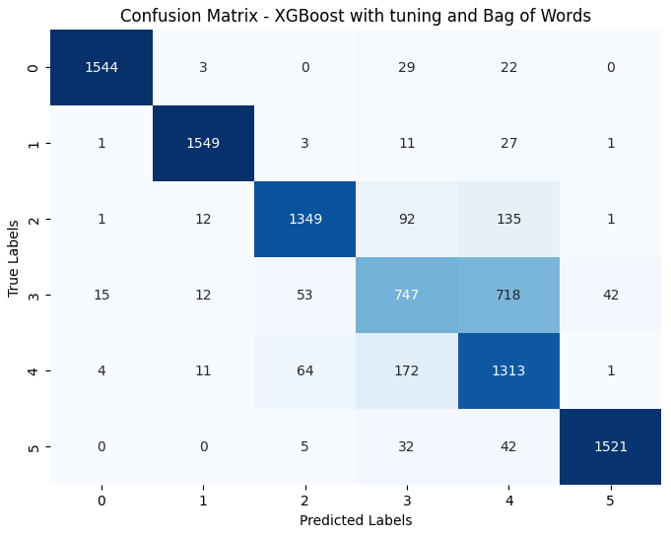
Post Optimization for XGBoost with BoW

Slide 37
Thanks!
Presented By ~ 21301509 - Kazi Israrul Karim
21301432 - Md Shamsur Shafi Nur E Aziz
21301502 - Eshtiak Alam Shihab

