Slide 1
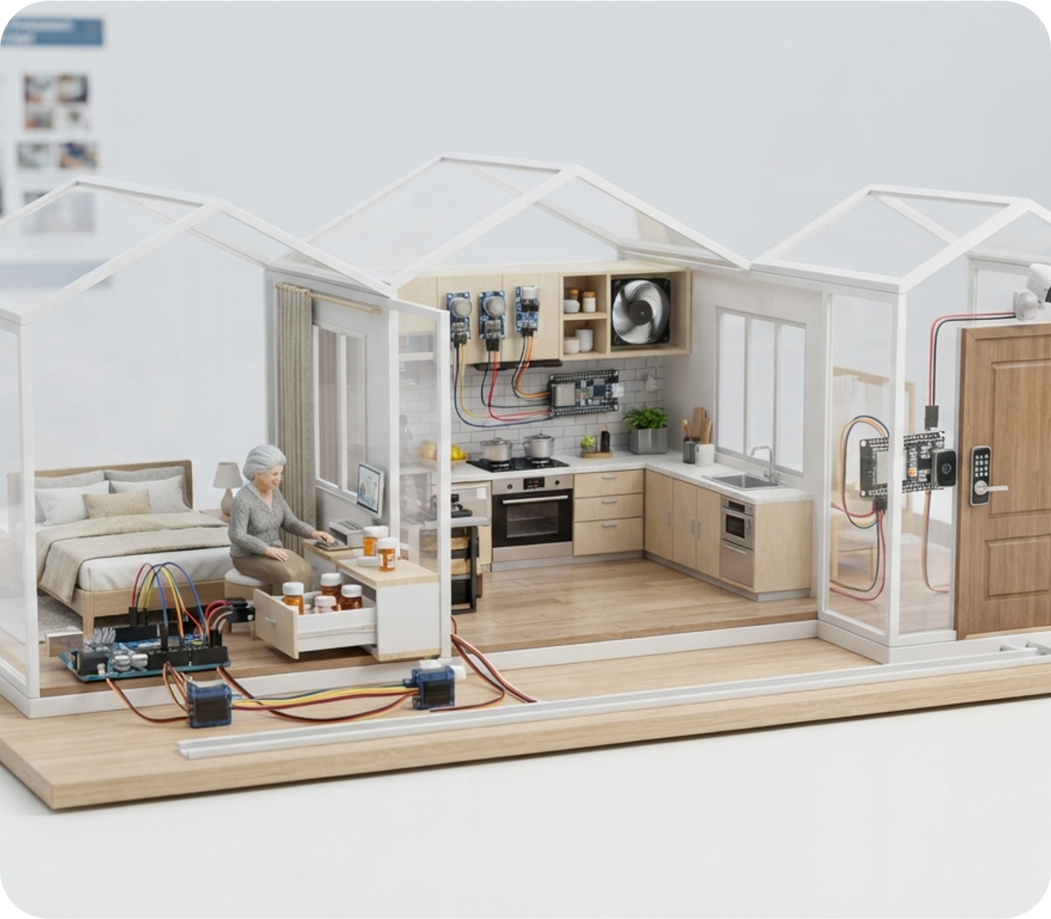
ELDERLY SAFETY · IoT PROTOTYPE
Smart Independent
Living Assistant
A low-cost, integrated smart-home system that helps elderly people
live safely and independently.

Slide 2

Team: Micro Minds
01
Maisha Tabassum (0112230333)
02
Mohiuddin Nafees (0112230322)
03
Mehnaz Fatima (0112230937)
04
Israt Jahan Rani (011201376)
05
Robiul Islam Tamim (011212039)
SMART CARE IoT
01

Slide 3
AGENDA
What we'll cover
01
Project Idea
05
Core Safety Features
02
Problem Statement
06
Expected Outcomes
03
Novelty & Improvements
07
Challenges & Solutions
04
System Components
08
Conclusion
SMART CARE IoT
02

Slide 4





PROJECT IDEA
Concept at a glance
A smart-home IoT prototype designed to help elderly people live more safely and independently. The system monitors medication, kitchen hazards, door security, and emergencies — responding automatically or notifying a caregiver when needed.
CORE CONCEPT
Sense
Decide
Action
Notify
Sense → Decide → Action → Caregiver Notification
SMART CARE IoT
03

Slide 5





PROBLEM STATEMENT
Everyday risks for elderly living alone
Forgetting to take medicine on time, or missing a dose
Gas leaks, smoke, or fire accidents in the kitchen
Unauthorized people attempting to enter the home
Falling or becoming injured with no one nearby to help
Caregivers cannot continuously monitor the elderly person
PROBLEM WE ADDRESS
How can IoT technology provide continuous safety monitoring and automatic assistance for elderly people, while reducing their dependence on caregivers?
SMART CARE IoT
04

Slide 6


NOVELTY
How this system improves on existing solutions
EXISTING SYSTEMS
OUR IMPROVEMENT
Usually focus on one or two elderly-care functions
Medicine compliance: 5–10 min dose window + missed-dose alert
Smart security: repeated unauthorized attempts trigger intruder alert + image
Most medicine systems provide only reminders
Automatic emergency: fall detection plus manual SOS
Emergency systems often depend on manual SOS
One integrated system: four safety features, one low-cost smart home
SMART CARE IoT
05

Slide 7


SYSTEM COMPONENTS
Hardware, software, and materials
Sensors
Controllers
Outputs
Software
DS3231 RTC
MQ-2 Gas Sensor
Flame Sensor
PIR Sensor
RFID RC522
Reed Switch
Fall Sensor (MPU6050)
SOS Button
Arduino UNO
ESP32
ESP32-CAM
Servo Motors
DC Fan
OLED Display
Buzzer
RGB / Colored LEDs
Relay Module
Arduino IDE
Embedded C/C++
ESP32 Wi-Fi
SMART CARE IoT
06

Slide 8
CORE SAFETY FEATURES · 1 OF 2
Medicine compliance & kitchen safety
Feature 1 — Smart Medicine Compliance
INFORMATION
DECISION
ACTION & SOLUTION
RTC + reed switch track time and drawer status.
Medicine time reached → unlock correct drawer → start 5–10 min timer.
Servo unlocks drawer; OLED + buzzer remind user. Not opened → relock + missed-dose alert.
Feature 2 — Kitchen Safety
INFORMATION
DECISION
ACTION & SOLUTION
MQ-2 + flame sensor detect gas, smoke, or flame.
Reading exceeds safe threshold, or flame is detected.
Servo closes gas valve, fan turns on, buzzer + red LED activate, OLED shows warning.
SMART CARE IoT
07

Slide 9

CORE SAFETY FEATURES · 2 OF 2
Door security & fall / emergency detection
Feature 3 — Smart Door Security
INFORMATION
DECISION
ACTION & SOLUTION
PIR + RFID + reed switch + camera monitor the entrance.
Authorized RFID → allow entry. Unauthorized or repeated attempts → intruder mode.
Servo controls the lock, alarm activates, camera captures the intruder, ESP32 alerts the caregiver.
Feature 4 — Fall & Emergency Detection
INFORMATION
DECISION
ACTION & SOLUTION
Fall sensor + SOS button detect abnormal movement or a manual press.
Fall detected, or SOS pressed → emergency mode activated.
Buzzer sounds, red LED flashes, OLED shows EMERGENCY, ESP32 notifies the caregiver.
SMART CARE IoT
08

Slide 10






EXPECTED OUTCOME
What the system delivers
Safer, independent living for elderly people
Reduced risk of missed medication
Automatic kitchen hazard response
Improved home security
Automatic fall / emergency assistance
Remote caregiver notification
LOW-COST | INTEGRATED | ELDERLY-FOCUSED SMART HOME
SMART CARE IoT
09

Slide 11




CHALLENGES & SOLUTIONS
Building this responsibly, at low cost
Cost Constraints
Sensor Reliability
Connectivity & Power
User Adoption
Keeping components affordable.
Avoiding false alarms or missed detections.
Wi-Fi drops or power interruptions.
Comfort with new technology.
SOLUTION
SOLUTION
SOLUTION
SOLUTION
Low-cost sensors and open-source Arduino / ESP32 platforms.
Multi-sensor confirmation and tuned safety thresholds.
Local fallback logic plus backup power for core functions.
Simple OLED / buzzer interface and a caregiver-friendly app.
SMART CARE IoT
10

Slide 12
CONCLUSION
A safer, more independent everyday life
This project brings together medicine reminders, kitchen hazard response, door security, and fall detection into a single, low-cost smart-home system built on Arduino and ESP32.
By automating routine safety checks and notifying caregivers only when needed, it reduces daily risk for elderly people while easing the burden on the people who care for them.
Next steps focus on field-testing the prototype with real households and refining sensor thresholds to further cut false alarms.
4
24/7
1
Integrated safety
features
Continuous
monitoring
Low-cost
smart-home unit
SMART CARE IoT
11

Slide 13
Thank You
Questions and feedback are welcome.

