Slide 1

QAF-Net: Federated, Quantized Brain Tumour MRI Classification
Digital Image Processing project, United International University
Department of Computer Science and Engineering, Dhaka, Bangladesh
Samsad Ibne Shakhawat
Israt Jahan Rani
Robiul Islam Tamim
Most. Jaynabunnessa Rumi
Privacy-preserving training, integer-only inference, and a new hospital the model has never seen.
sshakhawat221407@bscse.uiu.ac.bd
This card presents the project title, team members, and institutional affiliation. The core contribution addresses three simultaneous real-world constraints: data privacy, hardware limitations, and domain generalization to unseen hospitals.

Slide 2


The Problem Is Not Accuracy
Published CNNs report over 98% accuracy on public data.
Deployed systems remain rare in low-resource hospitals.
Three constraints hold at once: data cannot leave; no GPU; unseen scanner.
Each constraint is usually studied alone. We studied them together.
A random split of one dataset measures in-distribution performance, not what a new hospital gets on day one.

Slide 3
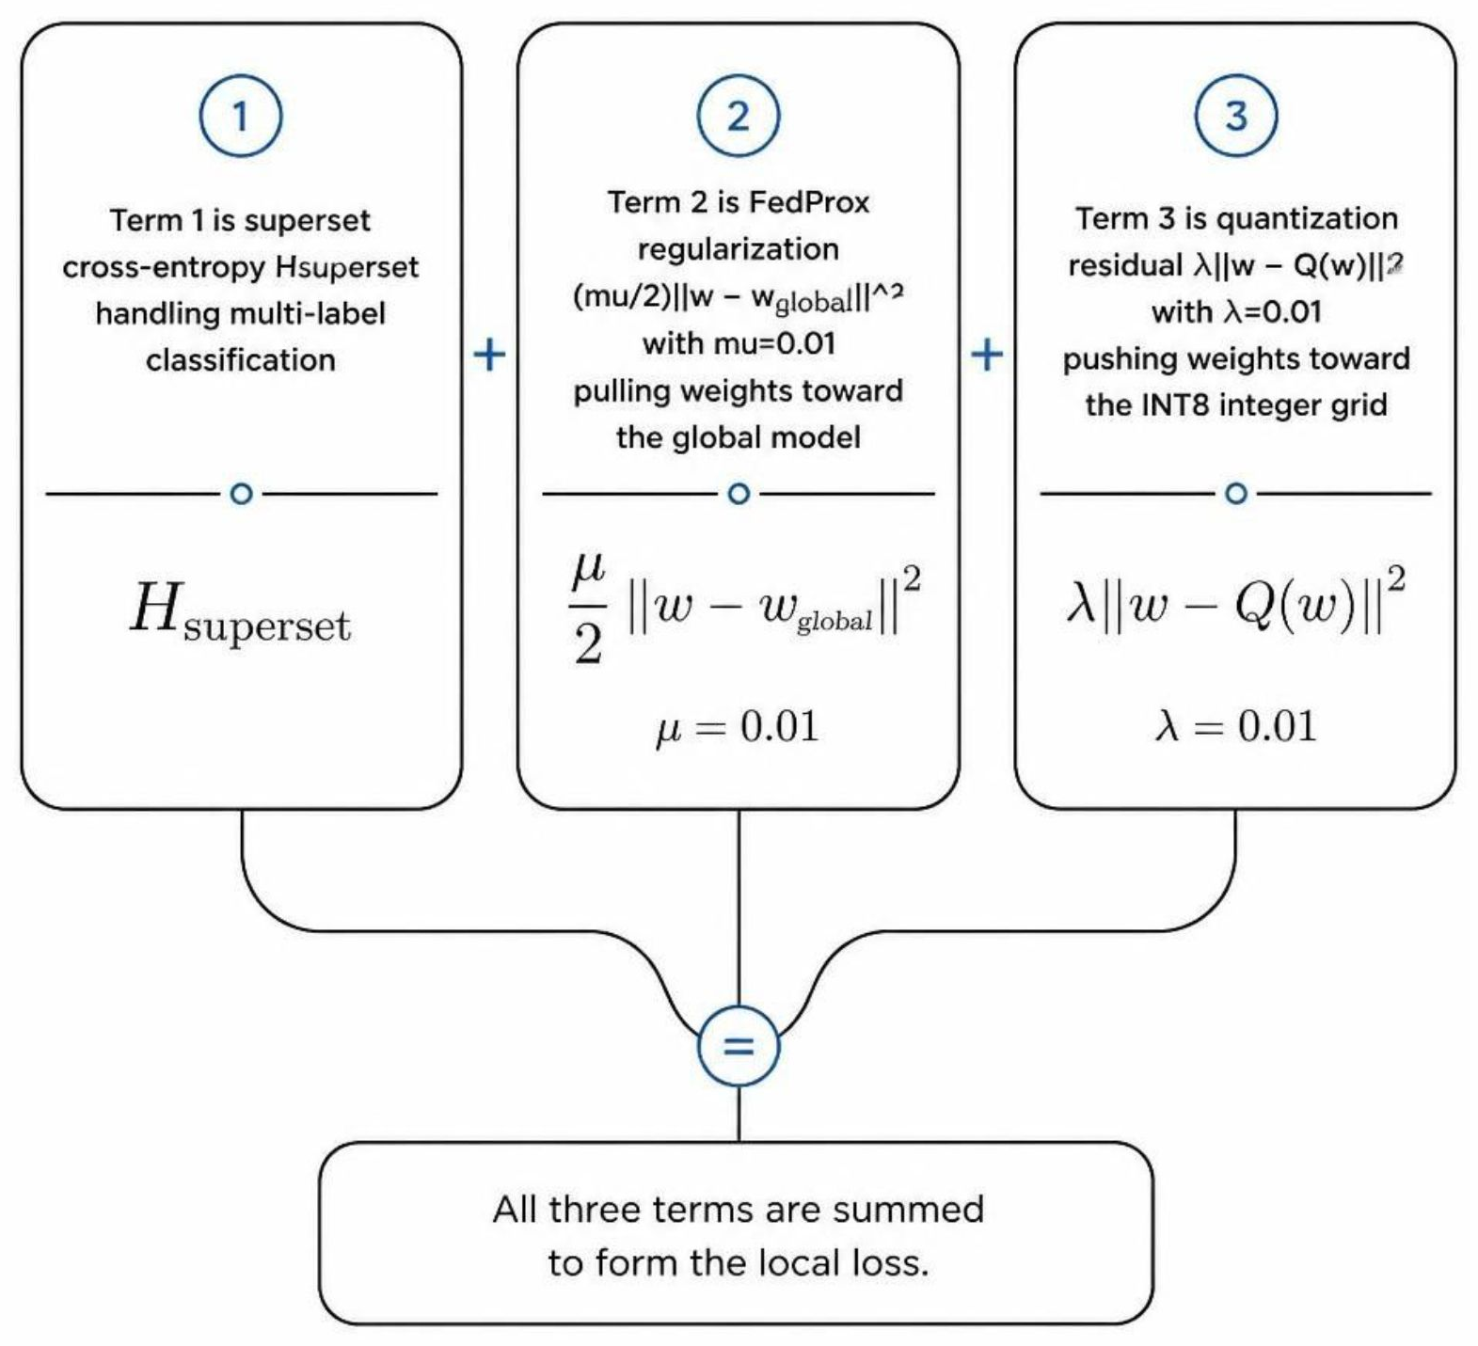

Our Hypothesis and Our Method
Hypothesis: Federated averaging lands in a poor minimum, so INT8 quantization should hurt it more than a centrally trained model.
L_{local} = H_{superset} + (μ/2) ‖w − w_{global}‖² + λ‖w − Q(w)‖²
μ = λ = 0.01
Batch-norm stays site-local; a new site re-estimates it from unlabeled scans — no labels, no gradients, no images leave.
Compared against FedAvg, FedProx, FedBN, centralized, and single-site training.
This card explains the core hypothesis and the mathematical formulation of the QAF-Net loss function. The three terms are labeled: superset cross-entropy for multi-label classification, FedProx regularization pulling weights toward the global model, and quantization residual pushing weights toward the INT8 integer grid.

Slide 4

Data: Four Cohorts, and a Duplicate Audit
Cohort | Origin | Images | Type
Cheng | China | 3,064 | Multi-class
PMRAM | Bangladesh | 6,012 | Multi-class
Sartaj | Mixed public | 3,264 | Multi-class
Br35h | Public | — | Binary
Perceptual hashing fails on brain MRI: every slice is a bright ovoid on black, so it flagged about 78% of independent images as duplicates. Normalized cross-correlation (tau = 0.999) revealed: 71.8% of Sartaj is copied from Cheng; 45.5% of Br35h repeats inside itself; 55.2% of the popular merged benchmark duplicates its own sources. Sartaj drops from 3,264 usable images to 544.

Slide 5
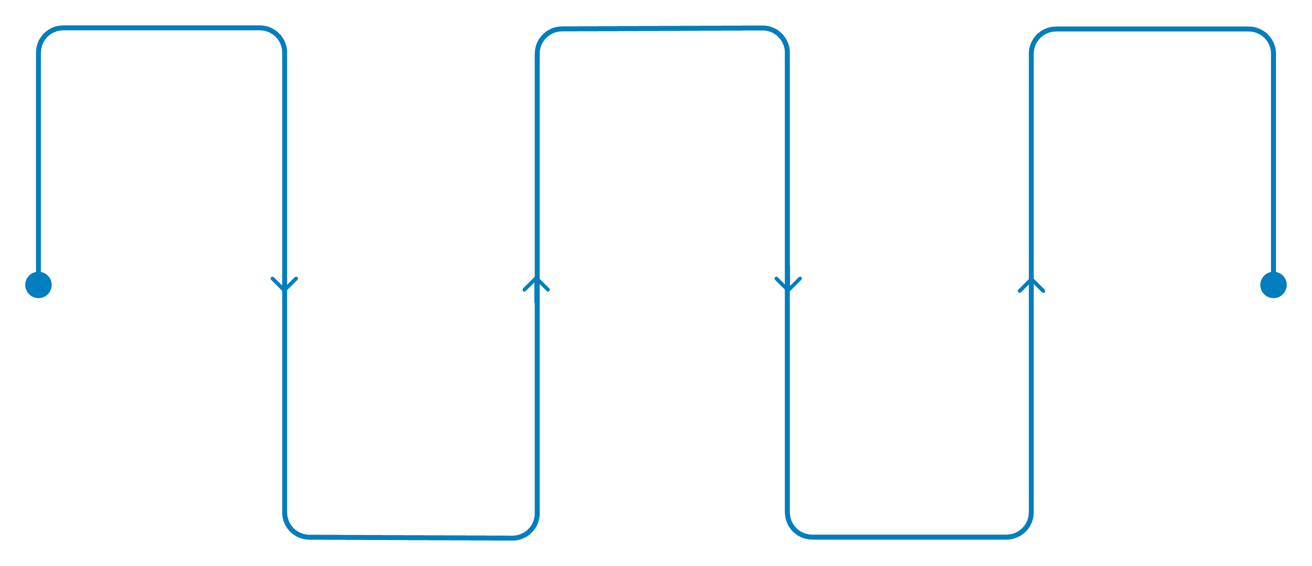
How We Ran It
Leave-one-site-out: train on three cohorts, test on a fourth that contributed nothing.
Three folds: Cheng held out, PMRAM held out, Sartaj held out (secondary, small).
Br35h has no subtype labels, so its tumour images enter through a superset loss over {glioma, meningioma, pituitary}.
Model: MobileNetV2 width 0.35 at 128x128, 415,332 parameters, converted to full-integer INT8.
4 methods x 3 folds x 3 seeds = 36 federated runs, on Kaggle T4 GPUs, in four notebooks: data preparation, baselines, federated training, TinyML export.
Cohorts
Duplicate Audit
Federated Training
Model Compression
Evaluation
Cheng, PMRAM, Sartaj, Br35h
Deduplicate via normalized cross-correlation
Leave-one-site-out cross-validation
INT8 quantization and TinyML conversion
Test on held-out hospital with BN recalibration
This card describes the experimental protocol. The leave-one-site-out design ensures the held-out cohort contributes nothing to training, simulating a genuinely unseen hospital. The pipeline diagram shows the five stages from raw data through final evaluation.

Slide 6
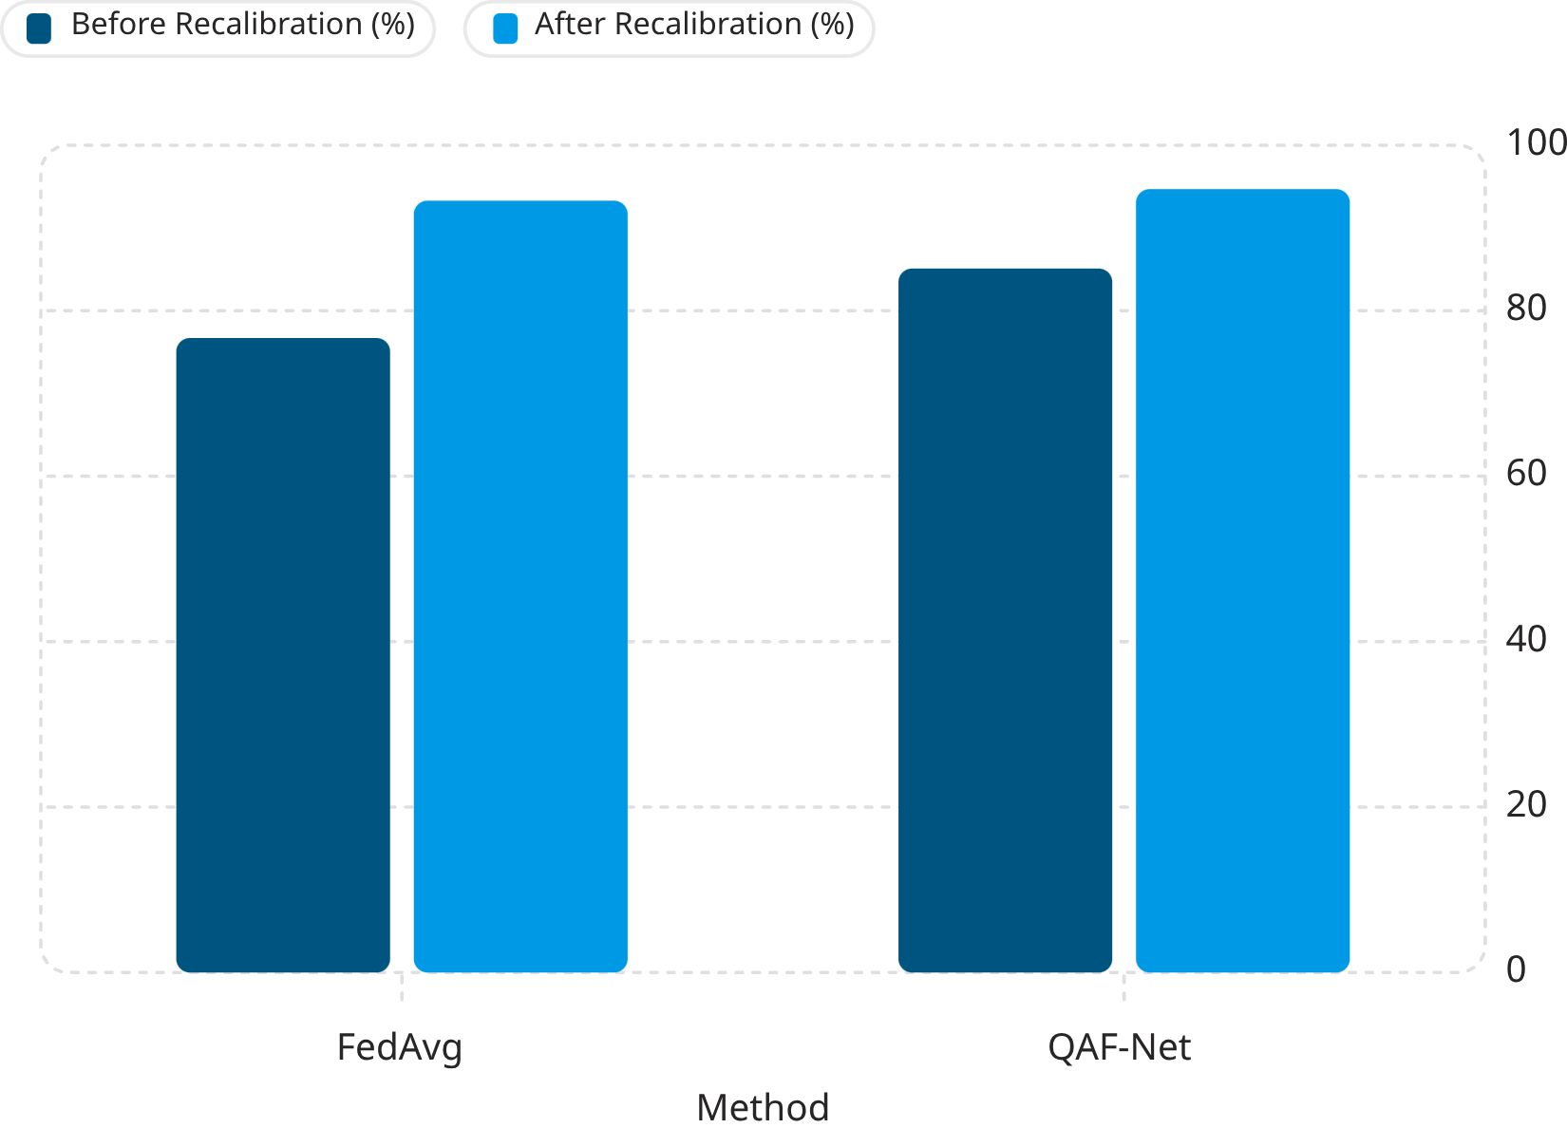

Main Result: Normalization Beats the Algorithm
FedAvg on Cheng: 76.7% → 93.3%, seed spread 17.7 → 2.0 points.
QAF-Net is highest on Cheng at 94.7%; FedBN is highest on PMRAM at 78.3%.
How the new site gets its normalization statistics matters more than which federated algorithm trained the model.
Averaged batch-norm statistics are unstable: FedAvg scored 56.4%, 88.5% and 85.1% on three seeds of the Cheng fold. Recalibrating on unlabeled scans from the new site: every method reaches 93.3-94.7% with a spread of at most 2.0 points.

Slide 7
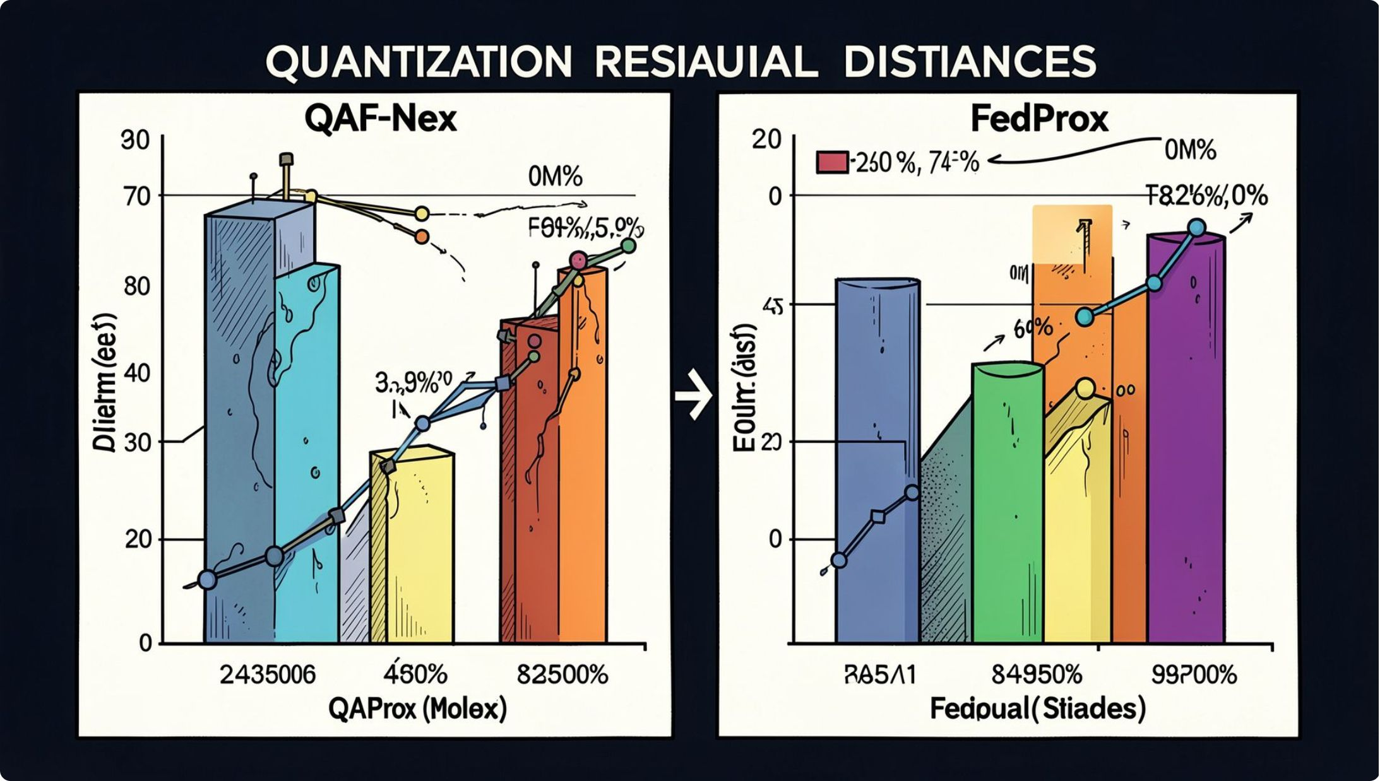

The Honest Result: Our Hypothesis Failed
Prediction: federated training should lose more accuracy to INT8. It did not.
Centralized lost 8.6 points on PMRAM; no federated method lost more than 4.6 on average.
We then tested whether our regularizer even worked: it did not move the weights toward the integer grid.
Mean squared distance from the grid: 0.0818 for QAF-Net, 0.0817 for FedProx (lambda = 0).
Reason: the term is worth about 0.00001 against a training loss of about 0.23 — far too small.
We report this rather than hide it; the fix is to scale lambda to the quantization step.
This card reports a negative result honestly. The hypothesis that federated models would lose more accuracy under INT8 quantization was not supported. Furthermore, the quantization regularizer had negligible effect because its magnitude was far too small relative to the training loss.

Slide 8
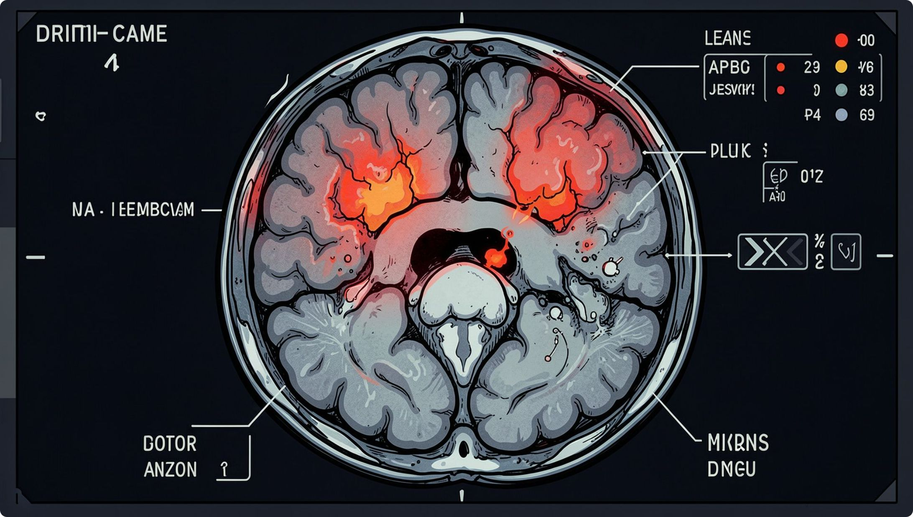

Where the Models Fail
On PMRAM, every federated method sends 43–53% of meningiomas to glioma.
On Sartaj, federated models almost never predict "no tumour": the best recognized 3% of the 309 normal scans, while centralized training recognized 43%.
Reason: Br35h was the only client holding normal scans, and it held 19% of the training images. A class owned by one client is outweighed by averaging.
Grad-CAM maps fall on the skull and background more often than on the lesion.
This card highlights systematic failure modes. Class imbalance across federated clients causes severe under-prediction of classes held by only one site. Grad-CAM analysis reveals that attention maps often focus on irrelevant regions rather than the actual lesion.

Slide 9
Does It Fit on a Small Device?
Specification | Value
Model size (INT8) | 606.3 KB
Parameters | 415,332
Compute per image | 18.9 M MACs
Inference speed (CPU) | ~1.9 ms / slice
95th percentile latency | 2.3 ms
Working memory needed | 453.6 KB
Fits Flash
Does Not Fit RAM
606.3 KB fits within 1 MB flash of Arduino Nano 33 BLE
453.6 KB exceeds the 256 KB RAM of Arduino Nano 33 BLE
Target today: microcontrollers with 512 KB or more of RAM, or a small single-board computer.
This card presents the TinyML deployment specifications. The INT8 model fits within the flash storage of common microcontrollers but exceeds their RAM, pointing to devices with at least 512 KB of RAM as the realistic target platform.

Slide 10



What We Learned, and What Is Next
Duplicate audit changed the study
Unlabeled recalibration was the largest gain
The standard merged benchmark cannot be treated as independent data.
Recalibrating batch-norm at the new hospital mattered more than the federated algorithm.
Our hypothesis was not supported
Next steps
We report the negative result with the measurement that exposes it.
Scale lambda to the quantization step and sweep it; class-aware aggregation for a class held by one site; a smaller network for 256 KB devices; multi-seed centralized baselines.
The pipeline is reproducible on Kaggle end to end, and the paper reports every number shown here.

