Slide 1
Welcome to my presentation

Slide 2
Polio Immunization

Slide 3
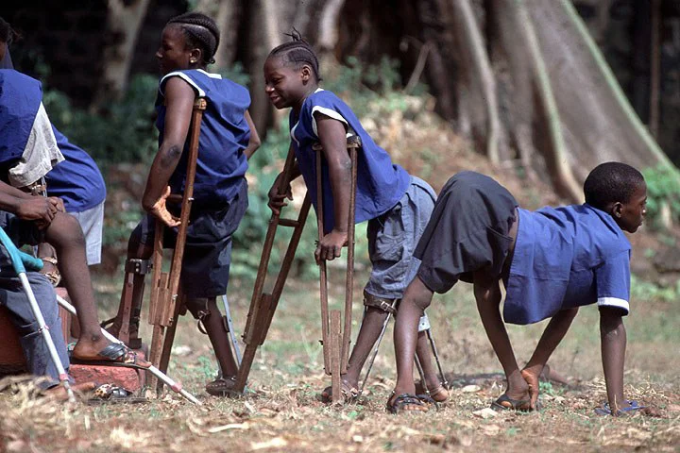
Introduction to Polio
Polio is a highly contagious viral disease that attacks the nervous system. It can cause paralysis, and in some cases, death. Polio is also known as poliomyelitis.

Slide 4
Causes of Polio
(1) Caused by Polio virus
(2) Spread through
(3) Oral-oral route
(4) Intake of contaminated food/water

Slide 5
Thank you

