Slide 1
Introduction to RISC-V ABI
PLCT Tech Report
Sinan Lin 林思南
sinan.lin@aalto.fi

Slide 2
Contents of table
Introduction
ELF and RISC-V specification
RISC-V processor-specific ABI

Slide 3
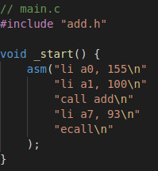
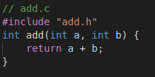

Step 1. Write down source code
main.c
add.c
add.h
sys_exit(add(100, 155))

Slide 4
Step 2. Use preprocessor to expand macro
main.c
Preprocessor expands macros
riscv64-unknown-linux-gnu-cpp -P main.c -o main.i riscv64-unknown-linux-gnu-cpp -P add.c -o add.i
add.i
add.h
main.i
add.c

Slide 5
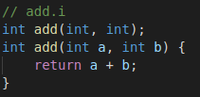
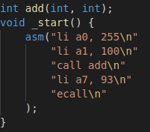
Step 2. Use preprocessor to expand macro
main.c
add.i
Preprocessor expands macros
riscv64-unknown-linux-gnu-cpp -P main.c -o main.i riscv64-unknown-linux-gnu-cpp -P add.c -o add.i
add.h
main.i
add.c

Slide 6
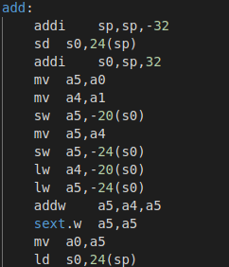
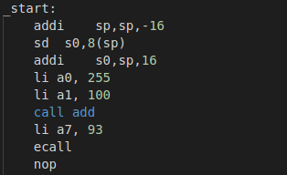
Step 3. GCC compiles source code to assembly
add.s
gcc generates assembly
riscv64-unknown-linux-gnu-gcc -S main.i -o main.s
riscv64-unknown-linux-gnu-gcc -S add.i -o add.s
add.c
add.i
add.h
main.i
main.s
main.c
Notes:
Generate position-independent code (PIC) suitable for use in a shared library

Slide 7
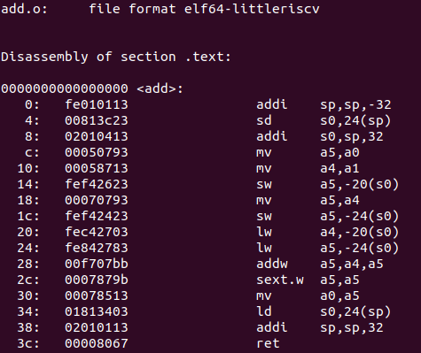
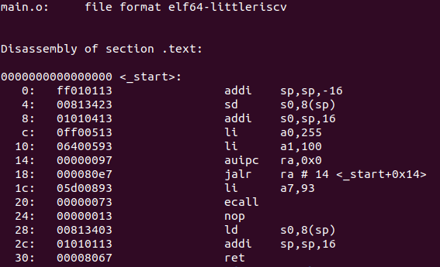
Step 4. Assembler converts code to object file
as converts assembly code into object code
riscv64-unknown-linux-gnu-as main.s -o main.o
riscv64-unknown-linux-gnu-as add.s -o add.o
add.c
add.i
add.s
add.o
add.h
main.i
main.s
main.o
main.c

Slide 8
Step 5. Linker combines object files and emits executable file
ld converts object files into executable file
riscv64-unknown-linux-gnu-ld -static main.o add.o
Runtime library (ctr0, ctr1)
C standard library
add.c
add.i
add.s
add.o
Linker
add.h
a.out
main.i
main.s
main.o
main.c
Evaluate result
qemu-riscv64 a.out
echo $?
>> 255

Slide 9
- RISC-V specification in ELF format
- RISC-V ABI
Runtime library (ctr0, ctr1)
C standard library
add.c
add.i
add.s
add.o
Linker
add.h
a.out
main.i
main.s
main.o
main.c

Slide 10
ELF (Executable and linkable file format)
ELF Header
.shstrtab
.strtab
.symtab
.comment
.bss
.note
.data
.rela.text
.text
NULL
section header table
ELF Header
General information about the binary
Sections
Information needed for linking object files in order to build an executable
Segments
Chunks of information to prepare the executable to be loaded into memory.
Sections
Layout of main.o

Slide 11
ELF (Executable and linkable file format)
ELF Header
.shstrtab
.strtab
.symtab
.comment
.bss
.note
.data
.rela.text
.text
NULL
section header table
ELF Header
General information about the binary
Sections
Information needed for linking object files in order to build an executable
Segments
Chunks of information to prepare the executable to be loaded into memory.
Sections
Layout of main.o

Slide 12
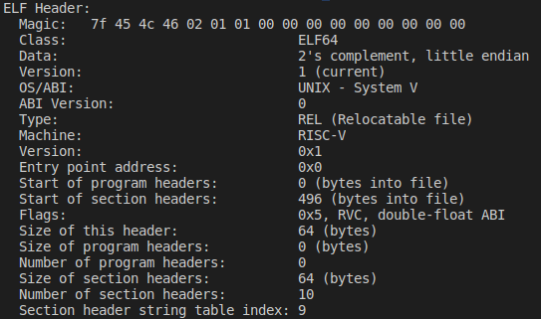
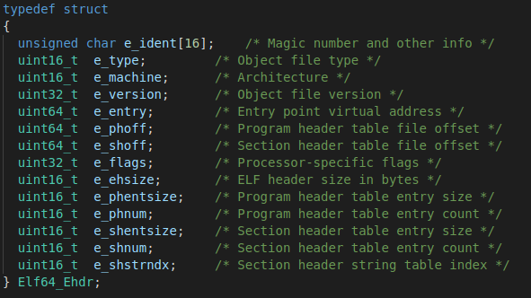
ELF Header
main.o
riscv-glibc/elf/elf.h

Slide 13

ELF Header with RISC-V specification
e_machine
EM_RISCV (243) for RISC-V ELF
e_flags
EF_RISCV_RVC (0x0001)
EF_RISCV_FLOAT_ABI_SOFT (0x0000)
EF_RISCV_FLOAT_ABI_SINGLE (0x0002)
EF_RISCV_FLOAT_ABI_DOUBLE (0x0004)
EF_RISCV_FLOAT_ABI_QUAD (0x0006)
EF_RISCV_FLOAT_ABI (0x0006)
EF_RISCV_RVE (0x0008)
EF_RISCV_TSO (0x0010)
readelf -h main.o
RVC allows instructions to be aligned to 16-bit boundaries, the linker is permitted to use RVC instructions such as C.JAL in the relaxation process. (‘C’ Standard Extension)
ILP64D: Integer calling-convention with hardware floating-point calling convention for FLEN=64
Notes:
E_flag i386 x86_64置空
16-bit instructions to be freely intermixed with 32-bit instructions, with the latter now able to start on any 16-bit boundary
Compressed
Chapter 12

Slide 14
Section header table
ELF Header
.shstrtab
.strtab
.symtab
.comment
.bss
.note
.data
.rela.text
.text
NULL
section header table
Sections
0x1F0
Layout of main.o
Notes:
ELF header通过section header offset e_shoff
SHT_NULL is that it is mandatory for the first header table entry (index 0, named SHN_UNDEF), which is magic.

Slide 15
Table look-up for .rela.text section
ELF Header
.shstrtab
.strtab
.symtab
.comment
.bss
.note
.data
.rela.text
.text
NULL
section header table
e_shoff
0x1f0
e_shoff - (2 * e_shentsize)
= 0x170
Layout of main.o

Slide 16
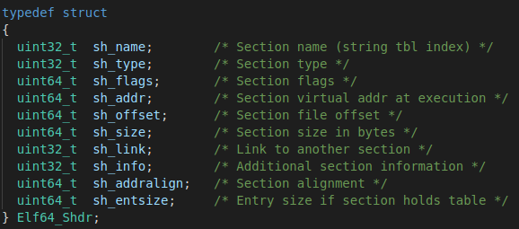
Sections
Name
Type
Virtual address
File Offset
Size
Flag
Alignment
riscv-glibc/elf/elf.h
Notes:
section type
type
Relocation
symbol table
🔗
sh_offset of the ELF header gives the starting position.
sh_entsize and sh_size from the ELF header say that we have 7 entries, each 0x40 bytes long.
So the table takes bytes from 0x40 to 0x40 + 7 + 0x40 - 1 = 0x1FF.

Slide 17
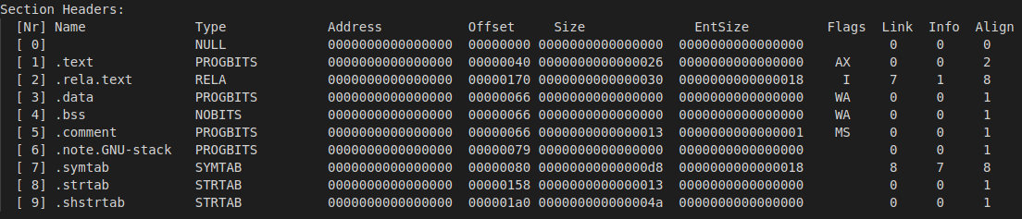
Relocation section
Name Type Virtual address Link Info
Name
Type
Virtual address
readelf -S main.o
Notes:
sh_name: index of section name in section header string table.
sh_type: section type.
name is supplied by the section to which the relocations apply. Thus a relocation section for .text normally will have the name .rel.text
名称由重定位所适用的部分提供。 因此，.text的重定位节通常将具有名称.rel.text

Slide 18
Table look-up in .rela.text section
ELF Header
.shstrtab
.strtab
.symtab
.comment
.bss
.note
.data
.rela.text
.text
NULL
section header table
the relocation section is linked to two other sections. One of them is the symbol table, where the symbols that will be relocated are held.
sh_link=7
sh_info=1

Slide 19

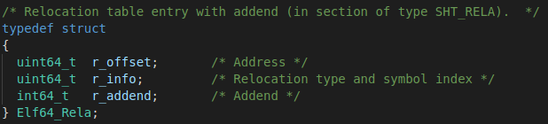
Relocation table entry
- location where a relocation will take place
- index of symbol
- relocation type
- addend
rela.text section in main.o
riscv-glibc/elf/elf.h
Notes:
sh_name: index of section name in section header string table.
sh_type: section type.
name is supplied by the section to which the relocations apply. Thus a relocation section for .text normally will have the name .rel.text
addend: This field specifies a constant addend to be added to compute the value to be stored in a given relocation reference.
重定位条目描述了如何更改以下指令和数据字段

Slide 20
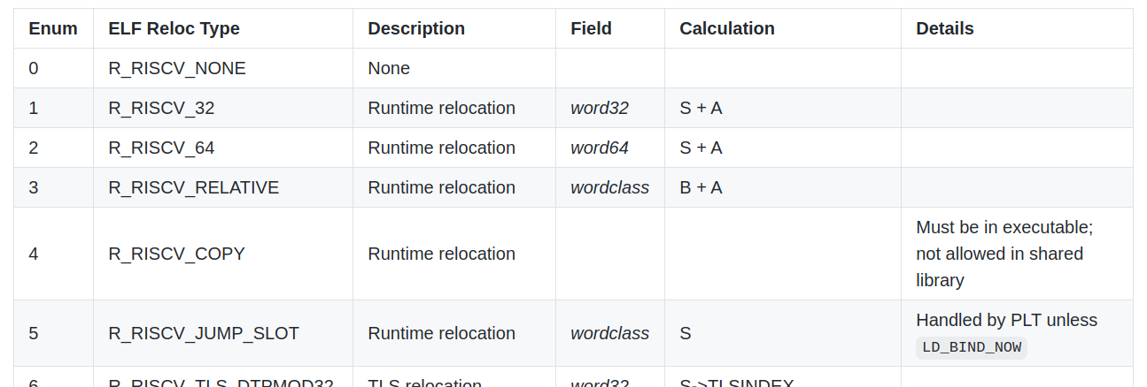
Relocation type
Relocations type in RISC-V
0~58 Defined
59~255 Reserved
Notes:
重定位条目描述了如何更改以下指令和数据字段

Slide 21
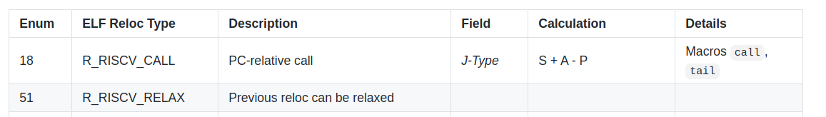
Relocation type
Relocations type R_RISCV_CALL and R_RISCV_RELEX
J type field:
the immediate field in a J-type instruction
R_RISCV_CALL is associated with pairs of instructions (AUIPC+JALR) generated by the CALL or TAIL pseudo instructions.
auipc x1, <hi20bits>
jalr x0, x1, <lo12bits>
Notes:
重定位条目描述了如何更改以下指令和数据字段
AUIPC+JALR
R_RISCV_CALL and R_RISCV_CALL_PLT relocations are associated with pairs of instructions (AUIPC+JALR) generated by the CALL or TAIL pseudoinstructions.

Slide 22
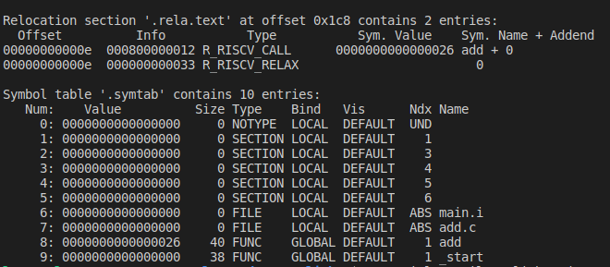
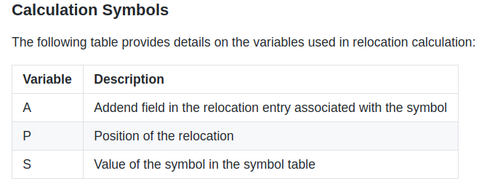
Calculation symbols
Concat main.o and add.o
riscv64-unknown-linux-gnu-ld -relocatable main.o add.o -o main_concat.o
riscv64-unknown-linux-gnu-readelf -rs main_concat.o
P = 0xe
S = 0x26
A = 0x0
S+A-P = 0x18
Notes:
重定位条目描述了如何更改以下指令和数据字段
AUIPC+JALR
R_RISCV_CALL and R_RISCV_CALL_PLT relocations are associated with pairs of instructions (AUIPC+JALR) generated by the CALL or TAIL pseudoinstructions.

Slide 23
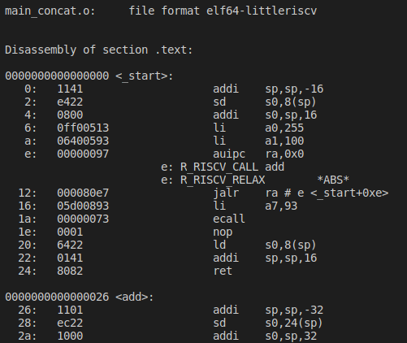
Symbols calculation for R_RISCV_CALL
P = 0xe
S = 0x26
A = 0x0
S+A-P = 0x18
0x18
riscv64-unknown-linux-gnu-objdump -Dr main_concat.o
Notes:
重定位条目描述了如何更改以下指令和数据字段
AUIPC+JALR
R_RISCV_CALL and R_RISCV_CALL_PLT relocations are associated with pairs of instructions (AUIPC+JALR) generated by the CALL or TAIL pseudoinstructions.

Slide 24
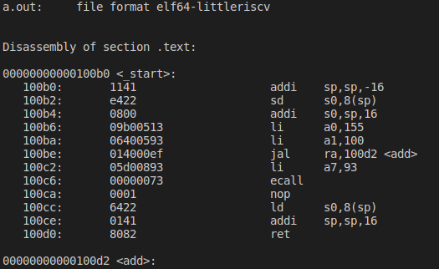
R_RISCV_RELAX
Linker optimization -- Relocation Relaxation
riscv64-unknown-linux-gnu-objdump -Dr a.out
riscv64-unknown-linux-gnu-objdump -Dr main_concat.o
Notes:
重定位条目描述了如何更改以下指令和数据字段
AUIPC+JALR
R_RISCV_CALL and R_RISCV_CALL_PLT relocations are associated with pairs of instructions (AUIPC+JALR) generated by the CALL or TAIL pseudoinstructions.

Slide 25
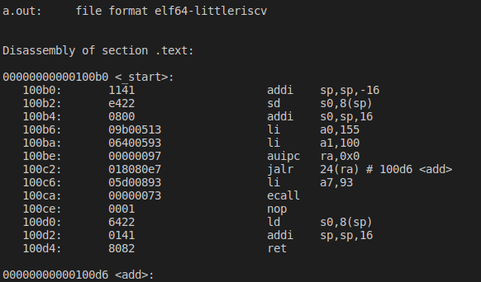
Without R_RISCV_RELAX
Compile without linker optimization with flag -mno-relax
riscv64-unknown-linux-gnu-gcc -c -mno-relax main.c -o main.o
riscv64-unknown-linux-gnu-gcc -c add.c -o add.o
riscv64-unknown-linux-gnu-ld main.o add.o
0x18
riscv64-unknown-linux-gnu-objdump -Dr a.out

Slide 26
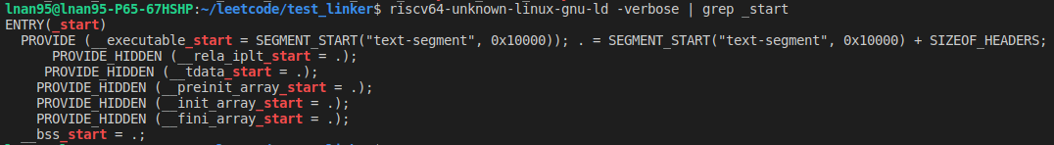
What’s the address of entry point?
Program entry address

Slide 27
ABI (Application Binary Interface)
High-level ABI (Itanium C++ ABI)
Name demangling
Data Layout
Generic ABI (UNIX System V ABI)
System call
Function Calling Sequence
Processor-specific ABI (RISC-V psABI)
Register Convention
Procedure Calling Convention
Code models
C type details
main.s
Name demangling in C++ ABI
call _Z3addii
Riscv64-unknown-linux-gnu-c++filt _Z3addii
>> add(int, int)
Notes:
通用寄存器 r0 r1

Slide 28
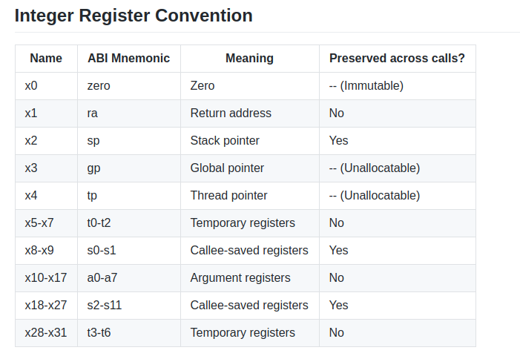
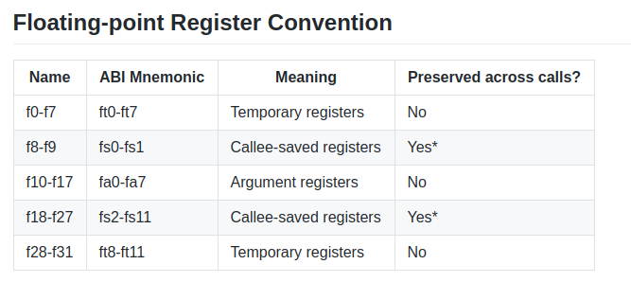
Register Convention
RISC-V psABI: Integer Register Convention
frame pointer: s0
integer registers tp and gp should not be modified

Slide 29
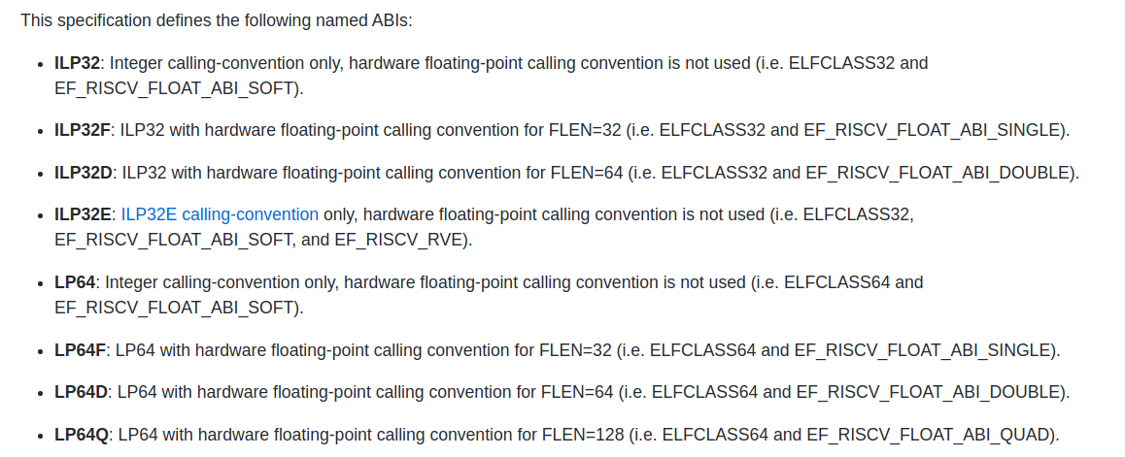
Named ABIs
Default
ABI
RISC-V ELF psABI specification named ABI
Notes:
Hardware Floating-point Calling Convention
width of a floating-point register in the ABI
Fa0 1

Slide 30
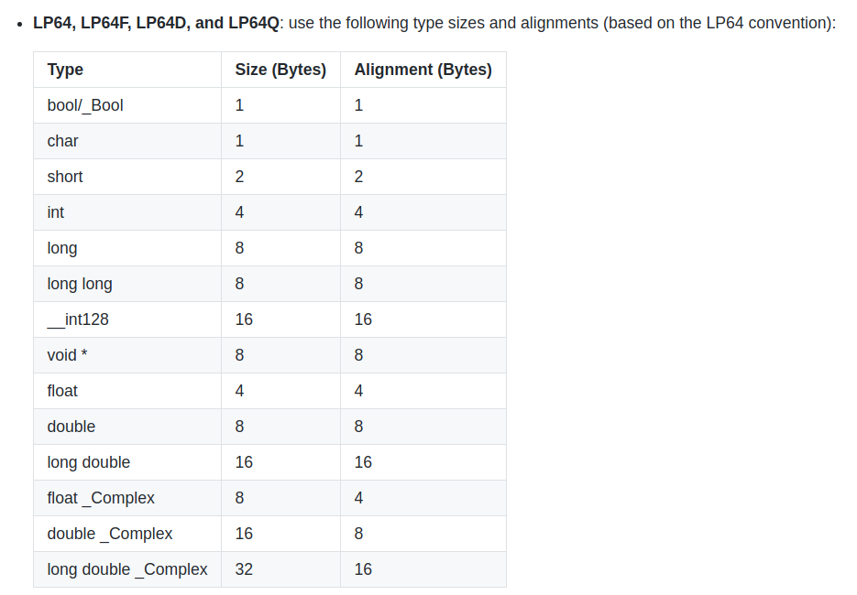
C type details
C type sizes and alignments in RISC-V 64

Slide 31
Procedure Calling Convention
Integer Calling Convention
Hardware Floating-point Calling Convention

Slide 32
Integer Calling Convention
The base integer calling convention provides eight argument registers, a0-a7, the first two of which are also used to return values.
size < XLEN
passed in a single argument register
Aggregate/Scalars
li a0, imm
call func
XLEN=32bits for ILP32* ABI
XLEN=64bits for ILP64* ABI
*Assume registers are available
Notes:
non-trival副本构造函数，析构函数或vtable的C ++

Slide 33
Integer Calling Convention
The base integer calling convention provides eight argument registers, a0-a7, the first two of which are also used to return values.
size <= XLEN
passed in a single argument register
size in (XLEN, 2*XLEN]
passed in a pair of argument registers for low bits and high bits
Aggregate/Scalars
ld a0, %lo
ld a1, %hi
call func
XLEN=32bits for ILP32* ABI
XLEN=64bits for ILP64* ABI
*Assume registers are available

Slide 34
Integer Calling Convention
The base integer calling convention provides eight argument registers, a0-a7, the first two of which are also used to return values.
size <= XLEN
passed in a single argument register
Aggregate/Scalars
passed in a pair of argument registers for low bits and high bits
size in (XLEN, 2*XLEN]
size > 2*XLEN
passed by reference and are replaced in the argument list with the address
XLEN=32bits for ILP32* ABI
XLEN=64bits for ILP64* ABI
*Assume registers are available
Notes:
通过引用传递，并在参数列表中替换为地址

Slide 35
Hardware Floating-point Calling Convention
The hardware floating-point calling convention adds eight floating-point argument registers, fa0-fa7, the first two of which are also used to return values.
size <= FLEN
passed in a single argument floating point register
Scalars
Otherwise
passed according to the integer calling convention
FLEN is the width of a floating-point register in the ABI
ILP64 and ILP32 ABI do not support hardware floating-point calling convention
*Assume registers are available

Slide 36
Hardware Floating-point Calling Convention
The hardware floating-point calling convention adds eight floating-point argument registers, fa0-fa7, the first two of which are also used to return values.
One floating point
Two floating point
One floating-point
and one integer
Otherwise
passed as though it were a standalone floating-point real
passed in two floating-point registers
passed in a floating-point register and an integer register
passed according to the integer calling convention
Aggregate
*Assume registers are available, and sizes of fp are all less or equal then FLEN
Notes:
通过引用传递，并在参数列表中替换为地址

Slide 37
Code models
Recall:
The code model determines what these addressing templates look like, and thus which relocations are emitted.
Small
Medium
Compact
riscv64-unknown-linux-gnu-objdump -Dr main_concat.o
Notes:
complier doesn't know the absolute address of any symbol but it still must know what addressing mode to use as some addressing modes may require scratch registers to operate.

Slide 38
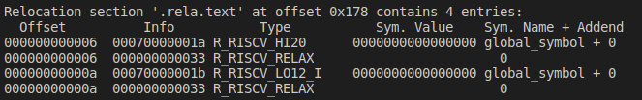
Code models
long global_symbol[2];
int main() {
return global_symbol[0] != 0;
}
// -mcmodel=medlow
lui a5,%hi(global_symbol)
ld a0,%lo(global_symbol)(a5)
snez a0,a0
Small
address the whole RV32 address space or the lower 2 GiB of the RV64 address space
lui and ld or st instruction pair
Medium
Compact
Relocation Type:
R_RISCV_HI20
R_RISCV_LO12_I
Notes:
complier doesn't know the absolute address of any symbol but it still must know what addressing mode to use as some addressing modes may require scratch registers to operate.

Slide 39
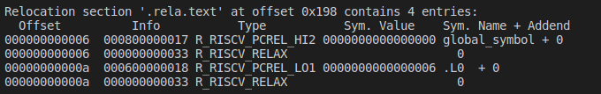
Code models
long global_symbol[2];
int main() {
return global_symbol[0] != 0;
}
// -mcmodel=medany
.LA0: auipc a5, %pcrel_hi(global_symbol)
addi a5,a5,%pcrel_lo(.LA0)
ld a5,0(a5)
snez a5,a5
Small
address the whole RV32 address space or the lower 2 GiB of the RV64 address space
lui and ld or st instruction pair
Medium
address the range between -2 GiB and +2 GiB from its position
auipc and ld or st
Compact
Relocation Type:
R_RISCV_PCREL_HI20
R_RISCV_PCREL_LO12_I
Notes:
complier doesn't know the absolute address of any symbol but it still must know what addressing mode to use as some addressing modes may require scratch registers to operate.

Slide 40
Code models
Small
address the whole RV32 address space or the lower 2 GiB of the RV64 address space
lui and ld or st instruction pair
Medium
address the range between -2 GiB and +2 GiB from its position
auipc and ld or st
Compact
address the whole 64-bit address space
lui and addi
Notes:
complier doesn't know the absolute address of any symbol but it still must know what addressing mode to use as some addressing modes may require scratch registers to operate.

Slide 41
Reference
The RISC-V Instruction Set Manual Volume I: User-Level ISA, page 67
RISC-V ELF psABI specification
SYSTEM V APPLICATION BINARY INTERFACE MIPS RISC Processor, page 4-16
CppCon 2019: Louis Dionne “The C++ ABI From the Ground Up”
CppCon 2017: Michael Spencer “My Little Object File: How Linkers Implement C++”
Itanium C++ ABI
All Aboard, Part 4: The RISC-V Code Models

