Slide 1
Implementation analysis of RISC-V Zfinx extension in QEMU
Duan Jiahua

Slide 2
Contents
RISC-V introduction
Zfinx extension
Qemu introduction
Qemu source code analysis
Implement zfinx extension in qemu

Slide 3
RISC-V introduction
An open standard ISA based on established RISC principles
Be supported in several popular software toolchains
Variable-width(32, 64, 128 bits) and extensible

Slide 4
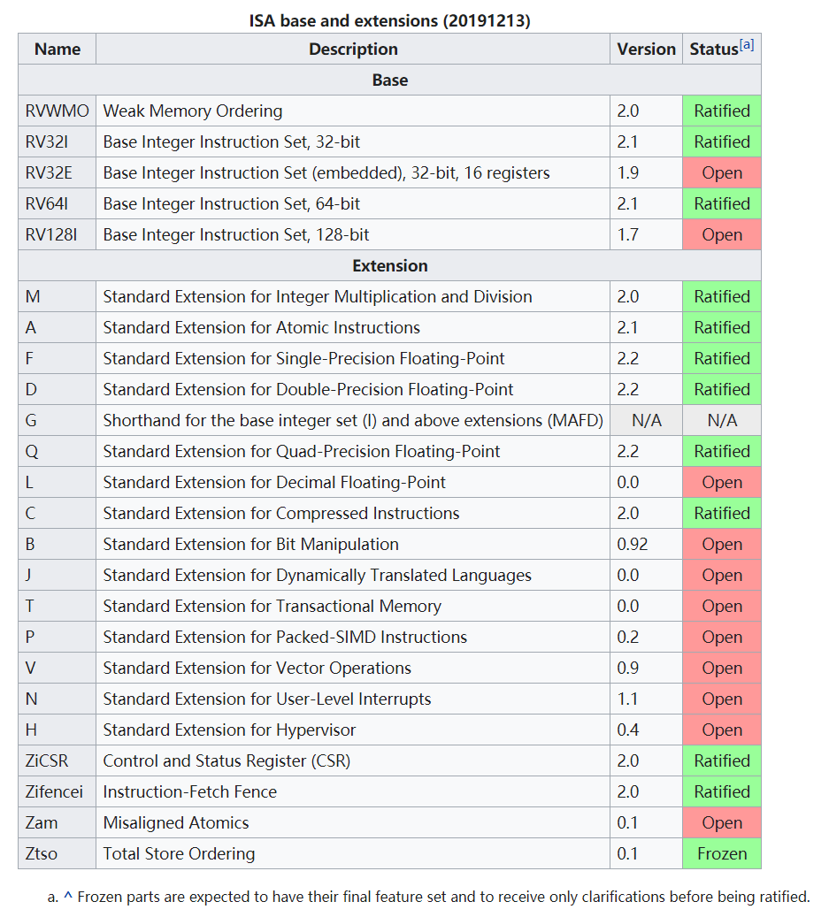
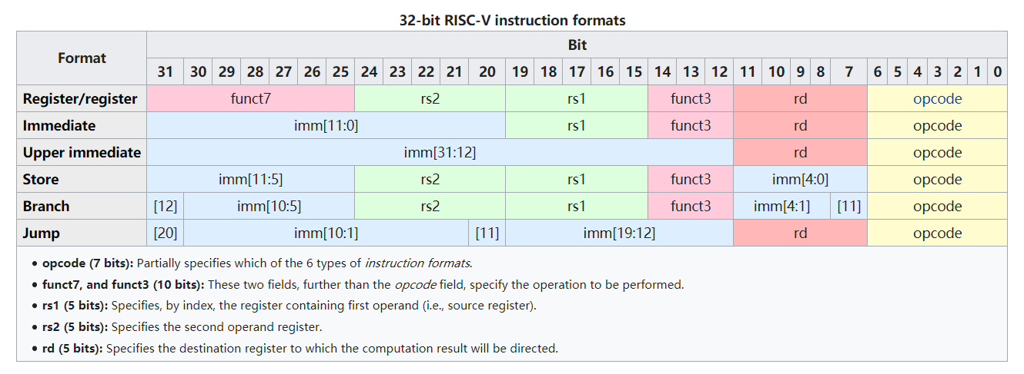
Instruction set architecture
wikipedia
wikipedia

Slide 5
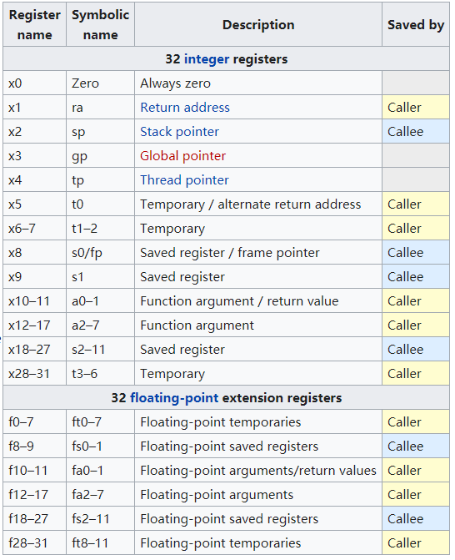

Register sets
32 (or 16 in the embedded variant) integer registers
32 floating-point registers(when the floating-point extension is implemented)

Slide 6
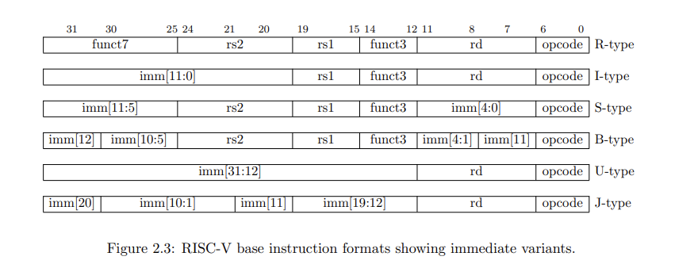
RV32I instructions
riscv-spec-20191213

Slide 7
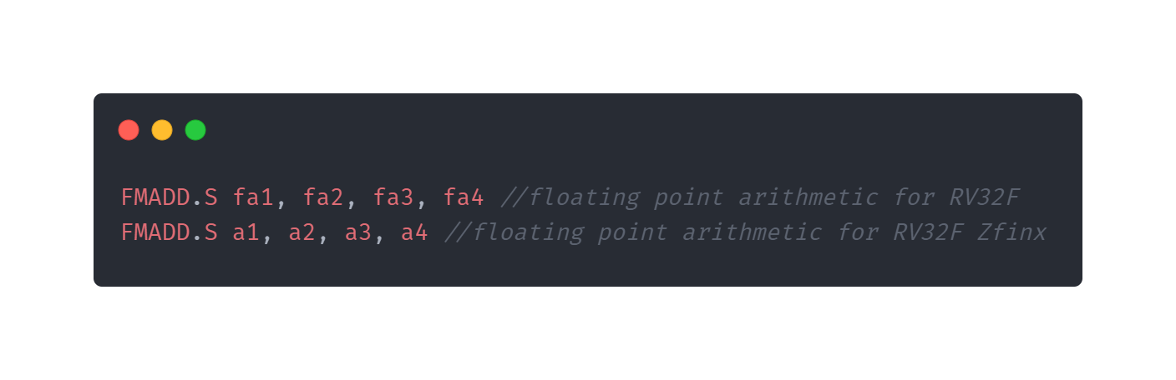
Zfinx extension
Change all existing and future floating point extensions which use the F floating point registers with the X registers
Same encoding

Slide 8
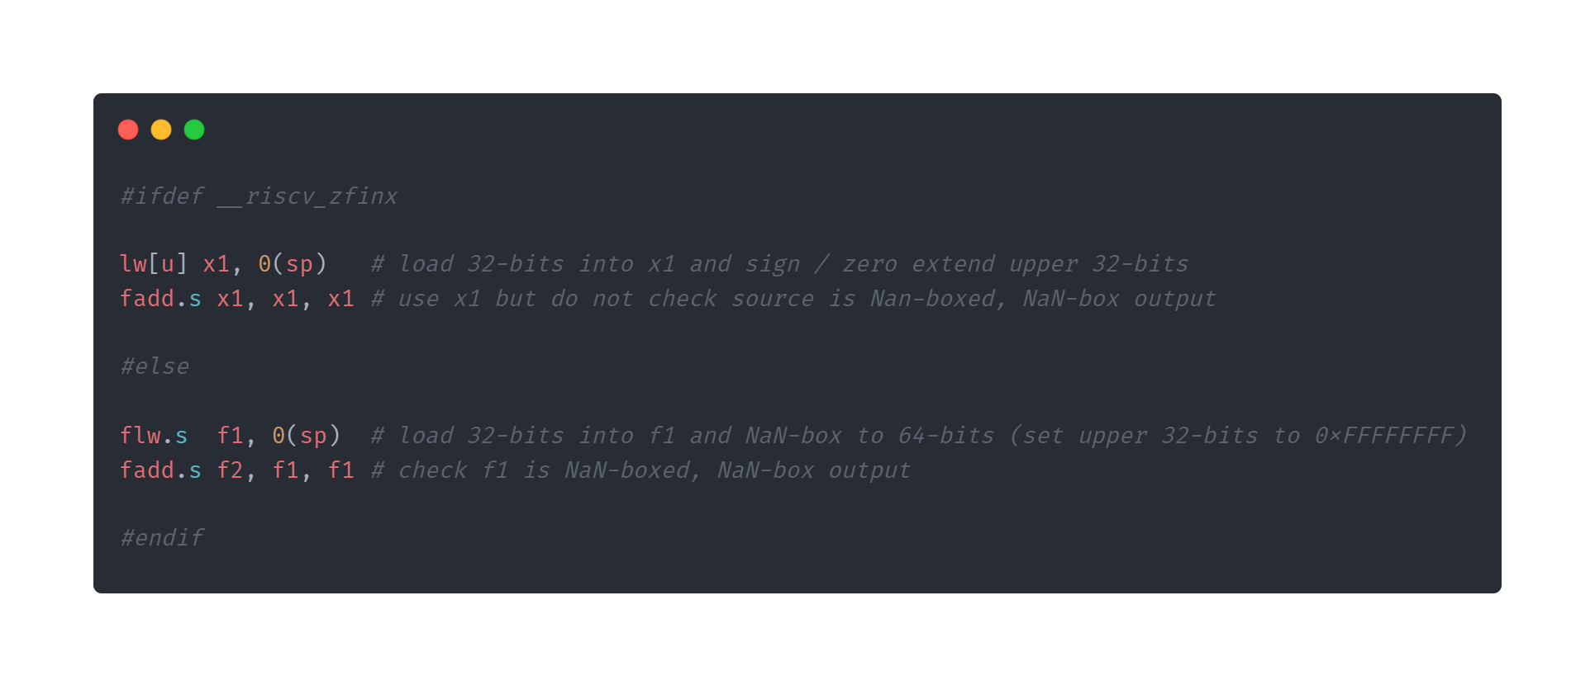
Zfinx extension
Remove all floating point load (e.g. FLW) store (e.g. FSW) and register move (e.g. FMV.X.W) encodings
The NaN-boxing behaviour of floating point arithmetic instructions is modified to suppress checking of sources only
RV64F

Slide 9
QEMU introduction
Short for Quick Emulator
A free and open-source emulator and virtualizer that can perform hardware virtualization
Emulates the machine's processor through dynamic binary translation

Slide 10
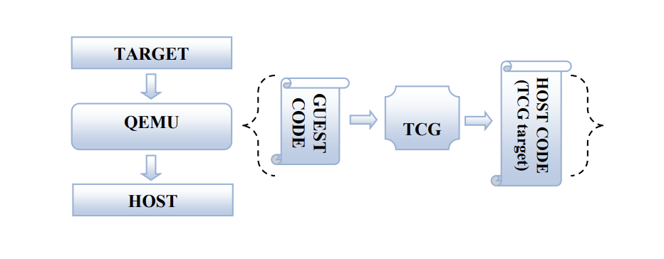
Tiny code generator
Target: the emulated architectures
Host: the real machine on which QEMU is running
Guest code: being run by the emulated processor
Host code: QEMU functions by extracting the Guest code and converting it to Host specific code
Qemu Detailed Study

Slide 11
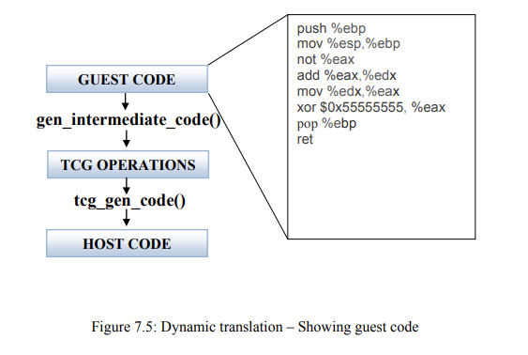
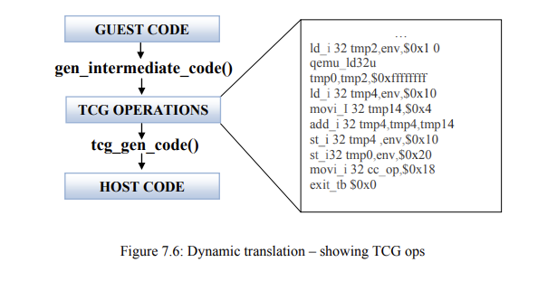
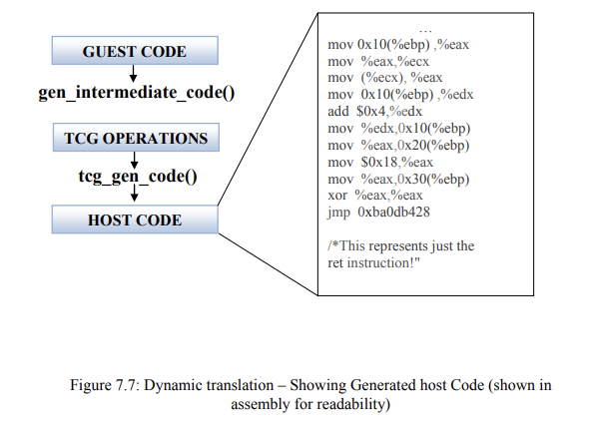
Translation task
A block of target code - Translation Block (TB) is converted into
TCG ops - a kind of machine-independent intermediate notation
The TCG ops for the TB is converted to Host code for the host’s
architecture by TCG

Slide 12
QEMU source code analysis
file | description
/target/target-xyz/translate.c | The extracted guest code is converted into architecture independent TCG ops
/tcg/tcg.c | The main code for TCG
/tcg/xyz/tcg-target.c | Code that converts the TCG ops to host code (host specific ISA)

Slide 13
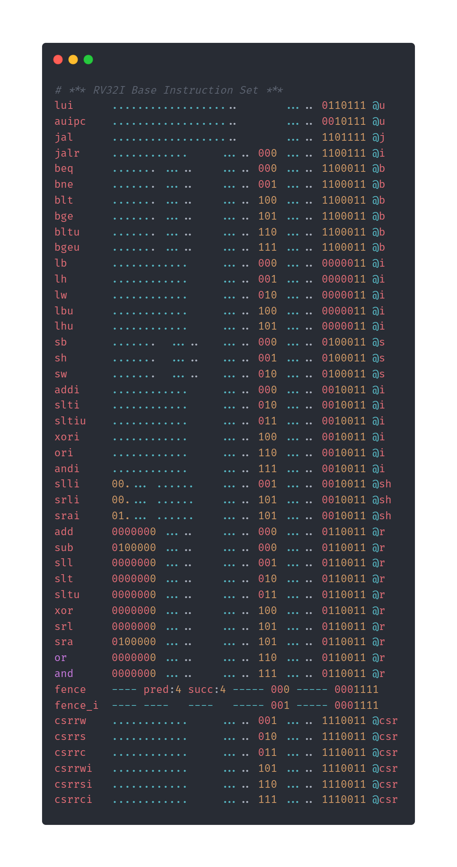
QEMU source code
/target/riscv/ insn32.decode

Slide 14
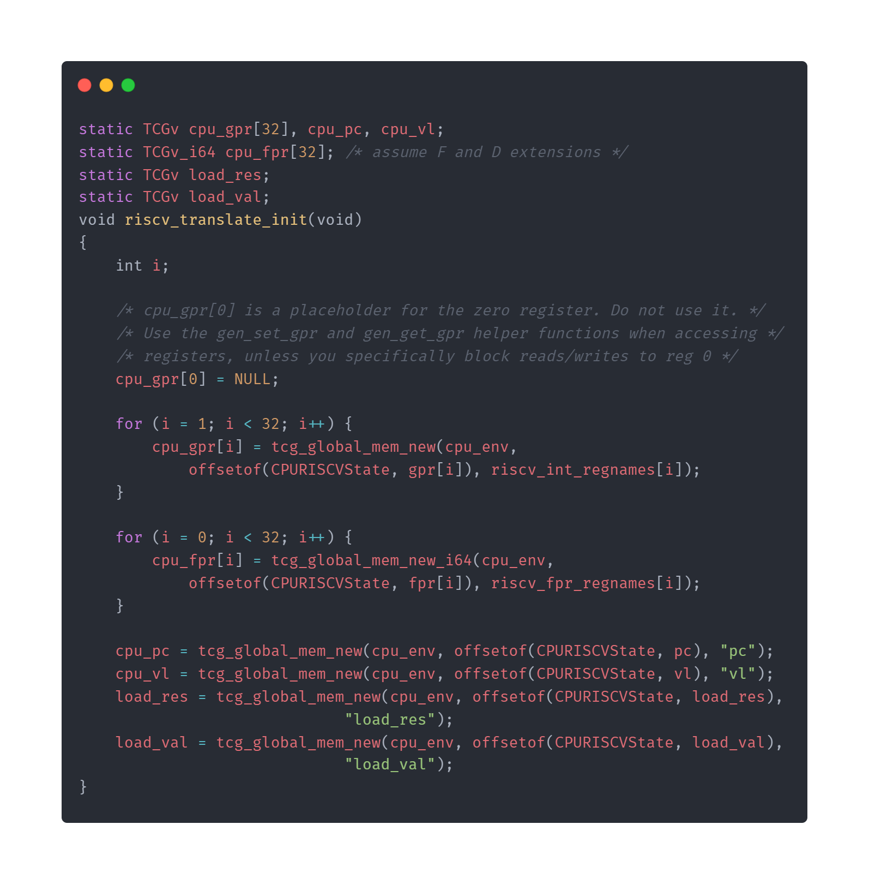
QEMU source code
/target/riscv/translate.c

Slide 15
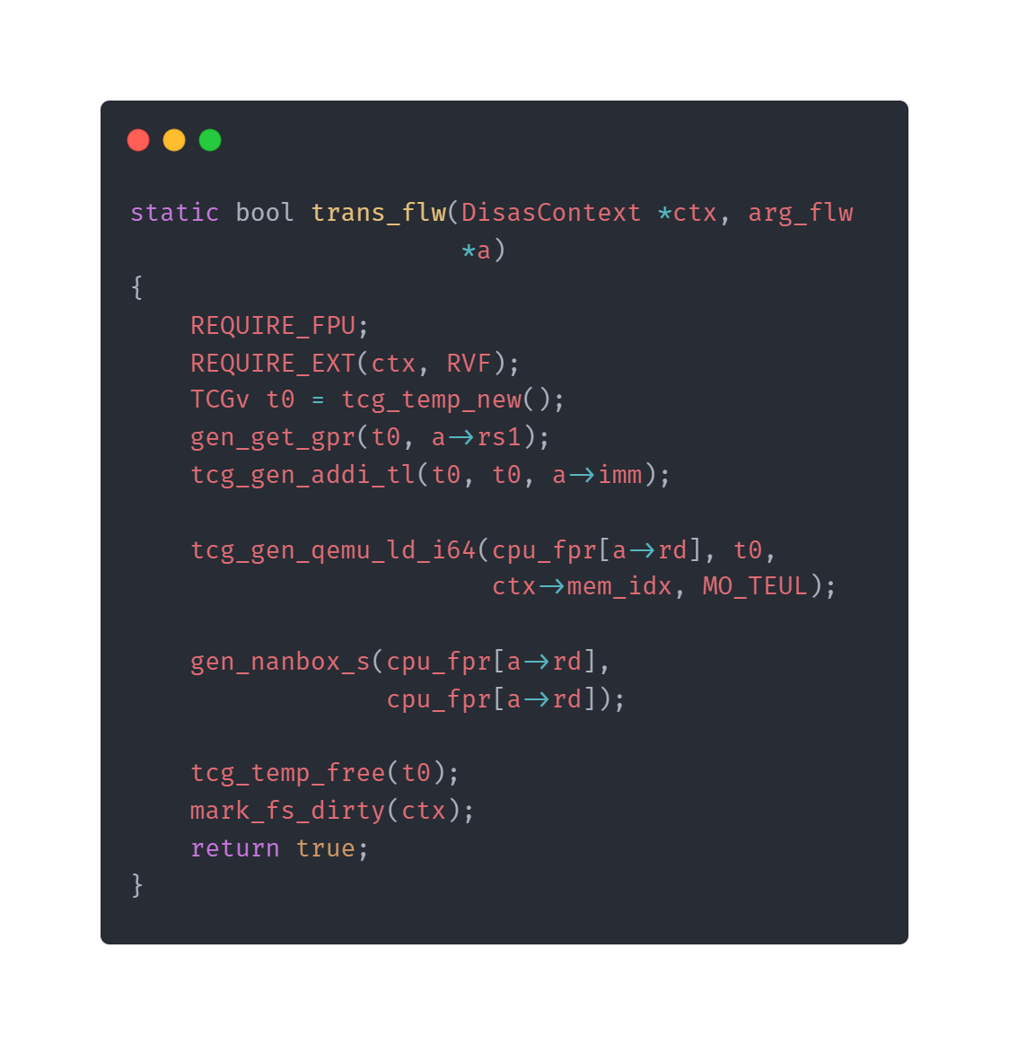
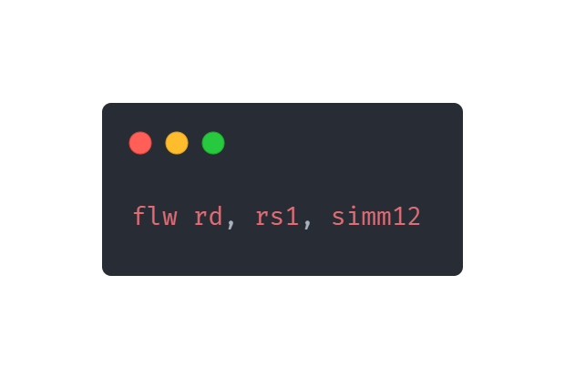
QEMU source code
/target/riscv/insn_trans/trans_rvf.c.inc

Slide 16
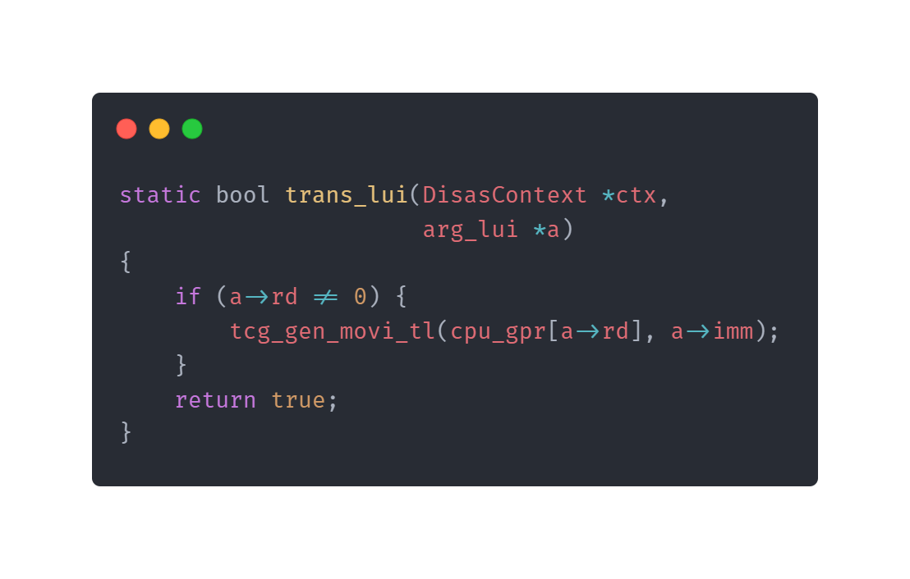
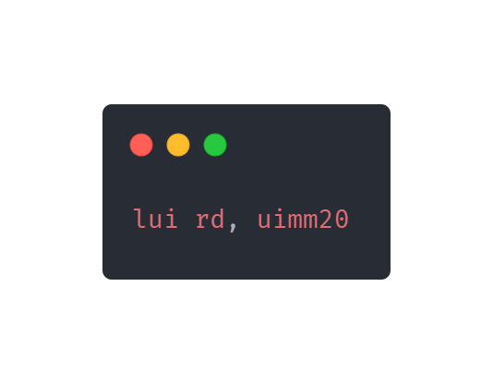
QEMU source code
/target/riscv/insn_trans/trans_rvi.c.inc

Slide 17
QEMU does not implement Zfinx
QEMU does not remove floating point load
QEMU use fpr not gpr in trans_flw function in the frontend
I can not find the Zfinx keyword in the source code

Slide 18
Implement zfinx extension in QEMU
When QEMU detects that the guest code implements Zfinx extension, it replaces floating-point registers with integer registers (it seems that the registers operated by the generated back-end machine code are only specified locations in memory)
Remove all floating point load store and register move encodings
Suppress checking of sources
Use specific floating point instructions for testing
Prerequisites and difficulties: Deeply understand the details of QEMU dynamic translation source code(gdb, Communicate with others)

Slide 19
Thanks!

