Slide 1
Course: Fundamentals of Intelligent Systems
Project Title: Heart Disease Diagnosis using Machine Learning Pipeline
Students: Ali Soltani & Seyed Mohammadreza Hosseini
Supervisor: Dr. Aliyari.

Slide 2
Overview
Introduction & Motivation
Dataset Overview
Data Preprocessing
Model Selection & Training
Impact of Dimensionality
Model Performance Comparison
7. Confusion Matrix Analysis
8. Feature Importance
10. Conclusion & Future Work

Slide 3
ARAS
Introduction & Motivation
Problem: Cardiovascular diseases (CVDs) are the leading cause of global mortality.
Objective: Developing a robust machine learning pipeline for early detection.
Focus: Minimizing False Negative (Recall) to ensure patient safety in clinical settings.

Slide 4
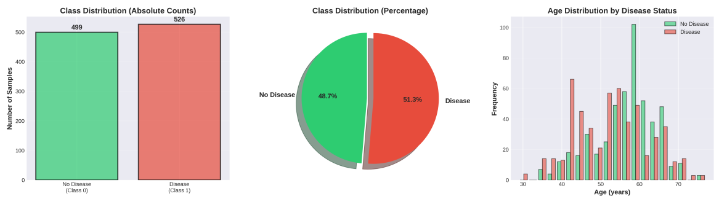
Dataset Overview
Source: Processed Cleveland Heart Disease Dataset
Structure: 1025 samples with 14 clinical attributes
Class Balance: Approximately 51% Disease vs. 49% No Disease (Balanced).

Slide 5
Data Preprocessing
Cleaning: Removed duplicate records and verified zero missing values.
Scaling: Applied StandardScaler to normalize numerical features for the MLP model.
Dimensionality Reduction: Explored PCA, LDA, and t-SNE for feature extraction.

Slide 6
Model Selection & Training
Random Forest (Ensemble): Chosen for its robustness to overfitting and interpretability.
Multi-Layer Perceptron (MLP): A deep learning approach to capture complex patterns.
Optimization: Used GridSearchCV with 5-fold Stratified Cross-Validation.

Slide 7
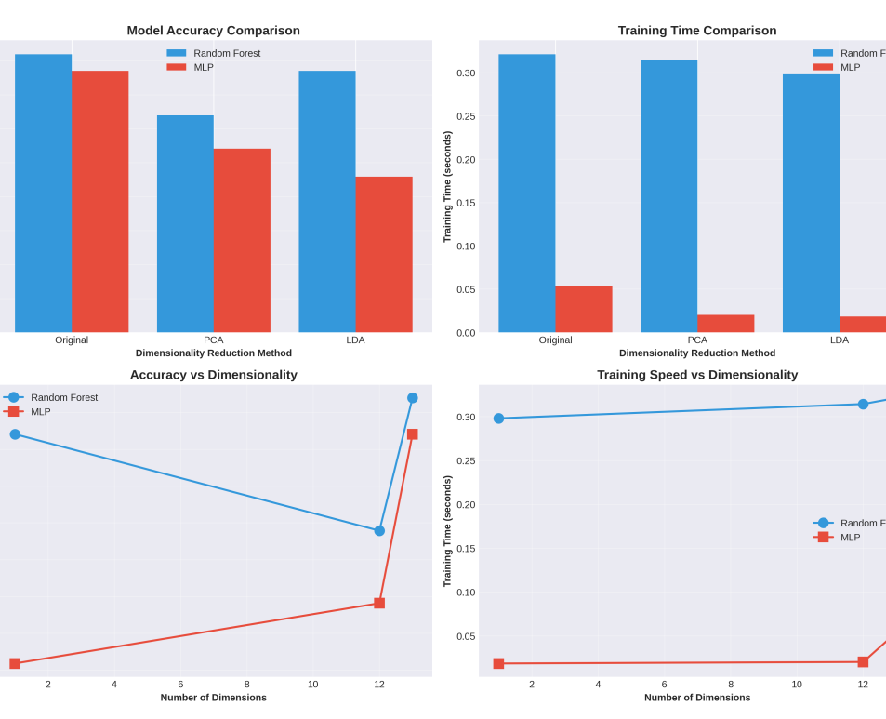
Impact of Dimensionality Reduction
Observation: Training on the full dataset yielded better performance than PCA-reduced data.
Efficiency: Training time was negligible for this dataset size, making reduction unnecessary.

Slide 8
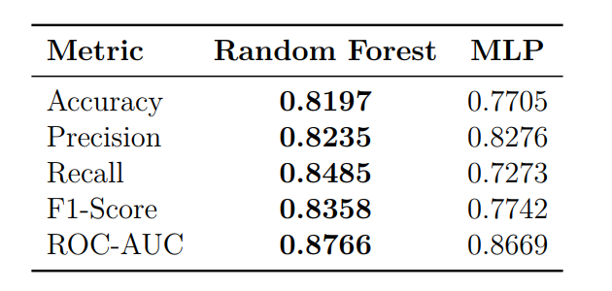
Model Performance Comparison
Key Results: Random Forest outperformed MLP across all metrics.
Accuracy: RF (82%) vs. MLP (77%).
Recall: RF achieved a significantly higher recall of 85%.

Slide 9
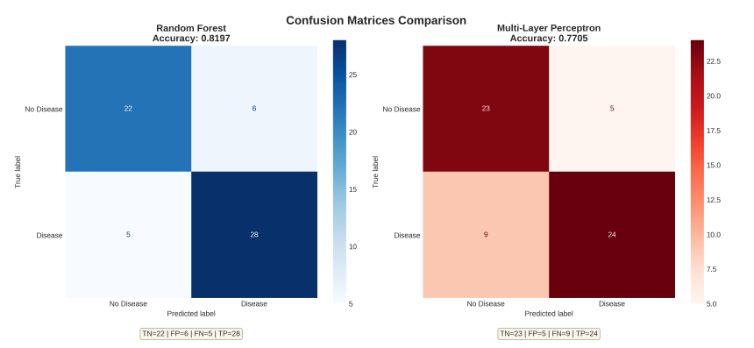
Confusion Matrix Analysis
Clinical Reliability: Random Forest produced fewer False Negatives (5) compared to MLP (9).
Insight: Lower False Negatives are critical in medical diagnostics to avoid missing actual cases.

Slide 10
Feature Importance
Top Predictors: Chest Pain (cp), Thalassemia (thal), and Number of Major Vessels (ca).
Validation: The model’s logic aligns with established clinical risk factors.

Slide 11

Conclusion & Future Work
Summary: Random Forest is the superior and safer choice for this clinical screening task.
Future Work: Tuning classification thresholds to further increase Sensitivity.
Expansion: Implementing Ensemble Stacking to boost overall accuracy.

