Slide 1

Iqtisodiyotning rivojlanishi va tarixi haqida
Iqtisodiyotning rivojlanishi va tarixi haqida
Isroilov Iqtisodiyotning rivojlanishi va tarixi haqida
Isroilov Iqtisodiyotning rivojlanishi va tarixi haqida

Slide 2

Iqtisodiyotning rivojlanishi va tarixi haqida
Reja:
1. Macroeconomics
2. Microeconomics
Isroilov Iqtisodiyotning rivojlanishi va tarixi haqida
3. International Economics

Slide 3

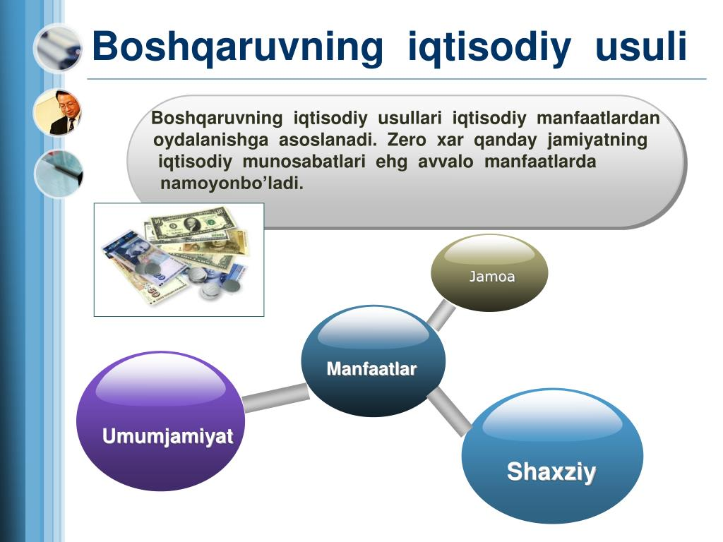
...
2. Microeconomics
## Monetary Economics: Monetary economics studies the role of money in the economy, focusing on: * Money supply: The total amount of money in circulation. * Interest rates: The cost of borrowing money. * Inflation: A general increase in prices. * Central banking: Institutions that manage monetary policy. Key concepts include: * Money demand: The amount of money people want to hold. * Money neutrality: The idea that changes in the money supply only affect nominal variables like prices, not real variables like output. * The Phillips curve: Shows the relationship between inflation and unemployment. * Monetary policy tools: Central banks use tools like interest rate adjustments and open market operations to influence the economy. Understanding monetary economics is crucial for policymakers and individuals alike, helping to navigate economic fluctuations and promote stability.
t.me/slaydai_bot

Slide 4

...
## Monetary Economics: Monetary economics studies the role of money in the economy, focusing on: * Money supply: The total amount of money in circulation. * Interest rates: The cost of borrowing money. * Inflation: A general increase in prices. * Central banking: Institutions that manage monetary policy. Key concepts include: * Money demand: The amount of money people want to hold. * Money neutrality: The idea that changes in the money supply only affect nominal variables like prices, not real variables like output. * The Phillips curve: Shows the relationship between inflation and unemployment. * Monetary policy tools: Central banks use tools like interest rate adjustments and open market operations to influence the economy. Understanding monetary economics is crucial for policymakers and individuals alike, helping to navigate economic fluctuations and promote stability.
t.me/slaydai_bot

Slide 5
...
## Monetary Economics: Monetary economics studies the role of money in the economy, focusing on: * Money supply: The total amount of money in circulation. * Interest rates: The cost of borrowing money. * Inflation: A general increase in prices. * Central banking: Institutions that manage monetary policy. Key concepts include: * Money demand: The amount of money people want to hold. * Money neutrality: The idea that changes in the money supply only affect nominal variables like prices, not real variables like output. * The Phillips curve: Shows the relationship between inflation and unemployment. * Monetary policy tools: Central banks use tools like interest rate adjustments and open market operations to influence the economy. Understanding monetary economics is crucial for policymakers and individuals alike, helping to navigate economic fluctuations and promote stability.
t.me/slaydai_bot

Slide 6
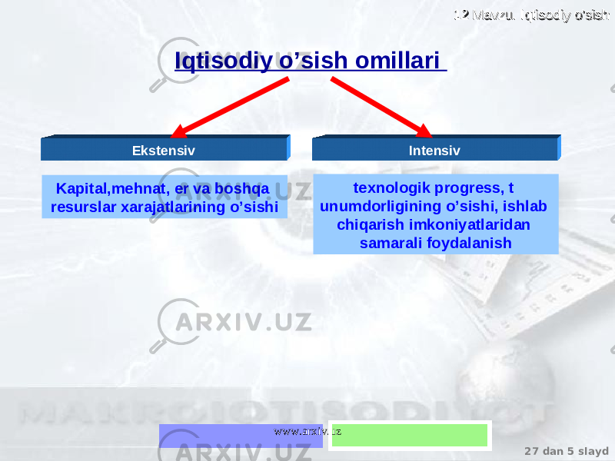
...
5. Labor Economics
## Monetary Economics: Monetary economics studies the role of money in the economy, focusing on: * Money supply: The total amount of money in circulation. * Interest rates: The cost of borrowing money. * Inflation: A general increase in prices. * Central banking: Institutions that manage monetary policy. Key concepts include: * Money demand: The amount of money people want to hold. * Money neutrality: The idea that changes in the money supply only affect nominal variables like prices, not real variables like output. * The Phillips curve: Shows the relationship between inflation and unemployment. * Monetary policy tools: Central banks use tools like interest rate adjustments and open market operations to influence the economy. Understanding monetary economics is crucial for policymakers and individuals alike, helping to navigate economic fluctuations and promote stability.
t.me/slaydai_bot

Slide 7
...
## Monetary Economics: Monetary economics studies the role of money in the economy, focusing on: * Money supply: The total amount of money in circulation. * Interest rates: The cost of borrowing money. * Inflation: A general increase in prices. * Central banking: Institutions that manage monetary policy. Key concepts include: * Money demand: The amount of money people want to hold. * Money neutrality: The idea that changes in the money supply only affect nominal variables like prices, not real variables like output. * The Phillips curve: Shows the relationship between inflation and unemployment. * Monetary policy tools: Central banks use tools like interest rate adjustments and open market operations to influence the economy. Understanding monetary economics is crucial for policymakers and individuals alike, helping to navigate economic fluctuations and promote stability.
t.me/slaydai_bot

Slide 8
...
## Monetary Economics: Monetary economics studies the role of money in the economy, focusing on: * Money supply: The total amount of money in circulation. * Interest rates: The cost of borrowing money. * Inflation: A general increase in prices. * Central banking: Institutions that manage monetary policy. Key concepts include: * Money demand: The amount of money people want to hold. * Money neutrality: The idea that changes in the money supply only affect nominal variables like prices, not real variables like output. * The Phillips curve: Shows the relationship between inflation and unemployment. * Monetary policy tools: Central banks use tools like interest rate adjustments and open market operations to influence the economy. Understanding monetary economics is crucial for policymakers and individuals alike, helping to navigate economic fluctuations and promote stability.
t.me/slaydai_bot

Slide 9
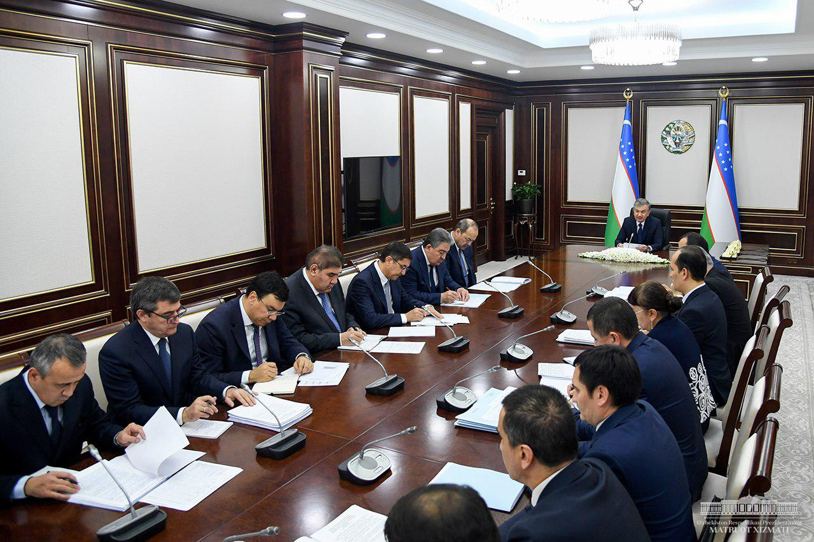
...
8. Econometrics
## Monetary Economics: Monetary economics studies the role of money in the economy, focusing on: * Money supply: The total amount of money in circulation. * Interest rates: The cost of borrowing money. * Inflation: A general increase in prices. * Central banking: Institutions that manage monetary policy. Key concepts include: * Money demand: The amount of money people want to hold. * Money neutrality: The idea that changes in the money supply only affect nominal variables like prices, not real variables like output. * The Phillips curve: Shows the relationship between inflation and unemployment. * Monetary policy tools: Central banks use tools like interest rate adjustments and open market operations to influence the economy. Understanding monetary economics is crucial for policymakers and individuals alike, helping to navigate economic fluctuations and promote stability.
t.me/slaydai_bot

Slide 10
...
## Monetary Economics: Monetary economics studies the role of money in the economy, focusing on: * Money supply: The total amount of money in circulation. * Interest rates: The cost of borrowing money. * Inflation: A general increase in prices. * Central banking: Institutions that manage monetary policy. Key concepts include: * Money demand: The amount of money people want to hold. * Money neutrality: The idea that changes in the money supply only affect nominal variables like prices, not real variables like output. * The Phillips curve: Shows the relationship between inflation and unemployment. * Monetary policy tools: Central banks use tools like interest rate adjustments and open market operations to influence the economy. Understanding monetary economics is crucial for policymakers and individuals alike, helping to navigate economic fluctuations and promote stability.
t.me/slaydai_bot

Slide 11
...
## Monetary Economics: Monetary economics studies the role of money in the economy, focusing on: * Money supply: The total amount of money in circulation. * Interest rates: The cost of borrowing money. * Inflation: A general increase in prices. * Central banking: Institutions that manage monetary policy. Key concepts include: * Money demand: The amount of money people want to hold. * Money neutrality: The idea that changes in the money supply only affect nominal variables like prices, not real variables like output. * The Phillips curve: Shows the relationship between inflation and unemployment. * Monetary policy tools: Central banks use tools like interest rate adjustments and open market operations to influence the economy. Understanding monetary economics is crucial for policymakers and individuals alike, helping to navigate economic fluctuations and promote stability.
t.me/slaydai_bot

Slide 12

...
11. Finance
## Monetary Economics: Monetary economics studies the role of money in the economy, focusing on: * Money supply: The total amount of money in circulation. * Interest rates: The cost of borrowing money. * Inflation: A general increase in prices. * Central banking: Institutions that manage monetary policy. Key concepts include: * Money demand: The amount of money people want to hold. * Money neutrality: The idea that changes in the money supply only affect nominal variables like prices, not real variables like output. * The Phillips curve: Shows the relationship between inflation and unemployment. * Monetary policy tools: Central banks use tools like interest rate adjustments and open market operations to influence the economy. Understanding monetary economics is crucial for policymakers and individuals alike, helping to navigate economic fluctuations and promote stability.
t.me/slaydai_bot

Slide 13
Iqtisodiyotning rivojlanishi va tarixi haqida
E'tiboringiz uchun raxmat!
Isroilov Iqtisodiyotning rivojlanishi va tarixi haqida

