Slide 1



BYTEBANDITS • AI TRACK
Container Congestion Predictor & Port Operations Optimiser
From real vessel-call data to proactive, shift-ready port decisions
Srujal Patel · Prince Patel · Manav Patel · Mantra Patel

Slide 2





Port congestion is discovered too late
Vessel arrivals
WHY IT HURTS OPERATORS
↓
↓
↓
Planning still runs on manual spreadsheets
Vessel queues build before capacity problems are visible
Berth and crane coordination is hard to align
Supervisors need immediate, actionable decisions
Manual planning
Late congestion discovery
WHEN VISIBILITY COMES TOO LATE
2021 LA/LB backlog: 100+ ships held offshore for weeks
Delays and waiting

Slide 3


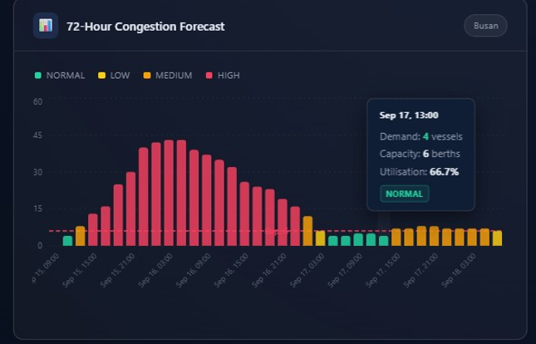
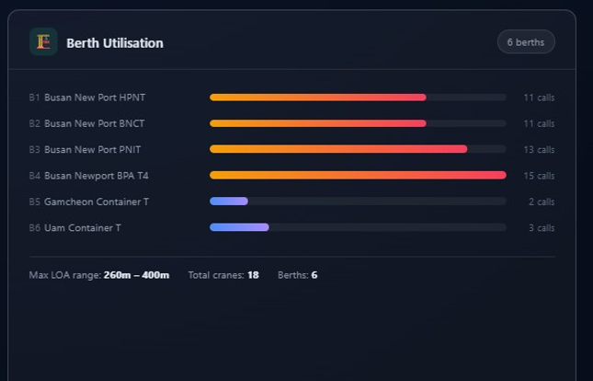
THE SOLUTION
One operational view connects arrivals, capacity, and action
01
02
03
04
05
06
IMF PortWatch AIS-based vessel-call data
72-hour calibrated vessel simulation
Congestion hotspot detection
Greedy berth & crane assignment
AI-generated operations brief
React operations dashboard
Operations dashboard — simulated per-vessel details labeled

Slide 4


Real aggregate data in, explainable decisions out
DATA
IMF PortWatch API → daily vessel-call aggregates → CSV cache / offline fallback
BACKEND
FastAPI → simulator.py → congestion.py → optimizer.py → brief_generator.py
OUTPUTS
72-hour congestion timeline · hotspot severity summary · berth & crane assignments · vessel wait times · Gemini or rule-based operations brief
FRONTEND
DEPLOYMENT
React + Vite + Recharts dashboard
Vercel frontend → Render backend

Slide 5


DEMO / KEY FEATURE
A shift supervisor can see the next 72 hours at a glance
Congestion timeline — demand, capacity, severity
Assignment table — berth, crane count, start/end, wait
Operations brief — concise, shift-ready plan
Detect the hotspot before the queue becomes the problem.

Slide 6




IBM Bob was load-bearing throughout the build
HOW WE USED IBM BOB
AI coding agent and development platform used end-to-end
Built and iterated the Python backend inside Bob
Built the React frontend inside Bob
Refined configuration and documentation with Bob
Prompt
↓
IBM Bob
↓
Backend + Frontend + Docs
TRANSPARENCY
↓
Google Gemini powers the optional natural-language operations brief and is not IBM technology. IBM Bob is our AI development platform and coding agent.
Working dashboard

Slide 7


RESULTS / IMPACT
The result is earlier visibility and explainable action
DEFENSIBLE RESULTS
CURRENT LIMITATIONS
72-hour forward planning window
One-hour congestion monitoring slots
LOW / MEDIUM / HIGH hotspot classification
Greedy berth assignment, O(V × B) complexity
~100 vessels handled in under 50 ms (architecture notes)
Structured operations brief for shift supervisors
Offline fallback when live data or Gemini is unavailable
Per-vessel ETAs and berth/crane counts are simulated
Greedy FCFS optimisation is not globally optimal
Gemini requires an API key
Render free-tier cold starts take 30–60s

Slide 8


THE TEAM
ByteBandits
Srujal Patel
Team Lead
Prince Patel
[Role to confirm]
Manav Patel
[Role to confirm]
Mantra Patel
[Role to confirm]
Turning vessel data into decisions before congestion becomes delay.

