Slide 1
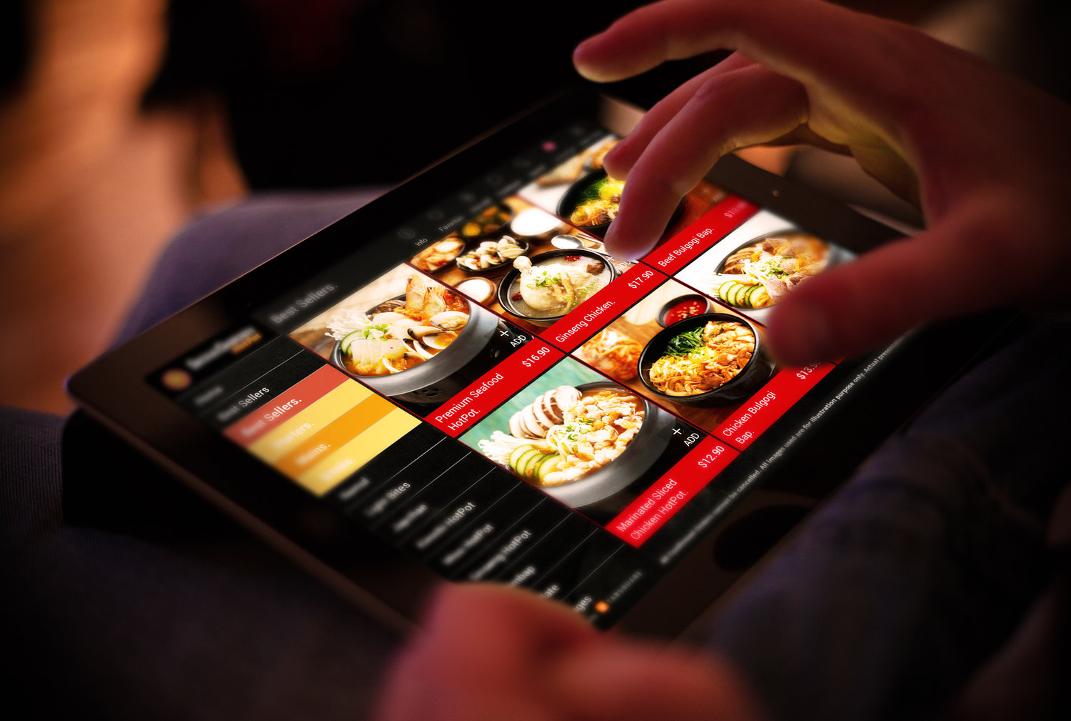
Smart Dining based on Restaurant Occupancy
-Vivek Narayanamurthy & Sriram Vamsi Ilapakurthy
Notes:
Search Engines are being dominat, the web is huge and we need someone to index it.
This is one of the projects which I developed for one of my courses.

Slide 2
Scope
Motivation
Hardware and Sensing
Middleware and Communication
Learning Algorithm
UI/UX
Video Demo

Slide 3
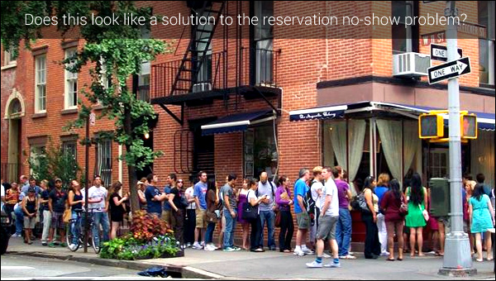
A 2 hour wait outside a Restaurant!!

Slide 4
Motivation
Can we predict the occupancy of a restaurant ?
An integrated app for occupancy and reservation.
Knowing the popular times helps in planning.
Predicts the supply and demand.
Better customer experience.
Improved productivity of restaurant.

Slide 5
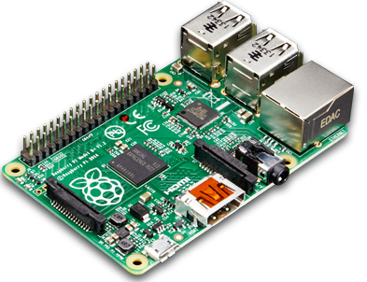
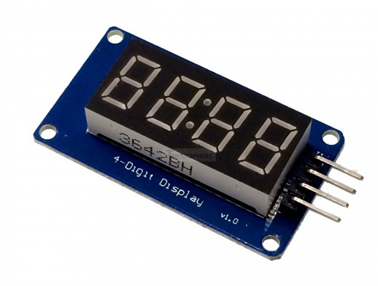
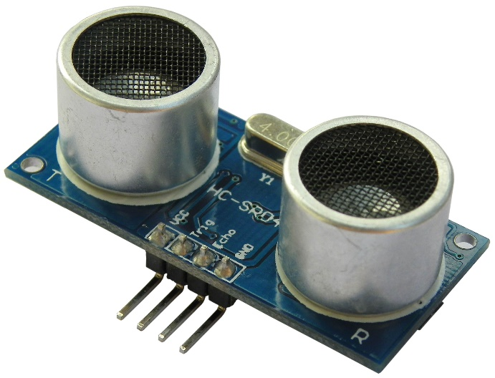
Hardware and Sensors
Most of all the restaurants have Wi-Fi
Raspberry Pi 3
Two ultrasonic sensors
Seven Display

Slide 6
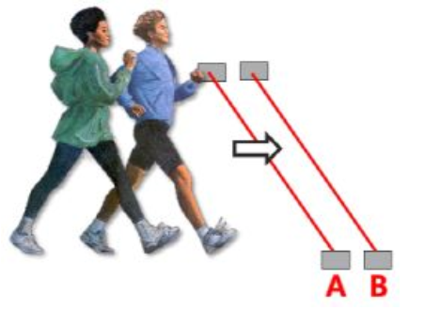

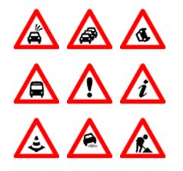
Sensing and Data collection
Bi-directional Sensor
Bing Traffic Incidents
Weather data from Open Weather

Slide 7
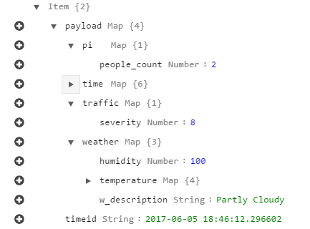
Captured Data Format

Slide 8
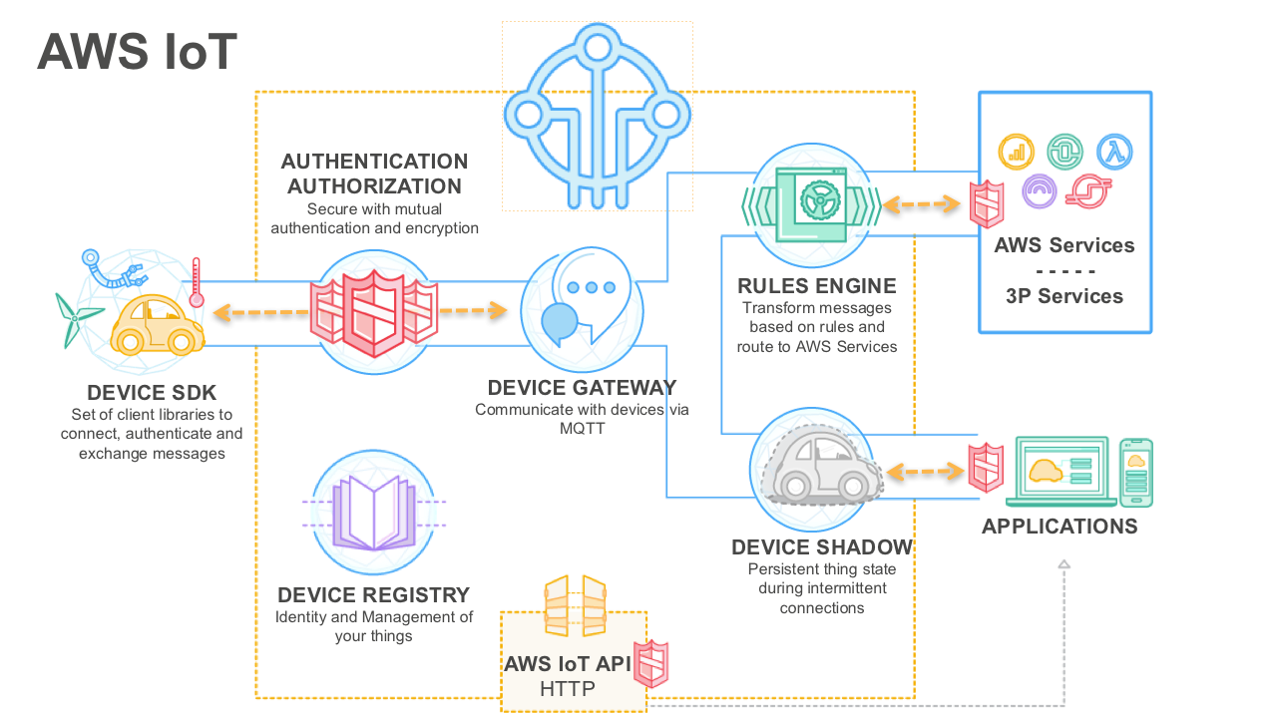

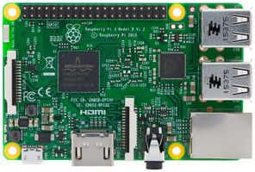

AWS and MQTT broker Dataflow

Slide 9
Intelligence
Using Machine Learning
Supervised learning
A regression problem
Time dependent (Exponentially Weighted Moving Average)
Sequentially Periodic dataset
Code: https://github.com/isrvamsi/smart-restaurant/blob/master/notebook.ipynb

Slide 10
Predictions

Slide 11
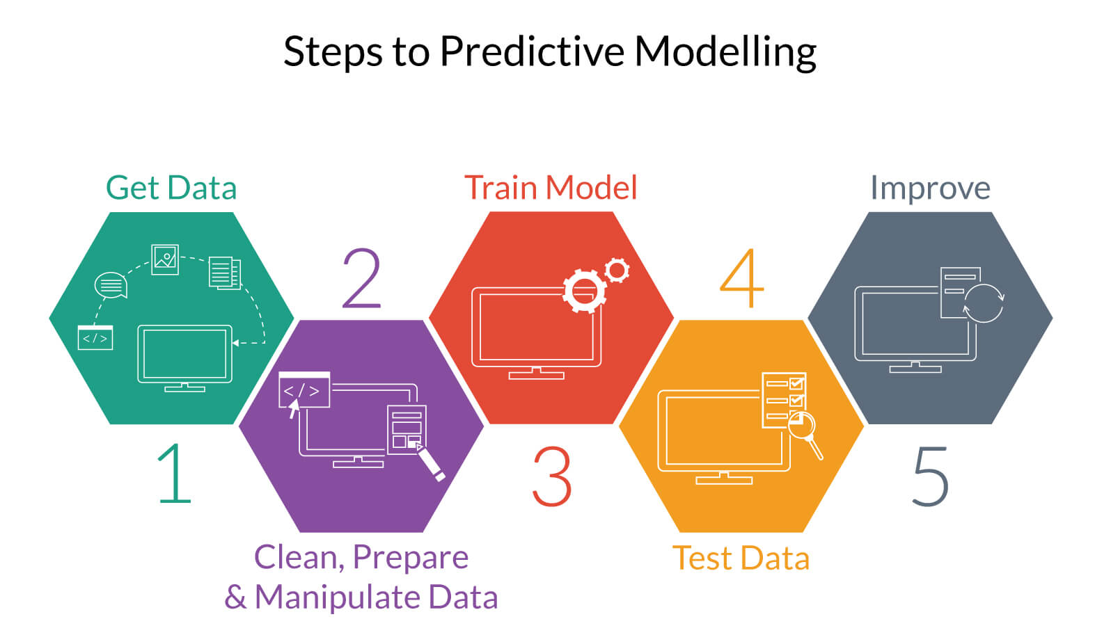
Steps in Learning Algorithm
Data pre-processing
Learning Algorithm
Linear Regression
Ridge Regression
Verification
Cross validation
Grid search

Slide 12
UI/UX
A box-shaped convenient hardware.
AWS IoT provides an overview of MQTT Communications.

Slide 13
End user interface

Slide 14

Security and Privacy
Security:
The box needs to be physically secured.
No data is stored locally, only keys. SD Card needs to be encrypted.
Communication is secure over MQTT.
Privacy:
Data collection is anonymous wrt to customers.

Slide 15
References
http://docs.aws.amazon.com/machine-learning/latest/dg/tutorial.html
https://www.modmypi.com/blog/hc-sr04-ultrasonic-range-sensor-on-the-raspberry-pi
https://archive.ics.uci.edu/ml/datasets.html
https://www.kaggle.com/discussion

