Slide 1

Barmij bl Lebneneh
SUPERVISED BY DR. gilbert tekli
Mira Amer, Malak seifeddine, issa assi

Slide 2
Introduction
A compiler is a computer program that translates source code written in a high-level programming language into machine code that can be executed by a computer.
All high-level programming languages require a compiler.

Slide 3
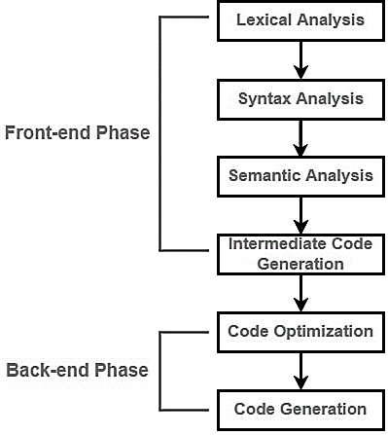
Phases of a Compiler
A compiler is composed of 2 main sections: front end & back end.
Front end
Lexical analysis, syntax analysis, semantic analysis, and intermediate code generation.
Back end
Code optimization and code generation.
Each phase passes on its work to the next phase.

Slide 4
Lexical Analysis
Source code is read and broken down into lexemes or tokens.
Lexemes are essential phrases in the code.
Removes whitespaces, large characters and comments.
Tokens are streamed to the syntax analyzer.
Source Code:
#tejhiz ra2m x=4 ra2m y=0 #barmajeh iza x>3.1: y=10
Tokens generated:
#tejhiz, INDENT, ra2m, x, =, 4, INDENT, ra2m, y, =, 0, DENDET, #barmajeh, INDENT, iza, x, >, 3.1, :, INDENT, INDENT, y, =, 10, DEDENT, DEDENT.

Slide 5
Syntax Analysis
The Stream of tokens from the lexical analysis is checked for grammar issues (syntax errors).
After checking, these tokens are arranged in an Abstract Syntax Tree (AST).
This AST is then passed into the semantic analyzer.

Slide 6
Example of Syntax Analysis
#tejhiz
#barmajeh
=
=
iza
>
t
f
x
4
y
0
x
3.1
=
y
10

Slide 7
Semantic Analysis
Verifies the AST built by the syntax analyzer.
Does type checking, label checking, and flow control checking to ensure that the code's meaning is consistent.
Sends semantically correct AST to intermediate code generator for the last phase of the front end of the compiler.

Slide 8
Intermediate Code Generation
Source:
#tejhiz ra2m x=4 ra2m y=0 #barmajeh iza x>3.1: y=10
Intermediate Code Generated:
ra2m x, 4 ra2m y, 0 iza x>3.1, goto true goto false true: y = 10 goto true_end false: true_end:
A set of pseudo code is generated in a similar structure to assembly code.
This makes it easy for the compiler to translate.

Slide 9
Code Optimization
Intermediate Code:
ra2m x, 4 ra2m y, 0 iza x>3.1, goto true goto false true: y = 10 goto true_end false: true_end:
Optimized Code:
ra2m x, 4 ra2m y, 0 iza x>3.1, goto true goto true_end true: y = 10 goto true_end true_end:
Optimizes intermediate code to reduce resource consumption and improve speed without altering the code's meaning.

Slide 10
Code Generation
Intermediate Code:
ra2m x, 4 ra2m y, 0 iza x>3.1, goto true goto false true: y = 10 goto true_end true_end:
Assembly Code:
mov r1, #4 /* ra2m x = 4 mov r2, #0 /* ra2m y = 0 ldr r3, =3.1 /* Load 3.1 into cmp r1, r3 /* Compare x with 3.1 blt false /* If 3.1-x<0, go to false true: mov r2, #10 /* ra2m y = 10 b true_end /* Go to true_end true_end:
The final stage of a compiler.
Translates optimized intermediate code into assembly code.

Slide 11

References
“Grouping of Phases in Compiler Design.” GeeksforGeeks, 2 Mar. 2022, www.geeksforgeeks.org/grouping-of-phases-in-compiler-design/.
“Phases of a Compiler.” GeeksforGeeks, 15 Nov. 2017, www.geeksforgeeks.org/phases-of-a-compiler/.

