Slide 1
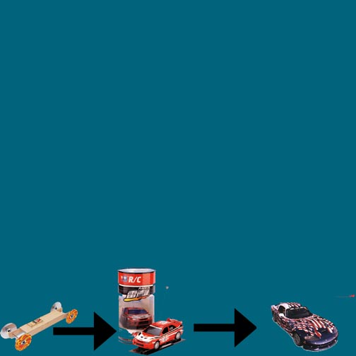
Cars
By: Ilyssa Evans ☺

Slide 2
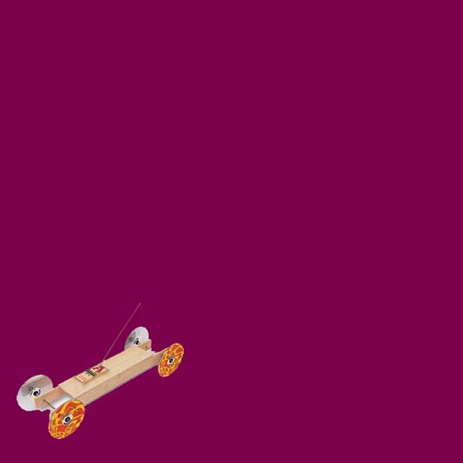
My Design--
I used a 10 inch piece of blue bass wood, 4 red wheels, a small motor, a battery, and 2 gears. The battery was attached to the motor. The motor was attached to the gears, and the gears were attached to the tires. The battery caused to motor to move and the motor caused the gears and the tires too move, which carried it forward.

Slide 3

History—Electric cars
Between 1832 and 1839 (the exact year is uncertain), Robert Anderson (from Scotland) invented the first electric carriage. A small scale electric car was designed by Professor Stratingh, and built by his assistant Christopher Becker in 1835. More successful electric road vehicles were invented by both American Thomas Davenport and Scotsmen Robert Davidson around 1842. Both inventors were the first to use non-rechargeable electric cells.

Slide 4
History—Mousetrap Cars
The first mousetrap car invented was in 1897 by James Henry Atkinson who was a British inventor. He invented a first of its kind mousetrap car. This was called "Little Nipper". The Little Nipper had the small flat wooden base, the spring trap, and the wire fastenings, which made it your common mousetrap.

Slide 5
History—Regular Cars (General)
The German Nikolas Otto (1832-91) made the first four-stroke engine in 1876 and in 1885 Daimler had installed a small four-stroke engine in a cycle frame. The automobile was not invented overnight. It took shape from a buildup of technical advances that resulted in a light and efficient engine.

Slide 6
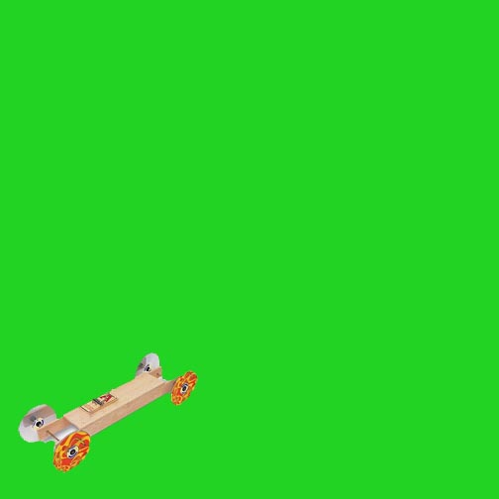
Electric And How It Works
The electric car is powered by a battery. The battery makes the motor power. The motor movies the gears and the gears are connected to the wheels so the wheels move. You can make the front wheels go forward and carry the back wheels, or you can power the back wheels power forward and push the front wheels.

Slide 7
A Way To Help It
With the electric cars, you have to be careful of the gears not coming off of the other gears. If one gear doesn’t go then the other one won’t go and the wheels won’t spin.
So some things you can do to help it become efficient are;
Make sure wheels don’t move
Make sure gears don’t move around
Make sturdy

Slide 8
My Model Is Proficient Because
It uses gears, which could make the car go longer and faster.
It uses a battery which means it can go any amount of distance depending on power, not the mouse trap.
It’s lightweight and easy which makes it easy to travel.

Slide 9
Speed & Distance
The predicted speed and distance was 3 miles per hour.

Slide 10
Resources
http://members.tripod.com/~Eagle_Planet/History_of_cars_part1.html#first
http://inventors.about.com/library/weekly/aacarselectrica.htm
http://inventors.about.com/library/weekly/aacarssteama.htm
http://inventors.about.com/library/inventors/blcar.htm
http://www.absupplies.com/index.php?act=viewProd&productId=32
Hobby Town USA
Ed Evans

