Slide 1

Mini Healthcare Helper

Slide 2
Project Description
This project is a healthcare helper created for small clinics during COVID like crisis.
Helps patient to schedule an appointment
Doctor can prepare as per the scheduled appointment
Blood donors can register and Admin can connect them in need.
Motivation: Patients can avoid queue in hospitals. Lessen social gathering during COVID crisis

Slide 3

Activities

Slide 4
Activities
Admin(HealthCare System) can register the doctors after verifying their certifications manually.
Doctors can register themselves with their qualification and can see the scheduled appointment
Patient can book appointments by selecting from the available doctors
Blood Donors can register. HealthCare System can look into list of donors and connect in need.

Slide 5
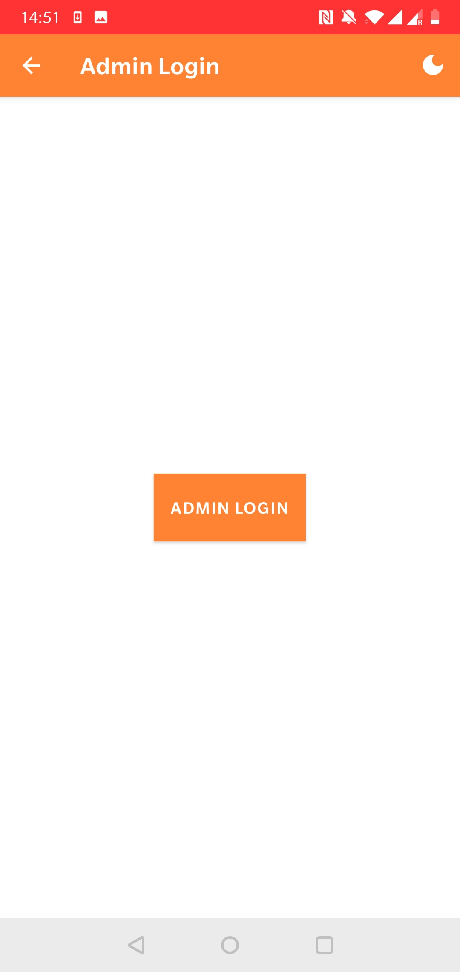
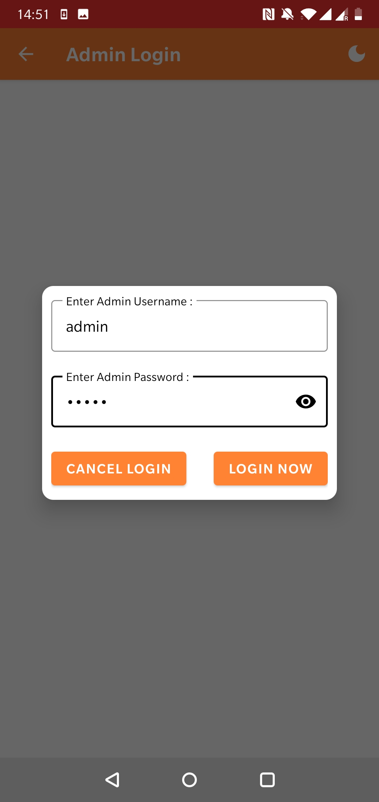
Activity 1.1: Admin Login

Slide 6
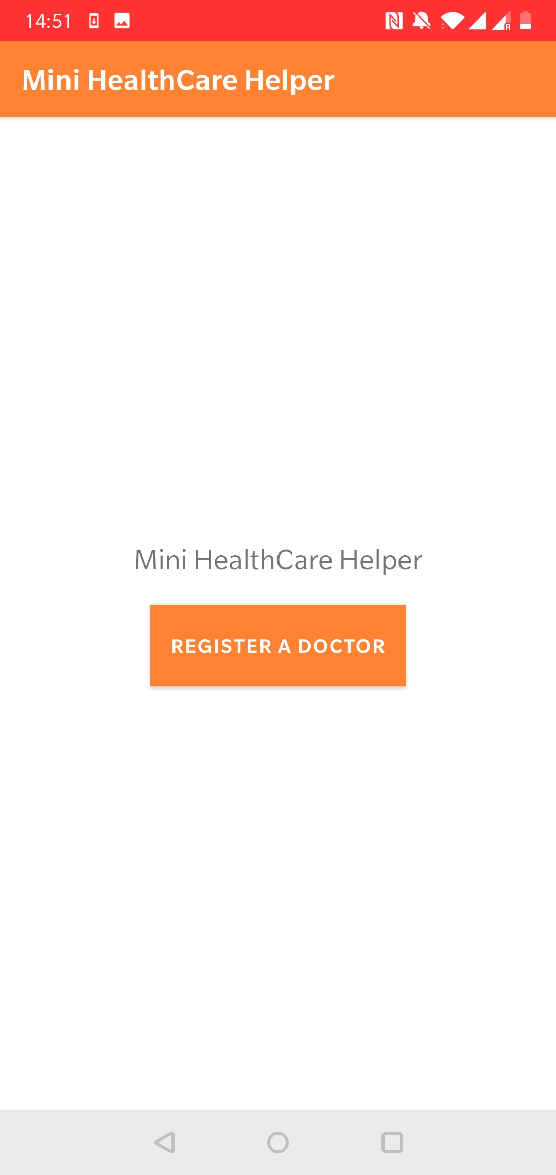
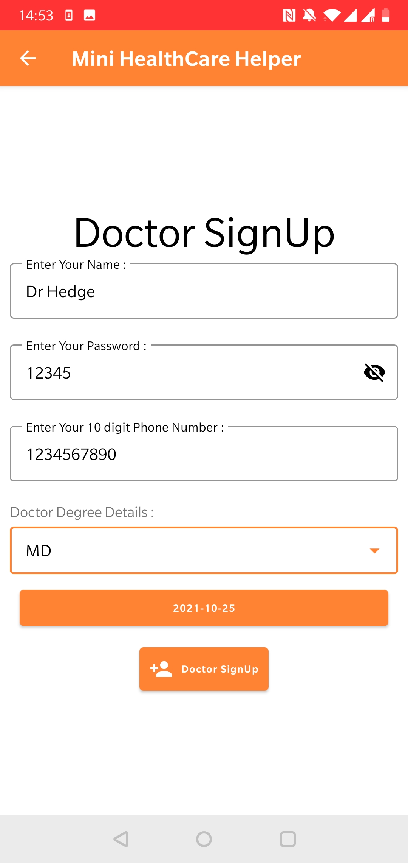
Activity 1.1: Admin Login
HealthCare will register doctor through Admin login

Slide 7
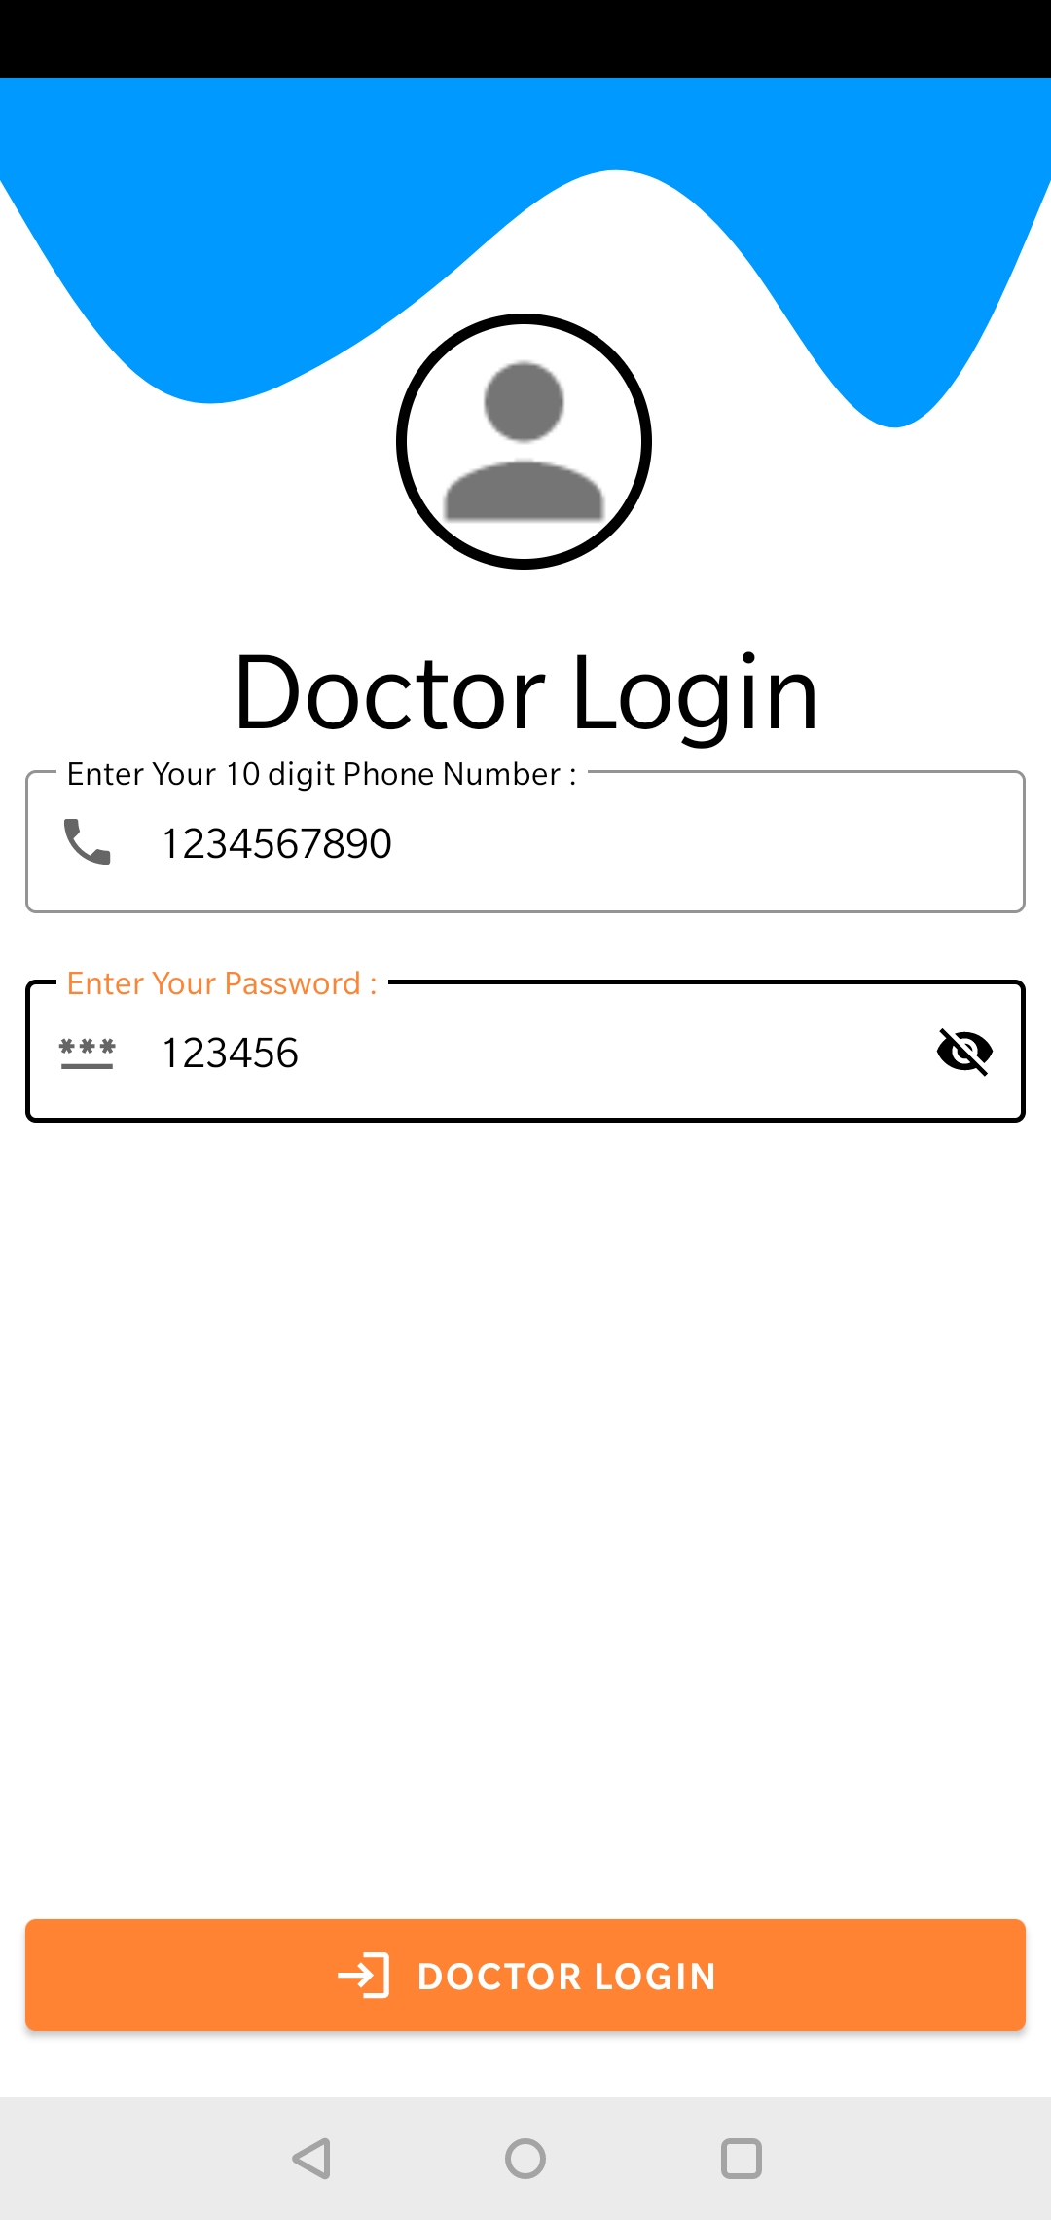
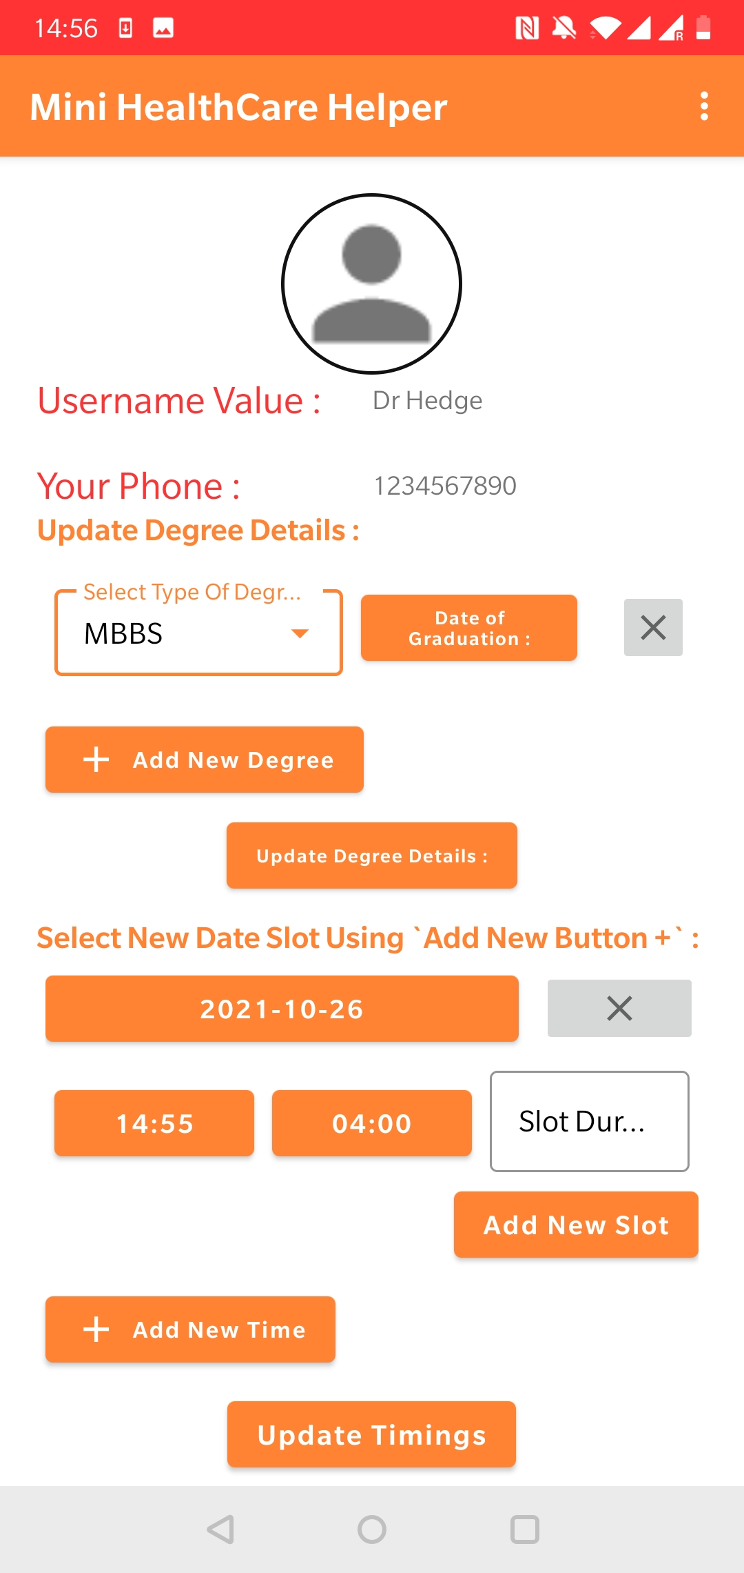
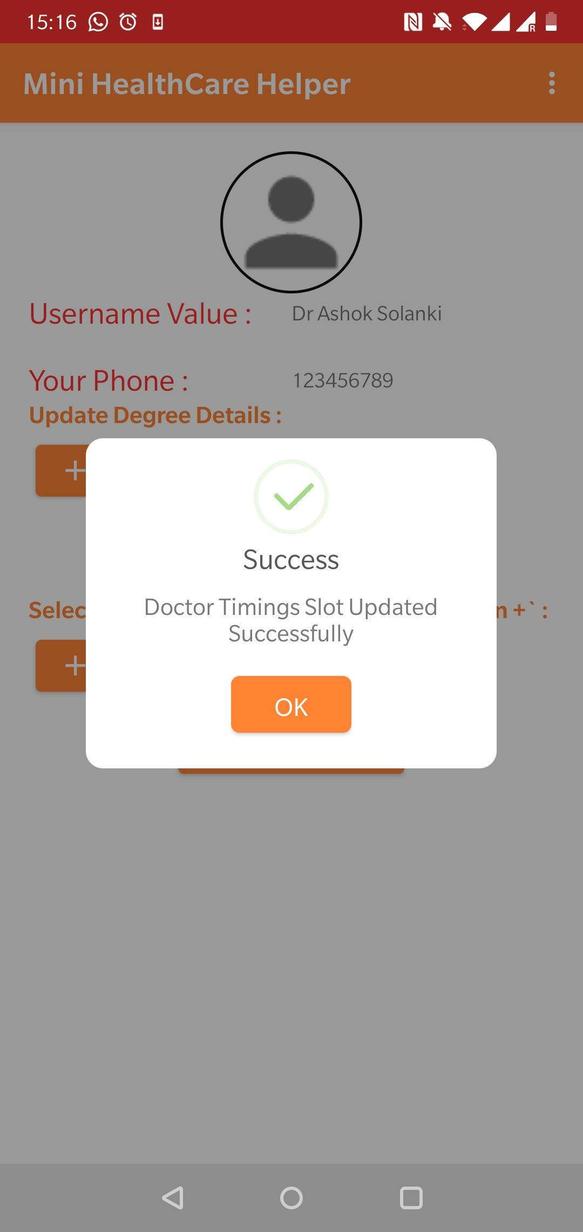
Activity 2.1: Doctor Login
Doctor can add his availability slots in the system

Slide 8
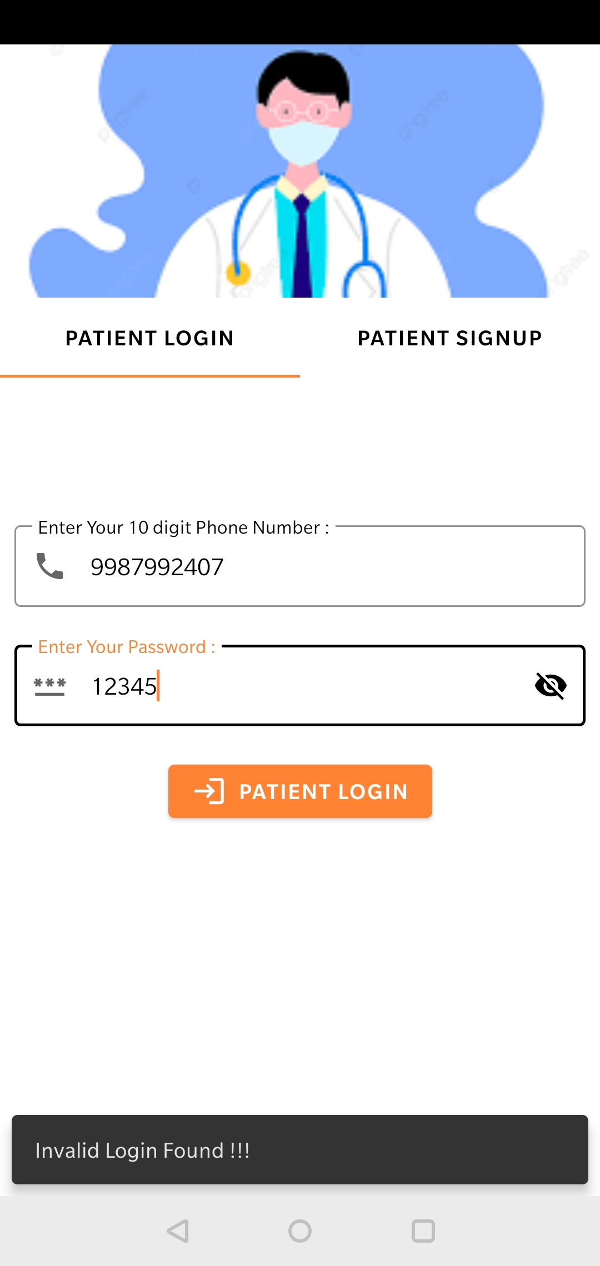
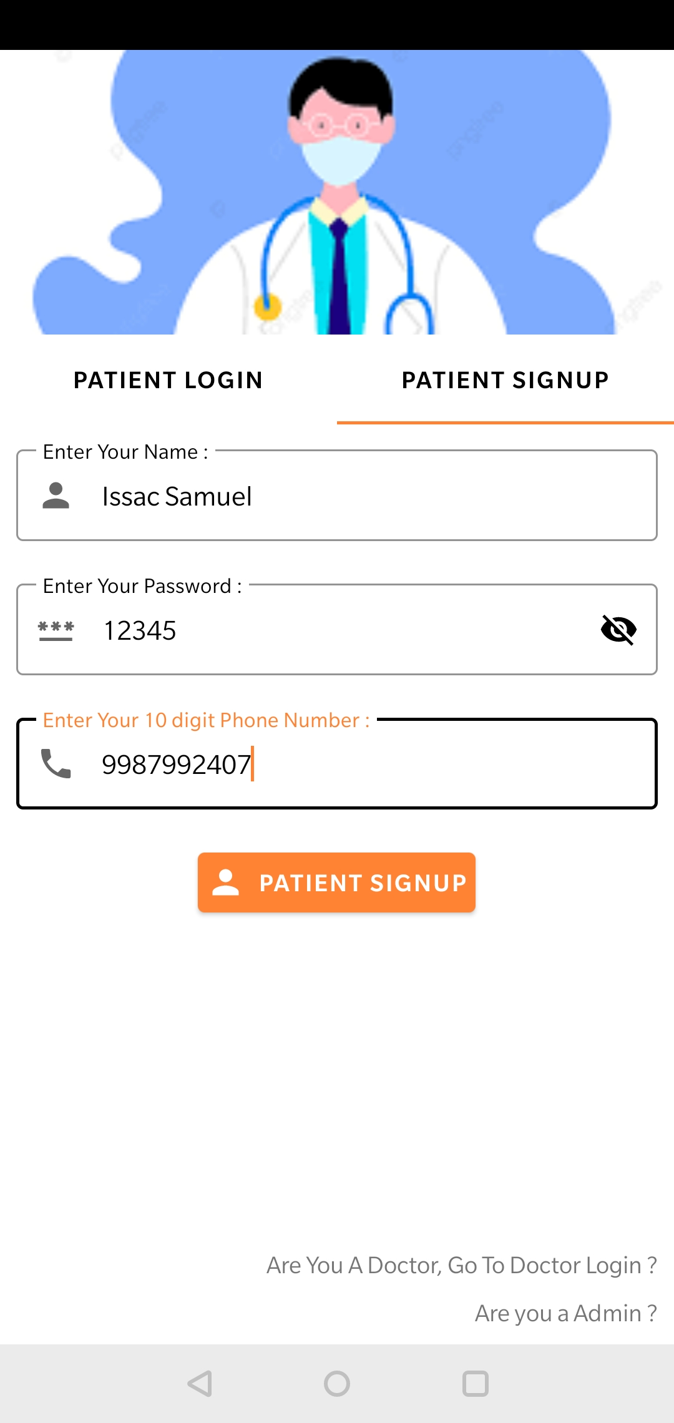
Activity 3.1 : Patient Login
Image 1 shows the patient does not exist
Image 2 Registration of the patient

Slide 9
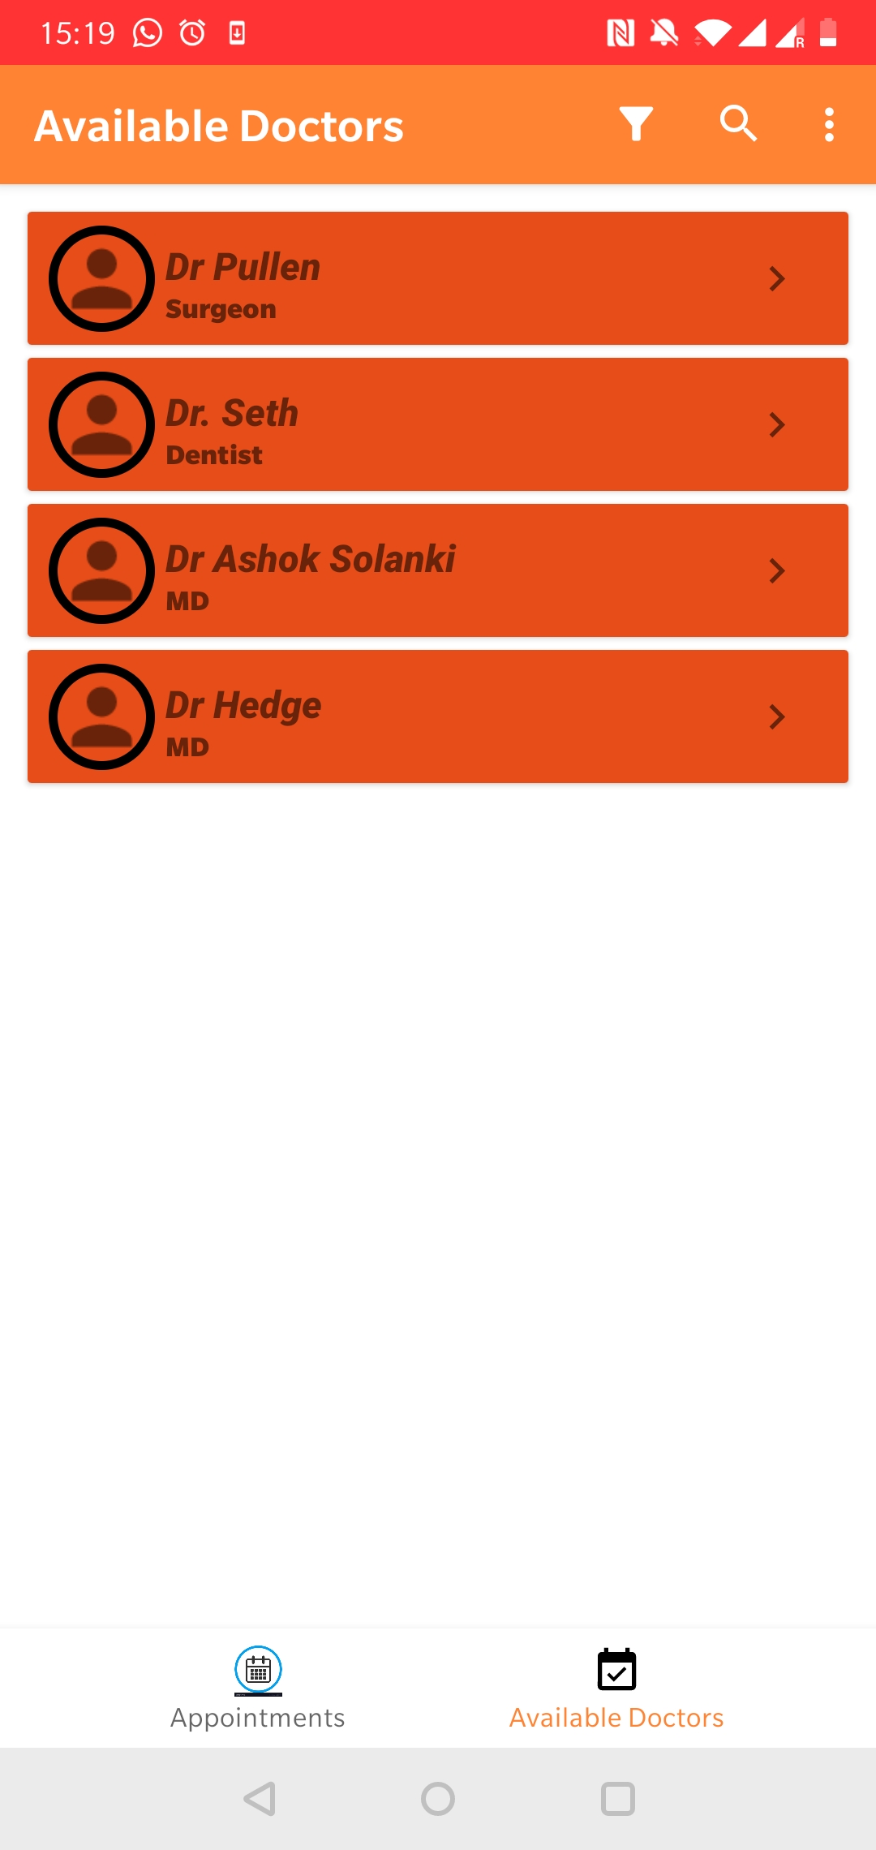
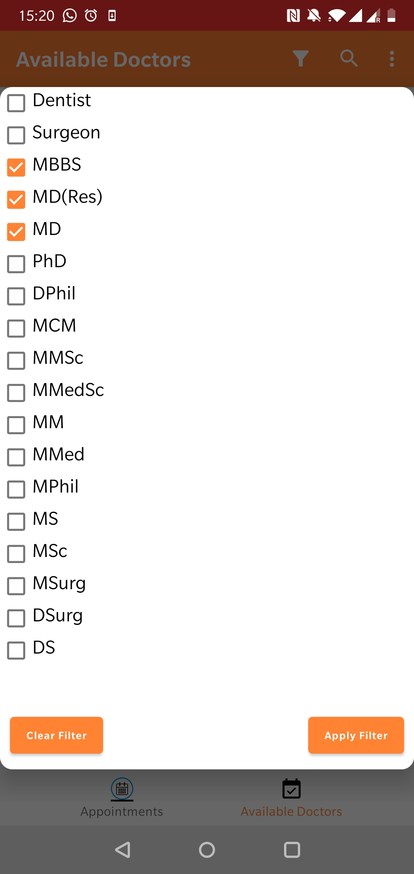
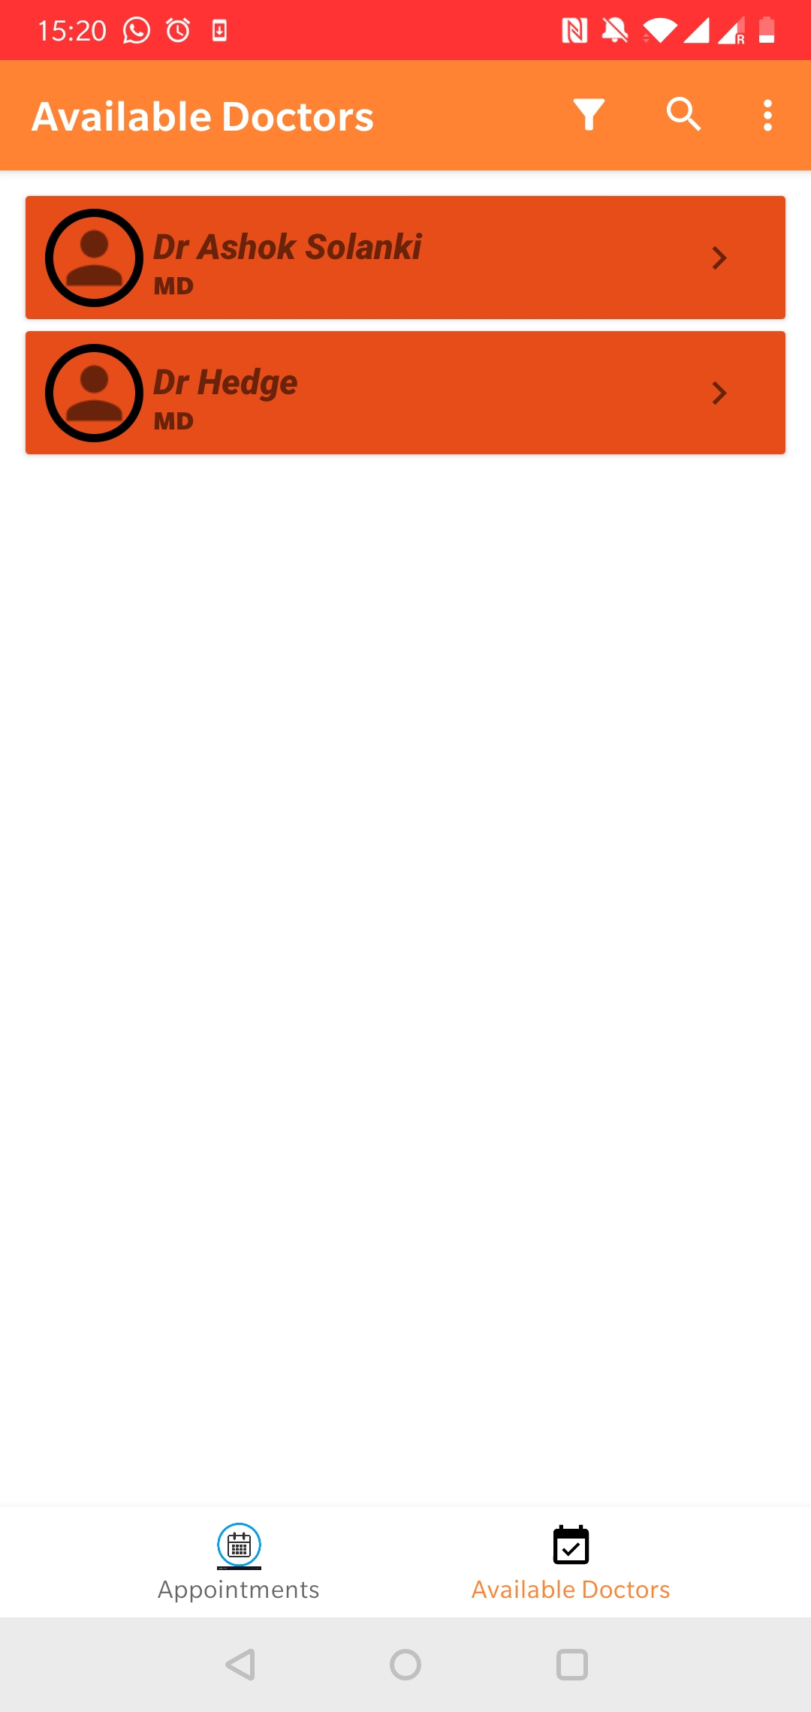
Activity 3.2 : Patient booking appointment
Patient filtering the needed doctor before booking appointment

Slide 10
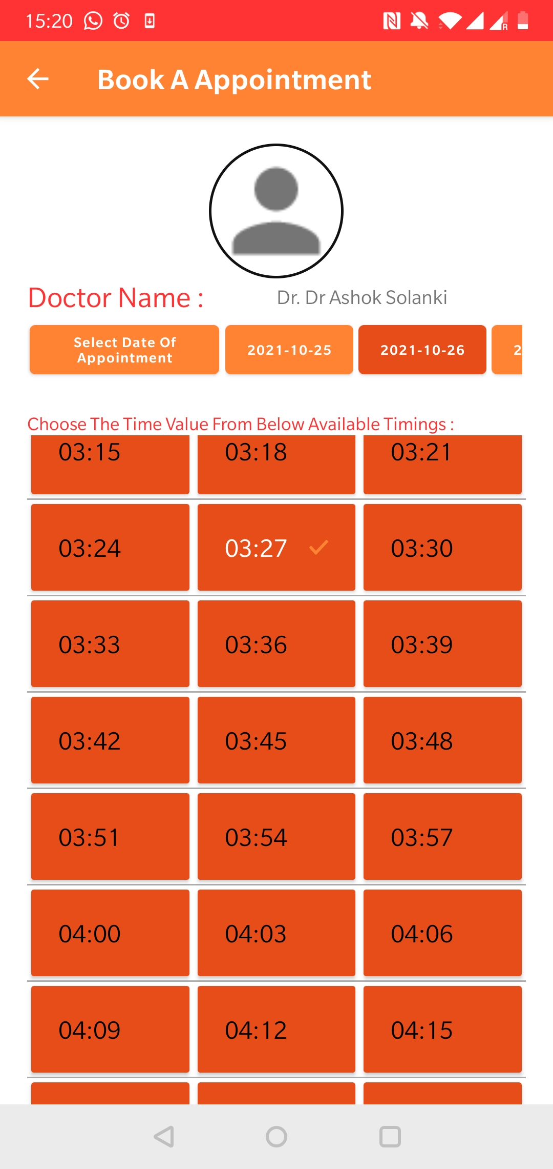
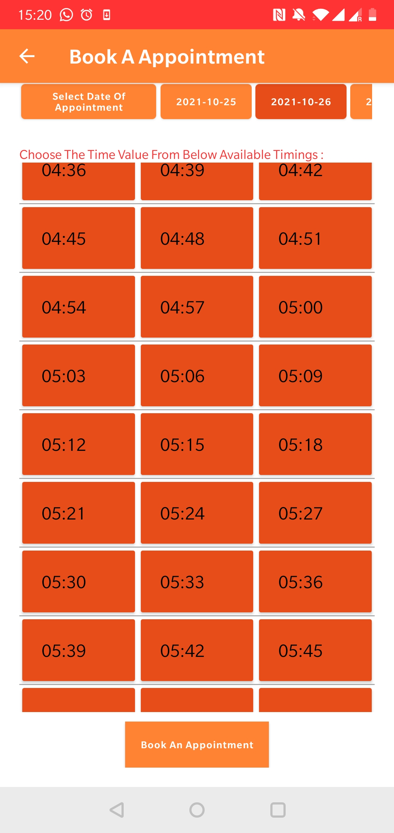
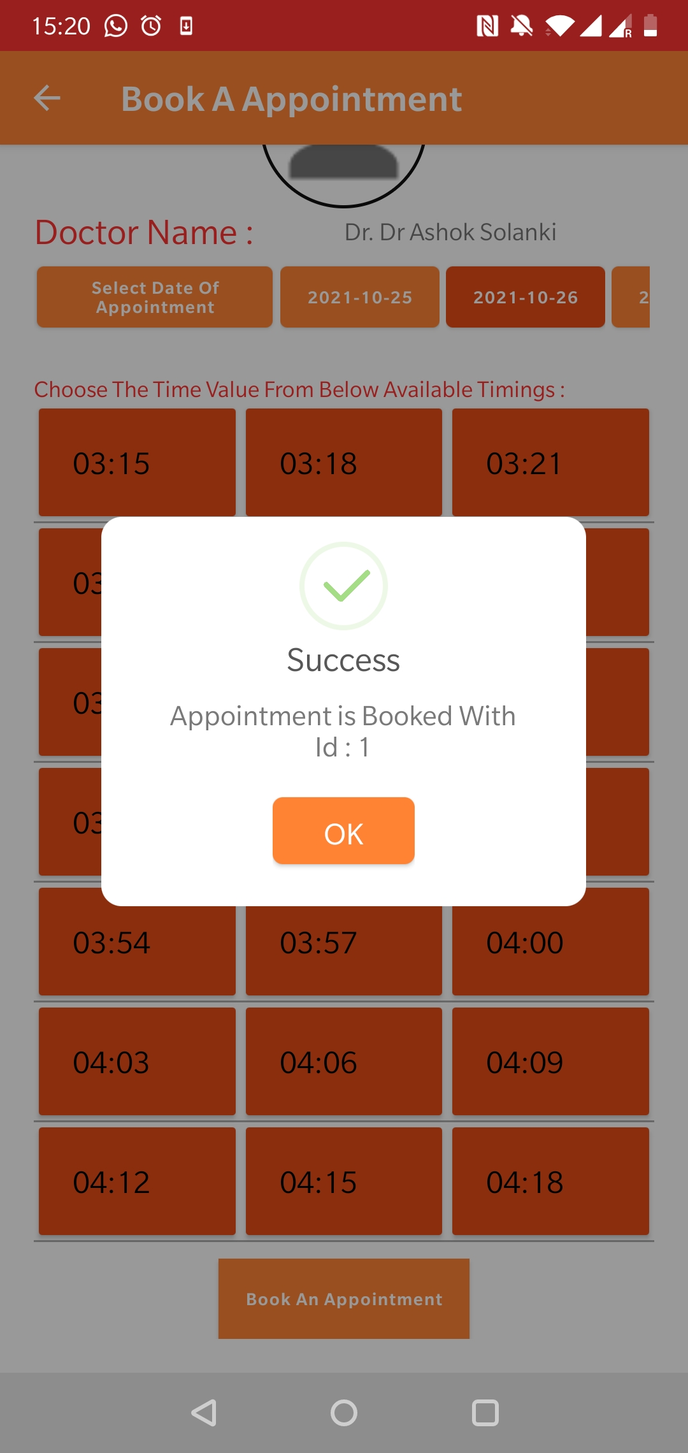
Activity 3.2 : Patient booking appointment (Ctd)
Patient filtering the needed doctor before booking appointment

Slide 11
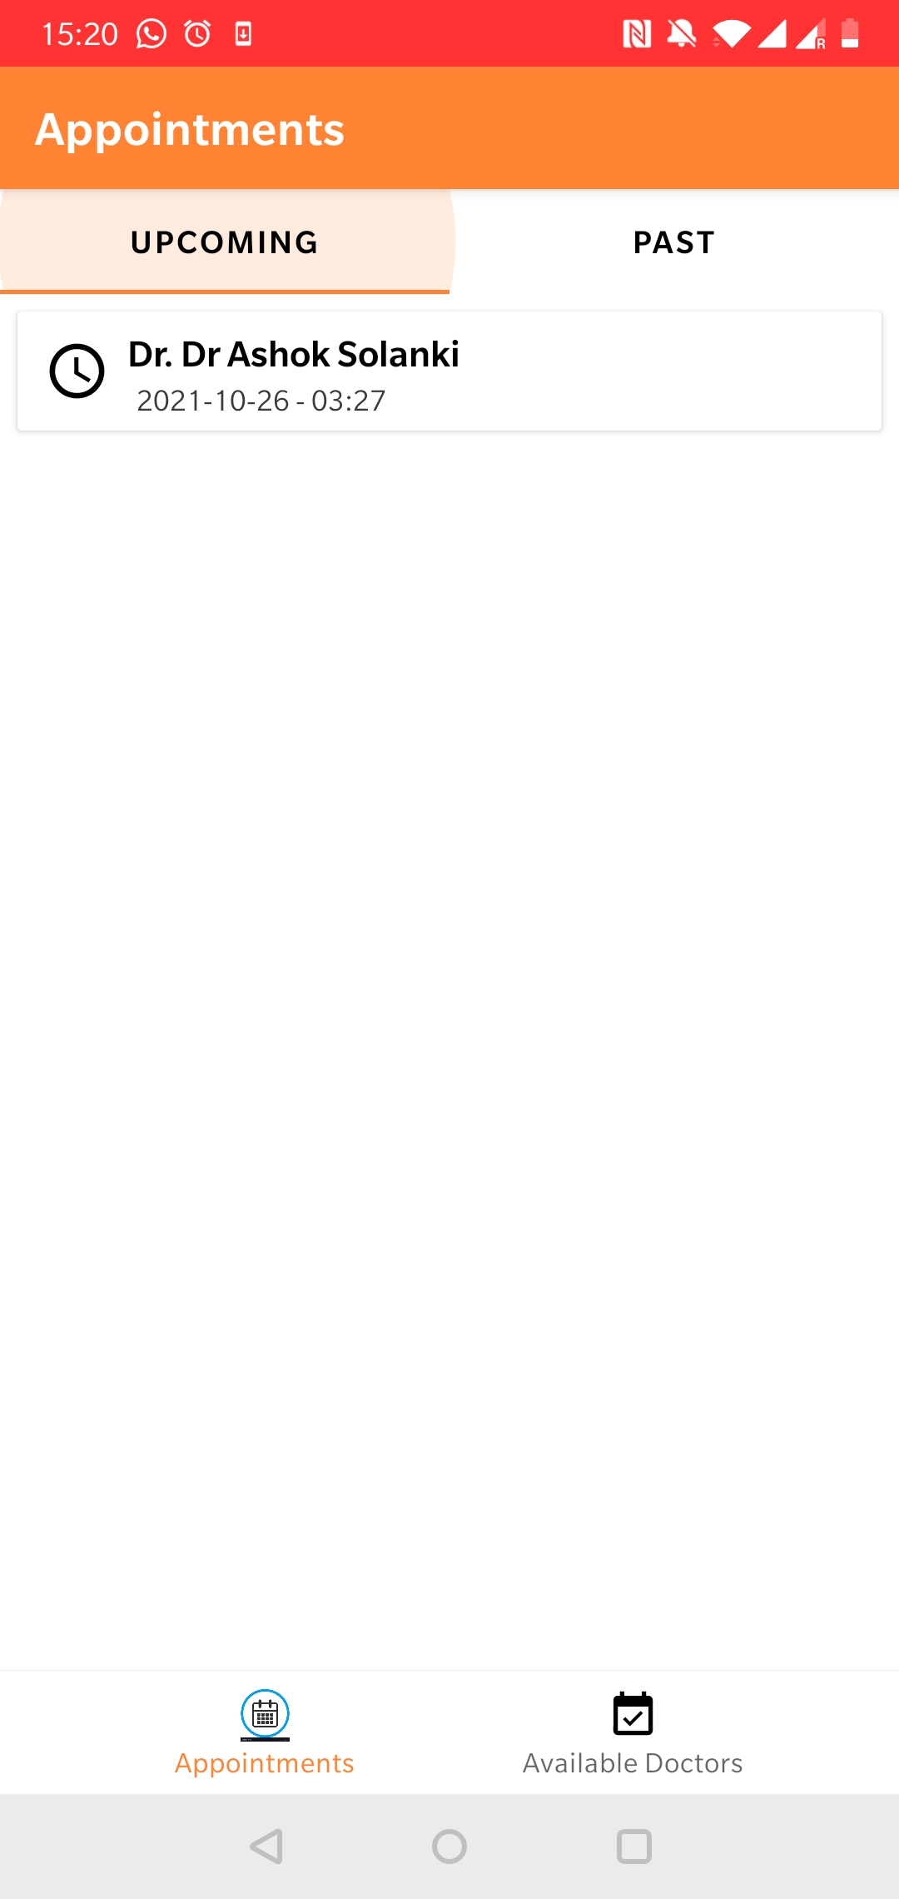
Activity 3.2 : Patient booking appointment (Ctd)
Patient filtering the needed doctor before booking appointment

Slide 12
Social Relevance
This mini helper software is to help small clinics to avoid social gathering during COVID.
Patient can book appointments by selecting from the available doctors from Home and visit only at appointed time. Thus, resolving issue of social gathering.
Blood Donors can register. HealthCare System can look into list of donors and connect in need.
Thus, the patient and healthcare system can function with social distance rules followed.

Slide 13
Database

Slide 14
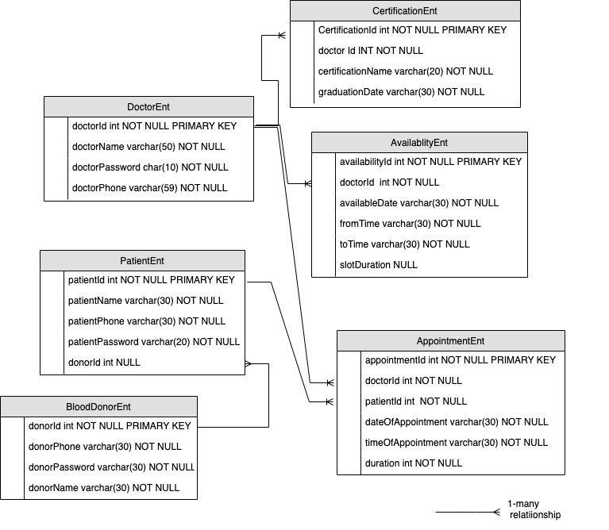
Firebase Database
Doctor can have multiple certifications, multiple availability timings and appointments.
Patient may have multiple appointment and may or may not have a blood donor
Blood Donor may have more than one recipients

Slide 15
Demo

