Slide 1

Mini Healthcare Helper

Slide 2
Project Description
This project is healthcare helper created for this COVID like crisis.
Helps patient to schedule an appointment
Doctor can prepare as per the scheduled appointment
Blood donors can register and Admin can connect them in need.
Motivation: Patients can avoid queue in hospitals. Lessen public gathering during COVID crisis

Slide 3

Activities

Slide 4
Activities
Admin(HealthCare System) can register the doctors after verifying their certifications mannually.
Doctors can register themselves with their qualification and can see the scheduled appointment
Patient
Blood Donors can register. HealthCare System can look into list of donors and connect in need.

Slide 5
Activity 1.1: Admin Login

Slide 6
Activity 1.1: Doctor Login

Slide 7
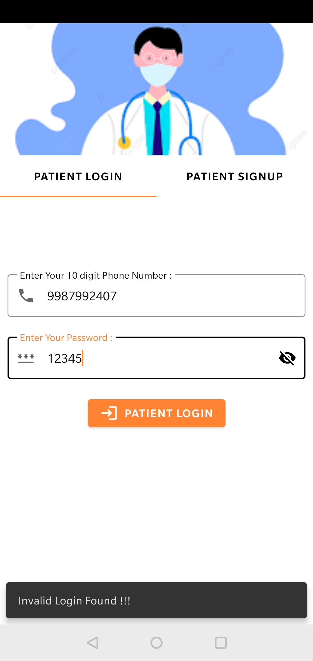
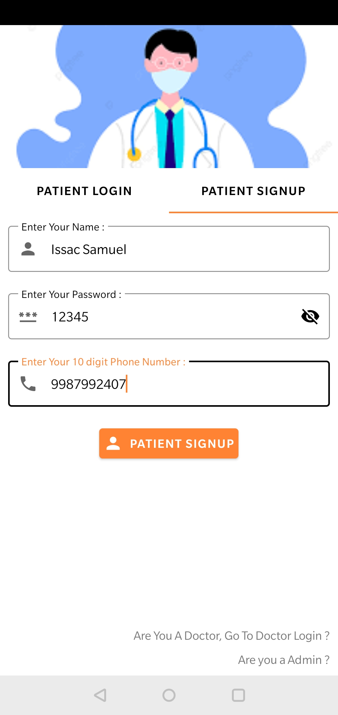
Activity 3.1 : Patient Login
Image 1 shows the patient does not exist
Image 2 Registration of the patient

Slide 8
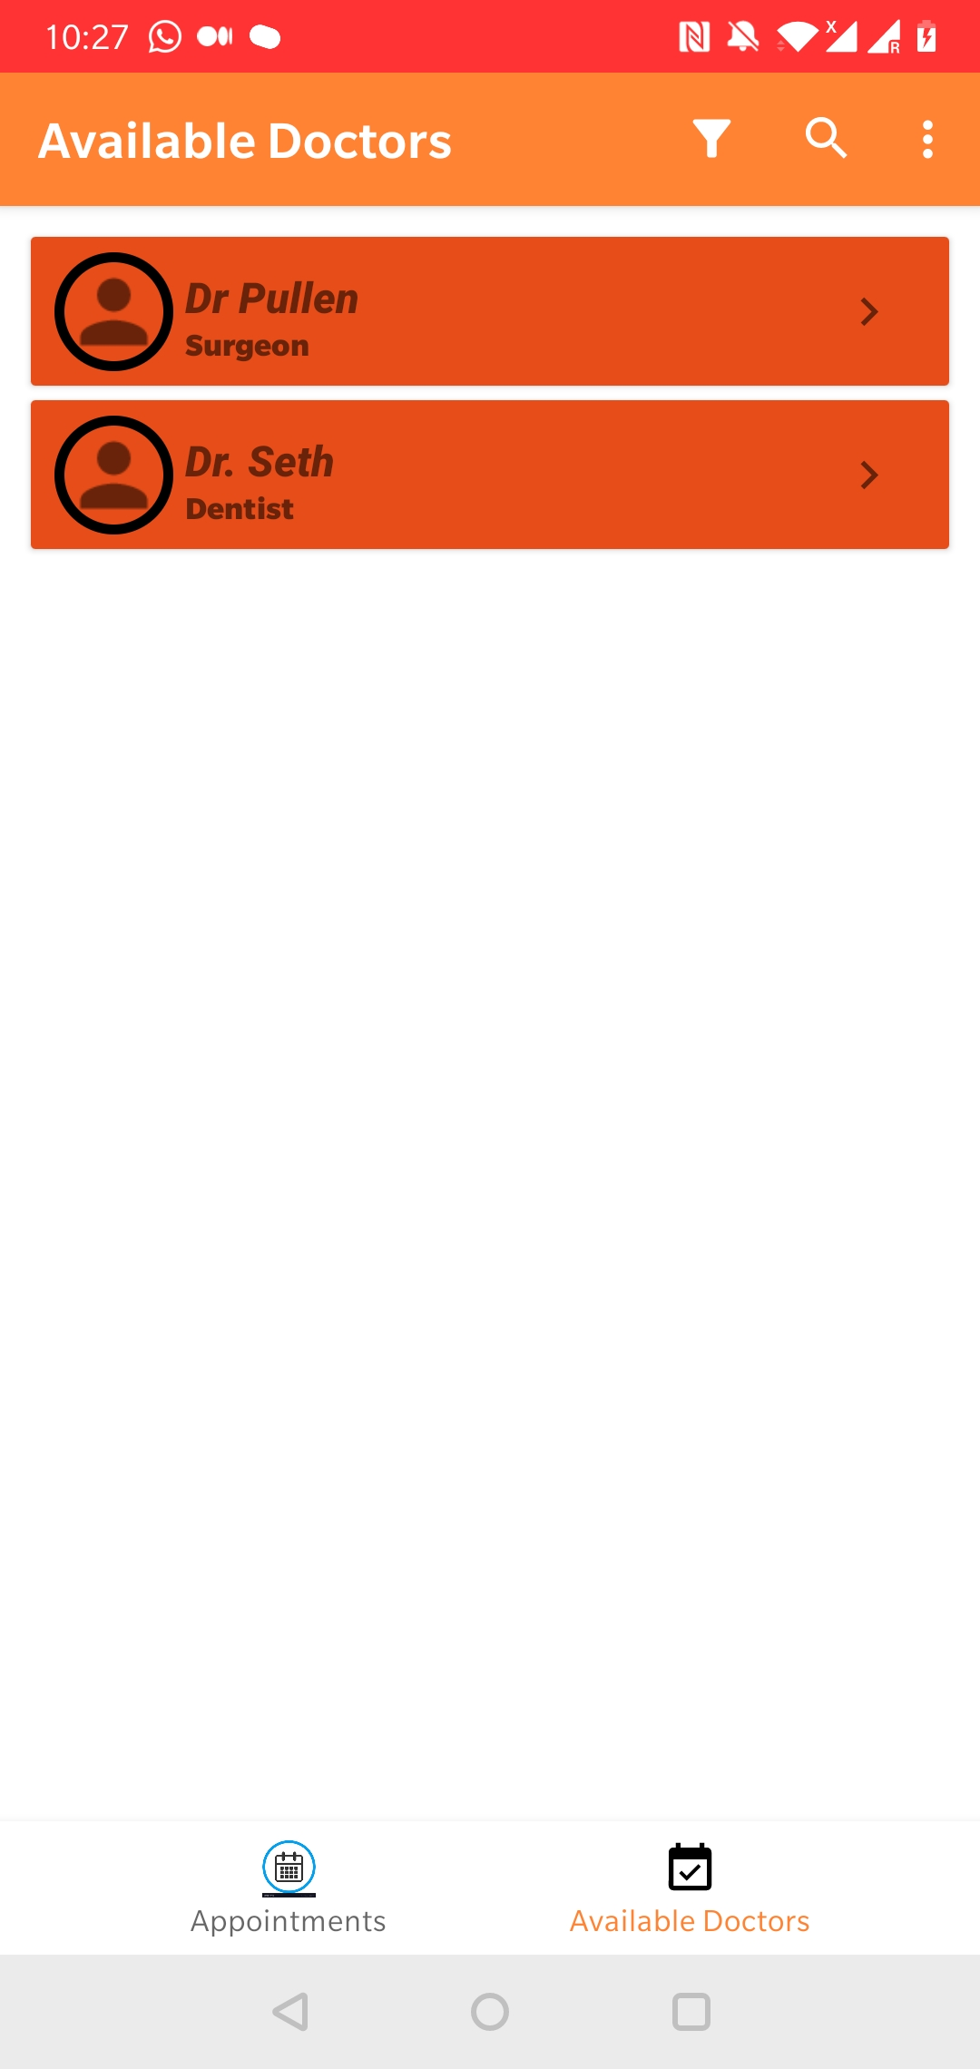
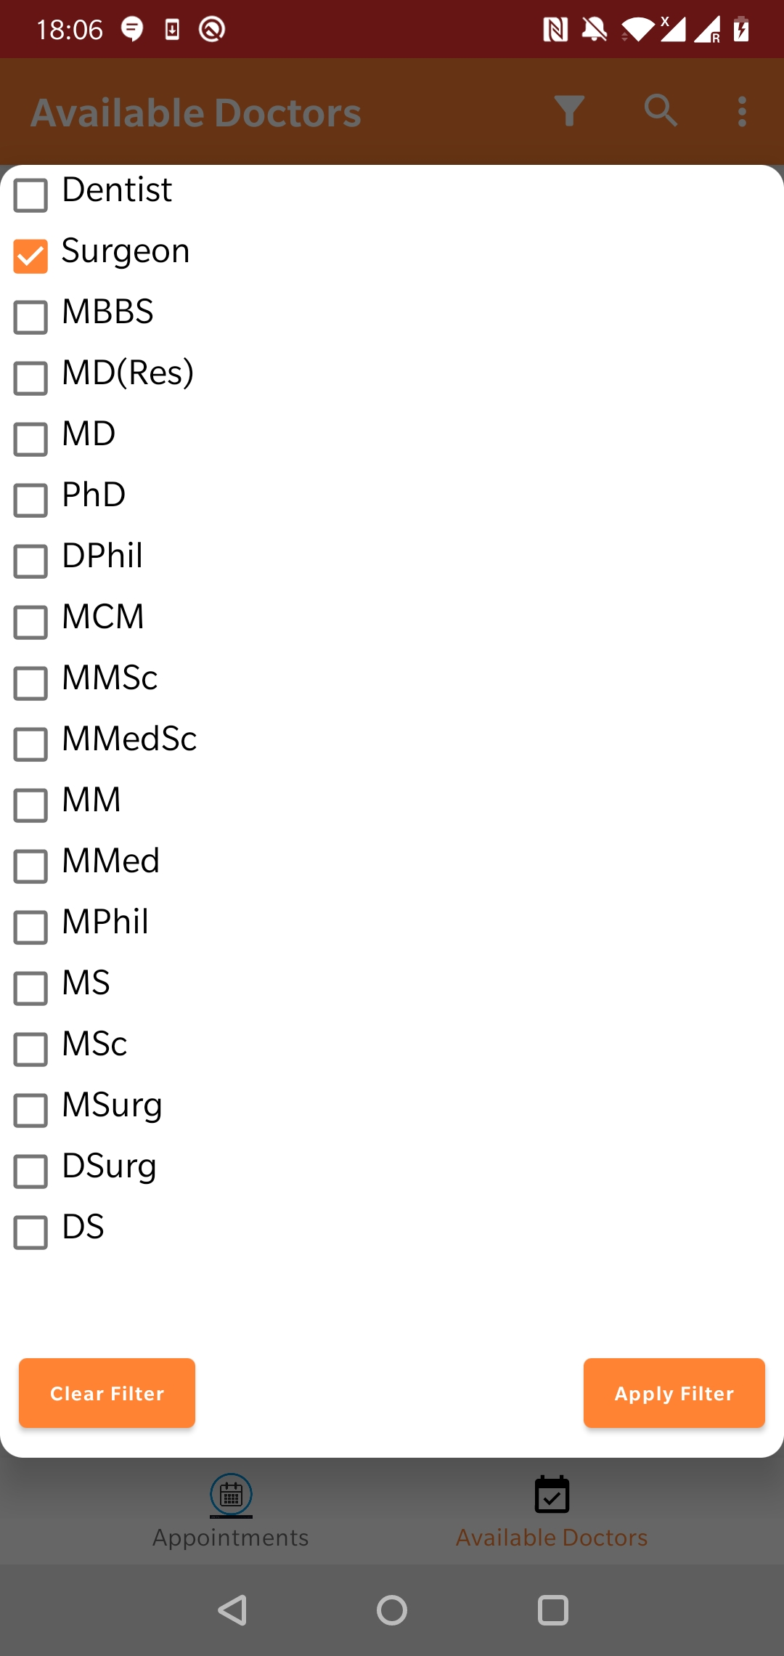
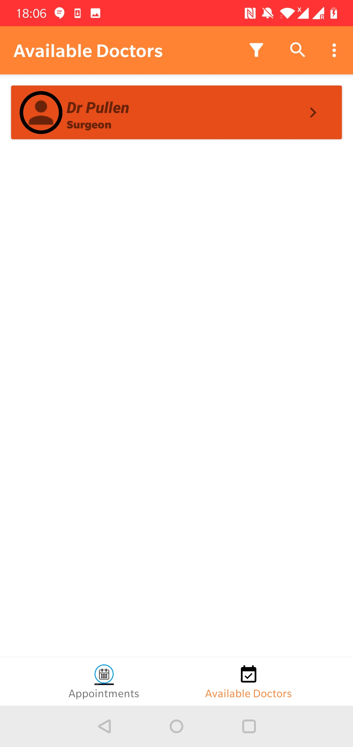
Activity 3.2 : Patient booking appointment
Patitent filtering the needed doctor before booking appointment

Slide 9
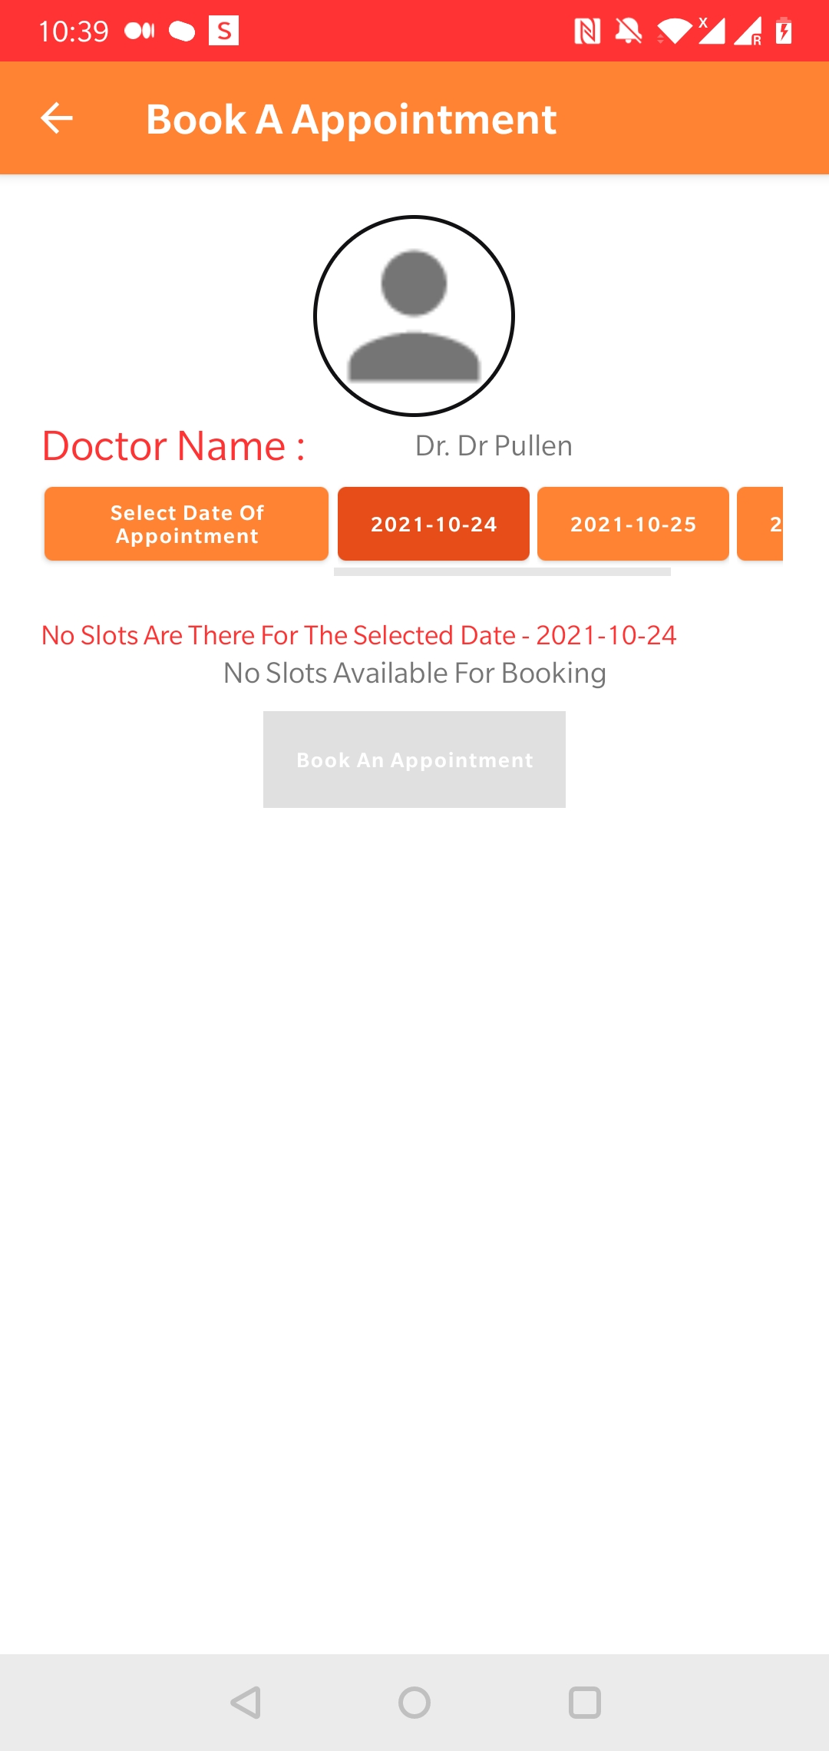
Activity 3.3 : Selecting slot for appointment

Slide 10
Social Relevance
Admin(HealthCare System) can register the doctors after verifying their certifications manually.
Doctors can register themselves with their qualification and can see the scheduled appointment
Patient
Blood Donors can register. HealthCare System can look into list of donors and connect in need.

Slide 11
Database

Slide 12
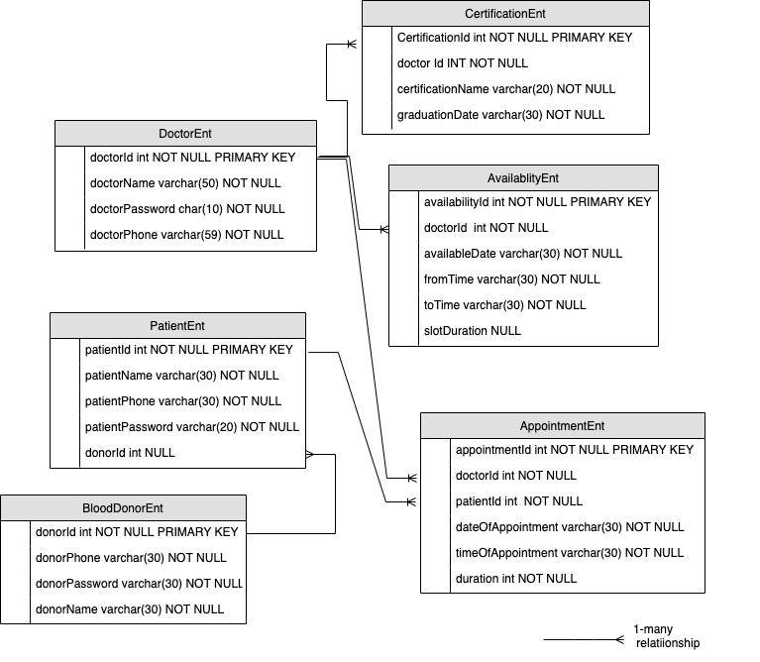
Firebase Database
Doctor can have multiple certifications, multiple availability timings and appointments.
Patient may have multiple appointment and may or may not have a blood donor
Blood Donor may have more than one recipients

Slide 13
Demo

