Slide 1
IS 437: Software and Systems Security Week 1: Introduction and Programming Languages
2015

Slide 2
Instructor
Instructor
Debin GAO
dbgao@smu.edu.sg
SIS Room 5021

Slide 3
TA
LIM Anyu
anyu.lim.2013@sis.smu.edu.sg

Slide 4
Course Objectives
Understand the most common vulnerabilities in software programs
Understand and implement various ways of exploiting software programs and computer systems
Understand basic security mechanisms to defend against software exploits

Slide 5
Learning Outcomes
2 | IT architecture, design and development skills
 | 2.1 System requirements specification skills | YY | Analyzing and experimenting vulnerable programs Analyzing and experimenting with vulnerable computer systems | Marking in-class hands-on exercises and assessments
 | 2.2 Software and IT architecture analysis and design skills | YY | Understanding vulnerabilities of software programs and computer systems Understanding of common defence mechanisms to fight against exploits | Marking in-class hands-on exercises and assessments
4 | Learning to learn skills
 | 4.1 Search skills | YY | Researching related technologies for in-class exercises and group project | Commenting in-class exercises

Slide 6
Course Material
No textbook
You will need to research yourself

Slide 7
Grading
Individual assessment: 75%
Attendance
Every student should mark their attendance on eLearn
Don’t be late for more than 15 minutes
Many in-class mini-projects (10% or 15% each)
Group assessment: 25%
Presentation and report

Slide 8
Tentative Lesson Plan
Week | Topic | Assessment
1 | Introduction and programming languages
2 | Debugging | Mini-project 1
3 | Function call | Mini-project 2
4 | Buffer overflow (1) | Mini-project 3
5 | Buffer overflow (2)
6 | In-class project | Mini-project 4
7 | Format string (1)
8 | Recess
9 | Format string (2)
10 | Return to libc (1) | Mini-project 5
11 | Return to libc (2)
12 | Group project presentation (1) | Mini-project 6
13 | Group project presentation (2)

Slide 9
Academic Integrity
All acts of academic dishonesty (including, but not limited to, plagiarism, cheating, fabrication, facilitation of acts of academic dishonesty by others, unauthorized possession of exam questions, or tampering with the academic work of other students) are serious offences.
All work (whether oral or written) submitted for purposes of assessment must be the student’s own work. Penalties for violation of the policy range from zero marks for the component assessment to expulsion, depending on the nature of the offense.
When in doubt, students should consult the instructors of the course. Details on the SMU Code of Academic Integrity may be accessed at http://www.smuscd.org/resources.html.

Slide 10
Group Project
Search for an open-source software program that has an exploitable vulnerability
Construct a working exploit
Propose a fix to the vulnerability
Demo must be part of the presentation

Slide 11
Group Project FAQ
There are existing exploits and known/easy fixes, can we use them?
Yes. You need to acknowledge that in your presentation and report though. Clearly state if the exploit and fix are your work or work of someone else.
How do I get a good grade
Work on your own exploit/fix
Work on an improvement of existing exploits/fixes
Your grade partially depends on the novelty and difficulty

Slide 12
Group Project To-do
Form a group of two to three students
Choose a program and a vulnerability
Two groups are not allowed to work on the same vulnerability
Declare your grouping and choice at https://docs.google.com/spreadsheets/d/1FjV74-AC4ouVwtfCxo70P8rcxequS_kEgAaL2hWjG3s/edit?usp=sharing

Slide 13
Hands-on
Most projects are conducted on our server machine running Linux operating system
You will be given an account on our server
You need to make your stuff work on our server in order to score
Making it work on your own machine does not count
Two servers (with identical configuration) for you to try on (you can work on either one)

Slide 14
Servers for hands-on
Is437-server-1.dyndns.org
Is437-server-2.dyndns.org
Grab a user name from the Google spreadsheet by filling your name https://docs.google.com/spreadsheets/d/1FjV74-AC4ouVwtfCxo70P8rcxequS_kEgAaL2hWjG3s/edit?usp=sharing
Password for all accounts on is437-server-1 is
Password for all accounts on is437-server-2 is

Slide 15
Exercises
Follow 1.EnvironmentSetup.docx and log in to the servers
Follow 2.LinuxCommandIntroduction.docx and change your password
Work on exercises in 3.LinuxCommandExercise.docx

Slide 16
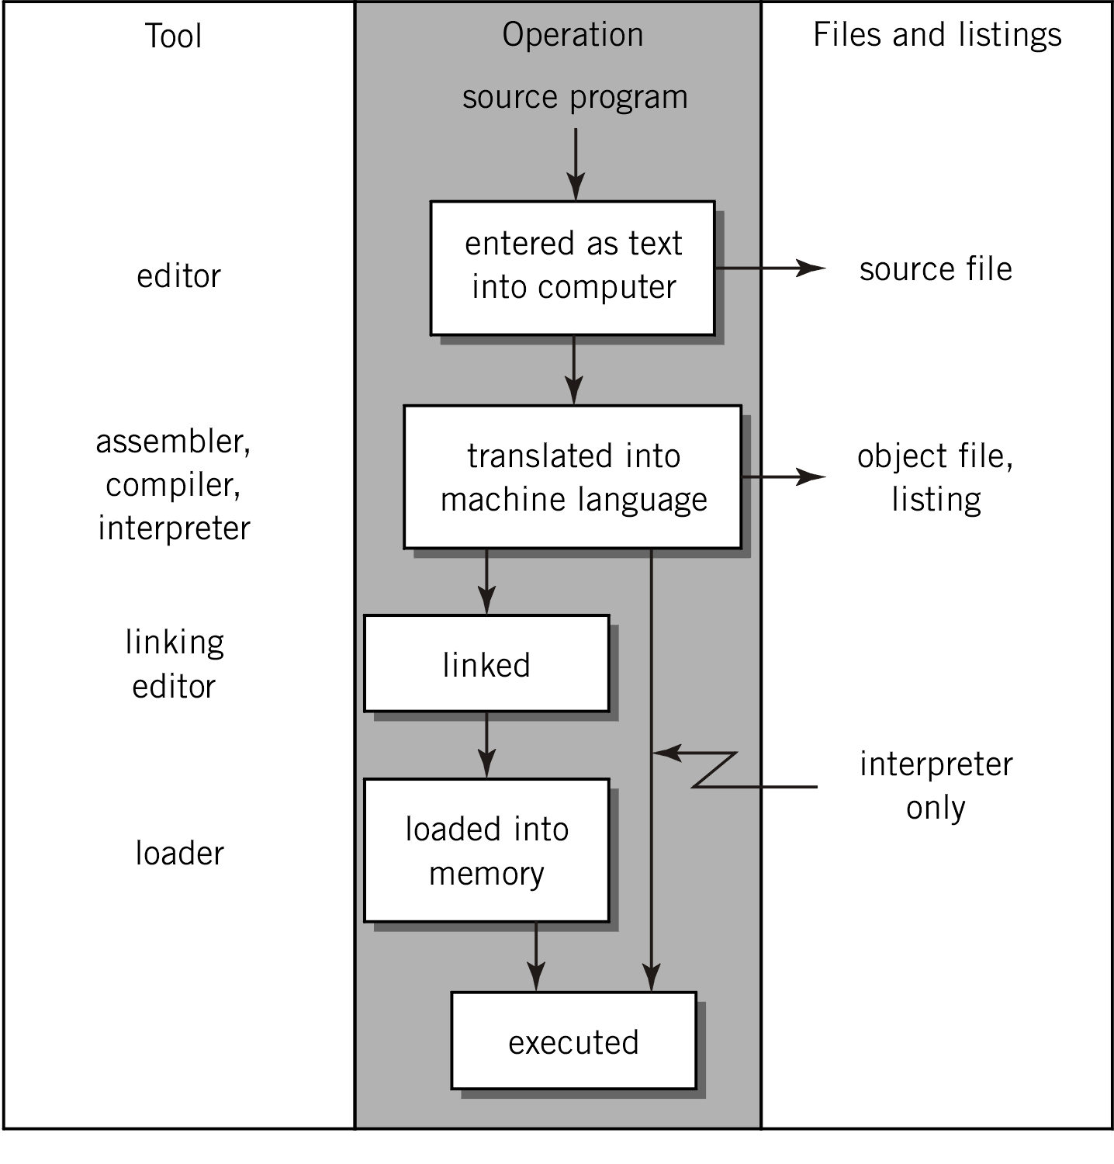
Program Translating Process

Slide 17
Programming Languages
Low-level programming languages
Machine language
Assembly language
High-level programming languages
C/C++
Java

Slide 18
Machine Language
The only language that is directly understood by the computer
Does not need any translator
Pro: Runs very fast
Con: Hard to understand (all numbers)

Slide 19
Assembly Language
A set of symbols and letters form the assembly language
A translator (assembler) is required to translate assembly language to machine language
Pros
Relatively easy to understand and modify
Use it when speed and size are criticle
Cons
Machine specific
Architecture may become obsolete
Lack of programming structure

Slide 20
High-level Programming Languages
Simple: instructions in English words and mathematical symbols
Need to be translated to machine language
Pro: easy to learn and use

Slide 21
Assembly vs. High-level
Type of Applications | High-Level Language | Assembly Language
Business application software for single platform | Formal structures make it easy to organize and maintain | No formal structure
Hardware device driver | Awkward coding techniques required. | Hardware access is straightforward and simple
Business application for multiple platforms | Portable | Difficult to maintain
Embedded systems and computer games requiring direct hardware access | Produces too much executable code, and may not run efficiently. | Ideal, because the executable code is small and runs quickly

Slide 22
Software Hierarchy
Level | Description
Application Program | Software designed for a particular class of applications
High-Level Language (HLL) | Programs are compiled into either assembly language or machine language. E.g. C++, Pascal, Java, Visual Basic, etc.
Operating Systems | Contains procedures than can be called from programs written in either high-level language or assembly language. This system may also contain an application programming interface (API).
Assembly Language (ASM) | Uses instruction mnemonics that have a one-to-one correspondence with machine language.
Machine Language (ML) | Numeric instructions and operands that can be stored in memory and directly executed by the computer processor.

Slide 23
Why Learn Assembly Language
To learn how high-level languages translate into machine language
To learn how vulnerabilities in high-level languages translate into vulnerable machine language
To speed up applications

Slide 24
IA32 Processors
Evolutionary design
Started in 1978 with 8086
Added more features as time went on
Still supporting old features, although obsolete
Complex instruction set computer (CISC)
Many different instructions with different formats
Hard to match performance of Reduced instruction set computers
But Intel has done just that!

Slide 25
Storage Size
Byte: 8 bits (smallest addressable unit)
Word: 2 bytes
Doubleword: 2 words
Quadword: 2 doublewords

Slide 26
Number System
MSB: Most significant bit
LSB: Least significant bit
System | Base | Digits | Example
Binary | 2 | 0 1 | 1010b
Octal | 8 | 0 1 2 3 4 5 6 7 | 25o
Decimal | 10 | 0 1 2 3 4 5 6 7 8 9 | 1010d
Hexadecimal | 16 | 0 1 2 3 4 5 6 7 8 9 A B C D E F | 25h
Notes:
Hexa => Binary convert each digit individually and concatenate them together

Slide 27
Signed and Unsigned Binary
Signed interpretation
Positive number if MSB = 0
Negative number if MSB = 1
Fewer bits are used for the magnitude
Unsigned interpretation
All digits are used to represent the magnitude
The same memory content can have two interpretations
Storage type | Range
 | Signed | Unsigned
Byte | -128 to 127 | 0 to 255
Word | -32,768 to 32,767 | 0 to 65,535
Doubleword | -2,147,483,648 to 2,147,483,647 | 0 to 4,294,967,295
Notes:
Cannot tell whether its signed or unsigned interpretation without assumption provided

Slide 28
Two’s Compliment
Negative numbers are stored as two-compliment notation
Complementing all bits of a positive number and add 1
Two’s compliment of x is denoted as NEG(x)
Examples:
0000 1010b (10d) -> 1111 0110b (-10d)
0000 0001b (1d) -> 1111 1111 (-1d)
Subtraction: x – y = x + NEG(y)

Slide 29
Characters and Strings
A character is usually stored as a one-byte ASCII code
A string is usually stored as an array of characters followed by a null byte

