Slide 1
ML IN HEALTHCARE
White blood cells classification
Daphne Bard-Krupa and Manon Chossegros
daphne.bard_krupa@sorbonne-universite.fr

Slide 2

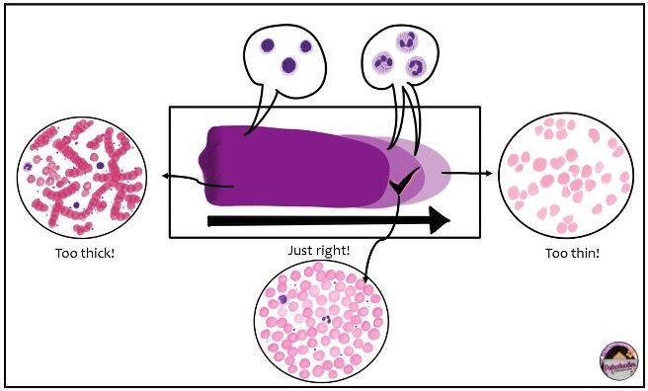
INTRODUCTION
The analysis of blood tests is performed by looking blood smears under a microscope

Slide 3
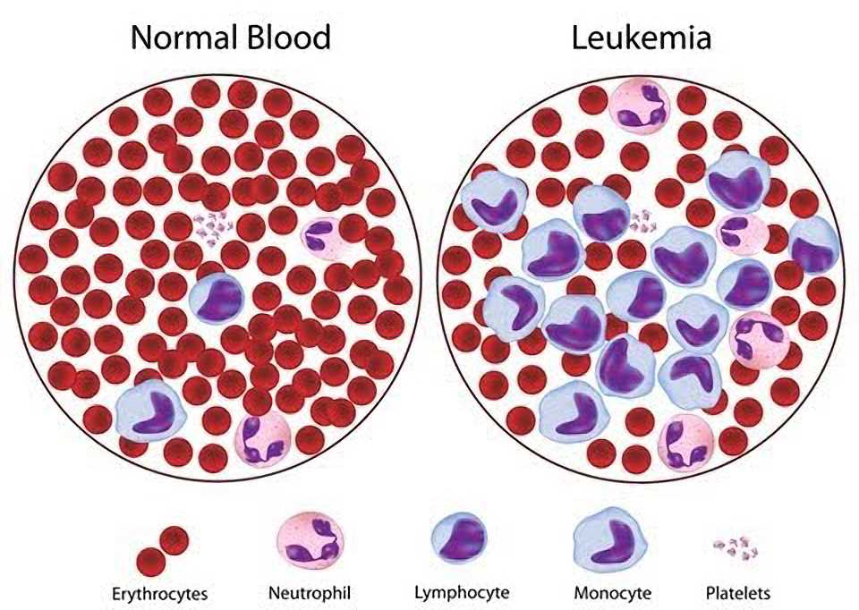
THE IMPORTANCE OF CELL CLASSES PROPORTION
The relative proportion of the different white blood cells categories indicates the presence or not of a pathology

Slide 4
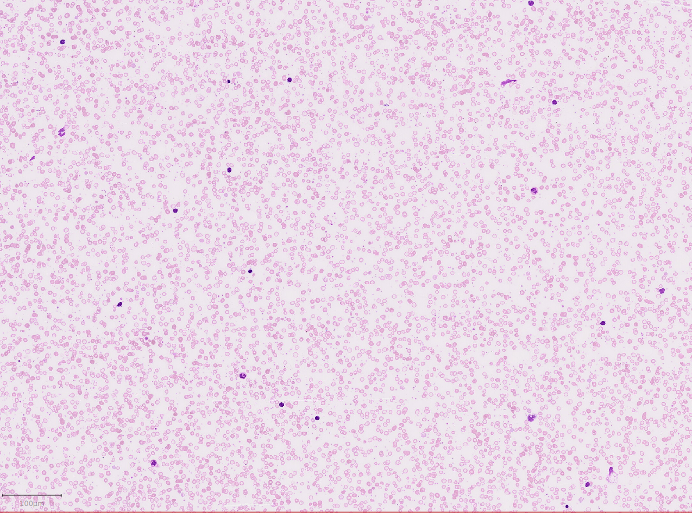
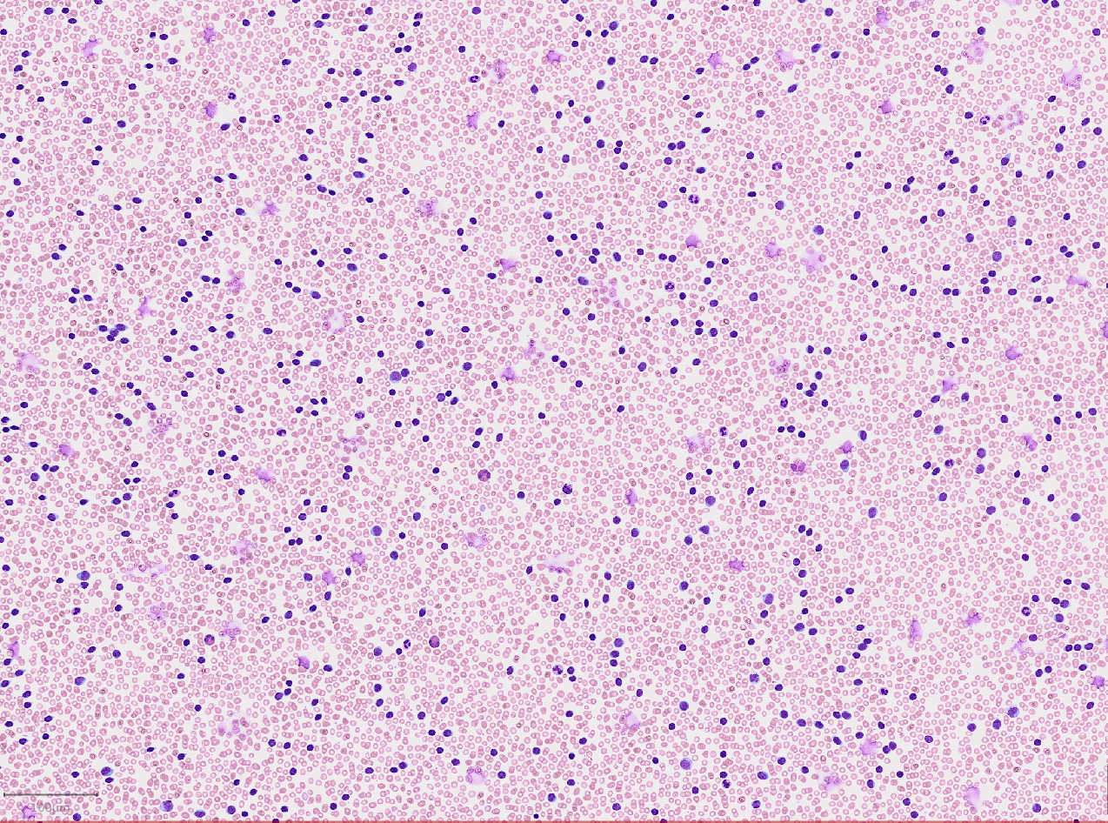
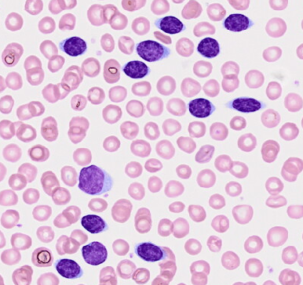
ON REAL DATA
Lymphocyte invasion is characteristic of leukemia
Healthy
Leukemia (clones of cancerous cells)

Slide 5
OUR DATASET

Slide 6
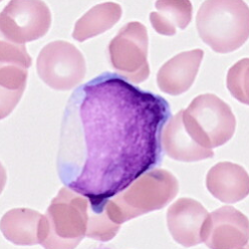
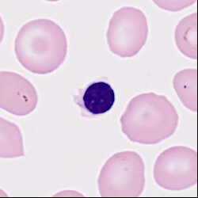
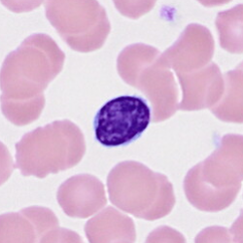
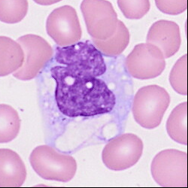
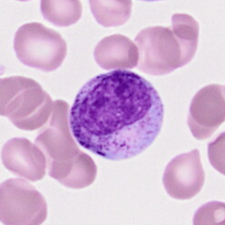
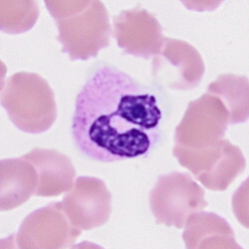
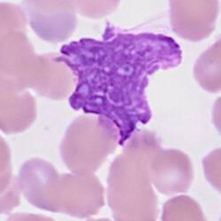
DIFFERENT TYPES OF CELLS
Blast
Erythroblast
Lymphocyte
Monocyte
Metamyelocyte
Neutrophil
Artefact

Slide 7
THE FEATURES

Slide 8
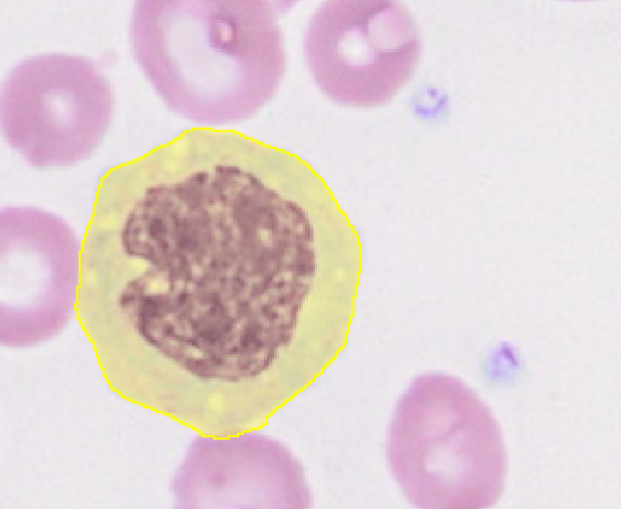
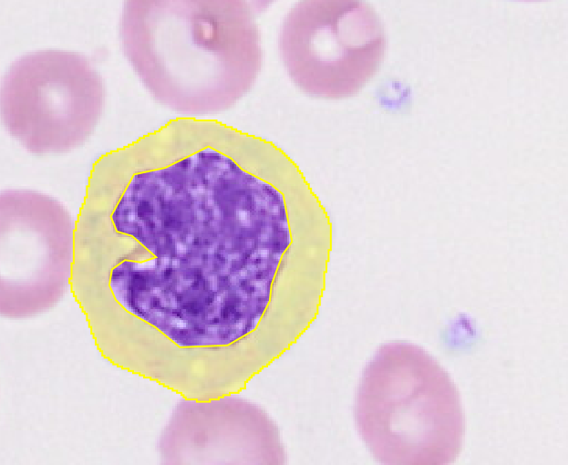
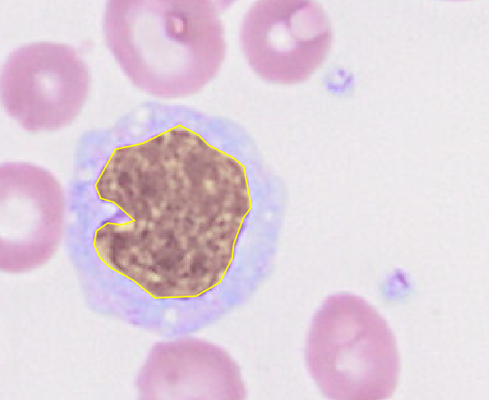
3 REGIONS OF INTEREST
Cyto
(full cell)
Cytoonly
(only cytoplasm)
Nucleus

Slide 9
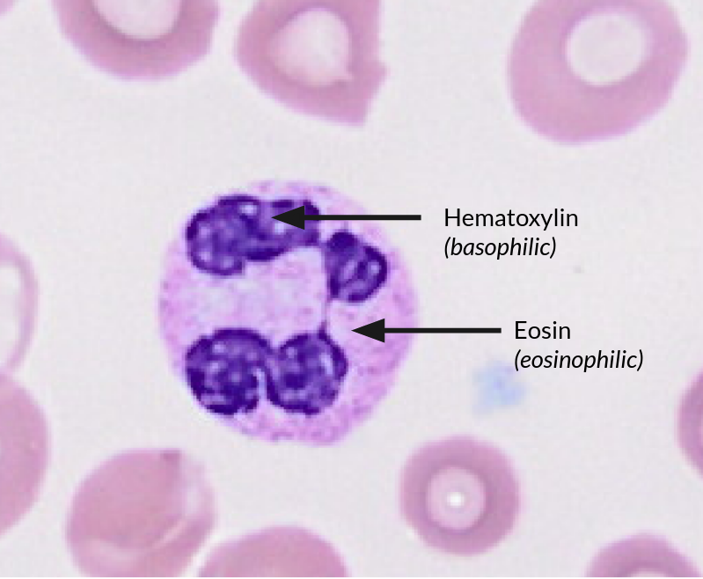
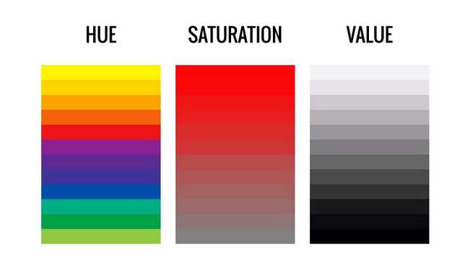
COLOUR FEATURES
2 coloring agents that stain:
Nucleus in blue
Cytoplasm in pink
Different ways to characterize a colour

Slide 10
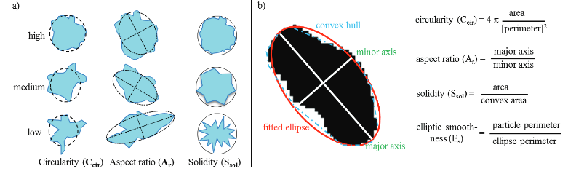
GEOMETRIC FEATURES

Slide 11
THE DATASET
Hematoxylin_Mean_nuclei Hematoxylin_Std_dev_nuclei Hematoxylin_Min_nuclei Hematoxylin_Max_nuclei Hematoxylin_Median_nuclei Eosin_Mean_nuclei Eosin_Std_dev_nuclei Eosin_Min_nuclei Eosin_Max_nuclei Hue_Mean_nuclei Saturation_Mean_nuclei Saturation_Std_dev_nuclei Saturation_Min_nuclei Saturation_Max_nuclei Saturation_Median_nuclei Eosin_Median_nuclei Area_µm^2_nuclei
Hematoxylin_Mean_cytoonly​​ Hematoxylin_Std_dev_cytoonly​​ Hematoxylin_Min_cytoonly​​ Hematoxylin_Max_cytoonly​​ Hematoxylin_Median_cytoonly​​ Eosin_Mean_cytoonly​​ Eosin_Std_dev_cytoonly​​ Eosin_Min_cytoonly​​ Eosin_Max_cytoonly​​ Hue_Mean_cytoonly​​ Saturation_Mean_cytoonly​​ Saturation_Std_dev_cytoonly​​ Saturation_Min_cytoonly​​ Saturation_Max_cytoonly​​ Saturation_Median_cytoonly​​ Eosin_Median_cytoonly​​ Area_µm^2_cytoonly
Length_µm_cyto
Circularity_cyto​ Solidity_cyto​ Max_diameter_µm_cyto​ Min_diameter_µm_cyto​ Perimeter_µm_cyto​

Slide 12
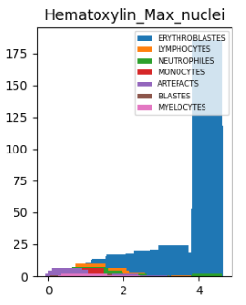
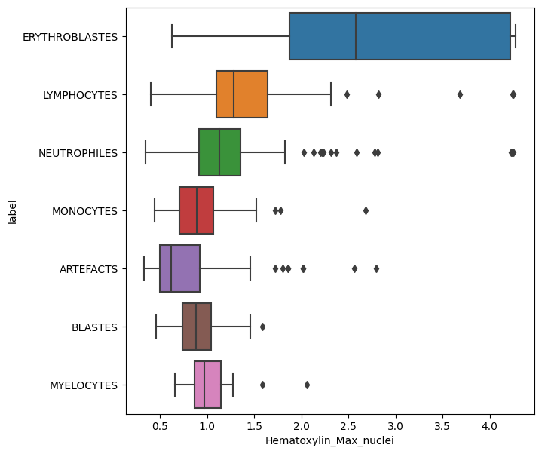
REPARTITION OF THE CLASSES WITH FEATURES

Slide 13
OVERVIEW
Pre-processing
Visualization of the data and the features
Training ML models
SVM
Random Forest
Evaluate performance
Improve the models
Interpretation

Slide 14
TRAINING MODELS

Slide 15
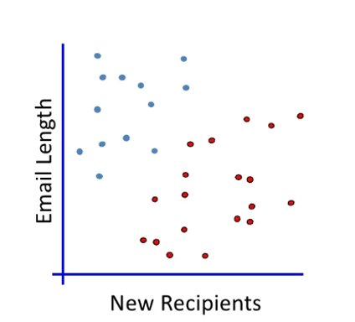
Filter emails between SPAM and not SPAM
2 characteristics of the email:
​
Email Length
New Recipients
​
​
​
Not SPAM​
​
SPAM​

Slide 16
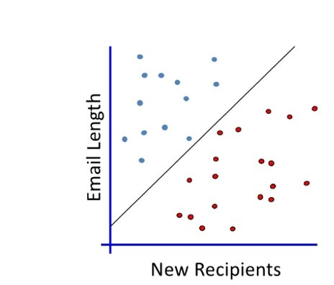
Linear Classification
When a new email arrives:
It is placed in the space
A label is given depending on its position​

Slide 17
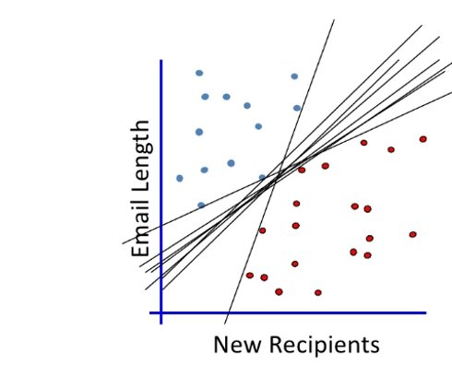
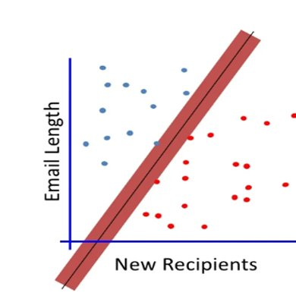
Linear Classification
All these lines work, which on will we chose
​
We chose the border that maximises the margin between the two closest blue and red points
Margin Classifier​
SVM​

Slide 18
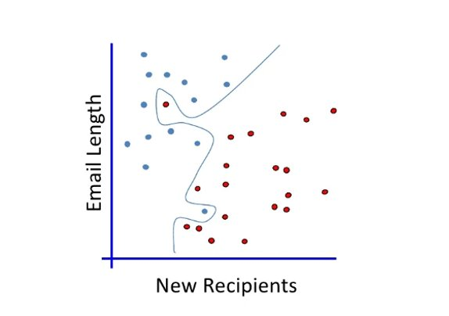
Non linear classifier
The border can be non linear
It adapts better to data

Slide 19
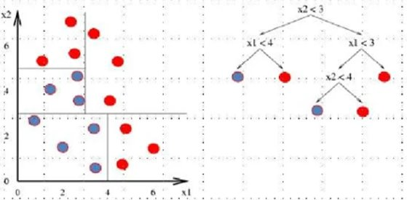
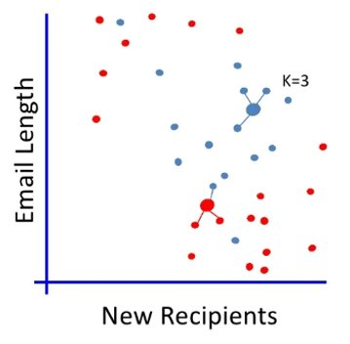
Autres exemples d’algorithmes​
K-nearest Neighbours
Decision Trees
How do we chose k?
How do we measure distances?
Each branch of the tree is a test.
The leaves (ultimate nodes) represent a class

Slide 20
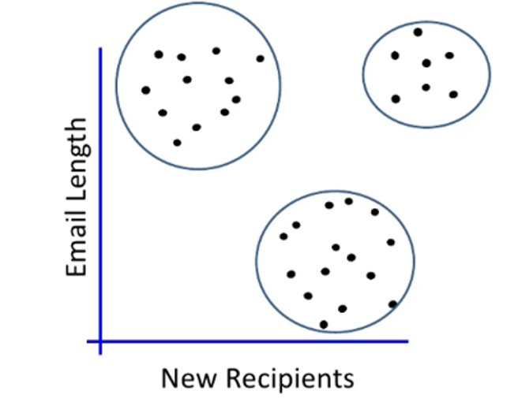
Unsupervised learning
Works by similarity
Each new email is associated with similar emails

Slide 21
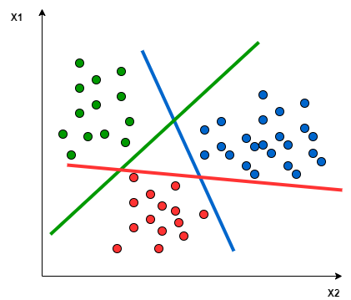
SVM
Goal: find the best boundary to delineate the regions of space

Slide 22
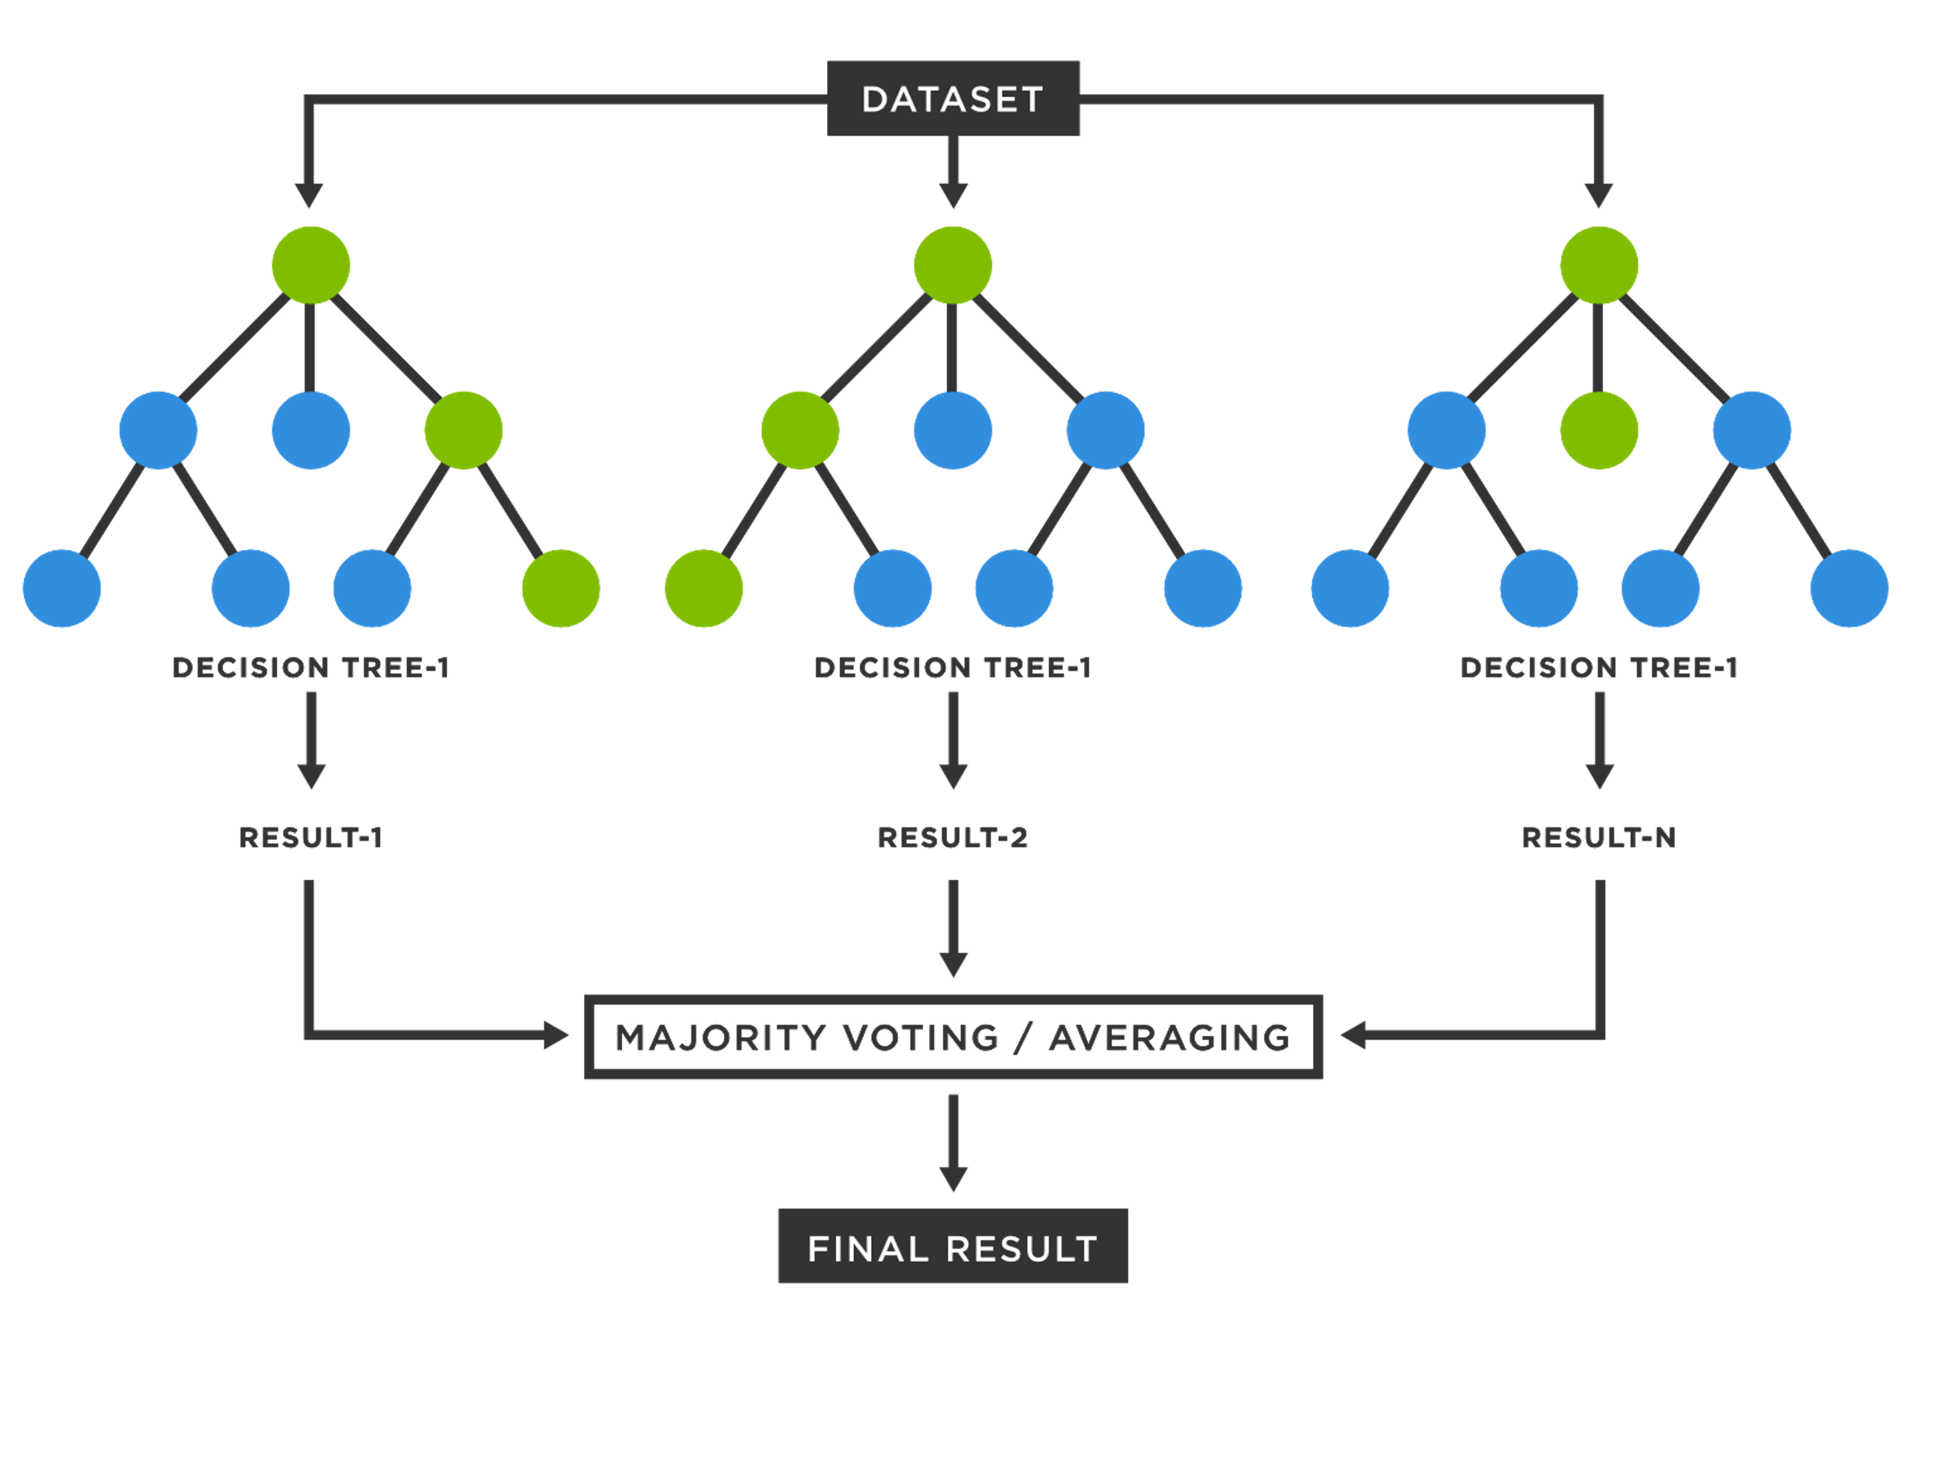
RANDOM FOREST
Goal: find the best decision trees to obtain a majority of good results

Slide 23
EVALUATION METRICS

Slide 24
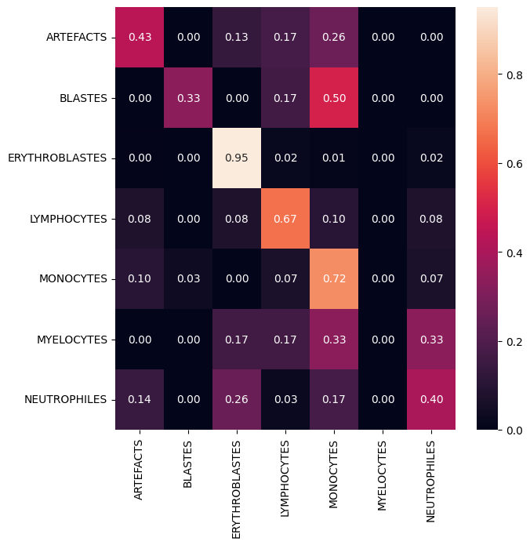
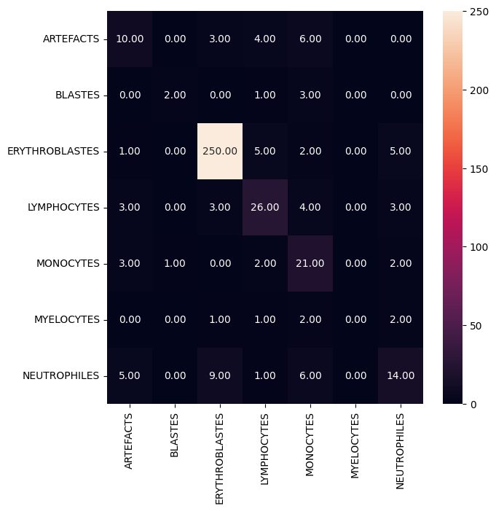
CONFUSION MATRIX
Visualises the predictions of the algorithm
Can be normalised or not
Normalized
Not normalized

Slide 25

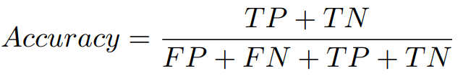


THE EXISTING METRICS

Slide 26





ACCURACY GRAPE
Truth
Prediction
Accuracy = 7/9

Slide 27
PRECISION GRAPE
Truth
Prediction
Precision = 2/3

Slide 28
RECALL GRAPE
Truth
Prediction
Recall = 2/3

Slide 29
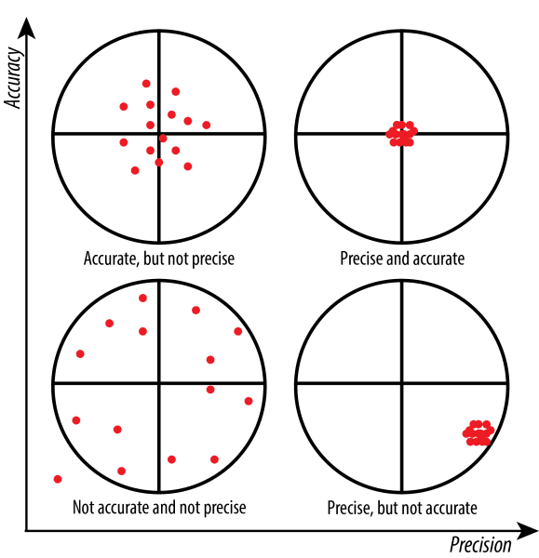
ACCURACY VS PRECISION

Slide 30
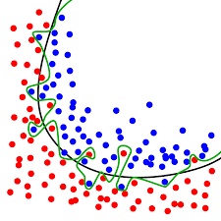
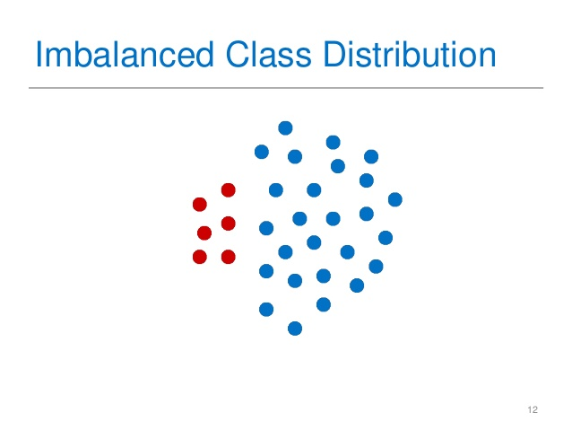
Dimensionality reduction and imbalance Classes
Overfitting problems
Lazy algorithm
PCA, dimensionality reduction methods
Overfitting

Slide 31
THANK YOU

