Slide 1

GlobalLogic
PROJECT OVERVIEW
PDLC_DEMO
PainEase PCA Advanced
PP3500 program
A patient-controlled analgesia infusion pump — with connectivity adapter and Cloud Suite
510(k) with Predetermined Change Control Plan (PCCP)
Device
PP3500 — PainEase PCA Advanced
Predicate
PP3000 / K190567 (illustrative)
Composition
SaMD + SiMD firmware + custom medical-electrical hardware
DHFs
10 total — 3 top-level + 7 nested under Cloud Suite
Prepared by
Ben Xavier · 2026-04-21
A GlobalLogic demo of agentic PDLC workflows in MedTech.
Demonstration only — device identity, predicate, clearance number, and all clinical data are illustrative. Not a real submission.

Slide 2
GlobalLogic · PDLC_DEMO
00 · Agenda
AGENDA
How this deck is organized
Five content sections plus the appendix. ~20 minutes.
01
Project Overview & Strategy
Device composition, DHF topology, regulatory approach (510(k) + PCCP).
02
Agentic Approach
Project shape, structure, skills, and 23 persona agents.
03
Quality & Process
How skills, hooks, and rules turn conventions into automatic guardrails.
04
Agents advise. Humans decide.
Cross-functional advisory panel with the human sign-off always required.
05
The Project Console
Local FastAPI browser app — agents, documents, dashboards, trace matrix.
A GlobalLogic demo of agentic PDLC workflows in MedTech. · Demo sample — not for clinical use.
2 / 22

Slide 3
GlobalLogic · PDLC_DEMO
01 · Project Overview & Strategy
PROJECT OVERVIEW & STRATEGY
What PP3500 is
Single composite system — SaMD + SiMD firmware + custom medical-electrical hardware.
PCA Device
Connectivity Adapter
Cloud Suite
pca-device · Class II medical device · IEC 62304 Class C
connectivity-adapter · MDDS (non-device, post-2015 FDA)
cloud-suite · platform DHF · 7 child DHFs
SiMD pump firmware + SaMD modules + custom hardware. On-pump delivery, dose-limit enforcement, alarms, touchscreen UI, barcode scan, self-test. The 510(k) anchor DHF.
On-prem bridge carrying PCA telemetry + drug-library pushes to and from the Cloud Suite. Named as adjacent infrastructure in the PP3500 510(k); only its cybersecurity posture is pulled in.
Drug Library Manager is Class II SaMD (PCA accessory, mutates the dose-limit table). The other six children (Fleet, Compliance Reports, Analytics, Inventory, Alerts, Clinical Interface) are non-device software.
A GlobalLogic demo of agentic PDLC workflows in MedTech. · Demo sample — not for clinical use.
3 / 22

Slide 4
GlobalLogic · PDLC_DEMO
01 · Project Overview & Strategy
PROJECT OVERVIEW & STRATEGY
Regulatory strategy
One 510(k) for the PCA device, with an integrated PCCP — pre-authorized post-market change.
Filing scope
Ct* carve-out
PCCP envelope
• PP3500 510(k) covers only the PCA device itself.
• Connectivity Adapter MDDS — not separately filed, cybersecurity only.
• Drug Library Manager Class II SaMD accessory — bundled vs. standalone TBD.
• Other Cloud Suite components non-device — out of filing.
• Predicate PP3000 / K190567 (illustrative).
• CtS Critical to Safety — failure can cause patient harm.
• CtF Critical to Function — failure breaks the therapy.
• CtC Critical to Compliance — required by standard.
• CtP Critical to Performance — degrades claimed spec.
• In scope = any Ct* tag. Commercial-only requirements ship post-clearance.
• Drug-library updates new drugs, limit changes inside bounds.
• Firmware patches against a fixed, frozen risk profile.
• Predictive-alarm SaMDs that meet change-protocol acceptance criteria.
• Out of envelope anything that changes the risk profile or indications.
A GlobalLogic demo of agentic PDLC workflows in MedTech. · Demo sample — not for clinical use.
4 / 22

Slide 5
GlobalLogic · PDLC_DEMO
01 · Project Overview & Strategy
PROJECT OVERVIEW & STRATEGY
Key deliverables
Four work products, sequenced from FDA dialogue through substantial equivalence.
1
Q-Sub (Pre-Submission) package
2
PCCP document
Cover letter · device description · proposed indications · predicates · PCCP summary · specific FDA questions. Validates classification and PCCP scope with FDA before the 510(k).
Device description · change categories per module · modification protocols · performance criteria · validation methodology · reporting plan.
3
510(k) submission
4
Trace matrix per DHF
Substantial-equivalence argument · software docs · performance / validation data · risk analysis · labeling. Composition driven by composition-manifest.md.
User Needs ↔ Design Inputs ↔ Architecture ↔ V&V ↔ Risk. Filing Scope column derived from Ct* tags.
A GlobalLogic demo of agentic PDLC workflows in MedTech. · Demo sample — not for clinical use.
5 / 22

Slide 6
GlobalLogic · PDLC_DEMO
02 · Agentic Approach
AGENTIC APPROACH
Project shape — flat multi-DHF
IEC 62304 § 5 software-system / software-item split, expressed in folders.
PDLC_DEMO/
├── CLAUDE.md · project operating rules (always loaded)
├── project.yml · single source of truth — identity, DHFs, team, registries, secops
├── project-overview.md · this overview
├── tasks/<person>/ · per-person task folders; every edit is task-gated
├── docs/external/ · FDA guidance, ISO/IEC standards, frameworks, literature
├── docs/internal/ · GlobalLogic QMS — Manual + 25 SOPs + 6 WIs + 14 Templates + 9 Forms
├── docs/project/strategies/ · 8 shared strategy docs (regulatory, architecture, dev, testing, …)
├── docs/project/dhfs/
│ ├── pca-device/ · TOP DHF — PP3500 (lead product)
│ ├── connectivity-adapter/ · TOP DHF — MDDS bridge
│ └── cloud-suite/ · PLATFORM DHF — 7 nested children
├── docs/project/submissions/ · qsub/ · 510k/ · pccp/ (each with composition-manifest.md)
├── tools/project-console/ · local FastAPI console (scaffolded from project-console skill)
└── .claude/ · skills/ agents/ hooks/ settings.json
A GlobalLogic demo of agentic PDLC workflows in MedTech. · Demo sample — not for clinical use.
6 / 22

Slide 7
GlobalLogic · PDLC_DEMO
02 · Agentic Approach
AGENTIC APPROACH
Operating rules baked into the project
Hooks and conventions that make Claude work with regulatory-grade discipline.
Task-first gate
One task, one file
PreToolUse hook denies any Edit/Write/NotebookEdit unless the session has an active task document. Every change is owned.
All analysis, drafts, and phase deliverables live in the task's numbered markdown file — never sibling notes.
Strategy / lessons capture
Session-start secops
UserPromptSubmit + Stop hooks detect strategic-intent signals and block session end if content wasn't captured.
project-secops agent audits the session against project.yml allowlists. Results cached with a 7-day TTL.
Docflow entry enforcement
project.yml as single source of truth
Bash hook refuses direct pandoc / soffice / pdftotext calls so all conversions round-trip through /docflow.
Identity, DHF topology, team, registries, secops allowlists, advisor curation — all in one manifest.
A GlobalLogic demo of agentic PDLC workflows in MedTech. · Demo sample — not for clinical use.
7 / 22

Slide 8
GlobalLogic · PDLC_DEMO
02 · Agentic Approach
AGENTIC APPROACH
Skills — reusable, expert-grade playbooks
15 project skills installed + 4 builtin format skills. Highest-leverage shown.
SKILL
WHAT IT AUTOMATES
/task
Task lifecycle · enforces the task-first gate · manages capture hooks.
/medtech-docs
Scaffolds docs/ tree · manages DHFs · imports FDA guidance and ISO/IEC standards.
/docflow
Round-trip DOCX / DOC / PDF / XLSX ↔ markdown with image and cross-ref fidelity.
/strategy
Harvests tagged blocks from tasks into 8 shared strategy docs.
/tracker
Builds 510(k) + PCCP submission tracker from strategy + composition manifests.
/trace-matrix
Bidirectional design-controls trace per DHF; emits md + json sidecar.
/advisors
Installs and curates 23 persona advisors; shared between Claude Code and the console.
/project-console
Scaffolds and maintains the local FastAPI console (agents / docs / dashboards / trace).
/lessons
Harvests lessons-learned blocks into the team ledger; promotes mature ones.
/best-practices
Audits project setup against registry checks and each skill's best-practices table.
/secops
Session-start security posture check, attestations, allowlists.
/change-control
(Scaffold.) Bridge to Confluence / Comala and Windchill for Part 11 review & release.
/sync-skills
Bidirectional sync with the shared hitachi skill registry.
/digest
Morning briefing + on-demand append to the project CHANGELOG.md.
A GlobalLogic demo of agentic PDLC workflows in MedTech. · Demo sample — not for clinical use.
8 / 22

Slide 9
GlobalLogic · PDLC_DEMO
02 · Agentic Approach
AGENTIC APPROACH
Agents — persona advisors
23 total — 11 Core Team Assistants + 8 KOLs + 4 panels. Same definitions feed Claude Code and the console.
11 Core Team Assistants
8 KOLs + 2 panels (project-specific)
• Regulatory Affairs · Clinical Affairs
• Systems Engineering · R&D Lead
• V&V Lead · Risk Management
• Human Factors · Quality Engineering
• Cybersecurity · Post-Market · Program Manager
• + 2 panels: Core Team (PM/RA/Clinical/QE/R&D) and Design Review (Sys/R&D/V&V/HFE/Risk/QE).
• James E. Paul PCA pump safety, acute pain — primary PP3500 anchor KOL
• Kathleen K. Giuliano IV smart-pump usability, medication safety
• Priyadarshini Pennathur Human factors engineering
• Lisa Gorski Infusion nursing standards, vascular access
• Evan Kirkendall / Parth Shah / Sini Kuitunen / Susan Braithwaite smart-pump safety, alert fatigue, pediatric dosing, insulin protocols
• + 2 panels: round-robin and LLM-moderated PP3500 KOL panels.
A GlobalLogic demo of agentic PDLC workflows in MedTech. · Demo sample — not for clinical use.
9 / 22

Slide 10
GlobalLogic · PDLC_DEMO
02 · Agentic Approach
AGENTIC APPROACH
Three-tier grounding model
Every advisor has grounding sources layered from most-portable to most-specific.
1
Universal
2
Shape-stable
3
Project-specific overlay
FDA guidance · ISO/IEC standards · industry frameworks · clinical literature. Identical across every medtech project scaffolded by /medtech-docs.
Paths guaranteed by /medtech-docs — DHF layout, strategies/, submissions/, input-analysis/. The advisor knows where to look, regardless of project.
project.yml → advisors.overlays.<name>.add / .exclude narrows the file set to what this program actually cares about (e.g. PCA regs, not hip-surgery regs).
A GlobalLogic demo of agentic PDLC workflows in MedTech. · Demo sample — not for clinical use.
10 / 22

Slide 11
GlobalLogic · PDLC_DEMO
03 · Quality & Process
QUALITY & PROCESS
Guardrails that make quality automatic
Skills, hooks, and rules turn written conventions into executed ones.
Skills — reusable playbooks
Hooks — automatic tripwires
Rules — conventions the tool obeys
Named, one-command actions that every team member runs the same way. Remove inconsistency at the source. /task, /medtech-docs, /docflow, /tracker, /trace-matrix, /best-practices.
Small automations fired at a specific moment (session start, before an edit, when work ends) that allow, block, or add context. The system refuses to let you drift.
Short conventions in CLAUDE.md / .claude/rules/ that Claude reads before acting. One task one file · READMEs have Conventions + Changelog · never fabricate standards or clinical content · demo banner everywhere.
A GlobalLogic demo of agentic PDLC workflows in MedTech. · Demo sample — not for clinical use.
11 / 22

Slide 12
GlobalLogic · PDLC_DEMO
03 · Quality & Process
QUALITY & PROCESS
Concrete automations, in plain language
The hooks running today. What each one refuses to let you skip.
Task-first gate
Session security check
No file edit without an active, owned task.
16 automated checks (identity, access, supply chain). High-severity failures block work.
Session env
Strategy / lessons capture
Exports CLAUDE_SESSION_ID — the task gate keys its state on this.
If a prompt shows strategic intent but the task never captured a STRATEGY block, Stop is blocked.
Docflow entry
Session cleanup
Raw pandoc / soffice / pdftotext Bash calls refused — must go through /docflow.
Per-session state files purged on SessionEnd.
A GlobalLogic demo of agentic PDLC workflows in MedTech. · Demo sample — not for clinical use.
12 / 22

Slide 13
GlobalLogic · PDLC_DEMO
04 · Humans in Charge
HUMANS IN CHARGE
Agents advise. Humans decide.
Cross-functional expertise on tap — with the decision-maker of record always a named human.
Advisors do
Humans do
What the regulator sees
• Brief the human with a structured, grounded analysis.
• Cite sources for every claim.
• Surface counterpoints automatically.
• Refuse to fabricate — say "source doesn't support this."
• Leave a paper trail of what they read and said.
• Review the analysis · ask follow-ups.
• Choose the answer (agent may have given three).
• Write the decision into the task document.
• Sign off in the QMS of record — Part 11 signature by a named human.
• No AI-generated content enters a controlled artifact without human review.
• A human-signed decision.
• In a task document owned by a named person.
• Backed by a trace matrix rebuilt from source.
• Supported by structured analysis with cited sources.
• Vetted by multiple specialist perspectives.
• Produced in a toolchain whose compliance properties are enforced by hooks, not hope.
A GlobalLogic demo of agentic PDLC workflows in MedTech. · Demo sample — not for clinical use.
13 / 22

Slide 14
GlobalLogic · PDLC_DEMO
04 · Humans in Charge
HUMANS IN CHARGE
Where the handoff happens
The AI never occupies step 3 or step 6. That is the design, not a limitation.
#
STEP
WHO
WHAT
1
Draft analysis
Agent
Reads grounded sources, drafts structured answer with citations + counterpoints.
2
Review & redirect
Human
Reviews the analysis, asks follow-ups, rejects or redirects.
3
Decision
Human
Chooses the path forward and writes it into the task document.
4
Implementation
Human + agent
Human directs; agent drafts; task-first gate ensures every edit is owned and traced.
5
Verification
Human (or panel)
Independent panel agent reviews before the change is finalized.
6
Sign-off in QMS of record
Human only
Controlled artifact promoted; signatures applied by named humans in the system of record.
A GlobalLogic demo of agentic PDLC workflows in MedTech. · Demo sample — not for clinical use.
14 / 22

Slide 15
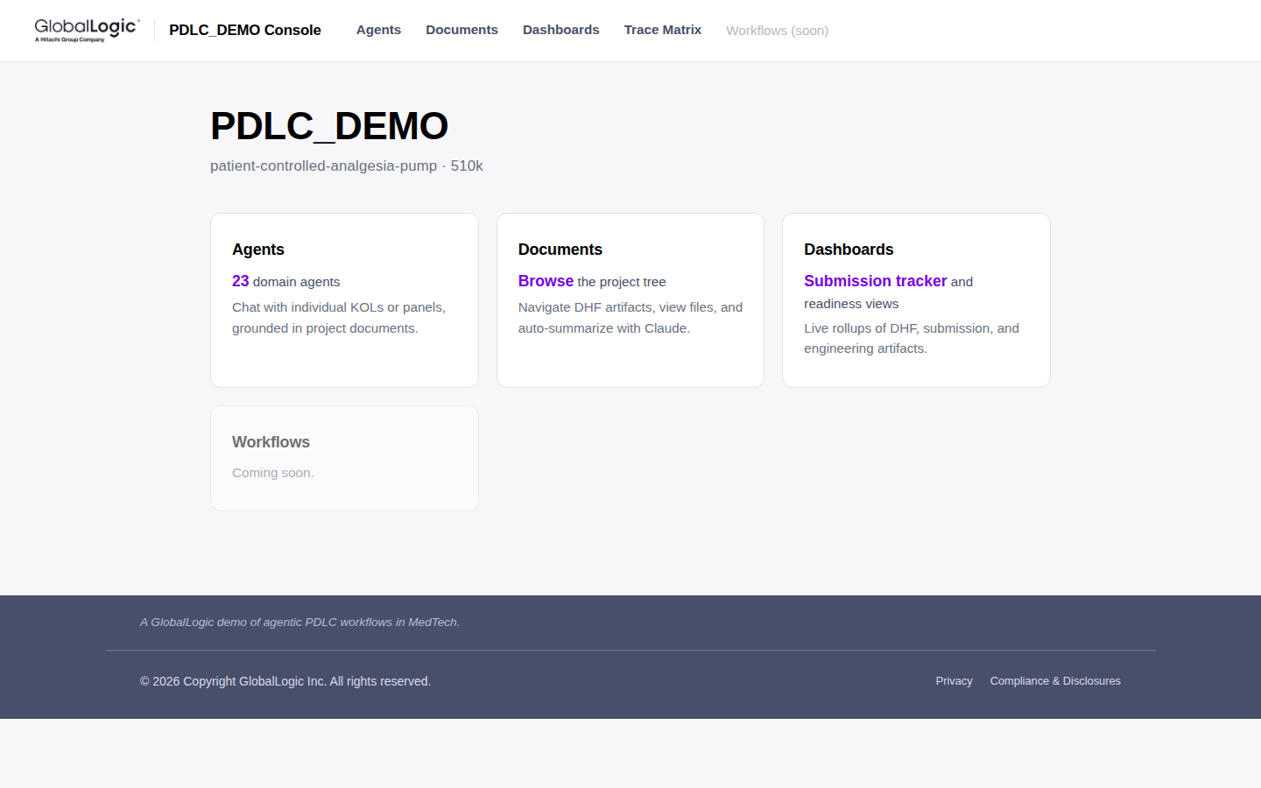
GlobalLogic · PDLC_DEMO
05 · The Project Console
THE PROJECT CONSOLE
Landing page
Top-level tiles for Agents, Documents, Dashboards, and Trace Matrix — branded with the GlobalLogic theme.
http://127.0.0.1:8765/
Start / restart: /project-console start or ./tools/project-console/run.sh
A GlobalLogic demo of agentic PDLC workflows in MedTech. · Demo sample — not for clinical use.
15 / 22

Slide 16
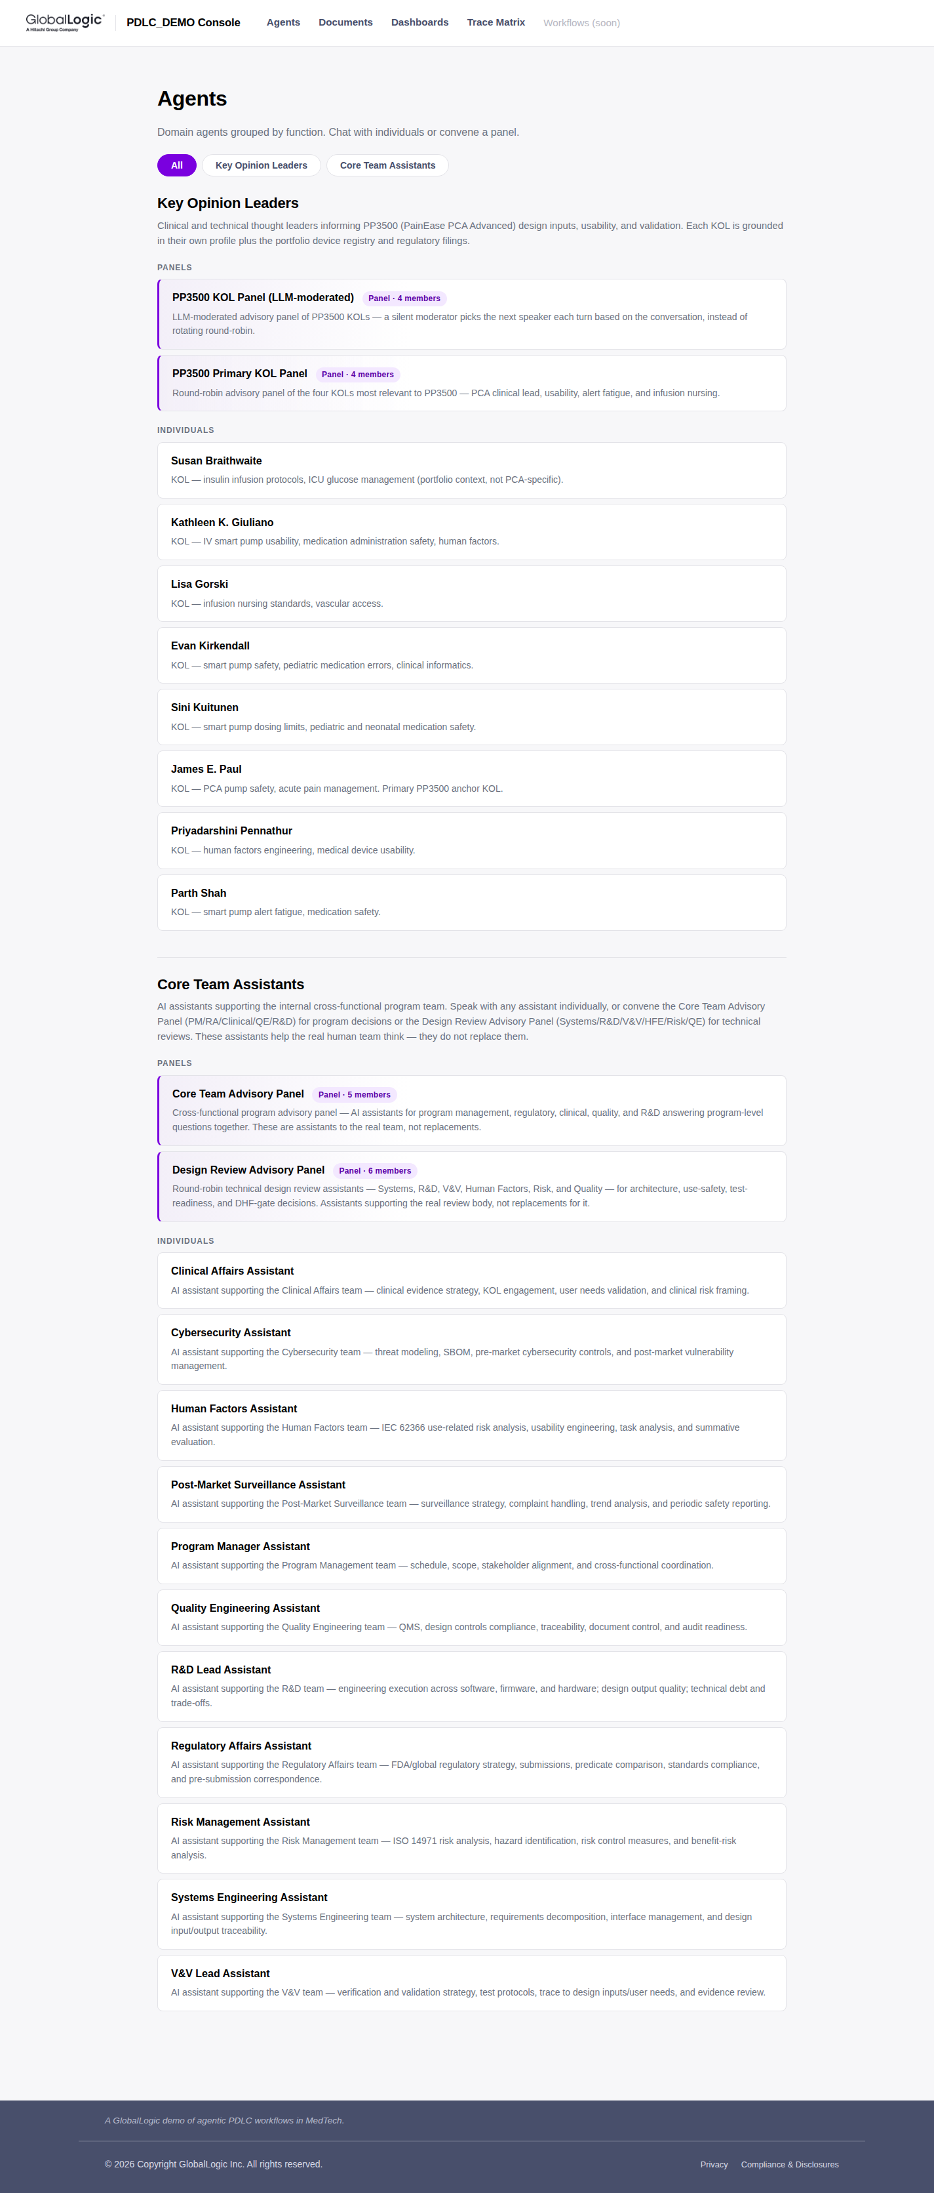
GlobalLogic · PDLC_DEMO
05 · The Project Console
THE PROJECT CONSOLE
Agents — 23 domain agents
11 Core Team Assistants + 8 KOLs + 4 panels. Curated via project.yml → advisors.enabled.
http://127.0.0.1:8765/agents
A GlobalLogic demo of agentic PDLC workflows in MedTech. · Demo sample — not for clinical use.
16 / 22

Slide 17
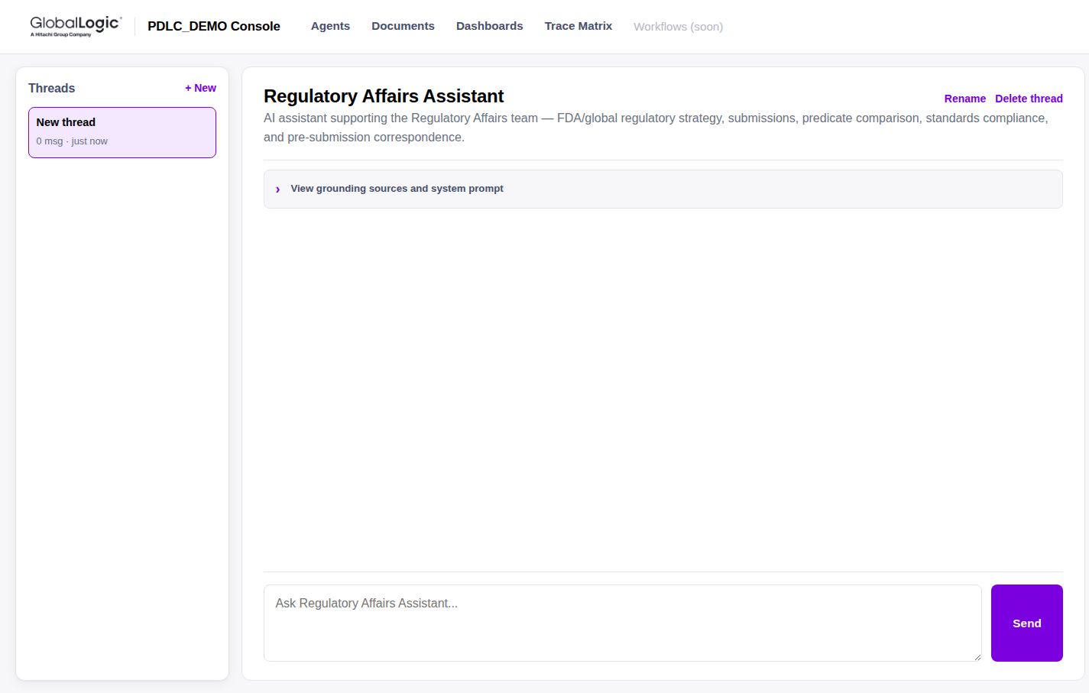
GlobalLogic · PDLC_DEMO
05 · The Project Console
THE PROJECT CONSOLE
A single agent chat
Threaded, renameable, with a collapsible grounding-sources + system-prompt panel.
http://127.0.0.1:8765/agents/regulatory-affairs
A GlobalLogic demo of agentic PDLC workflows in MedTech. · Demo sample — not for clinical use.
17 / 22

Slide 18
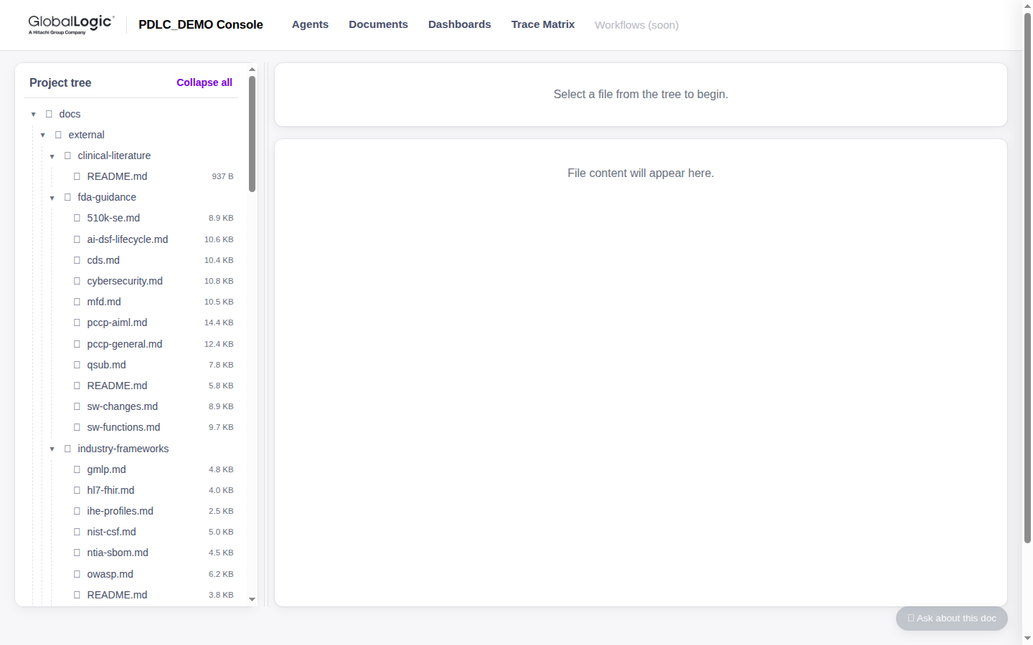
GlobalLogic · PDLC_DEMO
05 · The Project Console
THE PROJECT CONSOLE
Documents explorer
Full project tree · inline markdown rendering · unified Assistant drawer (ben/024) grounded on the open doc.
http://127.0.0.1:8765/documents
A GlobalLogic demo of agentic PDLC workflows in MedTech. · Demo sample — not for clinical use.
18 / 22

Slide 19
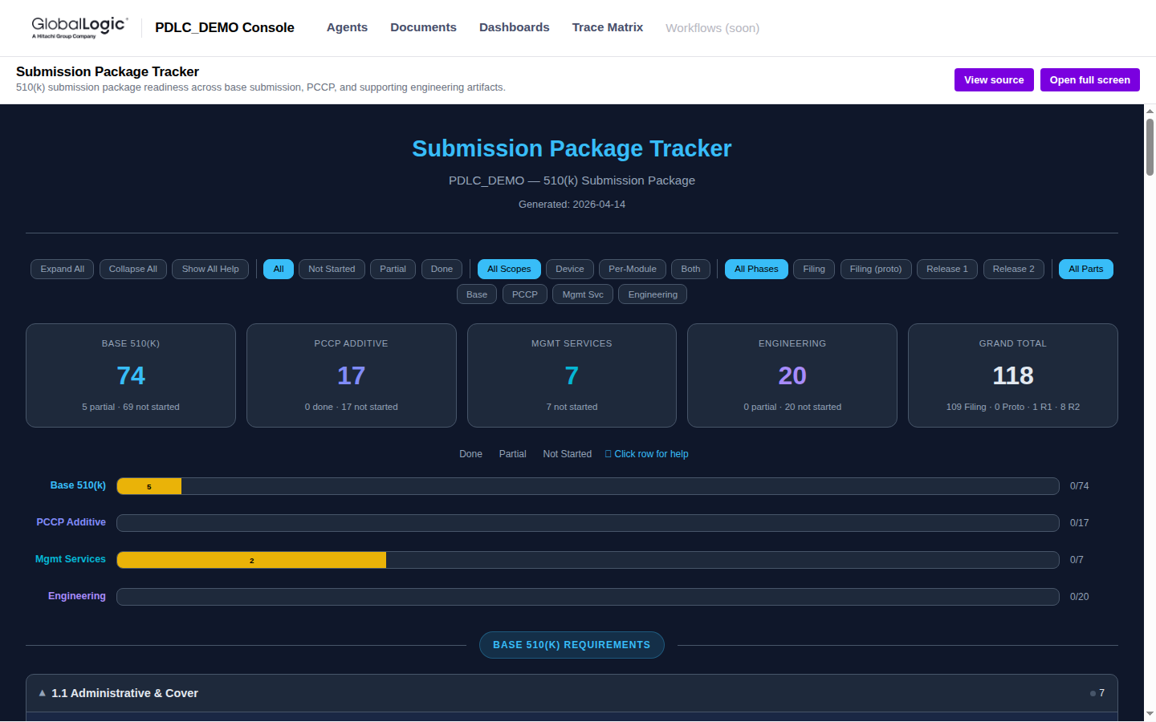
GlobalLogic · PDLC_DEMO
05 · The Project Console
THE PROJECT CONSOLE
Dashboards — submission tracker
Glob-discovered HTML dashboards rendered inline. Today: Submission Package Tracker (built by /tracker).
http://127.0.0.1:8765/dashboards/submission-tracker
A GlobalLogic demo of agentic PDLC workflows in MedTech. · Demo sample — not for clinical use.
19 / 22

Slide 20
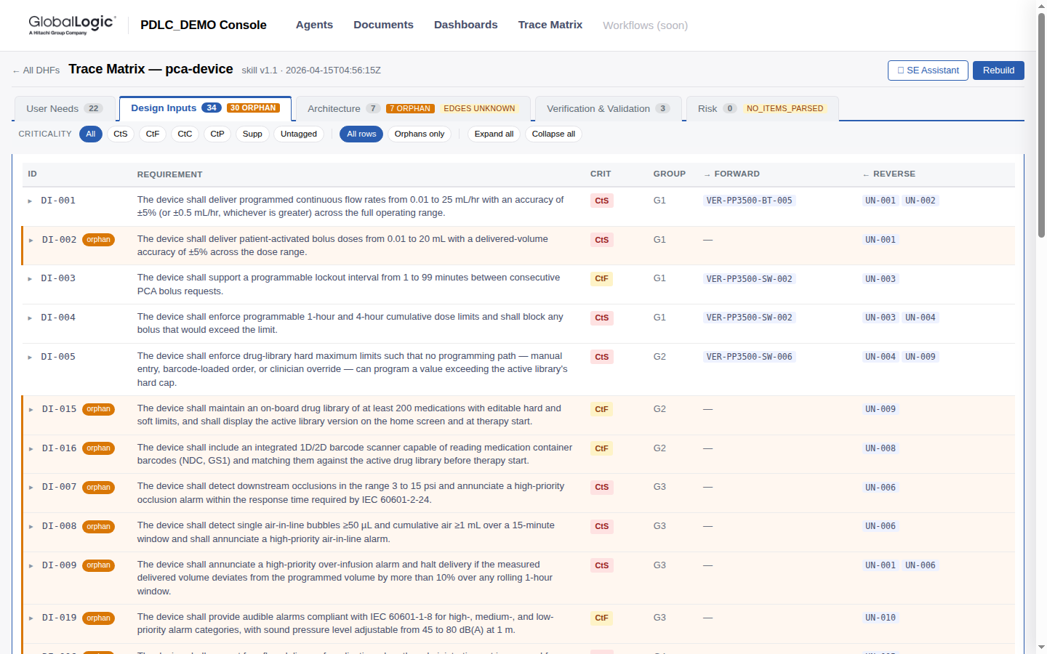
GlobalLogic · PDLC_DEMO
05 · The Project Console
THE PROJECT CONSOLE
Trace matrix — pca-device detail
UN 22 · DI 34 · Arch 7 · V&V 3. Ct* filters, orphans-only toggle, SE Assistant drawer.
http://127.0.0.1:8765/trace-matrix/pca-device
Headline gap — 30 Design-Input orphans — surfaced exactly as the trace matrix is designed to.
A GlobalLogic demo of agentic PDLC workflows in MedTech. · Demo sample — not for clinical use.
20 / 22

Slide 21
GlobalLogic · PDLC_DEMO
06 · Appendix
APPENDIX
Quick links
Everything referenced in this deck.
RESOURCE
LOCATION
Project operating rules
CLAUDE.md
Project manifest
project.yml
Companion markdown
project-overview.md
Regulatory strategy
docs/project/strategies/regulatory-strategy.md
Architecture strategy
docs/project/strategies/architecture-strategy.md
PCA device DHF
docs/project/dhfs/pca-device/
Cloud Suite DHF
docs/project/dhfs/cloud-suite/
510(k) composition manifest
docs/project/submissions/510k/composition-manifest.md
Submission tracker (md)
docs/project/submissions/submission-tracker.md
Console landing
http://127.0.0.1:8765/
Console agents
http://127.0.0.1:8765/agents
Console documents
http://127.0.0.1:8765/documents
Console dashboards
http://127.0.0.1:8765/dashboards
Console trace matrix
http://127.0.0.1:8765/trace-matrix
A GlobalLogic demo of agentic PDLC workflows in MedTech. · Demo sample — not for clinical use.
21 / 22

Slide 22
Thank you
Questions & discussion
ben.xavier@globallogic.com · PDLC_DEMO · PainEase PCA Advanced (PP3500)
A GlobalLogic demo of agentic PDLC workflows in MedTech.

