Slide 1
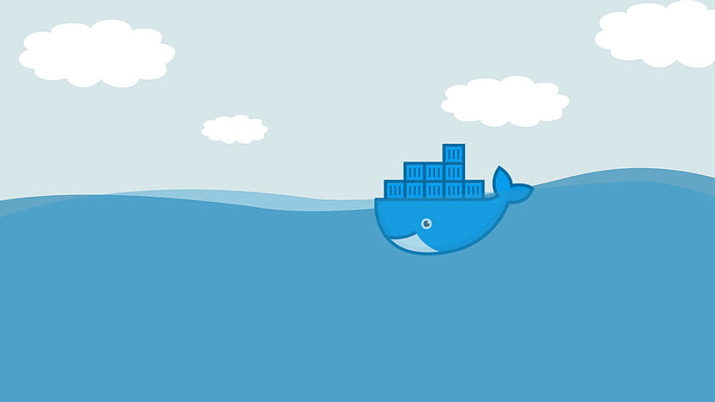
Docker

Slide 2




Who am I ?
Technical Expert PHP / Symfony
+11 years of experience
Symfony Certified Developer (Expert level)
Professor at EHEIO
https://connect.symfony.com/profile/ikhadiri
https://github.com/issamkhadiri1989
https://www.linkedin.com/in/issam-khadiri-30a31659/

Slide 3
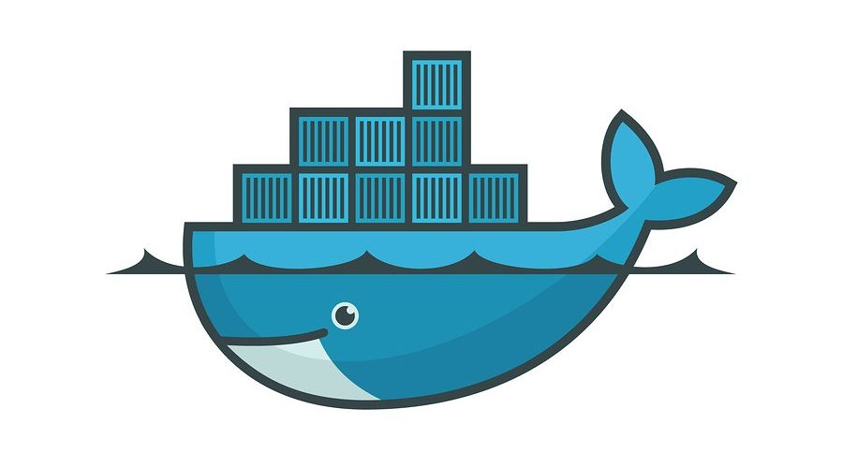
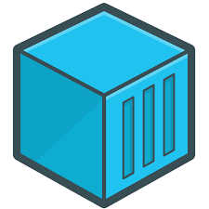
What is Docker ?
Used for developing and deploying any kind of software application
Notes:
Docker is a software framework for building, running, and managing containers on servers and the cloud.
What was the problem before Docker?
It used to be that when you wanted to run a web application, you bought a server, installed Linux, set up a LAMP stack, and ran the app.
Instead of focusing on single servers, the Internet is built upon sets of inter-dependent and redundant servers in a system commonly called "the cloud"
Now, the concept of a server could be removed from the constraints of hardware and instead became, essentially, a piece of software.
These software-based servers are called containers,
ECS de Amazone

Slide 4
Good to know
Continuously deploying software: possible to deploy containerized applications in a few seconds
Building a microservice-based architecture: Developers build and deploy multiple microservices, each inside their own container Then they integrate them to assemble a full software application with the help of a container orchestration tool (such as Docker Swarm)
Migrating legacy applications to a containerized infrastructure. A development team wanting to modernize a preexisting legacy software application can use Docker to shift the app to a containerized infrastructure
Notes:
While it's technically possible to use Docker for developing and deploying any kind of software application
Continuously deploying software : Docker technology and strong DevOps practices make it possible to deploy containerized applications in a few seconds
Updates or changes made to an application's code are implemented and deployed quickly when using containers that are part of a larger continuous integration/continuous delivery pipeline.
Building a microservice-based architecture: When a microservice-based architecture is more advantageous than a traditional, monolithic application, Docker is ideal for the process of building out this architecture. Developers build and deploy multiple microservices, each inside their own container. Then they integrate them to assemble a full software application with the help of a container orchestration tool, such as Docker Swarm
Docker is used to create, distribute and run isolated containers, while Docker Swarm is used to manage and orchestrate a cluster of Docker containers.
Use Docker Compose for development and testing your multi-container applications on a single machine. It's simple, lightweight, and gets you started quickly.
When you're ready for production deployments requiring high availability and scaling, Docker Swarm offers a good balance between ease of use and advanced orchestration features.
Migrating legacy applications to a containerized infrastructure. A development team wanting to modernize a preexisting legacy software application can use Docker to shift the app to a containerized infrastructure

Slide 5
Some terms
Docker Hub. is a container registry built for developers and open source contributors to find, use, and share their container images
Images are read-only templates containing instructions for creating a container
Compose. This tool is used to configure multicontainer application services, view container statuses, stream log output and run single-instance processes.
Notes:
Docker Hub. This software-as-a-service tool lets users publish and share container-based applications through a common library (docker hub). Trusted Registry. This is a repository that's similar to Docker Hub but with an extra layer of control and ownership over container image storage and distribution.
Docker Swarm. This is part of the Docker Engine that supports cluster load balancing for Docker. Multiple Docker host resources are pooled together in Swarm to act as one, which lets users quickly scale container deployments to multiple hosts.
Compose. This tool is used to configure multicontainer application services, view container statuses, stream log output and run single-instance processes.

Slide 6
What is container ?
Notes:
Docker is a software framework for building, running, and managing containers on servers and the cloud.
What was the problem before Docker?
It used to be that when you wanted to run a web application, you bought a server, installed Linux, set up a LAMP stack, and ran the app.
Instead of focusing on single servers, the Internet is built upon sets of inter-dependent and redundant servers in a system commonly called "the cloud"
Now, the concept of a server could be removed from the constraints of hardware and instead became, essentially, a piece of software.
These software-based servers are called containers,

Slide 7
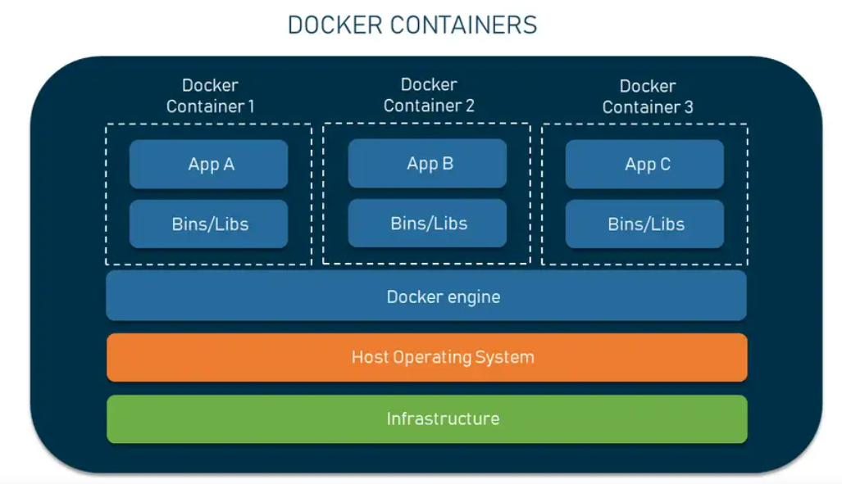
What a container ?
A Docker container is a standardized, encapsulated environment that runs applications.

Slide 8
What a container ?
Builder : a tool or series of tools used to build a container
Engine: an application used to run a container
Orchestration: : technology used to manage many containers
1
2
3
Notes:
Builder: a tool or series of tools used to build a container, such as distrobuilder for LXC, or a Dockerfile for Docker.
Engine: an application used to run a container. For Docker, this refers to the docker command and the dockerd daemon. For others, this can refer to the containerd daemon and relevant commands (such as podman.)
Orchestration: technology used to manage many containers

Slide 9
What is image ?

Slide 10
Docker Image
The Dockerfile is essentially the build instructions to build the image.
Notes:
The Dockerfile is essentially the build instructions to build the image.

Slide 11
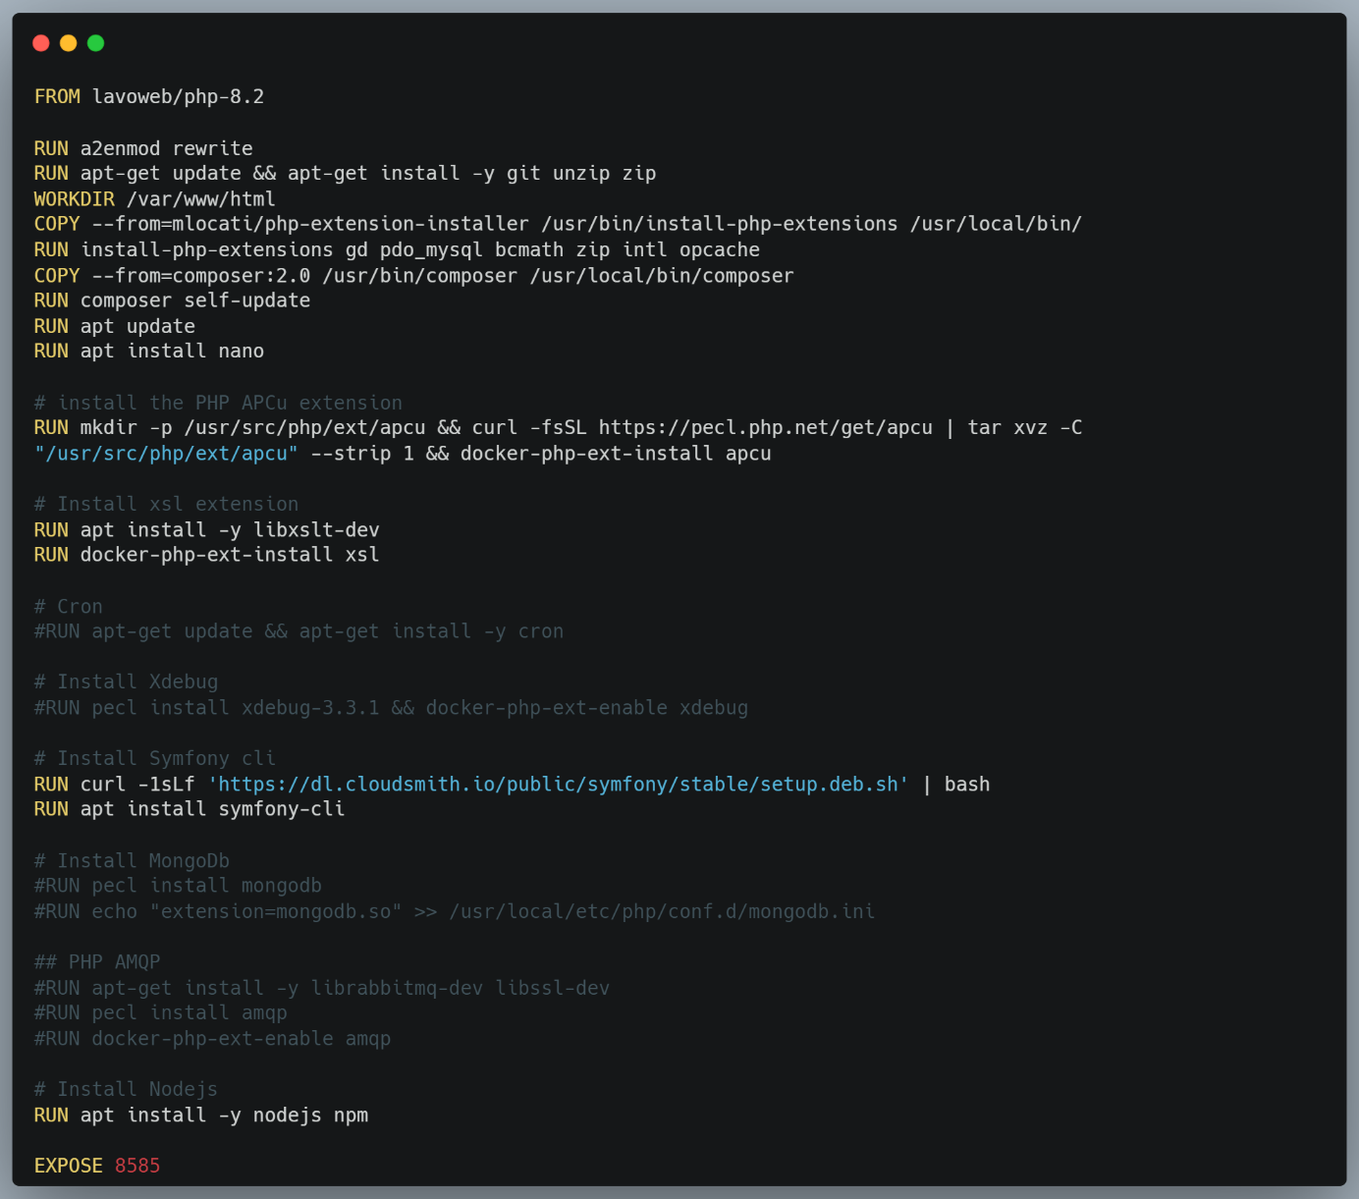

Slide 12
FROM command: tells us what image to base this off of
RUN commands: This is what runs within the container at build time.
VOLUME /var/www/html: Specifying allows it to be externally mounted via the host itself or a Docker data container. volumes are the primary way to manage persistent data for your containerized applications.
ENV MY_ENV_VAR VALUE: sets the environment variables, which can be used in the Dockerfile and any scripts that it calls
recommanded : I specify the volume in the docker-compose.yaml file

Slide 13
The COPY command is simply as it sounds. It can copy a file (in the same directory as the Dockerfile) to the container. COPY docker-entrypoint.sh /entrypoint.sh
ENTRYPOINT: Specifies the executable process that will be launched when the container starts.
CMD: Provides default arguments to be passed to the process specified by ENTRYPOINT (if defined) or the base image (if ENTRYPOINT is not defined).
EXPOSE : To expose a port using a Dockerfile, you should use the EXPOSE instruction for each port that you want to advertise.
For the full list you can see
https://docs.docker.com/reference/dockerfile/

Slide 14
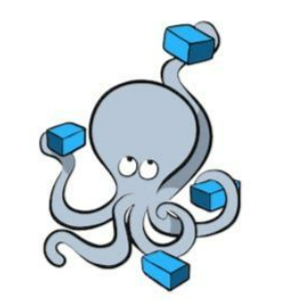
Docker Compose
To configure the orchestration, Docker Compose uses a docker-compose. yml file
It specifies what images are required, what ports they need to expose, whether they have access to the host filesystem, what commands should be run when they start up, and so on.
Notes:
The Dockerfile is essentially the build instructions to build the image.

Slide 15
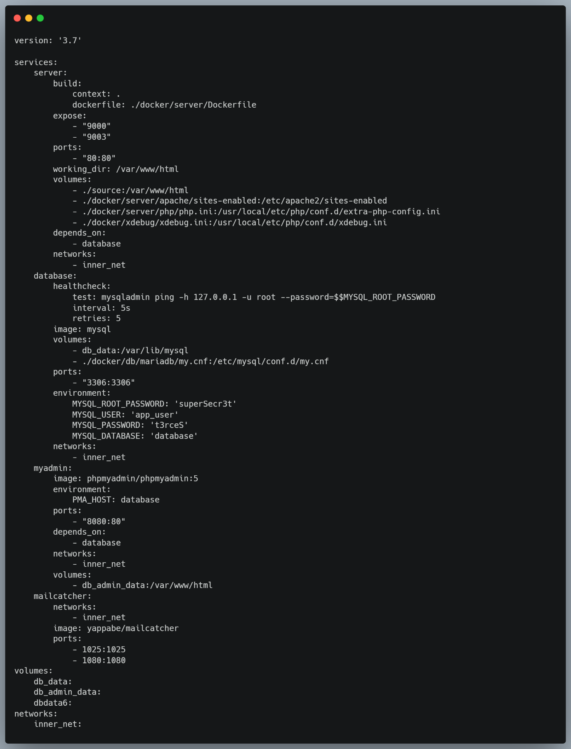
In a docker-compose.yml file, services represent the containers that will be created in the application
In the next section you can see each option in details

Slide 16
build: build it from the Dockerfile in the given directory
links keyword used to be a way to establish connections between containers.
ports: map the external port (e.g phpMyAdmin 8080) to the internal port 80
env_file: use the .emv file to supply environment variables to the container
Network: You can specify the networks that link the services and enable communication between them
Environment variables: Your containers can be dynamically configured without affecting the container images themselves. In the Example Below, The 'environment' variable for the database service of MySQL is defined. MYSQL_ROOT_PASSWORD
Configuring or mapping volume settings: You need to specify the volume mapping between the host system and the container in order to configure the bind mount volume setting.

Slide 17
Running Docker Compose commands
docker-compose up: For starting your application, you need to build and run all containers specified in the configuration file
docker-compose down: if you want to stop your application and remove all containers or services that were created and launched using the configuration file in the previous command
docker-compose build|: If you want to rebuild the images for each service defined in the YAML configuration file or If the Dockerfiles or build contexts have changed
docker-compose start and docker-compose stop : If you want to start or stop your application, but you want to avoid removing the containers

Slide 18
Docker compose environments
Once you have created multiple compose files for different configurations of different environments, docker-compose also offer you to override one configuration with another
docker-compose -f docker-compose.yml -f docker-compose.development.override.yml

Slide 19
Demo

Slide 20
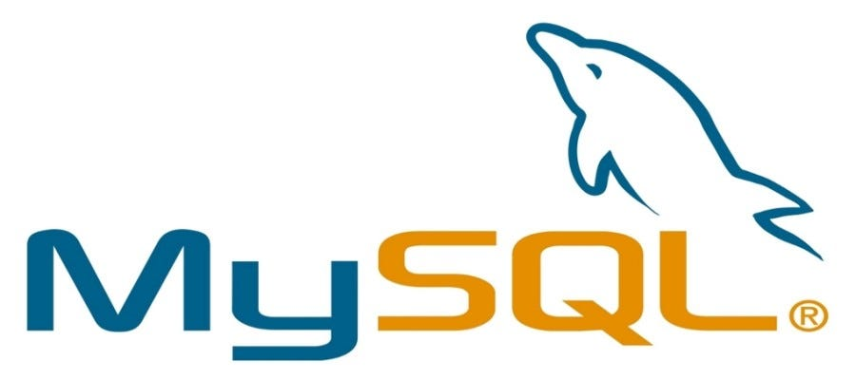
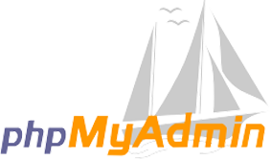


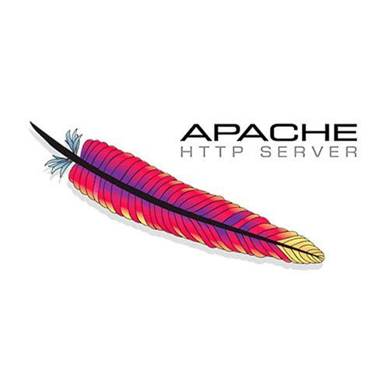
database
phpmyadmin
mailcatcher
server

Slide 21
Thank you !

