Slide 1


YarWeb
Web-based generic Yara Rule Generator

Slide 2
TEAM MEMBERS Mr. SHREYAS BIJU 20201CCS0108 Mr. KAILAS M K 20201CCS0118 Mr. LAALAS TADAVARTHY 20201CCS0119 Mr. GOWRISHANKAR T O 20201CCS0121 GUIDE Ms. SRIDEVI S

Slide 3
CONTENTS
Introduction | Project overview, goals, and significance.
Literature review | Reviewing relevant research in malware detection.
Objectives | Clear project objectives for focused execution
Methodology | Technical approach, requirements, and workflow details
Timeline for the project | Key milestones and deadlines for execution
Expected Outcomes | Anticipated results: Improved malware detection
Efficiency | Graphical representation of the accuracy of the rules produced by YarWeb and its competitors
Conclusion | Summarizing key points and project significance

Slide 4

INTRODUCTION
Introducing a groundbreaking cybersecurity tool, this project leverages YARA rules through a user-friendly web-based GUI, revolutionizing malware analysis. It democratizes advanced cybersecurity and automates YARA rule generation, optimizing detection with rule string deduplication. The robust backend ensures efficient rule management. This innovative tool benefits experts and institutions, streamlining malware detection, and saving analysis time.
Crucial for evolving digital threats, this project empowers businesses to safeguard assets and democratizes cybersecurity. By reducing complexity and improving efficiency, it promises a substantial impact on threat mitigation. Offering a reliable resource for threat identification, it sets a new cybersecurity standard. In an ever-changing digital landscape, this project provides an efficient solution for combating sophisticated malware threats.

Slide 5
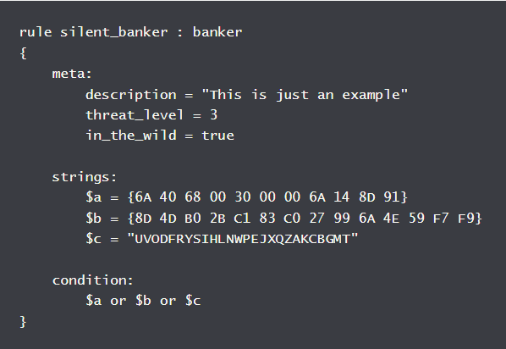
YARA RULE EXAMPLE
Rule Declaration: The `rule silent_banker : banker` line defines a new YARA rule named 'silent_banker' and classifies it as related to 'banker' malware.
Metadata Section: The `meta` block contains descriptive details about the rule, including a brief description, a threat level indicator set to 3, and a boolean flag `in_the_wild` signaling that the malware is actively circulating.
String Definitions: The `strings` block lists patterns to be matched in the scanned files, with `$a`, `$b`, and `$c` representing different byte sequences or text strings to be searched for.
Condition Logic: The `condition` block specifies when the rule should be considered a match, in this case, if any one of the strings (`$a`, `$b`, or `$c`) is found in the scanned content

Slide 6
LITERATURE REVIEW
David Bernal Michelena on Detecting Malicious Files with YARA Rules:
Focuses on using YARA for detecting suspicious files in network traffic.
Utilizes open-source Zeek IDS and a custom script for file extraction.
Highlights the challenge of minimizing false positives in YARA rules.
Discusses future steps like sandbox integration and adapting to encrypted protocols.
Automatic YARA Rule Generation by Khalid, Ismail, Hussain, and Durad:
Presents an automated framework for YARA rule-based malware signatures.
Utilizes a modular approach with a pre-trained Naïve Bayes model.
Highlights the dependency on training data quality for rule accuracy.
Michael Brenge & Christian Rossow on YARIX: Scalable YARA-based Malware Intelligence:
Proposes a methodology for efficient detection of malware using YARA rules.
YARIX optimizes search performance and reduces storage requirements.
Demonstrates scalability in malware sample storage and YARA rule searches.

Slide 7
LITERATURE REVIEW
Nitin Naik et al. on Evaluating Automatically Generated YARA Rules:
Assesses and enhances YARA rules' effectiveness in malware analysis.
Integrates YARA rules with fuzzy hashing techniques.
Addresses limitations like manipulation of IoC strings by attackers.
Generation of Static YARA-Signatures Using Genetic Algorithm by Regeciova, Kolar, and Milkovic:
Introduces a Genetic Algorithm for generating static YARA-signatures.
Compares algorithms for rule generation, noting GA's superior detection scores.
Discusses the high computational complexity of GA as a limitation.

Slide 8

OBJECTIVES
Efficient Malware Detection: The project aims to create advanced YARA rules for a wide range of malware detection, enhancing cybersecurity by providing timely threat identification and response capabilities.
Automated Rule Generation: It focuses on automating YARA rule creation, speeding up responses to emerging malware and keeping defenses up-to-date against rapidly evolving threats.
Optimized Signature Selection: A specialized search engine is integrated for selecting the most effective YARA signatures, improving malware detection efficiency and ensuring the application of the most suitable rules.
Scalability in Data Processing: The project is designed to process large datasets efficiently, maintaining effective malware detection without slowing down, even with increasing data volumes.
Generality of YARA Rules: The generated YARA rules are broadly applicable, making the tool resource-efficient and simplifying rule management across various malware types.

Slide 9
OBJECTIVES
Reduced False Positives and Negatives: The project emphasizes refining YARA rules to minimize false alerts, ensuring high accuracy in distinguishing between benign files and actual malware.
User-Friendly Interface: It includes an accessible interface for the search engine, making advanced cybersecurity tools usable for a wider audience, including non-experts.
Documentation and Knowledge Base: The project contributes to YARA rule creation knowledge through comprehensive documentation and practical examples, aiding future developments in the field.
Community Engagement and Feedback: Aims to build a community around YARA rule development and malware analysis, encouraging collaboration and feedback to continually enhance the tool's effectiveness.

Slide 10
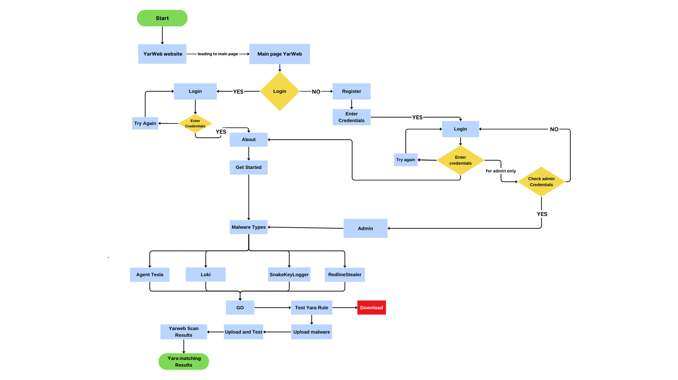
METHODOLOGY

Slide 11
Phase 1: Initialization and User Authentication
Start: User begins the interaction with the YarWeb website.
Main page YarWeb: The user lands on the main page of the YarWeb website.
Login/Register Process: The user is presented with the option to log in or register.
If the user chooses to log in, they must enter their credentials. If the login is successful, the user proceeds; if not, they are prompted to try again.
If the user needs to register, they will enter the registration process and upon successful registration, will proceed to log in..

Slide 12
Phase 2: Detailed User Experience and Administration
User Experience Navigation: After successful login, the user can explore the platform. The 'About' section provides background information about YarWeb, and 'Get Started' guides new users on how to utilize the platform effectively.
Administration Verification: For users with administrative privileges, a secondary authentication process ensures secure access. This step involves a rigorous check of admin credentials, granting access to advanced features and administrative tools.

Slide 13
Phase 3: Malware Exploration and Interaction
Malware Cataloging: The user can navigate through a categorized list of malware types. This database includes sophisticated threats such as Agent Tesla, Loki, SnakeKeyLogger, and RedlineStealer, among others.
Interactive Actions: Users can interact with the platform by selecting specific actions:
Testing YARA Rules: Users can test the effectiveness of YARA rules against known malware signatures.
Resource Downloading: The platform allows users to download resources, potentially including YARA rules, malware samples, or analytical tools, subject to user clearance level.

Slide 14
Phase 4: YARA Rule Testing and Malware Analysis Workflow
YarWeb Scanning Interface: The platform offers an interface for users to upload and test custom YARA rules. This could be a sandbox environment where users can safely test the rules against known malware signatures without risking system integrity.
Malware Submission and Analysis: Users are provided with the functionality to upload suspicious files or malware samples. These samples can be analyzed against the YARA rules database to detect known patterns or behaviors.
Results and Reporting: The outcome of the rule testing and malware analysis is compiled into a comprehensive report. This report details the matching results, providing insights into the behavior of the malware and the effectiveness of the YARA rules.

Slide 15
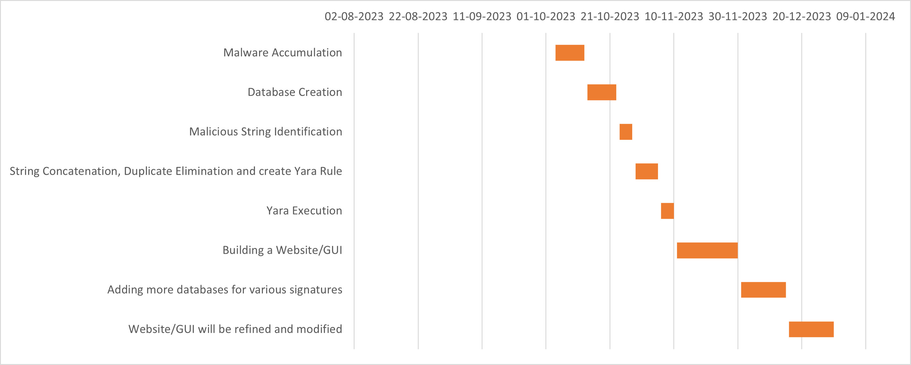
Timeline for the project

Slide 16
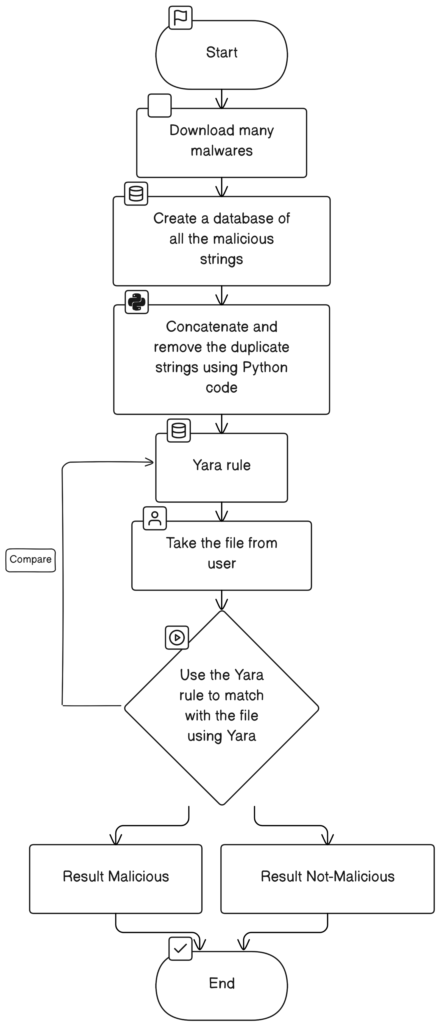
ER DIAGRAM

Slide 17
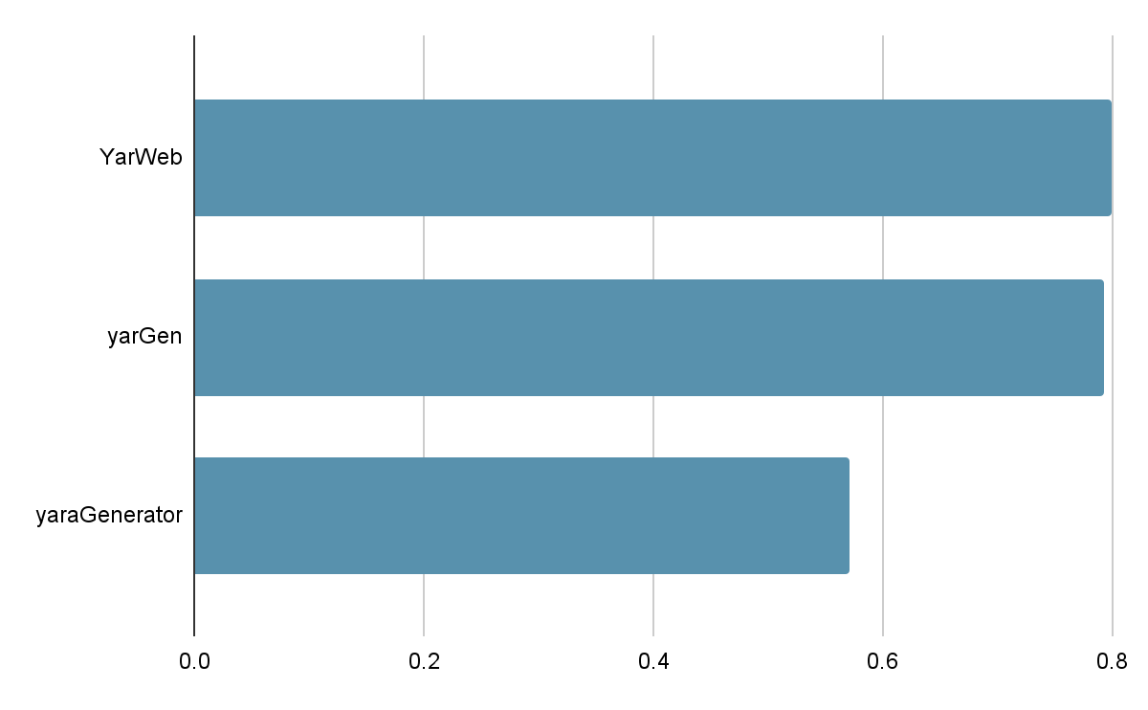
Graphical representation of the accuracy of the rules produced by YarWeb and its competitors

Slide 18
OUTCOMES
Efficient YARA Rule Generation
Quick generation of YARA rules from predefined malware signatures.
Simplifies and speeds up the rule creation process.
Enhanced Malware Analysis Capabilities
User-friendly platform for creating and testing YARA rules.
Immediate rule validation against .exe files improves malware detection.
Improved Accuracy and Reliability
Automated rule generation reduces human error.
Ensures syntactical correctness and effectiveness in malware pattern identification.
User Empowerment
Enables users of all skill levels in YARA and malware analysis.
Acts as an educational tool for learning about malware signatures.
Scalability and Extensibility
Easily updated to keep pace with evolving malware threats.
Modular design for future enhancements and integration.
Community Contribution
Open platform for collaborative YARA rule generation and testing.
Supports shared efforts in malware analysis and threat intelligence.

Slide 19
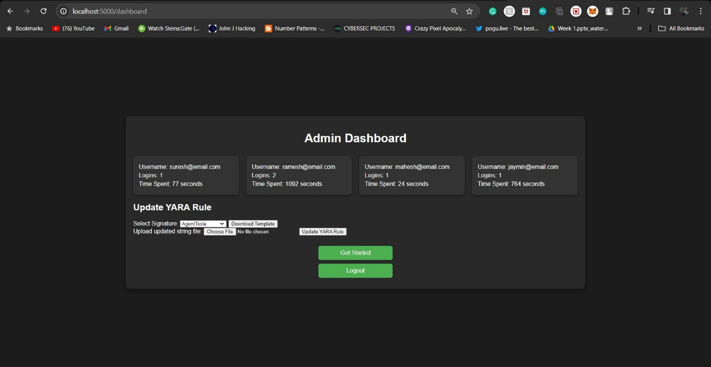
OUTPUT
Admin dashboard

Slide 20
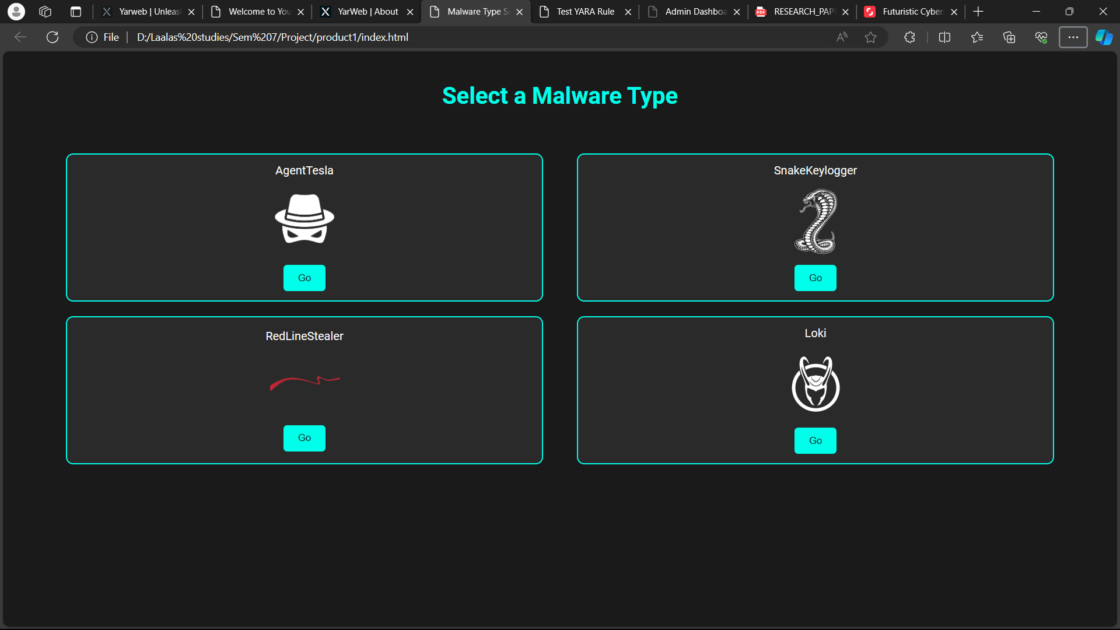
Types of malwares

Slide 21
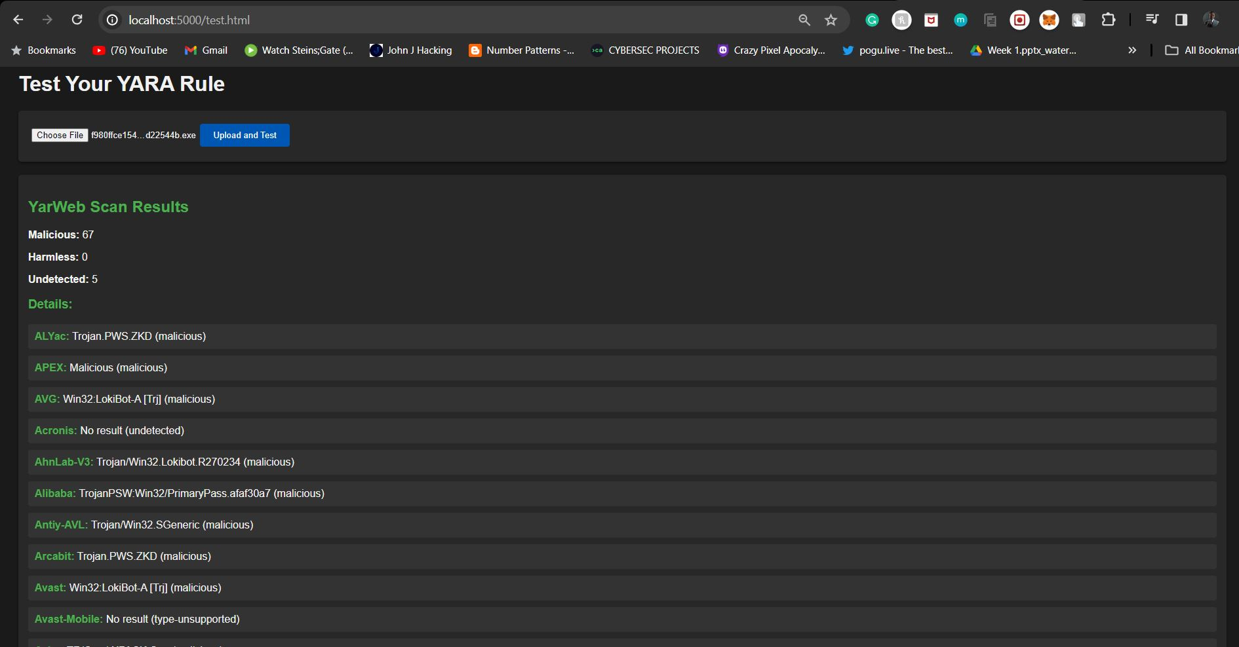
Upload a file

Slide 22
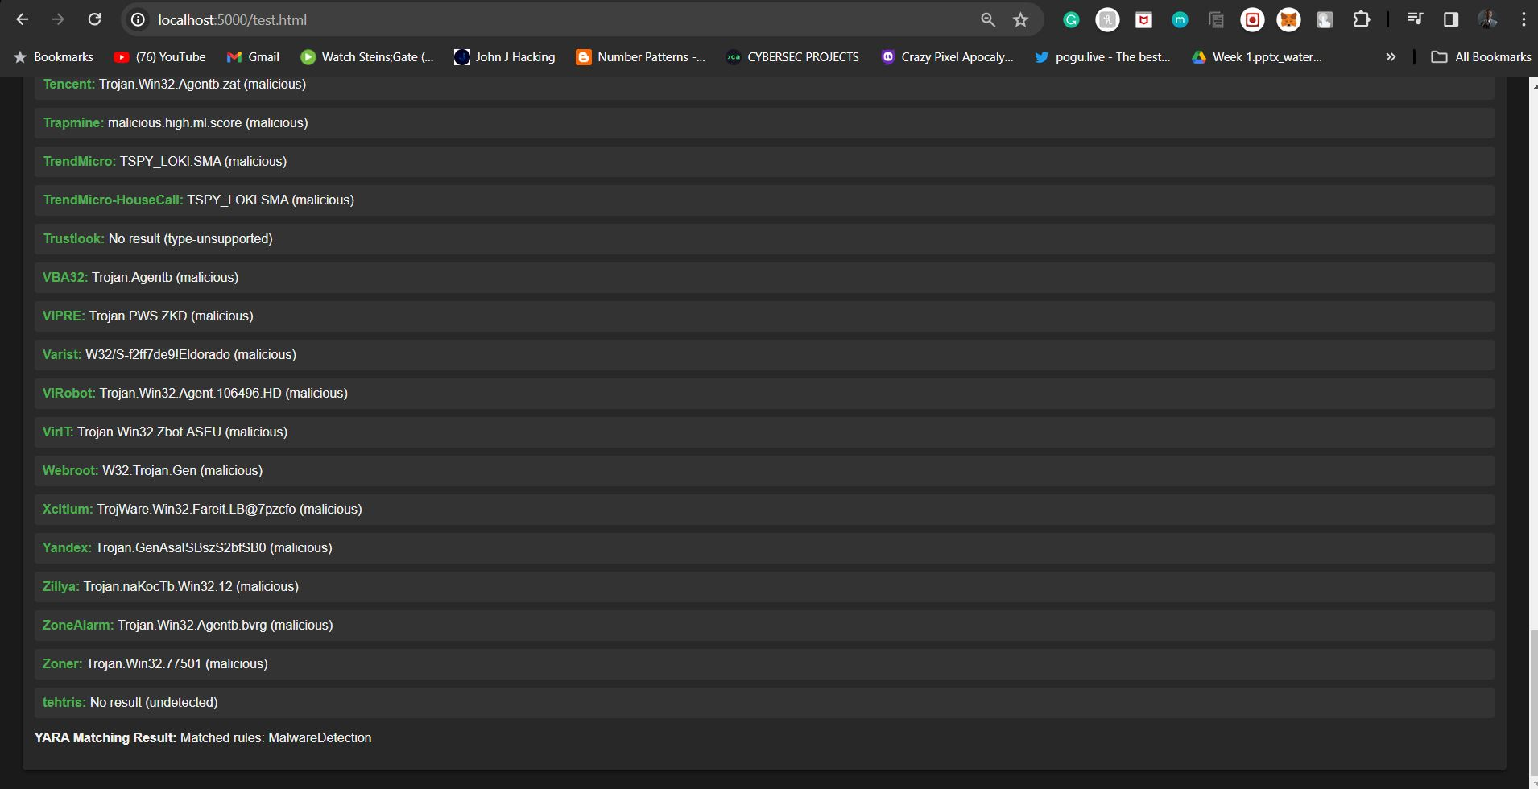
Scanned Results

Slide 23
CONCLUSION
In the summary the development of the YARA search engine project represents a pivotal advancement in the field of cybersecurity and malware detection.
Enhanced User Experience
User-friendly web interface for effortless interaction.
Simplified process for querying YARA rules based on malware specifics.
Efficient Malware Detection
Automated YARA rule generation for optimized accuracy.
Categorized rules based on malware characteristics to enhance detection.
Real-Time Feedback Mechanism .
Integrated with YARA tool for instant rule testing and validation..
Immediate feedback on rule matches improves malware identification accuracy.
Technical Requirements
High-performance server infrastructure: CPU, RAM, storage.
Backend development using Python.
Usability and Accessibility
Emphasis on ease of use for the user interface.
Comprehensive documentation for smooth user engagement.
The YARA search engine project represents a significant breakthrough in cybersecurity, providing a comprehensive and efficient solution for malware detection. With its focus on enhanced user experience, efficient detection, real-time feedback, and robust technical infrastructure, the project sets a new standard in the field, ensuring usability and accessibility for a wide range of users.

Slide 24
REFERENCES
[1] David Bernal Michelena. “Detecting Malicious Files with YARA Rules as TheyTraverse the Network using”:
[2] Michael Brenge, Christian Rossow.” YARIX: Scalable YARA-based Malware Intelligence” CISPA Helmholtz Centre for Information Security:
[3] Naik, N., Jenkins, P., Cooke, R., Gillett, J., & Jin, Y. (2020). Evaluating Automatically Generated YARA Rules and Enhancing Their Effectiveness. 2020 IEEE Symposium Series on Computational Intelligence (SSCI). doi:10.1109/ssci47803.2020.930817
[4] Regeciova, D., Kolar, D., & Milkovic, M. (2021). Pattern Matching in YARA: Improved Aho-Corasick Algorithm. IEEE Access, 9, 62857–62866. doi:10.1109/access.2021.3074801
[5] Naik, N., Jenkins, P., Savage, N., Yang, L., Naik, K., & Song, J. (2019). Augmented YARA Rules Fused With Fuzzy Hashing in Ransomware Triaging. 2019 IEEE Symposium Series on Computational Intelligence (SSCI). doi:10.1109/ssci44817.2019.900277
[6] Zhdanov, A. (2019). Generation of Static YARA-Signatures Using Genetic Algorithm. 2019 IEEE European Symposium on Security and Privacy Workshops (EuroS&PW). doi:10.1109/eurospw.2019.00031
[7] Khalid, M., Ismail, M., Hussain, M., & Hanif Durad, M. (2020). Automatic YARA Rule Generation. 2020 International Conference on Cyber Warfare and Security (ICCWS). doi:10.1109/iccws48432.2020.92923

