Slide 1
MPIK Update
Isabella Sofia
19/12/2022

Slide 2
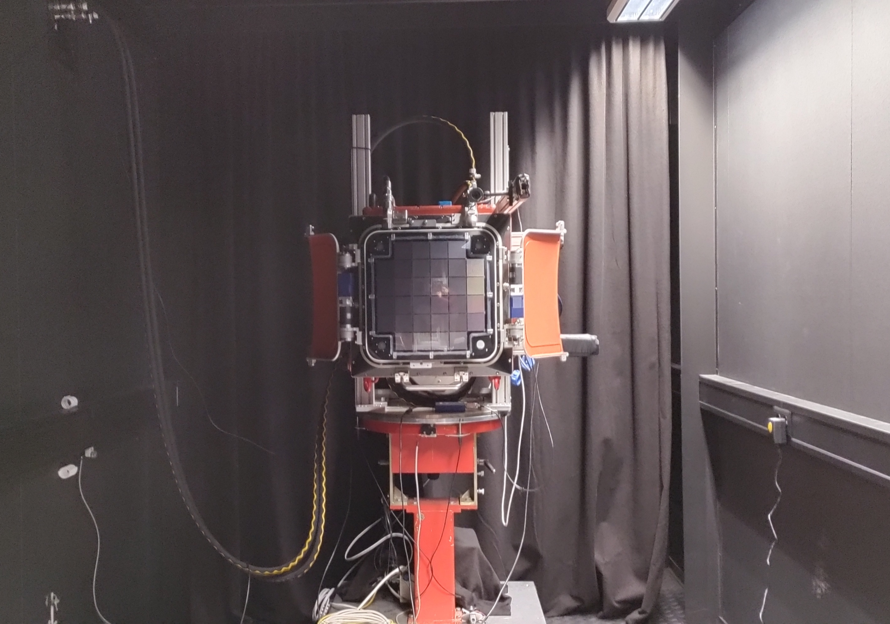
Main activities
Laser beam alignment
Robot arm scans on the diffused (and aligned) beam
Filter wheel calibration procedure (using PM on Robot Arm at 3 m distance)
CHEC-S Longterm tests implementation
Cherenkov images (currently)

Slide 3
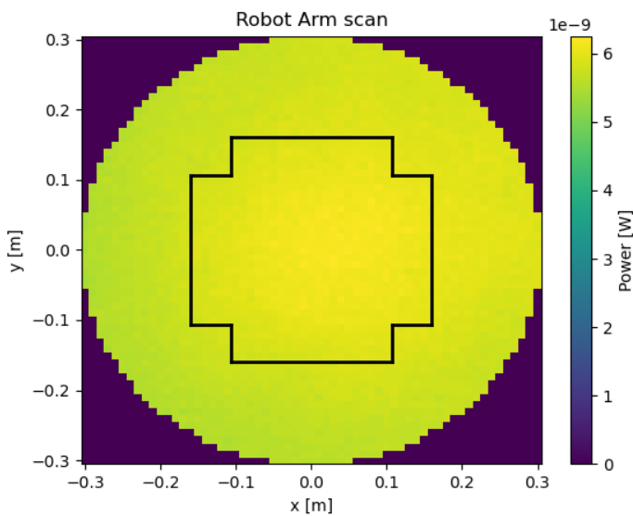
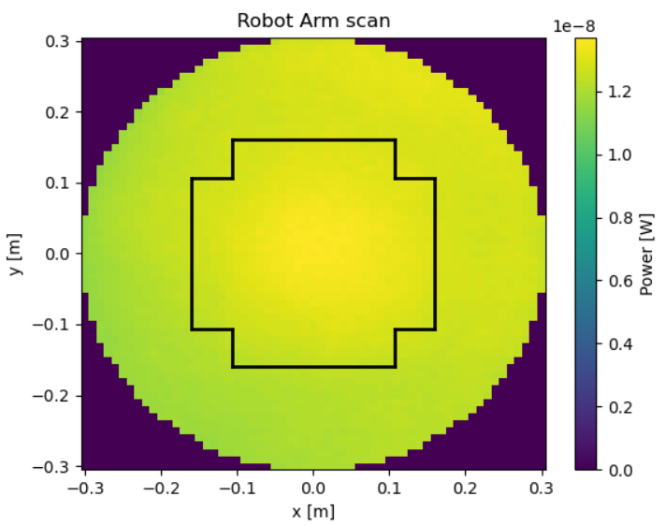
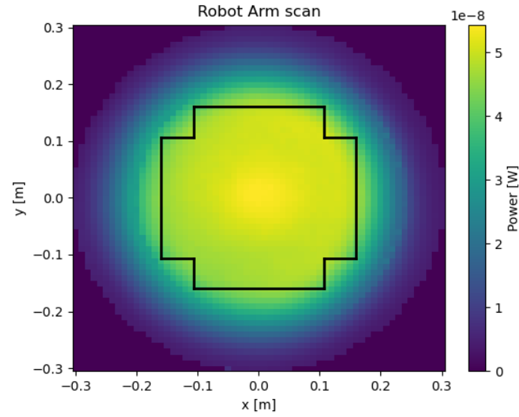
Diffused beam scans
Distance (m) | Diffusers | Beam expander (Y/N) | PM aperture (mm) | Aperture after diffuser | Number of measurements | σ/mean (%)
 |  |  |  |  |  | R < 0.1 | Inside camera
3 | 20 + 5 | Y | 10.3 | NO | 10 | 0.93 % | 1.68%
2 | 20 + 5 | Y | 10.3 | NO | 10 | 1.39 % | 2.43 %
1 | 20 + 5 | Y | 10.3 | NO | 10 | 2.93% | 4.77%
D = 2.9983 m
D = 2.0084 m
D = 1.0035 m

Slide 4
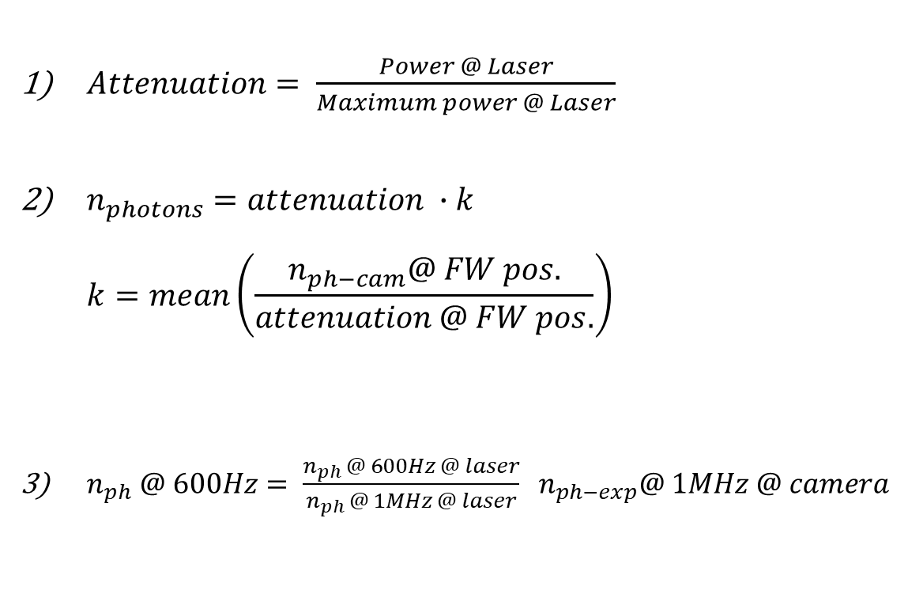
Filter Wheel calibration: procedure
$Attenuation= \frac{Power @ Laser}{Maximum power @ Laser}$
$n_{photons}=attenuation ∙k$ $k=mean\left(\frac{n_{ph−cam}@ FW pos.}{attenuation @ FW pos.}\right)$
$n_{ph} @ 600Hz= \frac{n_{ph }@ 600Hz @ laser}{n_{ph }@ 1MHz @ laser} n_{ph−exp}@ 1MHz @ camera$
Evaluate the attenuation (1 MHz data)
Evaluate the expected number of photons via the factor k
Evaluate the expected number of photons at 600 Hz: calculate the scale factor between measurements at 1 MHz and 600 Hz at the PM Laser. Mean factor = 0.946
Interpolation on the FW positions that yield at least 1 photon
Save interpolation values in a calibration file for the DBM.

Slide 5
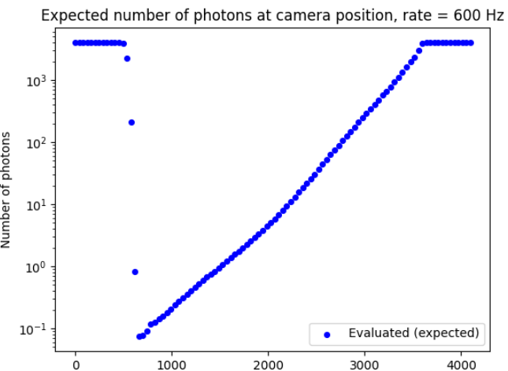
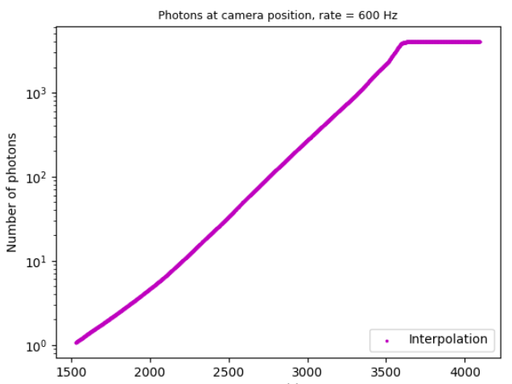


Example plots
$$n_{ph}=attenuation ∙k_{mean}$$
$$interpolation$$

Slide 6
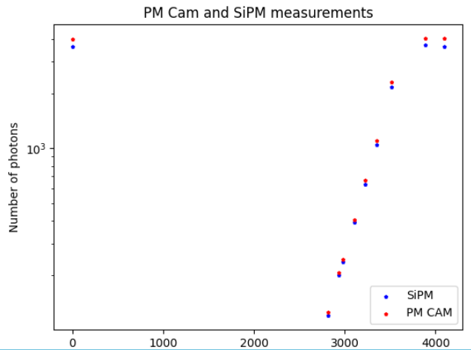
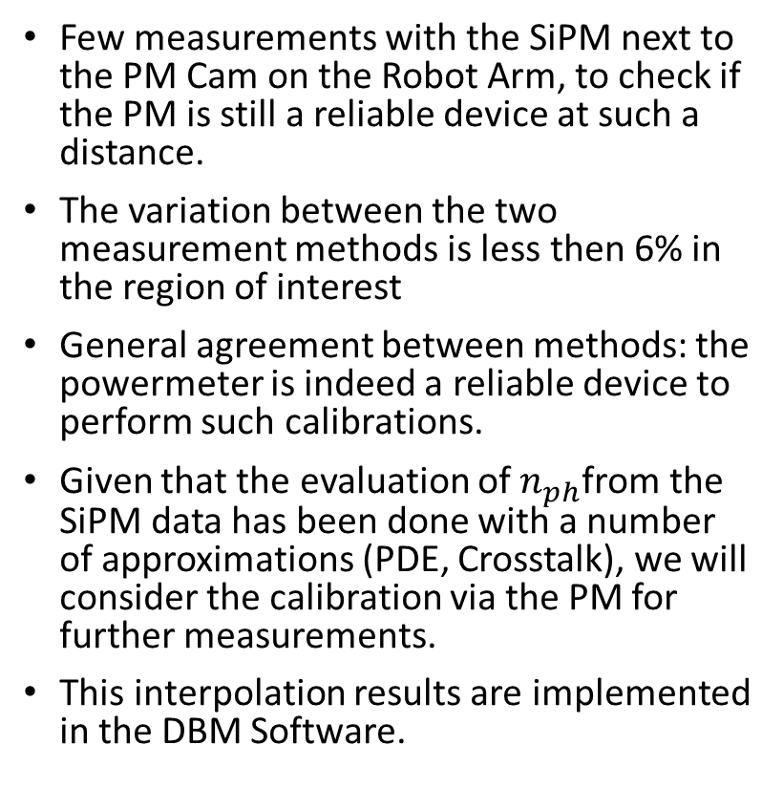
Other considerations
Few measurements with the SiPM next to the PM Cam on the Robot Arm, to check if the PM is still a reliable device at such a distance.
The variation between the two measurement methods is less then 6% in the region of interest
General agreement between methods: the powermeter is indeed a reliable device to perform such calibrations.
Given that the evaluation of $n_{ph}$from the SiPM data has been done with a number of approximations (PDE, Crosstalk), we will consider the calibration via the PM for further measurements.
This interpolation results are implemented in the DBM Software.

Slide 7
Trigger delay scan
Slightly different cable set-up → repeat scan on trigger delays
Delay = 315 ns
Single pulse (pixel n. 0)
Different pixels (bad pixels too)

Slide 8
Longterm tests
Idea:
Initial bootup
Pedestal run
Dynamic range scan
Quick analysis and tidying up data
Analysis of monitoring data (variations with temperature, humidity, versus time…)
Flowchart:
https://drive.google.com/file/d/1ipderqUFhA6Gs1_d45XclkdSIaL9oYHD/view?usp=sharing

Slide 9
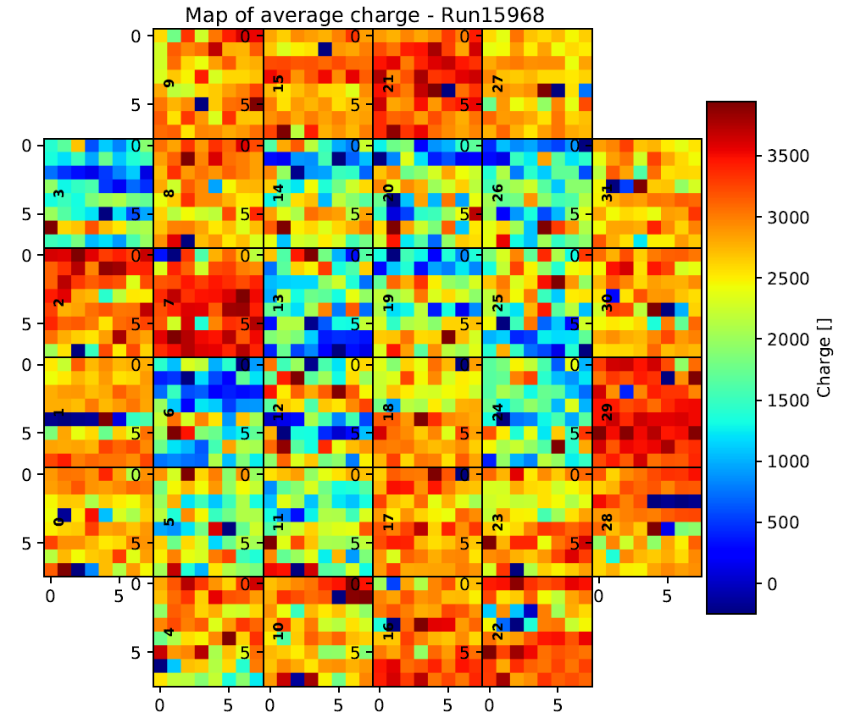
What’s next
Coming back in January
Data analysis
Beam scans
Longterm tests (periodic health check, monitoring data, dynamic range)
Cherenkov images
…

