Slide 1
MPIK Update
24/11/2022
Isabella Sofia
Filter wheel study
Robot Arm

Slide 2
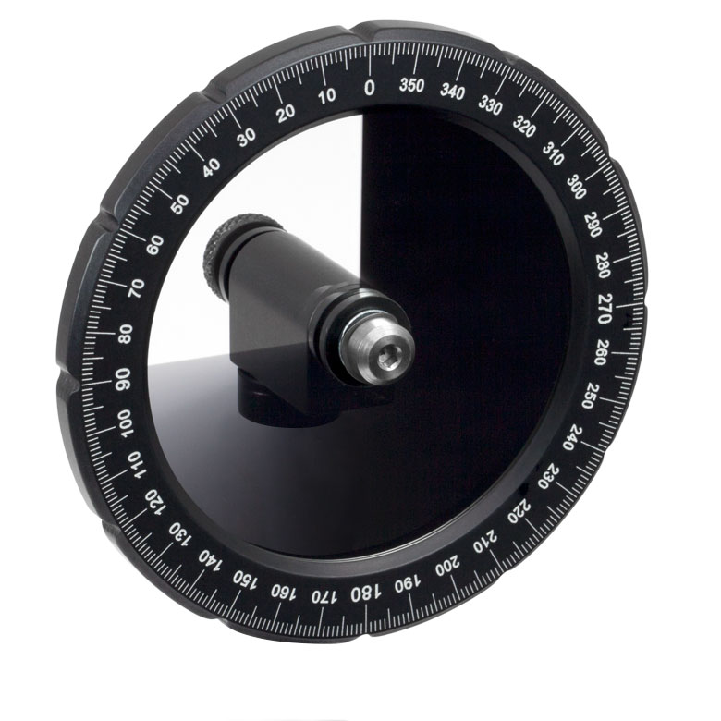
Filter Wheel
Beam splitter
PM Cam or SiPM
d
Filter wheel case
Laser
PM Laser
20° diffuser
THORLABS Continuously Variable ND Filter, Ø50 mm, OD: 0.04 - 4.0
4096 positions
Motor controlled over ethernet
Main goal
Extract a calibration to know how many photons we can expect at a certain distance at a certain Filter Wheel position, at a rate of 600 Hz (working rate of SST)

Slide 3
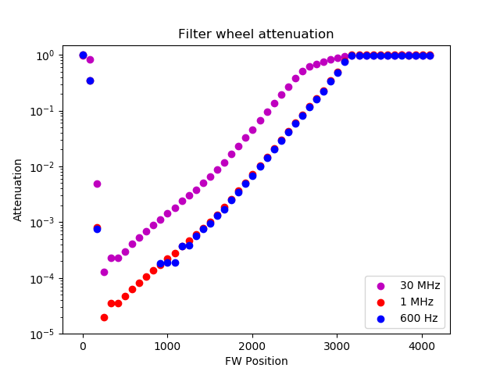
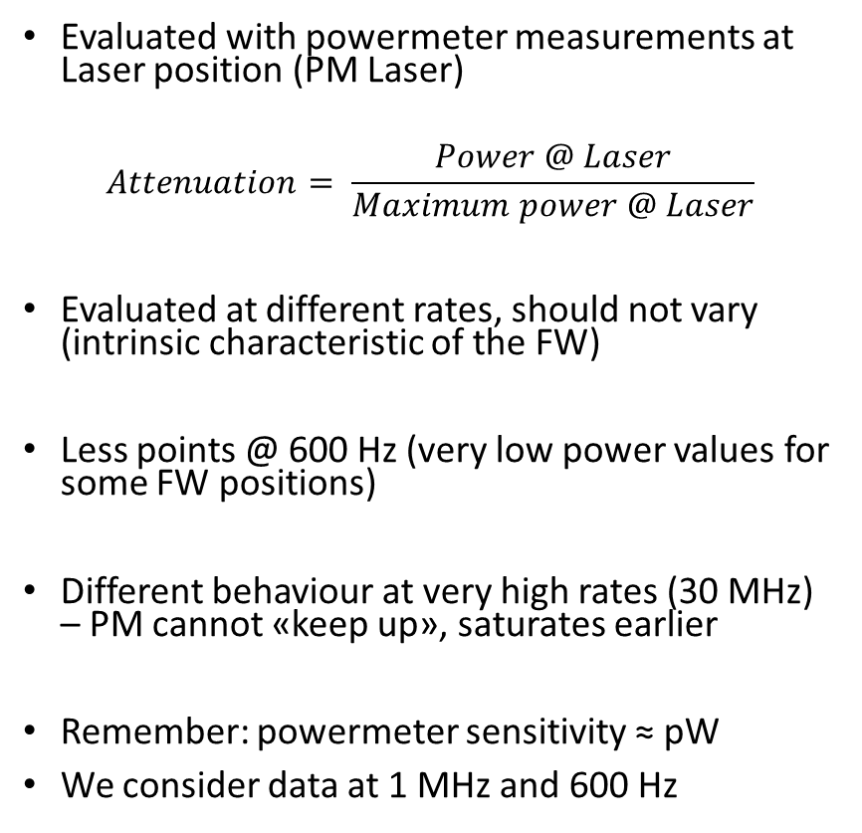
Attenuation
Evaluated with powermeter measurements at Laser position (PM Laser)
$$Attenuation= \frac{Power @ Laser}{Maximum power @ Laser}$$
Evaluated at different rates, should not vary (intrinsic characteristic of the FW)
Less points @ 600 Hz (very low power values for some FW positions)
Different behaviour at very high rates (30 MHz) – PM cannot «keep up», saturates earlier
Remember: powermeter sensitivity ≈ pW
We consider data at 1 MHz and 600 Hz

Slide 4
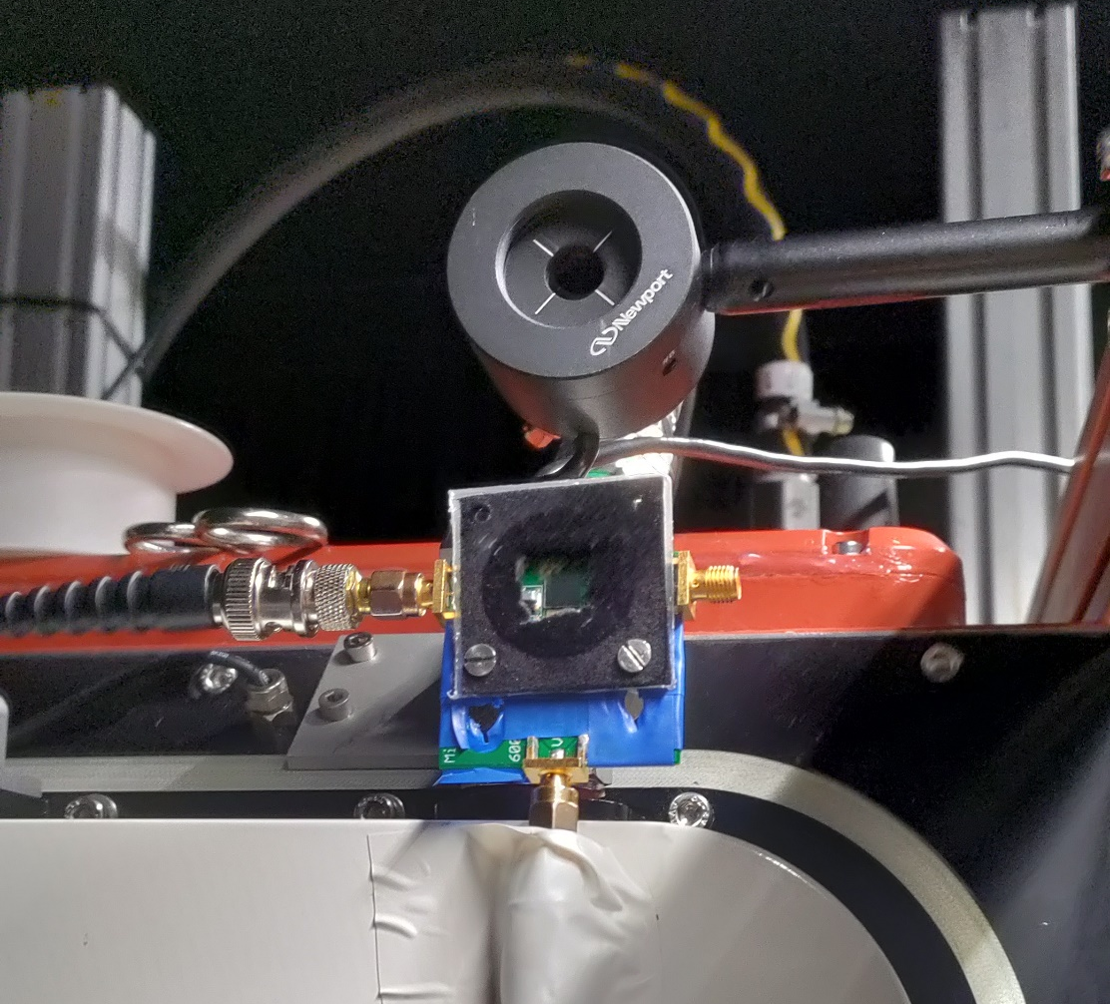
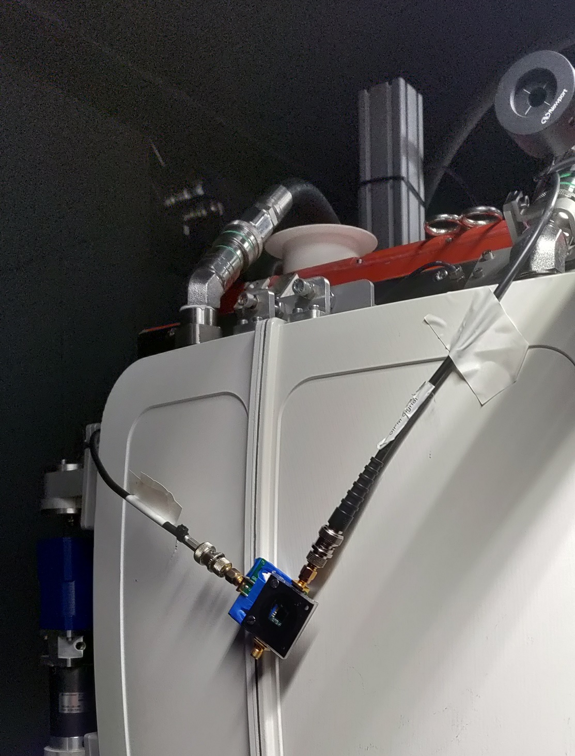
Various measurements
With and without beam expander → no beam expander
Different distances of 2 m and 3 m
Different laser intensities of 7 and 8 (laser is not linear, but can become unstable at high intensities)
Different rates of 600 Hz and 1 MHz
With a SiPM at camera position (on the PM Cam and in a central position w.r.t. CHEC-S)
For calibration: attenuation evaluated with measurements at 1 MHz, expected number of photons at 600 Hz evaluated with SiPM data
SiPM ‘next to’ PM Cam
SiPM in central position

Slide 5

Expected number of photons at camera position, rate 600 Hz
Evaluate the expected number of photons at 600 Hz via attenuation values (intrinsic FW characteristic)
$$n_{photons}@ 600 Hz=attenuation ∙k$$
With
$$k= \frac{n_{photons} @ FW position}{attenuation @ FW position}$$
Measured with SiPM @ 600 Hz
Evaluated from 1 MHz data

Slide 6
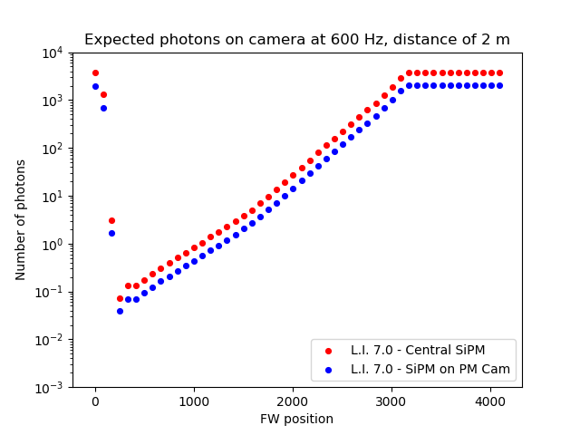
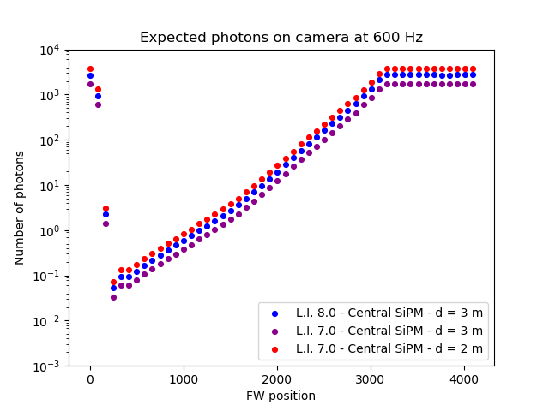
Moving the SiPM closer to the laser (d = 2 m) we gain a bit of photons at a L.I. of 7.0
We obtain quite the same result remaining at a 3 m distance (which we prefer) and increasing the laser intensity to 8.0 instead of 7.0
We evaluate the final calibration starting from the measurements made at a 3 m distance, a L.I. of 8.0 and with the SiPM at a central position

Slide 7
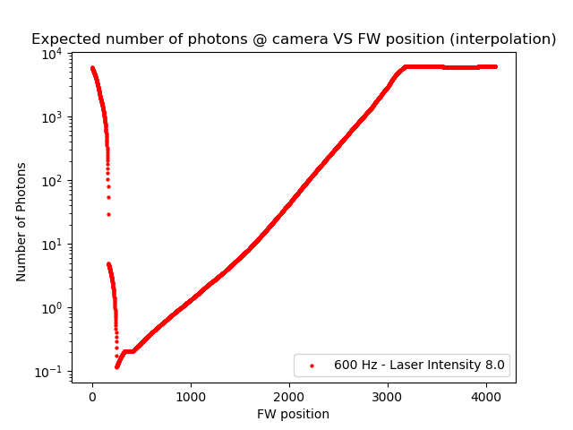
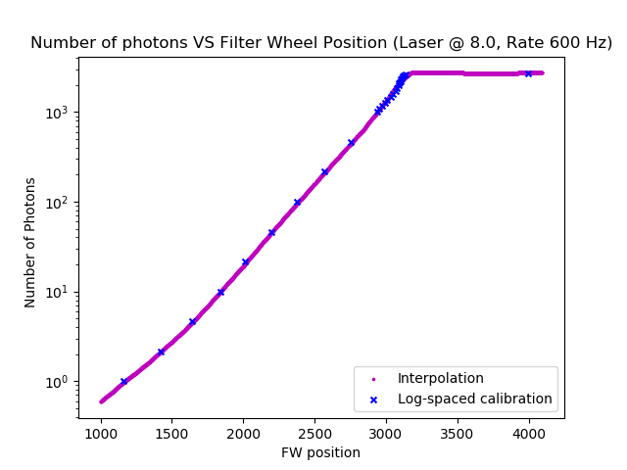
Two calibrations
Interpolation on data - Cutting out the first 1000 positions (FW is continuous… not perfectly aligned → should be fixed)
2. Calibration «by hand» measuring the peak signal from the SiPM for certain FW positions (log-spaced values)
Both implemented in the DarkBox Manager Software
It is now possible to set the desired FW position or directly the number of photons

Slide 8
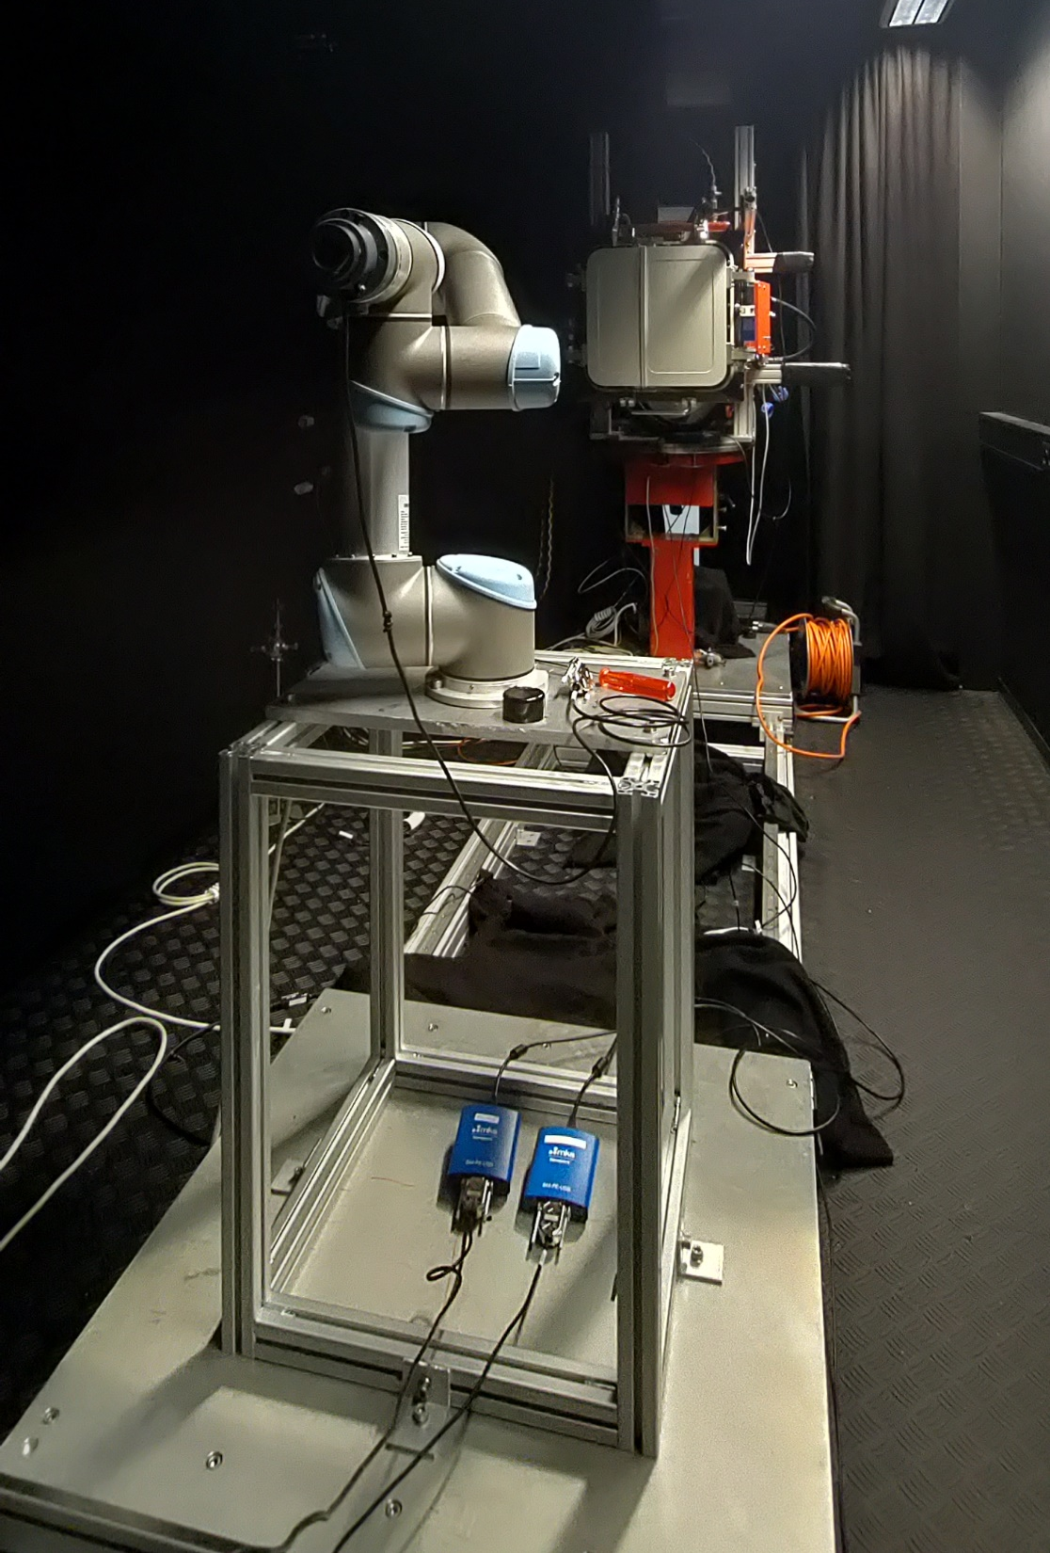
Robot Arm
Powermeter on RA’s tip
2D scan (fixed z coordinate): set the size, number of steps, number of measurements at each step
Main Goals
Verify the laser alignment - «By hand» ✔ - Via multiple scans at different distances
Scan the whole beam

Slide 9
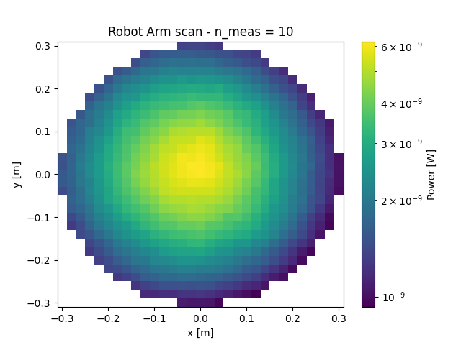
2D Scan: example
2D Scan - 30 cm x 30 cm - 2 cm step
On the diffused beam
Laser-RA distance of 1 m
With different number of measures for each spatial bin - n_meas = 5, 10, 20
Compare the data - Slicing along one axis - Looking at the standard errors (and their distribution)

Slide 10
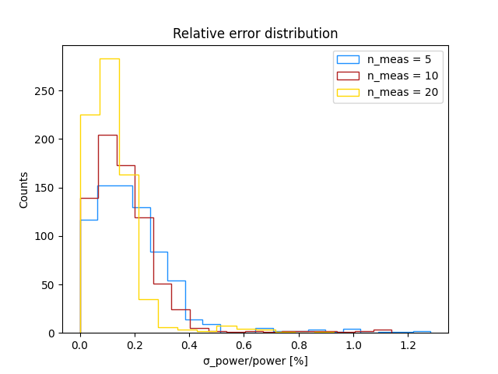
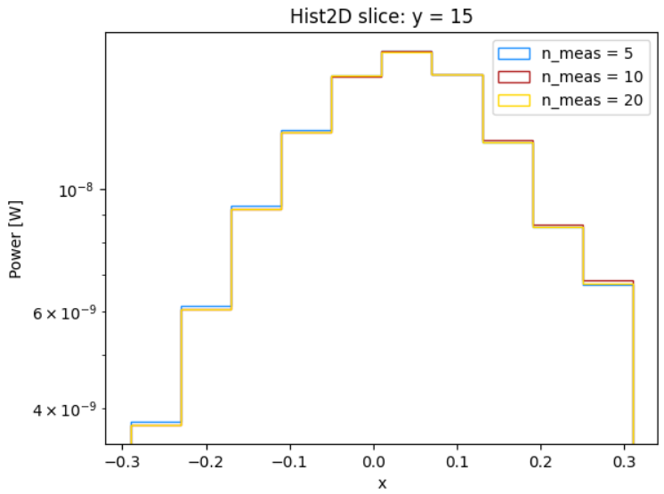
Comparing data
The power measures do not change
Taking a higher number of measurements improves the error, but takes longer in terms of time
n_meas = 10 seems to be a good compromise

Slide 11
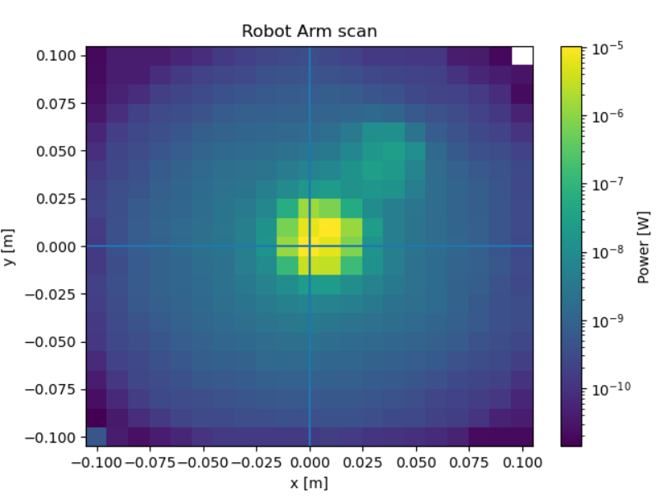
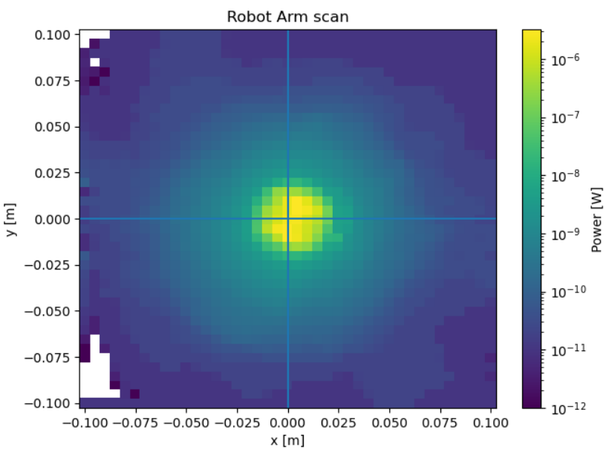
2D scan without the diffuser
2D scan on a smaller area - 10 cm x 10 cm - 5 mm or 1 cm steps
Distance RA-Laser = 2,007 m
Goal: verify that the beam is centered w.r.t. the sensor
But… Noticed some ghosts and reflections - For the potential reflections: both Robot Arm and CHEC-S covered with Thorlabs blackout material - For the ‘ghost’: could be some weird light path in the beam splitter, put an aperture at the end of it (~ 7 mm aperture)

Slide 12
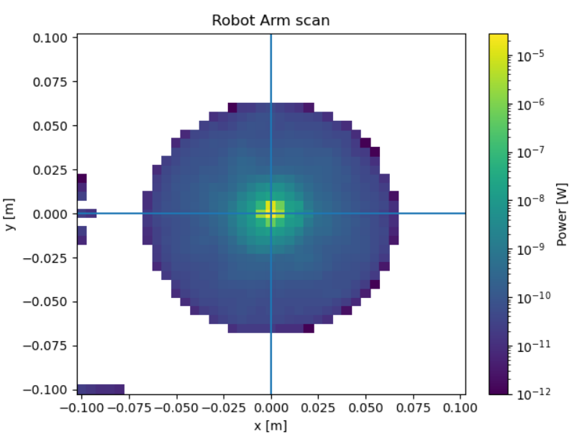
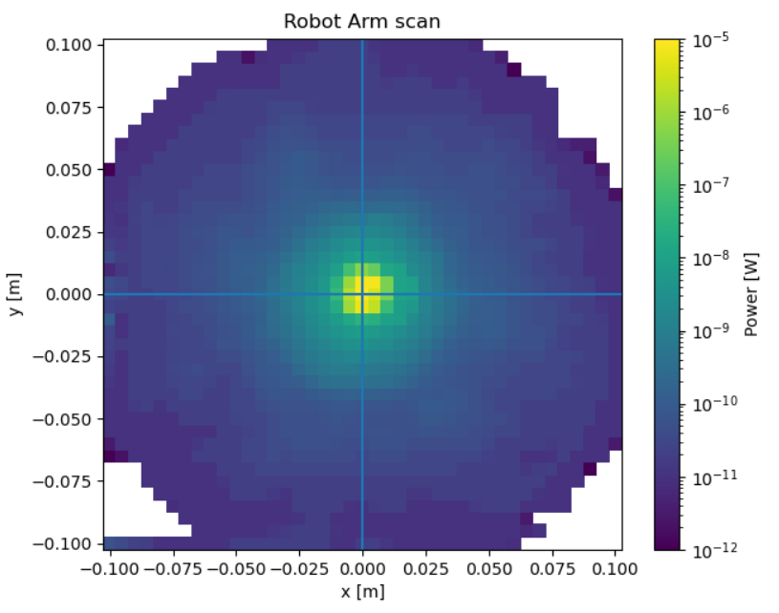
2D scan without the diffuser
D = 0.5008 m
D = 1.008 m
D = 2.007 m
D: distance between the PM on the RA’s tip and the laser tube

Slide 13
Next steps with the Robot Arm
Scan the diffused beam at differents distances
Add measure at a 3 m distance (CHEC-S distance) without the diffuser
Find the beam center coordinates

Slide 14
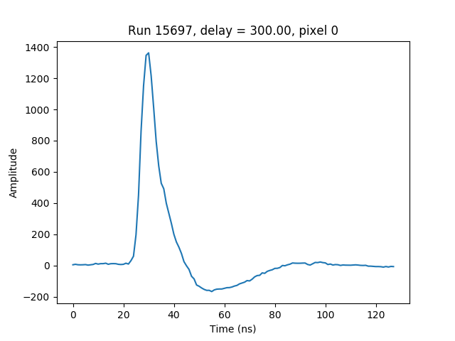
Trigger delay scan – CHEC-S
Script to run a scan over a range of trigger delays
First scan: (0, 1000) ns
Second finer scan: (150, 450) ns
Looking for the signal pulse
Delay = 300 ns
Samples

Slide 15
Dynamic range – CHEC-S
Setting the trigger delay, it is possible to run a scan over the FW positions → dynamic range of CHEC-S
Data still to be analyzed
All 32 modules of CHEC-S are connected and work (health check still to be done)

