Slide 1

The 2nd Innovation Camp for Computational Materials Science,
The Kaike Seaside Hotel, Tottori Pref., Oct.2-4, 2018
Krylov subspace methods for shifted linear systems
Tomohiro SOGABE
(Joint work with, T. Hoshi, S.-L. Zhang, and T. Fujiwara)
Dept. of Applied Physics, Nagoya University

Slide 2
Short CV (Tomohiro SOGABE)
2001 Graduated from the University of Tokyo.
2005 Research Associate, Nagoya Univ.
(Dept. Computational Science & Engineering )
2006 Ph.D. in Engineering, the University of Tokyo, 2006.
2009 Associate Professor, Aichi Prefectural Univ.
(Graduate School of Information Science & Technology)
2015 Associate Professor, Nagoya Univ.
( Dept. Computational Science & Engineering )
( Dept. Applied Physics )
(2018 Visiting researcher, AI research center, AIST)

Slide 3
Outline
1. Large-scale electronic structure theory
・General framework for obtaining any physical property
2. Efficient computation of the Green’s function
・ Krylov subspace (KS) methods
・ KS methods with shifted linear systems
3. Numerical results and concluding remarks

Slide 4
Large-scale electronic structure theory

Slide 5
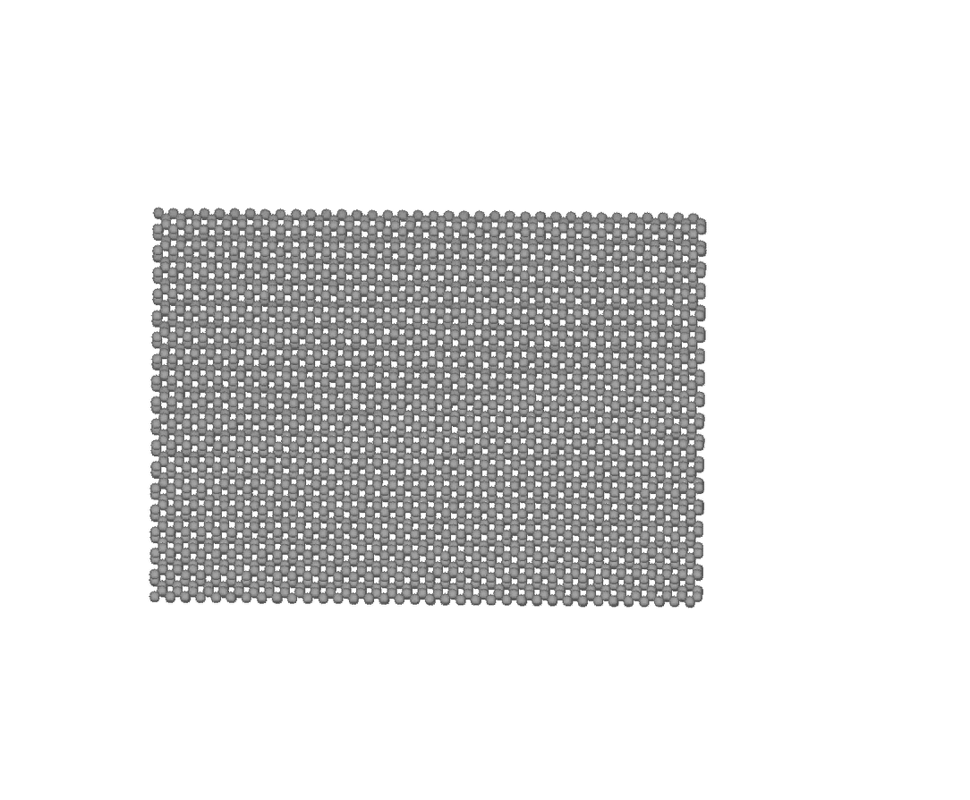
Large-scale electronic structure calculations
Fig. 1. Cleavage process of silicon with
bending of cleavage planes.
Nano-scale Electronic Structure
10 nm
HPC
[Hoshi et al., PRB 72, 075323 (2005)]
Numerical Algorithms
Quantum mechanics for electron systems

Slide 6
Large-scale electronic structure calculations
Fundamental idea:
[Kohn, PRL 76, 3168 (1996)] ]
Density functional theory
using short-range behavior of the one-body DM
Modern first-principles computational condensed-matter physics

