Slide 1
Real time evolution group
Harada Yuki
Noda Masashi
Tani Mizuki
Uemoto Mitsuharu

Slide 2
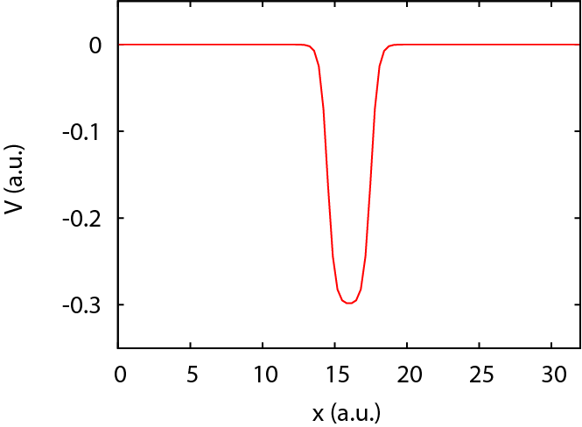

Target system : electron in 1D potential
Simulation box in real space
Single electron dynamics
$$H_{x}=\frac{1}{2}{\left(\frac{∂_{x}}{i}\right)}^{2}+V\left(x\right)+a\left(t\right)\frac{∂_{x}}{i}$$
$$i∂_{t}ψ\left(x,t\right)=H_{x}ψ\left(x,t\right)$$
$$H_{x}ψ\left(x,0\right)=εψ\left(x,0\right)$$

Slide 3

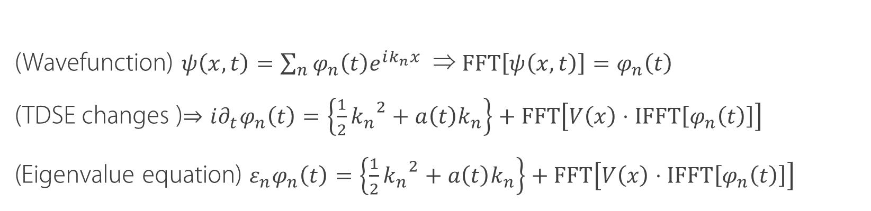
Solving the SE
Transformation into fourier space
(Wavefunction) $ψ\left(x,t\right)=\sum_{n}{φ_{n}\left(t\right)e^{ik_{n}x}}$ ⇒ $FFT\left[ψ\left(x,t\right)\right]=φ_{n}\left(t\right)$
(TDSE changes )$⇒i∂_{t}φ_{n}\left(t\right)=\left\{\frac{1}{2}{k_{n}}^{2}+a\left(t\right)k_{n}\right\}+FFT\left[V\left(x\right)⋅IFFT\left[φ_{n}\left(t\right)\right]\right]$
(Eigenvalue equation) $ε_{n}φ_{n}\left(t\right)=\left\{\frac{1}{2}{k_{n}}^{2}+a\left(t\right)k_{n}\right\}+FFT\left[V\left(x\right)⋅IFFT\left[φ_{n}\left(t\right)\right]\right]$
Real time evolution
$$φ_{n}\left(t\right)=e^{−iHt}φ_{n}\left(0\right)$$
$$φ_{n}\left(t+∆t\right)=e^{−iH∆t}φ_{n}\left(t\right)$$

Slide 4
Matrix representation

Slide 5
Directory structure
https://github.com/mn2007/iccms-te.git ├── readme_command_memo_01.txt ├── readme_command_memo_02.txt ├── readme_command_memo_02B.txt ├── EIGEN_EK.F90 ├── EIGEN_LAPACK.F90 ├── GS.F90 ├── HPHI.F90 ├── MAIN.F90 ├── README.md ├── RT.F90 ├── SETV.F90 └── Makefile
EIGEN_EK.F90, EIGEN_LAPACK.F90
固有値計算用サブルーチン(Eigenkernel使用・LAPACK使用)
HPSI.F90
ハミルトニアン計算サブルーチン
GS.F90
初期状態（基底状態）計算用サブルーチン
RT.F90
時間発展サブルーチン
SETV.F90
ポテンシャル関数系設定ルーチン
MAIN.F90
メインルーチン

Slide 6
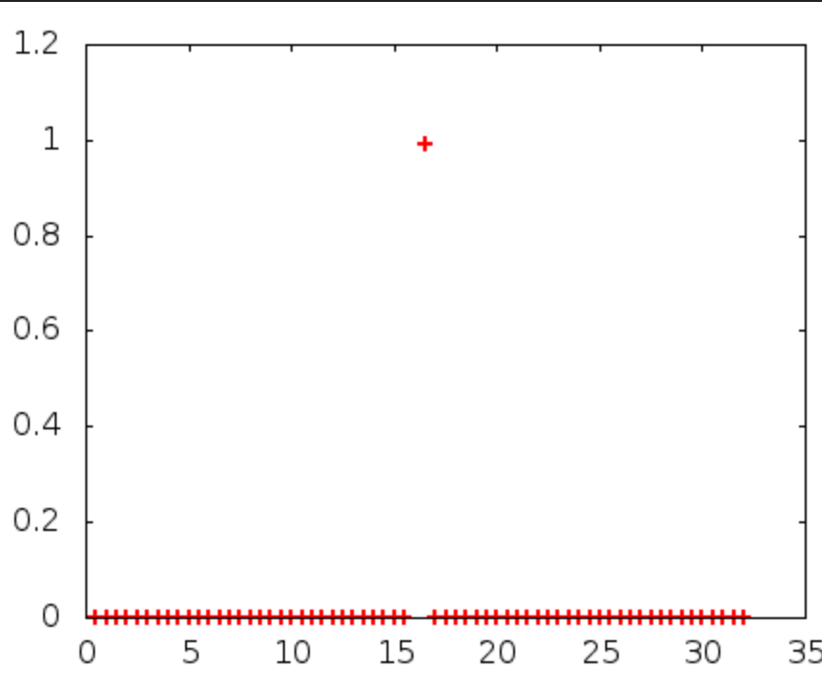
result
Wavefunction
Could not see transition…
Trapped in the bottom of potential

Slide 7
MateriApps
Eigenkernel,k-ep
Eigenkernel⇒completed build?(unverified)
after all, we used LAPACK
K-ep⇒error when using MUMPS
OpenFFT
OpenFFT uses FFTW3
＆ after all, we used FFTW3
Our target is 1D problem

Slide 8
おわり

Slide 9
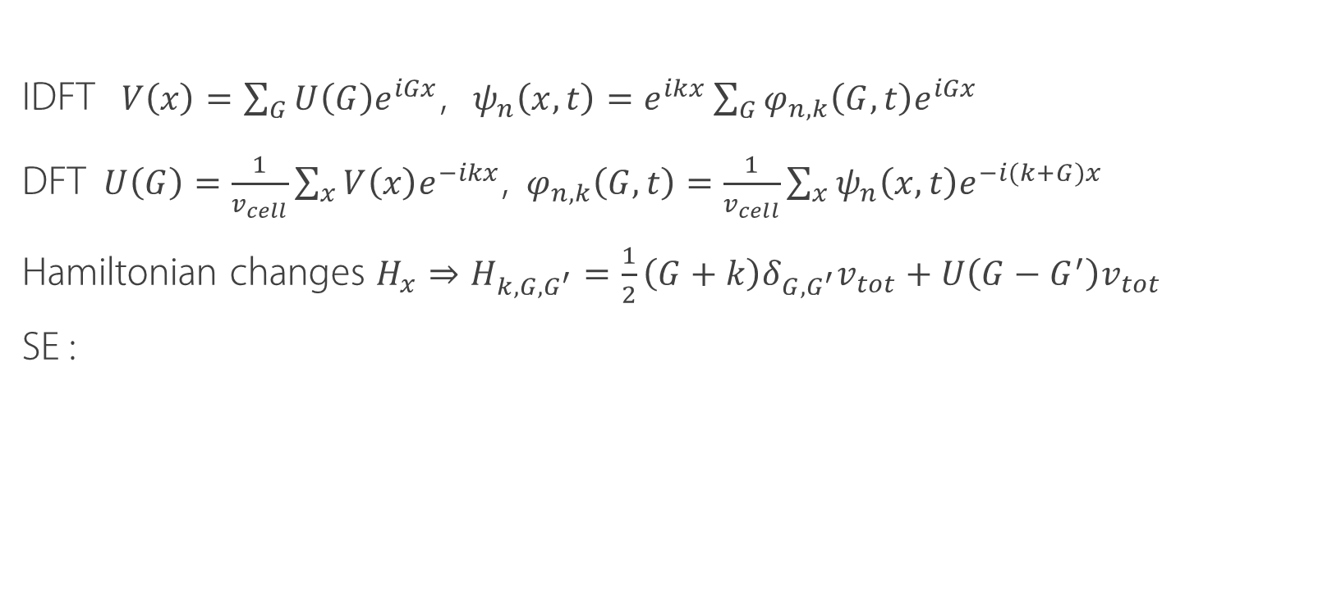
algorithm
Solve the TDSE in reciprocal lattice space
IDFT $V\left(x\right)=\sum_{G}{U\left(G\right)e^{iGx}}$, $ψ_{n}\left(x,t\right)=e^{ikx}\sum_{G}{φ_{n,k}\left(G,t\right)e^{iGx}}$
DFT $U\left(G\right)=\frac{1}{v_{cell}}\sum_{x}{V\left(x\right)e^{−ikx}}$, $φ_{n,k}\left(G,t\right)=\frac{1}{v_{cell}}\sum_{x}{ψ_{n}\left(x,t\right)e^{−i(k+G)x}}$
Hamiltonian changes $H_{x}⇒H_{k,G,G^{′}}=\frac{1}{2}\left(G+k\right)δ_{G,G^{′}}v_{tot}+U\left(G−G^{′}\right)v_{tot}$
SE :

Slide 10
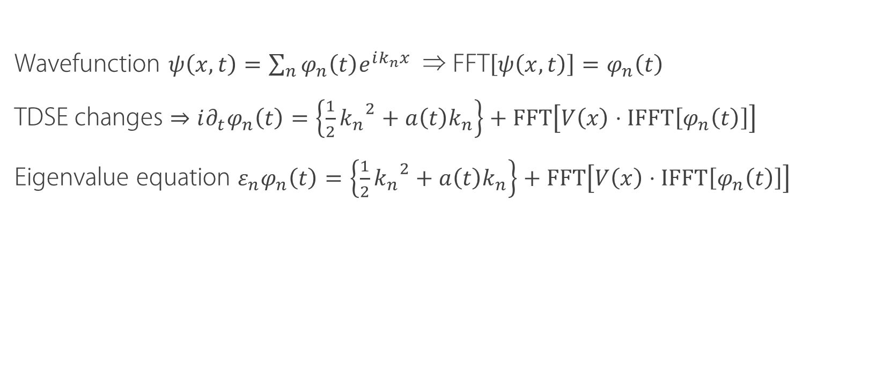
Solving the SE
Transformation into fourier space
Wavefunction $ψ\left(x,t\right)=\sum_{n}{φ_{n}\left(t\right)e^{ik_{n}x}}$ ⇒ FFT$\left[ψ\left(x,t\right)\right]=φ_{n}\left(t\right)$
TDSE changes $⇒i∂_{t}φ_{n}\left(t\right)=\left\{\frac{1}{2}{k_{n}}^{2}+a\left(t\right)k_{n}\right\}+FFT\left[V\left(x\right)⋅IFFT\left[φ_{n}\left(t\right)\right]\right]$
Eigenvalue equation $ε_{n}φ_{n}\left(t\right)=\left\{\frac{1}{2}{k_{n}}^{2}+a\left(t\right)k_{n}\right\}+FFT\left[V\left(x\right)⋅IFFT\left[φ_{n}\left(t\right)\right]\right]$

Slide 11
results

