Slide 1
Using software team 〜Applications of ALPS to J1-J2 Heisenberg model〜
2018/10/3 @米子
Kota Ido, Katsuhiro Morita, Pohle Rico, Yasushi Shinohara

Slide 2


Introduction
ALPS (MateriApps LIVE!)
Qunatum Monte Carlo (QMC)
Negative sign problem
DMRG
Variational
Exact diagonalization
Only small system size
Target system
J₁-J₂ Heisenberg model
Frustration

Slide 3
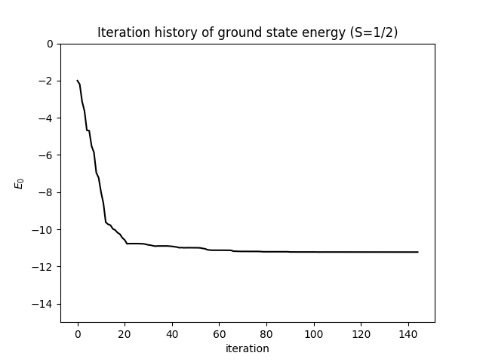
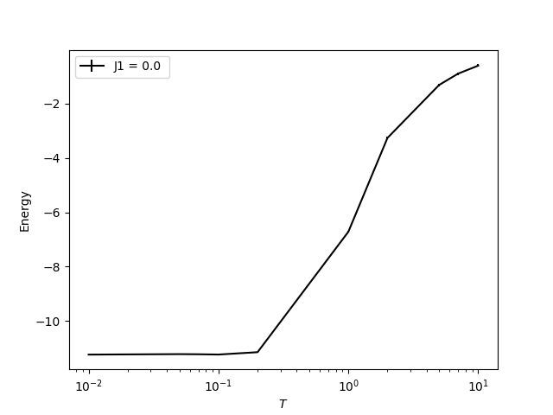
Heisenberg model w/o frustration
Energy (J₁/J₀=0.0)
QMC:﻿-11.234(3) (T/J₀=0.01)
DMRG:-11.228 (truncation error=9×10⁻⁵, α=200, T/J₀=0)
Exact diagonalization:
DMRG
QMC

Slide 4
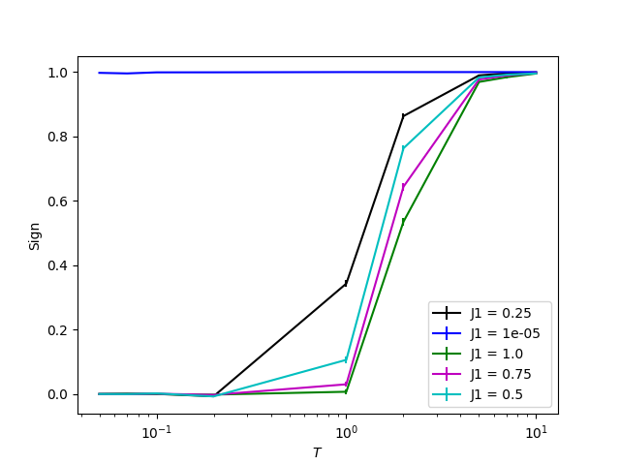
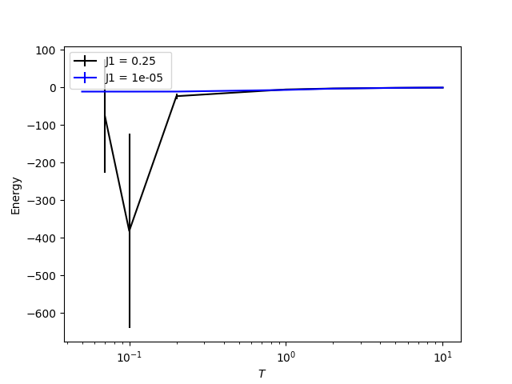
Negative sign problem
QMC for finite J₁/J₀

Slide 5
J₁-J₂ Heisenberg model on square lattice
DMRG VS ED

Slide 6
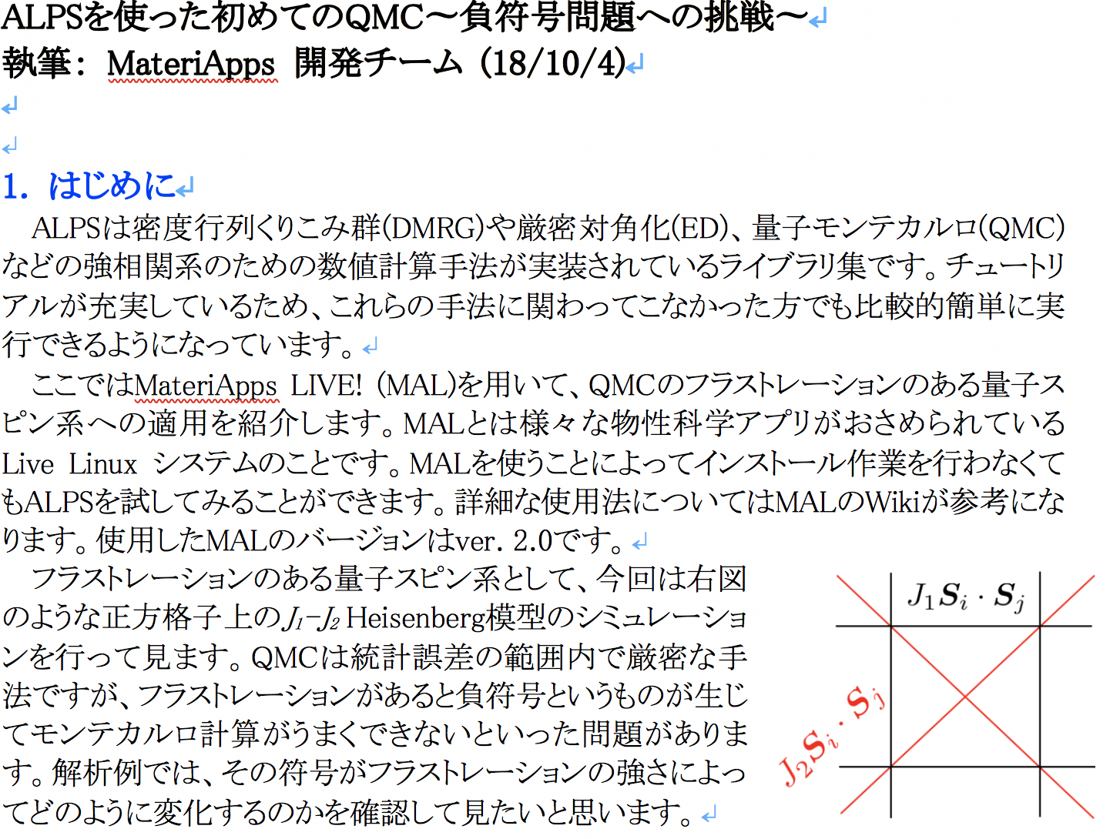
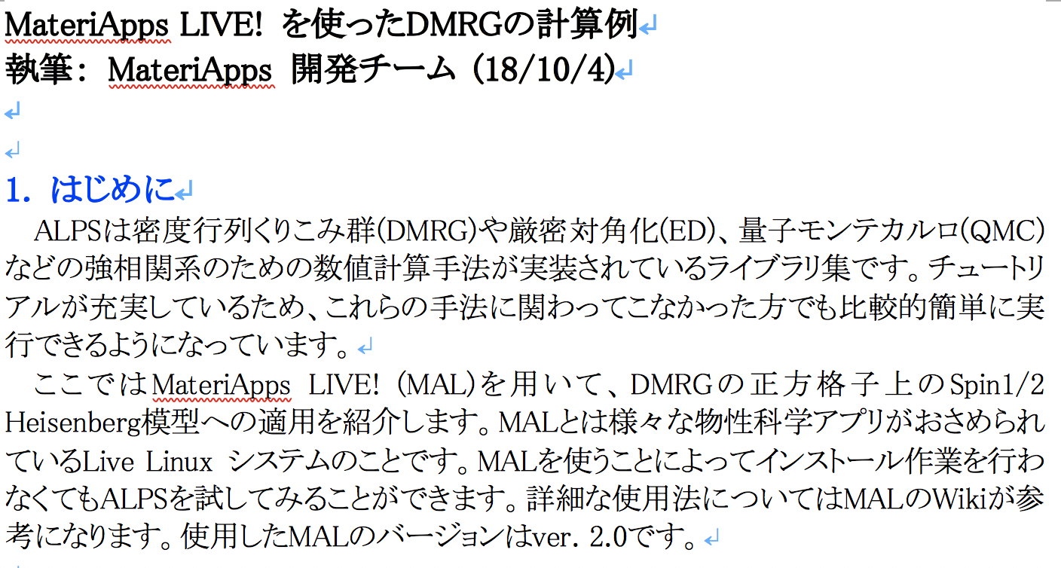
Review
4 review pages: 3 (jp) + 1(en)
QMC
DMRG
ED

